Slide 1
Some Perspective on Operating Systems
CS 374 Operating Systems
Lecture 1

Slide 2
Today’s class
Brief overview of operating systems
read chapter 1
take note of bold faced terms

Slide 3
What Do Operating Systems Do?
Well, for one thing, they let a user control the machine’s hardware
So what does hardware look like?

Slide 4
Basic Computer Structure von Neumann model
0
CPU
(Program Counter,
Instruction Register,
Memory Register,
Execution Unit)
Buses
Main Memory
(Instructions
And Data)
I/O Module
(Buffers connect
to Devices)
N-1

Slide 5
Classifying Parallel Architectures
Processor arrays
Have one central CPU and lots of synchronized processing elements (ALUs or similar, usually)
Data and instructions are fed on separate buses from the CPU to the processing elements
Example: Connection Machine CM-200

Slide 6
Classifying, Continued
Multiprocessors
Have many CPUs, but share a single memory
Two types: UMA and NUMA
UMA (Uniform memory access) (YOU-ma)
EXAMPLE: Sequent Symmetry
CPU 1
CPU 2
CPU 3
…
CPU N
CPU TO RESOURCE SWITCH MECHANISM
DEVICES
MEMORY

Slide 7
Still More Architectures
Multiprocessors, cont…
NUMA (Nonuniform memory access) (NEW-ma)
NUMA machines have local memory with each CPU, which combined creates the complete address space (EXAMPLE: TC 2000 made by BBN, AMD Infinity Fabric)
0-127
128-255
256-383
…-…
CPU 1
CPU 2
CPU 3
…
CPU N
RESOURCE SWITCH MECHANISM

Slide 8
Last of Architectures…
Multicomputers
Identical processors, each with its own memory
Usually high-speed backplane to allow fast communication between processors
MEM 1
MEM 2
MEM 3
MEM N
CPU 1
CPU 2
CPU 3
…
CPU N
HIGH SPEED COMMUNICATIONS

Slide 9
Basic Instruction Execution
All von Neumann architectures do the following fetch-and-execute loop:
Fetch a machine instruction
Increment the program counter
Decode the instruction and operands
Fetch operands if necessary
Execute the instruction, saving results

Slide 10
Machine Instructions
Are very simple, primitive commands; e.g.:
load a register with a value
add values in two registers
Problems:
too complex for programmers
far too intricate for most computer users
We resolve these problems by using compilers and interpreters most of the time for programming, and operating systems to interact with users

Slide 11
Three Key Concepts in Operating Systems (key point for the day)
Abstraction
Helps us hide complexity; eg: programming (and compilers)
Do so by hiding low level details
Virtualization
Helps us share resources; eg: spooling
Do so by creating an illusion of one or more dedicated resources that don’t need sharing
Resource Management
Helps us maximize performance; eg: hard drives
Do so by balancing different requirements

Slide 12
Role of Operating Systems
Thus, operating systems and compilers both serve a role in helping people get more use out of computers by letting the computers do repetitive, simple tasks
Operating systems help us use the computer most efficiently for whatever purpose it is designed for—but there are many purposes

Slide 13
So what is an Operating System?
Good definition: the software which manages the computers devices and provides users with a simpler interface to the hardware.

Slide 14
Some Kinds of Operating Systems
Mainframe systems
Servers
Multiprocessor machines
Personal computers
Real-time systems
Embedded systems
Smart cards

Slide 15
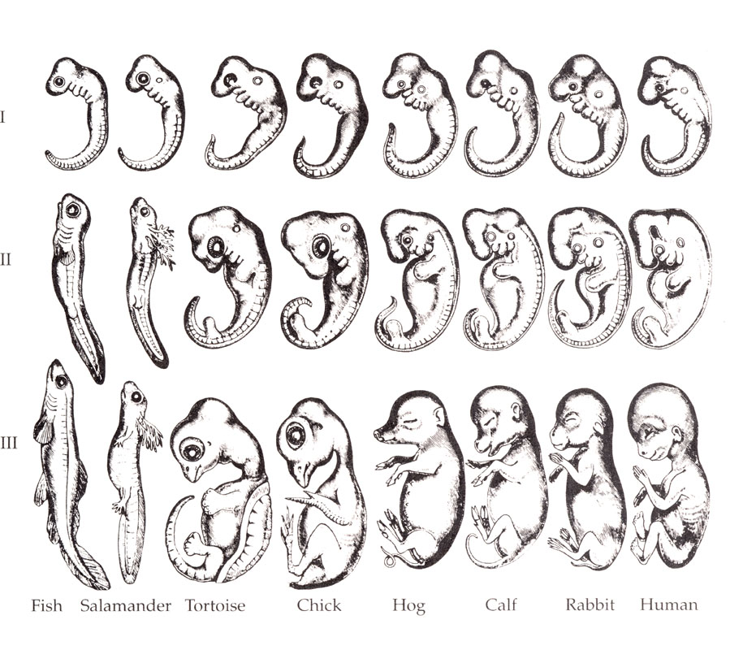
Development of Operating Systems Relative to Application
“Ontogeny recapitulates phylogeny,” an important (discredited) biology theory

Slide 16
Operating System Organization
Monolithic structure—the entire OS is one big program; must be completely recompiled to effect changes (advantage: speed)
Microkernel structure—the core functions of the OS are one program; other features are added to the outside of this (advantage: security)
Modular structure—the OS comprises many modules; parts can be changed and replaced without altering the whole
eg: device drivers

Slide 17
Generations of Operating Systems
ONE: Vacuum tubes and plugboards
TWO: Transistors and batch systems
THREE: Integrated circuits and multiprogramming
FOUR: Personal Computers
FIVE: Massive Parallelism
(Note: there are other ways to break up the history—this is just one to get us started)

Slide 18
The Role of Interrupts
Interrupts and traps help us change programs that are running
An interrupt is a hardware signal from an external device (external to the CPU)
A trap is an internal CPU signal (ie: an instruction, so that the currently running program can say it wants to stop)
Both send program control to an interrupt handler in the operating system—it is this programs responsibility to decide what happens next
Some CS folks casually refer to a trap as an interrupt—but you won’t, right?

Slide 19
A database is configured on a server so that students on remote machines think they have private copies of the database. This is an example of:
Abstraction
Virtualization
Resource Management
None of the above

Slide 20
Suppose a hard drive completion results in a signal to the CPU. This is an example of _____
Virtualization
A trap
An interrupt
A batch system
Abstraction

Slide 21
Multiprogramming and Interrupts
Multiprogramming simply means running more than one program on the computer
Can be done sequentially even on single CPU
Can be done by having completing processes call the scheduler
Why is this dangerous?
Time-sharing is one form of multiprogramming used a lot in modern computers
Clock interrupt timer is used to give fixed chunks of time to processes
This fast switching makes it look to a user as though programs are running simultaneously, even with one CPU

Slide 22
And Onward…
Next lecture will start on processor management—go over the introduction and begin reading about process instantiation and interaction!

