Slide 1
In this module…
Basic elements of an OS: Processor Management
Jobs, processes, basic synchronization of processes

Slide 2
Remember von Neumann architecture
We have a CPU executing instructions
Memory and devices connected by a bus
The CPU keeps track of where it is in the instructions by use of a program counter
A running program may have resources allocated to it

Slide 3
Processes and Hardware
For processes to run on the system, they have to interact with the hardware
First place: during the boot sequence, when special hardware loads a bootstrapping program into memory
Even the earliest computer systems faced this problem

Slide 4
Interrupts
Interrupts initially added to allow I/O completion signals to get immediate attention of the CPU
Alternate way: have CPU check I/O channel (I/O processor) to see if completed; this is called polling
Needed to do this for system efficiency
Expanded interrupts to cover many different conditions

Slide 5
Traps
Traps use interrupt facilities and are generated by the running program, instead of from an external device
Eg: divide-by-zero error
Eg: request for services
Clock timer interrupts are used to allow time sharing
They allow context switching to a different process

Slide 6
Processes versus Jobs (Tasks)
We sometimes speak of the terms process and job (task) interchangeably sometimes, but they are different
A job (task) is an activity submitted to the operating system to be done
A process is an activity being worked on by the system
Thus {processes} {jobs}

Slide 7
Jobs versus Processes, Cont.
Distinction comes from old batch processing systems, which had job and process schedulers
Jobs used to be organized by a Job Scheduler which decided such issues as which job runs first and which ones wait on hard disc or external storage
The Process Scheduler has a list of jobs loaded into memory that it currently is supposed to work on--it decides which one gets the CPU at a given time

Slide 8
Why different schedulers under the old system?
Responsibilities: system resources, interrupts, etc… differ
Job Scheduler
decides job sequence that maximizes resources
needs to know what resources are actually used! (From user? SysOp? Analysis?)
some desired numbers include: estimated run time, memory usage, I/O, importance

Slide 9
Why different schedulers? Continued…
Processor Scheduler
decides CPU usage that maximizes resources
may be several current jobs from Job Scheduler
interleaves I/O with CPU cycles

Slide 10
Modern View
We still distinguish between process and job for convenience
Processes on many common systems are interactive, so they need new resources that must be allocated dynamically
Thus there really aren’t separate process and job schedulers anymore.

Slide 11
The Five State Model
READY
RUNNING
NEW
TERMINATED
WAIT

Slide 12
Threads versus Processes
A thread is a single path of instruction
Modern processes can have more than one thread of execution—but they share the resources of the process
This is done by having more than one program counter and copies of variables (or stack)
Threads may be scheduled by the process or by the kernel

Slide 13
Threads versus Processes
What do three processes look like (program counters, stack, data)?
What do three threads look like?
What are the advantages and disadvantages of using processes versus threads?

Slide 14
The View of Threads, cont.
LOAD X0, MEM
ADD X0, X13
MULT X0, X27
STORE X0,X9
….

Slide 15
Types of Threads
User Threads
Designed for applications to use
Managed by application programmer
May not get used!
Kernel Threads
Managed by OS
More overhead

Slide 16
Process Control Block
Is a small chunk of data about the job submitted to the operating system
Contents (four major parts):
unique identification
process status (ie: 5 state model)
process state (ie: instruction counter, memory map, list of resources allocated, priority)
other useful information (eg: usage stats)
Schedulers use instead of entire process

Slide 17
Why Use Process Structure?
Hardware-independent solutions
Processes cooperate and compete correctly, regardless of the number of CPUs
Structuring mechanism
Tasks are isolated with well-defined interfaces

Slide 18
Summary of Process Basics
Processes are running segments of code
5 state model summarizes typical states processes go through (know this!)
Threads provide some functionality without all the overhead that processes have
The PCB summarizes important information about processes

Slide 19
New Processes and Their Relationships
Processes often are created/terminated in a particular order
can you think of examples?
Process creation can be implicit or explicit, static or dynamic
We can represent an ordering of processes as a process control graph or process flow graph

Slide 20
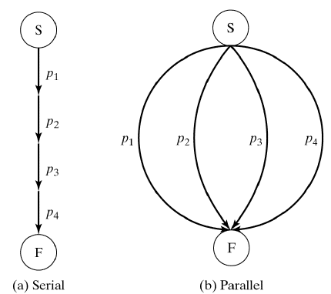
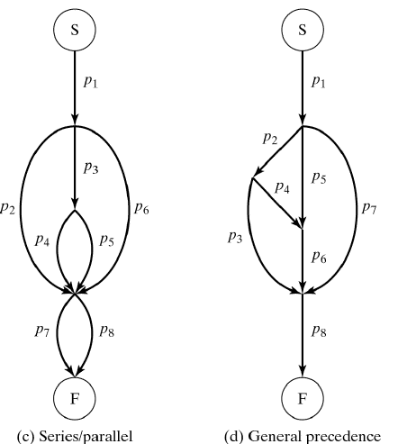
Defining/Instantiating Processes Examples of Precedence Relationships
Figure 2-1

Slide 21
Process flow graphs described with expressions
Serial execution is expressed as: S(p1, p2, …)
Parallel execution is expressed as: P(p1, p2, …)
Figure 2.1(c) represents the following:
S(p1, P(p2, S(p3, P(p4, p5)), p6), P(p7, p8))

Slide 22
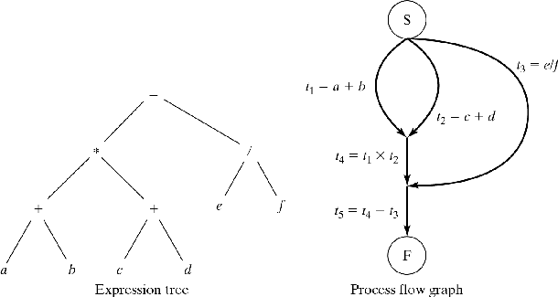
Process flow graphs
(a + b) * (c + d) - (e / f) gives rise to
Figure 2-2

Slide 23
Process flow graphs
Compare:
We have seen expression for (c) using S/P
(d) cannot be expressed using S/P It is not properly nested

Slide 24
Implicit Process Creation
In some languages, processes are created dynamically using language constructs; no process declaration
cobegin/coend
syntax: cobegin C1 // C2 // … // Cn coend
meaning:
All Ci may proceed concurrently
When all terminate, the statement following cobegin/coend continues

Slide 25
cobegin/coend
cobegin/coend have the same expressive power as S/P notation
S(a,b) = a; b (sequential execution by default)
P(a,b) = cobegin a // b coend
cobegin/coend implement one kind of control parallelism

Slide 26
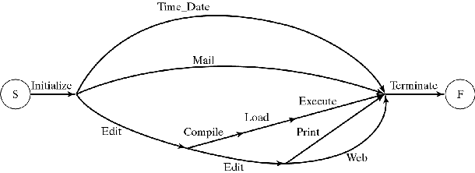
cobegin/coend example
Figure 2-4
cobegin
Time_Date // Mail // Edit; cobegin
Compile; Load; Execute // Edit; cobegin Print // Web coend
coend
coend;

Slide 27
Data parallelism
Same code is applied to different data
The forall statement
syntax: forall (parameters) statements
Meaning:
Parameters specify set of data items
Statements are executed for each item concurrently
common in scripting languages
Let’s look at some Dataparallel C code…

Slide 28
The forall statement
Example: Matrix Multiply
forall ( i:1..n, j:1..m )
{ A[i][j] = 0;
for ( k=1; k<=r; ++k )
A[i][j] = A[i][j] +
B[i][k]*C[k][j]; }
Each inner product is computed sequentially
All outer products are computed in parallel

Slide 29
The fork and join primitives
cobegin/coend are limited to properly nested graphs
forall is limited to data parallelism
fork/join can express arbitrary functional parallelism (any process flow graph)
so why don’t we use fork/join all the time?

Slide 30
The fork and join primitives
Syntax: fork x Meaning: create new process that begins executing at label x
Syntax: join t,y Meaning:
t = t–1;
if (t==0) goto y;
The operation must be indivisible. (Why?)
What does t represent?

Slide 31
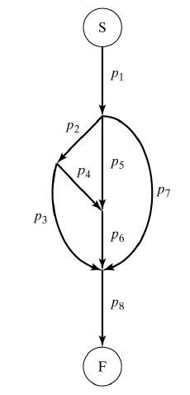
The fork and join primitives
Example: Graph in Figure 2-1(d)
t1 = 2; t2 = 3;
p1; fork L2; fork L5;
fork L7; quit;
L2: p2; fork L3; fork L4; quit;
L5: p5; join t1,L6; quit;
L7: p7; join t2,L8; quit;
L4: p4; join t1,L6; quit;
L3: p3; join t2,L8; quit;
L6: p6; join t2,L8; quit;
L8: p8; quit;

Slide 32
The Unix fork
procid = fork();
Replicates calling process
Parent and child are identical except for the value of procid
both executing same code in memory
Use procid to diverge parent and child:
if (procid==0)do_child_processing
else do_parent_processing

Slide 33
Explicit Process Declarations
Designate piece of code as a unit of execution
Facilitates program structuring
Instantiate:
Statically (like cobegin) or
Dynamically (like fork)

Slide 34
Explicit Process Declarations
process p
process p1 // static process creation
declarations_for_p1
begin ... end
process type p2
declarations_for_p2
begin ... end
begin
...
q = new p2; // dynamic process creation
...
end

Slide 35
Process Interactions
Competition: The Critical Problem
x = 0;
cobegin
p1: …
x = x + 1;
…
//
p2: …
x = x + 1;
…
coend
x should be 2 after both processes execute
almost no one wants programs that exhibit unpredictable behavior!

Slide 36
The Critical Problem
Interleaved execution (due to parallel processing or context switching):
p1: R1 = x; p2: …
R1 = R1 + 1; R2 = x;
x = R1 ; R2 = R2 + 1;
… x = R2;
x has only been incremented once— The first update (x=R1) is lost!

Slide 37
Naming the Problem
Loss of data due to improper sharing of data locations (memory, registers, hard discs) is called a race condition
Note that this is not like a road race at all
Key issue for race conditions is the loss due to overwriting data that should be saved

Slide 38
The Critical Problem Revisited
Problem statement of critical sections:
cobegin
p1: while(1) {CS1; program1;}
//
p2: while(1) {CS2; program2;}
//
...
//
pn: while(1) {CSn; programn;}
coend
Guarantee mutual exclusion: At any time, only one process executing within its CSi

Slide 39
Two Views
Note that there are two similar but complementary views of the problem:
Processes are competing for a resource and should not simultaneously be in their critical sections
When a resource is being used, it should be locked to prevent other processes from using it
Thus both locks and critical section protections can solve resource competition issues

Slide 40
Software Solutions
In addition to mutual exclusion, prevent mutual blocking:
1. Process outside of its CS must not prevent other processes from entering its CS. (No Dog in the Manger –Aesop)
2. One process must not be able to repeatedly reenter its CS and starve other processes (fairness)
3. Processes must not block each other forever (deadlock)
4. Processes must not repeatedly yield to each other (“after you”--“after you” livelock)

Slide 41
Peterson’s Software Solution
Book goes through discussion of three possible solutions
Each has flaws, leads to another idea
Each is slightly harder to understand
There are errors!
1981 – Peterson
Developed an elegant solution that works
But… we don’t care because it is impractical to extend this solution to more processes

Slide 42
Cooperation
Problems with software-only solutions:
Difficult to program and to verify
Processes loop while waiting (busy-wait)
Applicable only to the “critical problem”: Competition for a resource
Cooperating processes must also synchronize
Classic generic scenario:
Producer → Buffer → Consumer

Slide 43
Semaphores
A semaphore s is a nonnegative integer
P and V operate on s
Semantics:
V(s): increment s by 1
P(s): if s>0, decrement s; else wait until s>0
The waiting can be implemented by
Blocking the process, or
Busy-waiting (see Chapter 4)
P and V are indivisible operations (atomic)

Slide 44
Solving Common Problems: Mutual Exclusion w/ Semaphores
semaphore mutex = 1;
cobegin
...
//
p_{i}: while (1) {
P(mutex); CSi; V(mutex); programi;
}
//
...
coend; // a mutex is a binary semaphore

Slide 45
Self Blocking with Semaphores
semaphore s = 0;
cobegin
p1: ...
P(s); /* block until signal */
...
//
p2: ...
V(s); /* wake process p1 */
...
...
coend;

Slide 46
Converting A Precedence Graph With Semaphores (busy-wait)
S
Semaphore S1 = 0; S1B = 0; S2 = 0; S3 = 0;
Cobegin
p1; V(S1);
//
p2; V(S1);
//
P(S1); P(S1); V(S1B); p3; V(S2);
//
P(S2); p4; V(S3);
//
P(S1B); p5; V(S3);
//
P(S3); P(S3); p6;
Coend
p1
p2
p3
p5
p4
p6
F

Slide 47
Notes on this conversion
p1 and p2 start immediately; others wait
Note that S1, S2, and S3 are countdown semaphores that tell me how many predecessors completed
S1B is used in the same manner as fork
Why can’t I just use a P(S1) before each of p3 and p5?
Why must V(S1B) be done before p3?

Slide 48
Bounded Buffer Problem
semaphore e = n, f = 0, b = 1;
cobegin
Producer: while (1) {
Produce_next_record;
P(e); P(b); Add_to_buf; V(b); V(f);
}
//
Consumer: while (1) {
P(f); P(b); Take_from_buf; V(b); V(e);
Process_record;
}
coend // e = # of empty buffer slots
// f = # of full buffer slots

Slide 49
Event synchronization
Synchronous event (e.g. I/O completion)
Process waits for it explicitly
Constructs: E.wait, E.post
Asynchronous event (e.g. arithmetic error)
Process provides event handler
Invoked whenever event is posted

Slide 50
Case study: Event synch.
UNIX signals
kill(pid, sig) send signal (SIGHUP, SIGILL, SIGKILL, …)
Process may catch signal
Process may ignore signal
Default: kill process

Slide 51
Case study: Event synch. (cont)
Windows 2000
WaitForSingleObject or WaitForMultipleObjects
Process blocks until object is signaled
object type | signaled when:
process | all threads complete
thread | terminates
semaphore | incremented
mutex | released
event | posted
timer | expires
file | I/O operation terminates
queue | item placed on queue

