Slide 1
3. Higher-Level Synchronization
3.1 Shared Memory Methods
Monitors
Protected Types
3.2 Distributed Synchronization/Comm.
Message-Based Communication
Procedure-Based Communication
Distributed Mutual Exclusion
3.3 Other Classical Problems
The Readers/Writers Problem
The Dining Philosophers Problem
The Elevator Algorithm
Event Ordering with Logical Clocks

Slide 2
Motivation
Semaphores and Events are:
Powerful but low-level abstractions
Programming with them is highly error prone
Such programs are difficult to design, debug, and maintain
Not usable in distributed memory systems
Need higher-level primitives
Based on semaphores or messages

Slide 3
Shared Memory Methods
Monitors
Invented in the early 1970’s by Per Brinch Hansen and C. A. R. Hoare
Follow the principles of an abstract data type (object-oriented) programming:
A data type is manipulated only by a set of predefined operations
A monitor is
A collection of data representing the state of the resource controlled by the monitor, and
Procedures to manipulate that resource data
[Is there an “object-ion” here? :-) ]

Slide 4
Monitor Implementation
Generally speaking, it only makes sense really to implement monitors with hardware support (to guarantee atomicity)
Popular languages with monitor variants include Concurrent Pascal (the first!), Java, C#, Visual Basic, Rust, and Ada; the ICE Library adds them to C++
As we’ll see, the implementations can vary in important characteristics

Slide 5
Monitors
Implementation must guarantee:
Resource accessible only by monitor procedures
Monitor procedures are mutually exclusive
For coordination, monitors provide condition variable c with:
c.wait
Calling process is blocked and placed on waiting queue associated with c
c.signal
Calling process wakes up first process on c queue

Slide 6
Monitors
“condition variable” c is not a conventional variable
c has no value
c is an arbitrary name chosen by programmer to designate an event, state, or condition
Each c has an associated waiting queue
A process may “block” itself on c -- it waits until another process issues a signal on c

Slide 7
Are c.wait and c.signal like semaphores passing messages?
Yes, with c.wait being like P(c) and c.signal being like V(c).
Yes, but c.wait is like V(c) and c.signal is like P(c).
No, there is no relationship.

Slide 8
Hoare Monitors
After c.signal, there are 2 ready processes:
The calling process which did the c.signal
The process which the c.signal “woke up”
Which should continue?
(Only one can be executing inside the monitor!)
Hoare monitor:
Woken-up process continues
Calling process is placed on high-priority queue

Slide 9
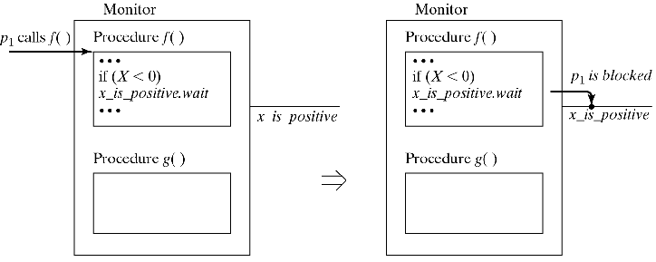
Hoare Monitors
Effect of wait

Slide 10
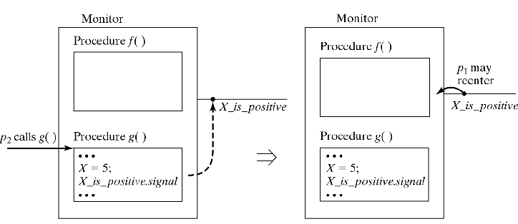
Effect of Hoare Monitors, Continued
Effect of signal

Slide 11
Bounded buffer problem
monitor BoundedBuffer {
char buffer[n];
int nextin=0, nextout=0, fullCount=0;
condition notempty, notfull;
deposit(char data) {
...
}
remove(char data) {
...
}

Slide 12
Bounded buffer problem
deposit(char data) {
if (fullCount==n) notfull.wait;
buffer[nextin] = data;
nextin = (nextin+1) % n;
fullCount = fullCount+1;
notempty.signal;
}
remove(char data) {
if (fullCount==0) notempty.wait;
data = buffer[nextout];
nextout = (nextout+1) % n;
fullCount = fullCount - 1;
notfull.signal;
}

Slide 13
Priority waits
Hoare monitor signal resumes longest waiting process
Not always what one wants, so Hoare introduced “Priority Waits” (aka “conditional” or “scheduled”):
c.wait(p)
p is an integer (priority)
Blocked processes are kept sorted by p
c.signal
Wakes up process with lowest (!) p

Slide 14
Example: alarm clock
monitor AlarmClock {
int now=0;
condition wakeup;
wakeme(int n) {
int alarm;
alarm = now + n;
while (now<alarm)wakeup.wait(alarm);
wakeup.signal;
}
tick() {
/*invoked automagically by hardware*/
now = now + 1;
wakeup.signal;
}
}

Slide 15
Example: alarm clock
Clock “tick” increments time by some amount
Priority here can be thought of as earliest time
Only one process wakes up at each tick—second wake_up.signal gets the next
Queue doesn’t manage items—if clock ticks, then the highest priority process wakes, checks to see if it should continue
Without priority waits, all processes would need to wake up to check their alarm settings

Slide 16
Mesa and Java monitors
Semantics differs from Hoare monitors
notify is a variant of signal After c.notify:
Calling process continues
Woken-up process continues when caller exits
Problem
Caller may wake up multiple processes, Pi, Pj, Pk, …
Pi could change condition on which Pj was blocked

Slide 17
Mesa and Java monitors
Solution
instead of: if (!condition) c.wait
use: while (!condition) c.wait
signal vs notify in programming languages (Beware: There is no universal terminology!)
signal may involve caller “stepping aside”
notify usually has caller continuing
signal “simpler,” but notify may be more efficiently implemented

Slide 18
Protected types
Special case of monitor where:
c.wait is the first operation of a procedure
c.signal is the last operation
Typical in producer/consumer situations
wait/signal combined into a when clause
when c forms a “barrier”:
Procedure continues only when c is true

Slide 19
Example
entry deposit(char c)
when (fullCount < n) { // implicit wait
buffer[nextin] = c;
nextin = (nextin + 1) % n;
fullCount = fullCount + 1;
} // implicit signal here!
entry remove(char c)
when (fullCount > 0) { // implicit wait
c = buffer[nextout];
nextout = (nextout + 1) % n;
fullCount = fullCount - 1;
} // implicit signal here!

Slide 20
When clause syntax
When clause often has a colon syntax:
when (fullCount < n)
: accept(message)
{ // do stuff }
There are two conditions that need to be met here:
fullCount must be less than n
Also, there must be a message this server can receive!
Only when both conditions are met do you “do stuff”

Slide 21
Distributed Synchronization
Semaphore-based primitive Requires Shared Memory
For Distributed Memory:
send(p,m)
Send message m to process p
receive(q,m)
Receive message from process q in variable m
Semantics of send and receive vary very substantially in different systems.

Slide 22
Distributed Synchronization
Types of send/receive:
Does sender wait for message to be accepted?
Does receiver wait if there is no message?
Does sender name exactly one receiver?
Does receiver name exactly one sender?

Slide 23
Types of send/receive
Notes:
Blocking = synchronos
Nonblocking = a synchronous
Blocking implicit send is rare
Blocking receive is common
Blocking implicit receive is a natural situation

Slide 24
Channels, Ports, and Mailboxes
Allow indirect communication:
Senders/Receivers name channel instead of processes
Senders/Receivers determined at runtime
Sender does not need to know who receives the message
Receiver does not need to know who sent the message

Slide 25
Named Message Channels
CSP (Communicating Sequential Processes)
Named channel, ch1, connects processes p1 and p2
p1 sends to p2 using: send(ch1,”a”)
p2 receives from p1 using: receive(ch1,x)
Guarded commands:
when (c) s
Set of statements s executed only when c is true
c may contain receive statements
Allow processes to receive messages selectively based on arbitrary conditions

Slide 26
Bounded buffer with CSP
Producer P, Consumer C, and Buffer B are Communicating Sequential Processes
Problem:
When Buffer full: B can only send to C
When Buffer empty: B can only receive from P
When Buffer partially filled: B must know whether C or P is ready to act
Solution:
C sends request to B first; B then sends data
Inputs from P and C are guarded with when

Slide 27
Bounded Buffer with CSP
Define 3 named channels
deposit: P → B
request: B ← C
remove: B → C
P does:
send(deposit, data);
C does:
send(request)
receive(remove, data)

Slide 28
Bounded buffer with CSP
process BoundedBuffer {
...
while (1) {
when ((fullCount<n) &&
receive(deposit, buf[nextin])){
nextin = (nextin + 1) % n;
fullCount = fullCount + 1;
}
or
when ((fullCount>0) && receive(req)){
send(remove, buf[nextout]);
nextout = (nextout + 1) % n;
fullCount = fullCount - 1;
}
}

Slide 29
Ports and Mailboxes
Indirect communication (named message channels) allows a receiver to receive from multiple senders (nondeterministically)
When channel is a queue, send can be nonblocking
Such a queue is called mailbox or port, depending on number of receivers:
mailbox can have multiple senders and receivers
port can have only one receiver

Slide 30
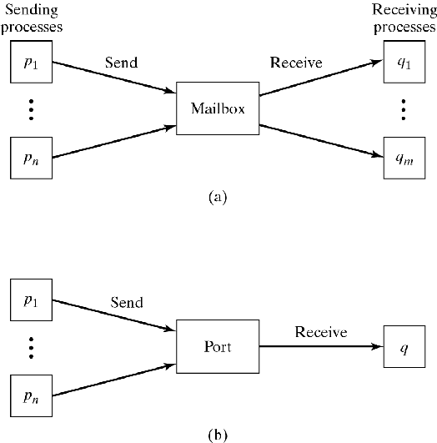
Ports and Mailboxes
Figure 3-2

Slide 31
Procedure-Based Communication
Send/Receive are too low level (like P/V)
Typical interaction: Send Request & (then) Receive Result
Make this into a single higher-level primitive
Use RPC (Remote Procedure Call) or Rendezvous
Caller invokes procedure on remote machine
Remote machine performs operation and returns result
Similar to regular procedure call, but parameters cannot contain pointers because caller and server do not share any memory

Slide 32
RPC
Caller issues: res = f(params)
This is translated into:
Calling Process: Server Process:
... process RP_server {
send(RP,f,params); while (1) {
rec(RP,res); rec(C,f,params);
... res=f(params);
send(C,res);
}
}

Slide 33
Rendezvous
With RPC: Called process p is part of a dedicated server
With Rendezvous:
p is part of an arbitrary process
p maintains state between calls
p may accept/delay/reject call
Setup is symmetrical: Any process may be a client or a server

Slide 34
Rendezvous
Caller: Similar syntax/semantics to RPC
q.f(param)
where q is the called process (server)
Server: Must indicate willingness to accept:
accept f(param) S
Rendezvous: Caller (calling process) or Server (called process) waits for the other, Then they execute in parallel after sync.
(“Rendezvous” is French for “meeting.”)

Slide 35
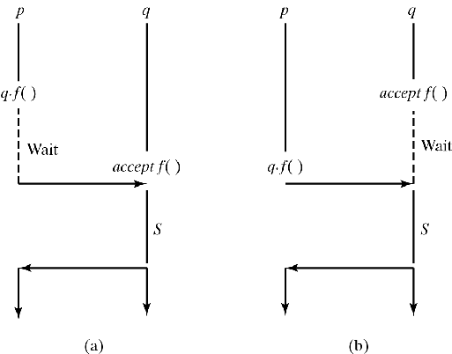
Rendezvous
Figure 3-3

Slide 36
Rendezvous
To permit selective receive:
select {
[when B1:]
accept E1(…) S1;
or
[when B2:]
accept E2(…) S2;
or
…
[when Bn:]
accept En(…) Sn;
[else R]
}

Slide 37
Example: Bounded Buffer
process BoundedBuffer {
while(1) {
select {
when (fullCount < n):
accept deposit(char c) {
buffer[nextin] = c;
nextin = (nextin + 1) % n;
fullCount = fullCount + 1;
}
or
when (fullCount > 0):
accept remove(char c) {
c = buffer[nextout];
nextout = (nextout + 1) % n;
fullCount = fullCount - 1;
}
}}}

Slide 38
Distributed Mutual Exclusion
CS problem in a Distributed Environment No shared memory, No shared clock, Delays in message transmission.
Central Controller Solution
Requesting process sends request to controller
Controller grants it to one process at a time
Problems: Single point of failure, Performance bottleneck
Fully Distributed Solution:
Processes negotiate access among themselves

Slide 39
Distributed Mutual Exclusion
Token Ring solution
Each process has a controller
Controllers are arranged in a ring
Controllers pass “token” around ring
Process whose controller holds token may enter CS

Slide 40
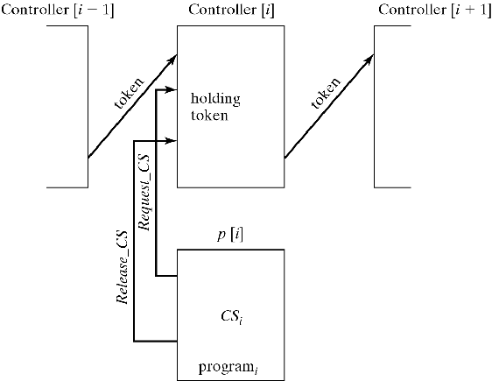
Distributed Mutual Exclusion with Token Ring
Figure 3-4

Slide 41
Distributed Mutual Exclusion
process controller[i] {
while(1) {
accept Token;
select {
accept Request_CS() {busy=1;}
else null;
}
if (busy) accept Release_CS() {busy=0;}
controller[(i+1) % n].Token;
}
}
process p[i] {
while(1) {
controller[i].Request_CS();
CSi;
controller[i].Release_CS();
programi;
}
}

Slide 42
Readers/Writers Problem
Extension of basic CS problem (Courtois, Heymans, and Parnas, 1971)
Two types of processes entering a CS:
Only one W may be inside CS, (exclusive) or
Any number of R may be inside CS
Prevent starvation of either process type:
If Rs are in CS, a new R must not enter if W is waiting
If W is in CS, once it leaves, all Rs waiting should enter (even if they arrived after new Ws)

Slide 43
Solution using monitor
monitor Readers_Writers {
int readCount=0, writing=0;
condition OK_R, OK_W;
start_read() {
if (writing || !empty(OK_W)) OK_R.wait;
readCount = readCount + 1;
OK_R.signal; }
end_read() {
readCount = readCount - 1;
if (readCount == 0) OK_W.signal; }
start_write(){
if ((readCount != 0)||writing) OK_W.wait;
writing = 1; }
end_write() {
writing = 0;
if (!empty(OK_R)) OK_R.signal;
else OK_W.signal; }
}

Slide 44
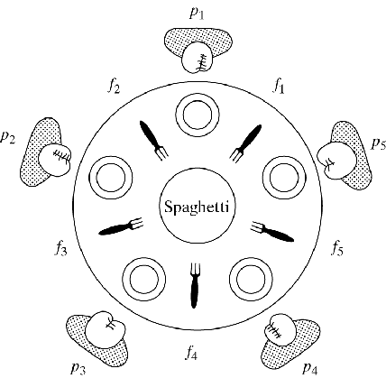
Dining philosophers
Each philosopher needs both forks to eat
Requirements
Prevent deadlock
Guarantee fairness: no philosopher must starve
Guarantee concurrency: non-neighbors may eat at the same time
Figure 3-5

Slide 45
Dining philosophers
p(i) {
while (1) {
think(i);
grab_forks(i);
eat(i);
return_forks(i);
}
grab_forks(i): P(f[i]); P(f[(i+1)%5]);
return_forks(i): V(f[i]); V(f[(i+1)%5]);
Only one process can grab any fork
May lead to deadlock

Slide 46
To think about…
What if I could do something like:
grab_forks( i ){
repeat {
P(f[i]);
if ( !P(f[(i+1)%5]) )
V(f[i]);
until (f[i] == f[(i+1)%5] == 0)
}
Where the if-semantics are that if the attempt to grab the second fork fails, then we don’t hold the fork f[i] AND we don’t enter the wait queue for the second fork!
In this case: no deadlock! But also no fairness!

Slide 47
Dining Philosophers
Solutions to deadlock
Use a global counter: At most n–1 philosophers may attempt to grab forks
One philosopher requests forks in reverse order, e.g., grab_forks(1): P(f[2]); P(f[1]) Violates concurrency requirement: While P(1) is eating, all other could be blocked in a chain
Divide philosophers into two groups:
Odd grab Left fork first,
Even grab Right fork first

Slide 48
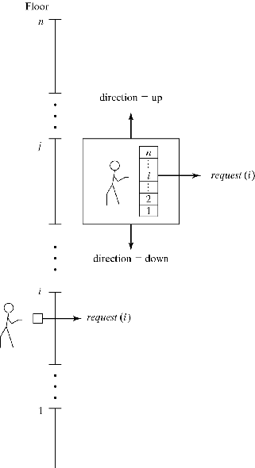
Elevator algorithm
Pressing button at floor i or button i inside elevator invokes: request(i)
Door closing, invokes: release()
Scheduler policy:
When elevator is moving up: it services all requests at or above current position; then it reverses direction
When elevator is moving down: it services all requests at or below current position; then it reverses direction
Figure 3-6

Slide 49
Elevator algorithm
monitor elevator {
...
request(int dest) { /*Called when button pushed*/
if (busy) {
if ((position<dest) ||
((position==dest) && (dir==up)))
upsweep.wait(dest);
else downsweep.wait(-dest);
}
busy = 1;
position = dest;
}
If position<dest, wait in upsweep queue
If position>dest, wait in downsweep queue
If position==dest, service immediately,
wait in upsweep or downsweep, depending on current direction

Slide 50
Elevator algorithm
release() { /*Called when door closes*/
busy = 0;
if (direction==up) {
if (!empty(upsweep)) upsweep.signal;
else {
direction = down;
downsweep.signal;
}
else if /*direction==down*/
(!empty(downsweep)) downsweep.signal;
else {
direction = up;
upsweep.signal;
}
}
}

Slide 51
Logical Clocks
Many applications need to time-stamp events
for debugging, recovery, distributed mutual exclusion, ordering of broadcast messages, transactions, etc.
Centralized system allows one to attach clock value:
C(e1)<C(e2) means e1 happened before e2
Physical clocks in distributed systems are skewed
Example below shows what can happen if one relies on physical clocks which are skewed.

Slide 52
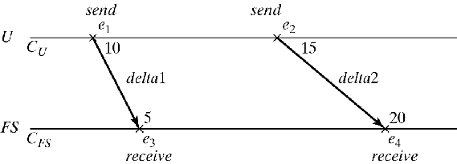
Physical Clocks
Figure 3-7
Based only on times, the log shows an impossible sequence: e3, e1, e2, e4
Possible sequences: e1, e3, e2, e4 or e1, e2, e3, e4

Slide 53
Logical Clocks
Use counters as logical clocks:
Within a process p, increment counter for each new event: L_{p}(e_{i+1}) = L_{p}(e_{i}) + 1
Label each send event with new clock value: L_{p}(e_{s}) = L_{p}(e_{i}) + 1
Label each receive event with maximum of local clock value and value of message: L_{q}(e_{r}) = max( L_{p}(e_{s}), L_{q}(e_{i}) ) + 1

Slide 54
Logical Clocks
Logical Clocks use a happened-before relation: e_{i} e_{j} holds if:
e_{i} and e_{j} belong to the same process and e_{i} happened before e_{j} , or
e_{i} is a send and e_{j} is the corresponding receive

Slide 55
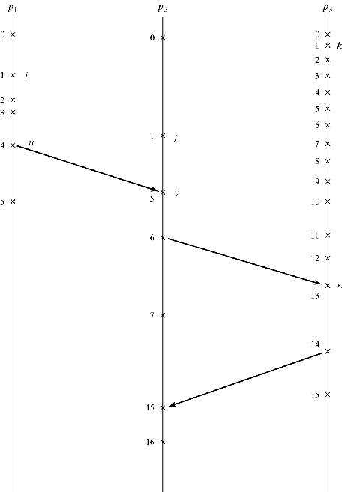
Logical Clocks
L_{p1}(u)=4
L_{p2}(v)=max(4,1)+1=5
L_{p3}(x)=max(6,12)+1=13
L_{p2}(y)=max(7,14)+1=15
Figure 3-8

