Slide 1
Process Scheduling
Chapters 4 & 5

Slide 2
Chapter 4
Terminology and ideas to note:
kernel
microkernel
mechanism versus policy
ready list
processes versus threads
5 State Model
context switch

Slide 3
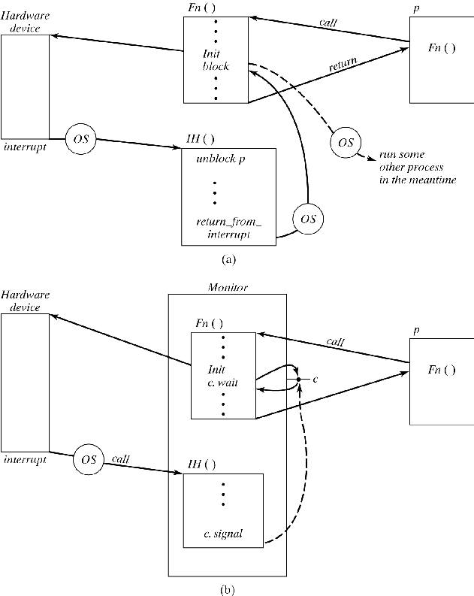
Interrupt Handling

Slide 4
Call sequence:
P uses procedure F(n) to compute using hardware
F(n) initializes hardware, then blocks itself
Device finishing creates interrupt
IH unblocks p, then invokes OS
OS schedules p, which completes F(n)

Slide 5
Interrupts
Difficulties with first implementation:
Process must be able to block itself via OS
So programmer must know OS details
I H must be able to unblock process that was previously blocked
I H must be able to pass control to OS
All of these require messy kernel mechanisms

Slide 6
Interrupts with Monitors
Pushes process model to hardware level
Replace blocking/wakeup with monitor operations
Result: F(n) and I H have no knowledge of the kernel—they just use monitor primitives

Slide 7
Context Switches and Time
As we noted before, context switching wastes time
Common operating systems often allocate a quantum of time to each process, halted by a clock interrupt
You know what a switch does from architecture: unloading and reloading of registers from cache
Can think of “useful work” T alternating with context switches S:
Imagine this is unbounded, and a context switch is 30% of the quantum or useful time… what is the waste?
T | S | T | S | T…

Slide 8
5. Process and thread scheduling
5.1 Organization of Schedulers
Embedded and Autonomous Schedulers
Priority Scheduling
5.2 Scheduling Methods
A Framework for Scheduling
Common Scheduling Algorithms
Comparison of Methods
5.3 Priority Inversion
5.4 Multiprocessor and Distributed Scheduling

Slide 9
Process and Thread Scheduling
Process scheduling
Long term scheduling
Move process to Ready List (“RL”) after creation (When and in which order?)
Dispatching
Short term scheduling
Select process from Ready List to run
We use “scheduling” to refer to both

Slide 10
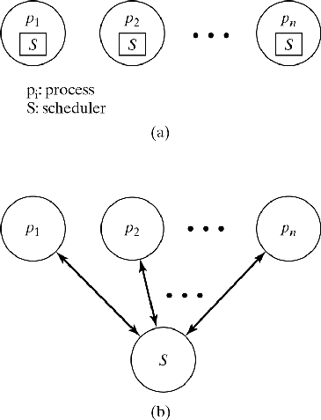
Organization of Schedulers
Embedded
Called as function at end of kernel call
Runs as part of calling process
Autonomous
Separate process
May have dedicated CPU on a multiprocessor
On single-processor, run at every quantum: scheduler and other processes alternate
Figure 5-1

Slide 11
Priority Scheduling
Priority function returns numerical value P for process p: P = Priority(p)
Static priority: unchanged for lifetime of p
Dynamic priority: changes at runtime
Priority divides processes into levels
implemented as multi-level Ready List
p at RL[i] run before q at RL[j] if i>j
p, q at same level are ordered by other criteria

Slide 12
An Embedded Scheduler
Scheduler() {
do {
Find highest priority ready process p;
Find a free cpu;
if (cpu != NIL) Allocate_CPU(p,cpu);
} while (cpu != NIL);
do {
Find highest priority ready process p;
Find lowest priority running process q;
if (Priority(p) > Priority(q)) Preempt(p,q);
} while (Priority(p) > Priority(q));
if (self->Status.Type!=’running’) Preempt(p,self);
}

Slide 13
Scheduling Methods
When is scheduler invoked?
Decision mode
Preemptive: scheduler called periodically (quantum-oriented) or when system state changes
Nonpreemptive: scheduler called when process terminates or blocks
How does it select highest priority process?
Priority function: P = Priority(p)
Arbitration rule: break ties
Random
Chronological (First In First Out = FIFO)
Cyclic (Round Robin = RR)

Slide 14
Priority function
Possible parameters:
Attained service time (a)
Real time in system (r)
Total service time (t)
Period (d)
Deadline (explicit or implied by period)
External priority (e)
Memory requirements (mostly for batch)
System load (not process-specific)

Slide 15
Scheduling algorithms
Name, Decision mode, Priority, Arbitration
FIFO: nonpreemptive P = r random
SJF: nonpreemptive P = –t chrono/random
SRT: preemptive P = –(t–a) chrono/random
RR: preemptive P = 0 cyclic
ML: preemptive P = e cyclic
nonpreemptive P = e chronological
n fixed priority levels from n down to 1
level P is serviced when n through P+1 empty

Slide 16
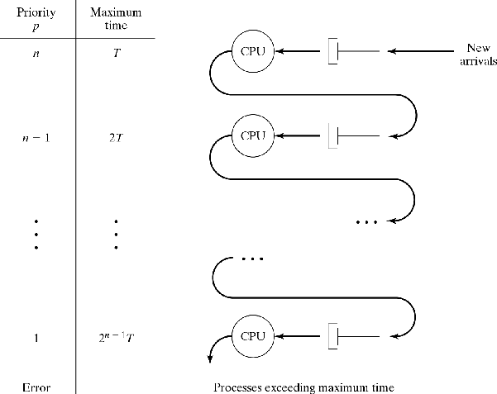
MLF (Multilevel Feedback)
Like ML, but priority changes dynamically
Every process enters at highest level n
Each level P prescribes maximum time t_{P}
t_{P} increases as P decreases
Typically:
t_{n} = T (constant)
t_{P} = 2 × t_{P+1}
Figure 5-3

Slide 17
Scheduling algorithms
MLF priority function:
Find the final priority level P = n–i for given a:
priority attained time
n a<T
n–1 a<T+2T
n–2 a<T+2T+4T
. . . . . .
n–i a<(2^{i+1}–1)T
Find smallest i such that a<(2^{i+1}–1)T:
Solve for i: i = ⎣lg₂(a/T+1) ⎦
P = n–i = n– ⎣lg₂(a/T+1)⎦

Slide 18
Scheduling Algorithms
Rate Monotonic (RM):
Intended for periodic (real-time) processes
Preemptive
Highest priority: shortest period: P = –d where d is the time between activations
Earliest Deadline First (EDF):
Intended for periodic (real-time) processes
Preemptive
Highest priority: shortest time to next deadline
r ÷ d number of completed periods
r % d time in current period
d – r % d time remaining in current period
P = –(d – r % d)

Slide 19
Which are the optimal preemptive and nonpreemptive scheduling policies with respect to turnaround time?
FIFO and Round Robin
SRT and MLF
SJN and Round Robin
SJN and SRT
ML and EDF

Slide 20
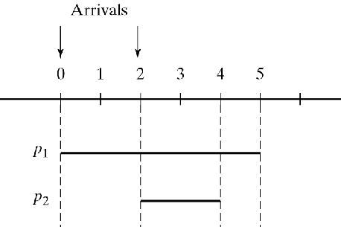
Comparison of Methods
FIFO, SJF, SRT: Primarily for batch systems
FIFO simplest, SJF & SRT have better average turnaround times: (r1+r2+…+rn)/n
FIFO: ((0+5) + (3+2))/2 = 5.0
SRT: ((2+5) + (0+2))/2 = 4.5
Figure 5-2

Slide 21
Comparison of Methods
Time-sharing systems
Response time is critical
RR or MLF with RR within each queue are suitable
Choice of quantum determines overhead
When q → ∞, RR approaches FIFO
When q → 0, context switch overhead → 100%
When q >> context switch overhead, n processes run concurrently at 1/n CPU speed

Slide 22
Let s = time for a context switch. Then, if q = 2s, what is the long run usable CPU time relative to the total CPU time?
50%
25%
75%
33%
66%

Slide 23
OS Design Consideration
Because of this, we generally want to choose a quantum value so that:
The quantum is at least 100x a context switch (lower bound to q)
An average of 75% of each quantum is used by the system (upper bound to q)

Slide 24
Example
Suppose that the average process uses 1200ms before being interrupted or hitting a trap
Further, suppose that context switching requires an average of 3ms
What are reasonable upper and lower bounds on a quantum?
How might I decide what value to use from there?

Slide 25
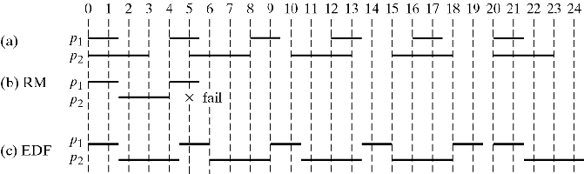
Comparison of Methods 2
Real-time systems
Feasible = All deadlines are met
CPU utilization is defined as: U=∑ t_{i}/d_{i}
Schedule is feasible if U ≤ 1
EDF always yields feasible schedule (if U ≤ 1)
RM yields feasible schedule if U ≤ 0.7
Figure 5-9

Slide 26
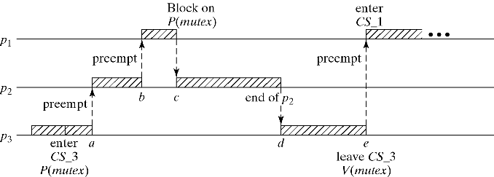
Priority Inversion Problem
Assume priority order p1>p2>p3
(Unrelated) p2 may delay p1 indefinitely.
Naïve “solution”: Always run CS at priority of highest process that shares the CS. Problem: p1 cannot interrupt lower-priority process inside its CS -- a different form of priority inversion.
Figure 5-10

Slide 27
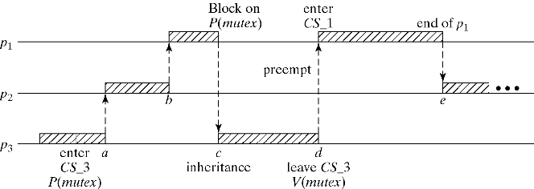
Priority Inversion Problem
Solution: Dynamic Priority Inheritance
p3 is in its CS
p1 attempts to enter its CS
p3 inherits p1’s (higher) priority for the duration of CS
Figure 5-11

