Slide 1
7. Physical Memory
7.1 Preparing a Program for Execution
  Program Transformations
  Logical-to-Physical Address Binding
7.2 Memory Partitioning Schemes
  Fixed Partitions
  Variable Partitions
7.3 Allocation Strategies for Variable Partitions
7.4 Dealing with Insufficient Memory
CS 374

Slide 2
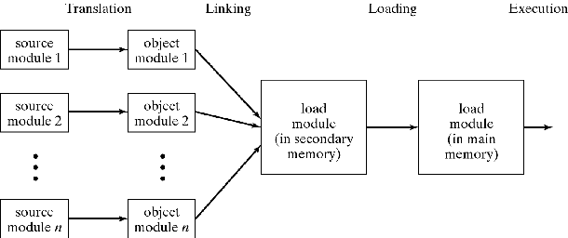
Preparing Program for Execution
Program Transformations
  Translation (Compilation)
  Linking
  Loading
Figure 7-1
CS 374

Slide 3
Address Binding
Assign Physical Addresses = Relocation
  Imaginary address to real address
  Movement from storage to memory too
Static binding
  Programming time
  Compilation time
  Linking time
  Loading time
Dynamic binding
  Execution time
CS 374

Slide 4
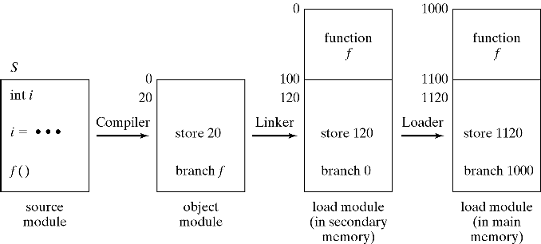
Static Address Binding
Static Binding = At Programming, Compilation, Linking, and/or Loading Time
Figure 7-2
CS 374

Slide 5
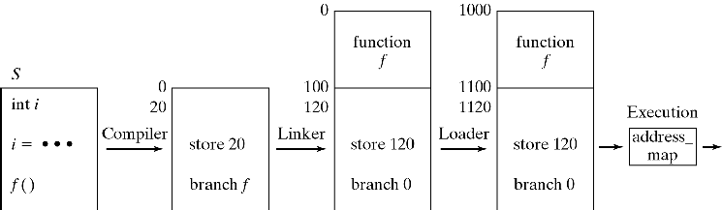
Dynamic Address Binding
Dynamic Binding = At Execution Time
Figure 7-4
CS 374

Slide 6
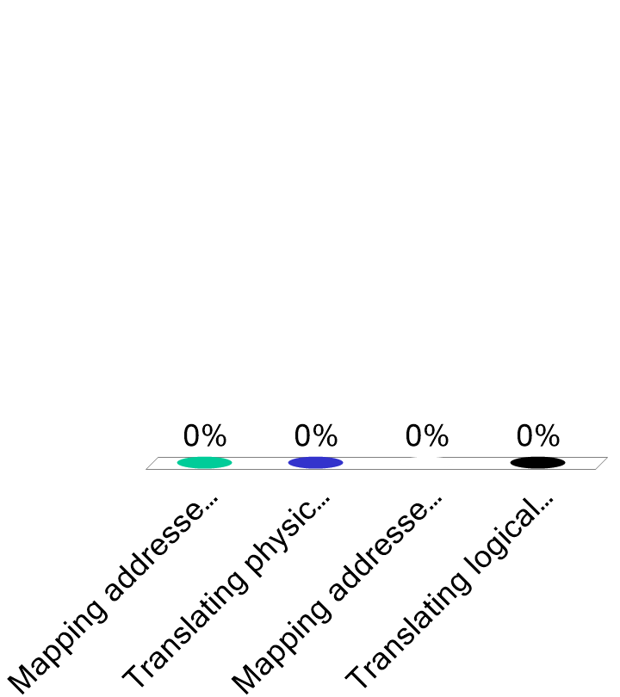
“Address binding” might be best defined as…
Mapping addresses at compile time
Translating physical addresses to logical addresses
Mapping addresses at run time
Translating logical addresses to physical addresses
CS 374

Slide 7
Address Binding
How to implement dynamic binding
  Perform for each address at run time:
  phys_a = address_map(log_a)
  Simplest form of address_map:
  Relocation Register: phys_a = log_a + RR
  More general form:
  Page/Segment Table (Chapter 8)
CS 374

Slide 8
Memory Partitioning Schemes
Fixed Partitions
  Note novel: The Adolescence of P-1 by Thomas Ryan (Gregory Burgess is main character)
  Single-program systems: 2 partitions (OS/user)
  Multi-programmed: partitions of different sizes
How to assign processes to partitions
  FIFO for each partition: Some partitions may be unused
  Single FIFO: More complex, but more flexible
Limitations of fixed partitions
  Program size limited to largest partition
  Internal fragmentation (unused space within partitions)
CS 374

Slide 9
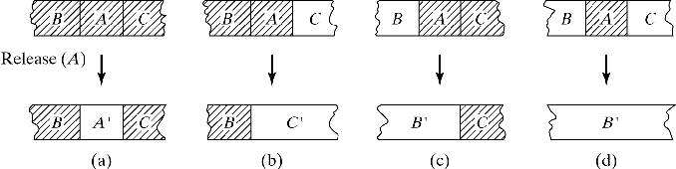
Variable Partitions
Memory not partitioned a priori
Each request is allocated portion of free space
Memory = Sequence of variable-size blocks
  Some are occupied, some are free (holes)
  External fragmentation occurs
Adjacent holes (right, left, or both) must be coalesced to prevent increasing fragmentation
Figure 7-6
CS 374

Slide 10
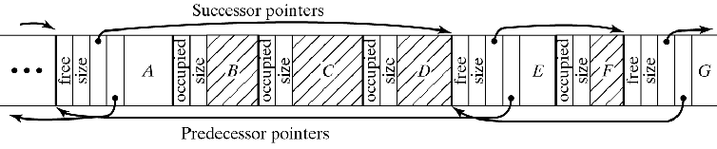
Linked List Implementation 1
Type/Size tags at the start of each Block
Holes (must be sorted by physical address)
contain links to predecessor hole and to next hole
Checking neighbors of released block b (=C below):
  Right neighbor (easy): Use size of b
  Left neighbor (clever): Use sizes to find first hole to b’s right, follow its predecessor link to first hole on b’s left, and check if it is adjacent to b.
Figure 7-7a
CS 374

Slide 11
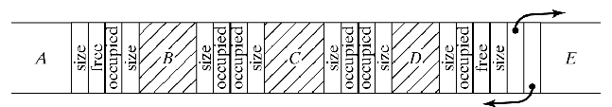
Linked List Implementation 2
Better solution:
Replicate tags at end of blocks (need not be sorted)
Checking neighbors of released block b:
  Right neighbor: Use size of b as before
  Left neighbor: Check its (adjacent) type/size tags
Figure 7-7b
CS 374

Slide 12
Bitmap Implementation
Memory divided into fix-size blocks
Each block represented by a 0/1 bit in a binary string: the “bitmap”
Can be implemented as char or int array
Operations use bit masks
  Release: B[i] = B[i] & '11011111'
  Allocate: B[i] = B[i] | '11000000'
  Search: Repeatedly, Check left-most bit and
  Shift mask right: TEST = B[i] & '10000000'
CS 374

Slide 13
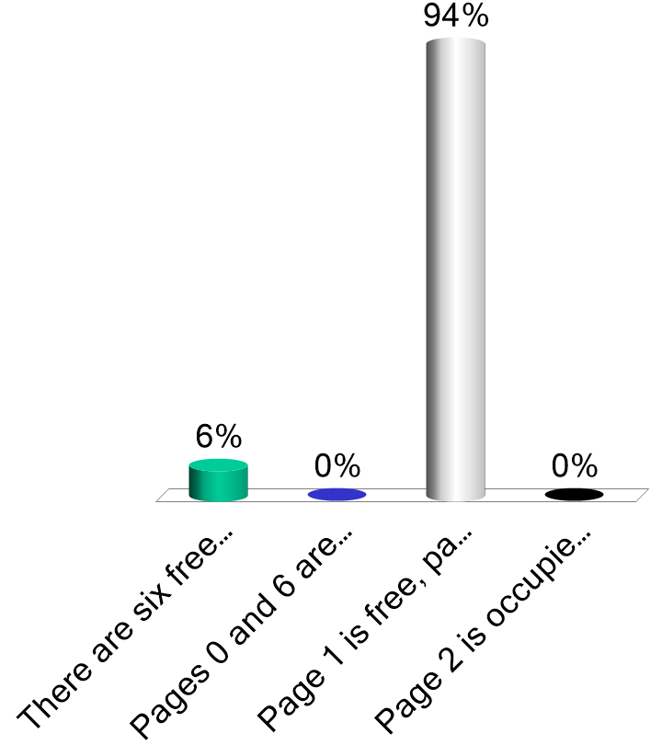
For the bitmap 10111101, which of these is true:
There are six free pages of memory
Pages 0 and 6 are occupied
Page 1 is free, page 5 is not
Page 2 is occupied, page 7 is not
CS 374

Slide 14
The Buddy System
Compromise between fixed and variable partitions
Fixed number of possible hole sizes; typically, 2^{i}
  Each hole can be divided (equally) into 2 buddies.
  Track holes by size on separate lists
When n bytes requested, find smallest i so that n≤ 2^{i}
  If hole of this size available, allocate it;
  otherwise, consider larger holes.
  Recursively split each hole into two buddies
  until smallest adequate hole is created
  .Allocate it and place other holes on appropriate lists
On release, recursively coalesce buddies
  Buddy searching for coalescing can be inefficient
CS 374

Slide 15
The Buddy System
Special Note: it is best to visualize the Buddy System as forcing a Binary Tree structure atop memory
  First division is into left and right halves
  Next is left and right quarters of each half
  And so on…
“Buddies” are only pairs according to this structure, not arbitrary chunks of some size
CS 374

Slide 16
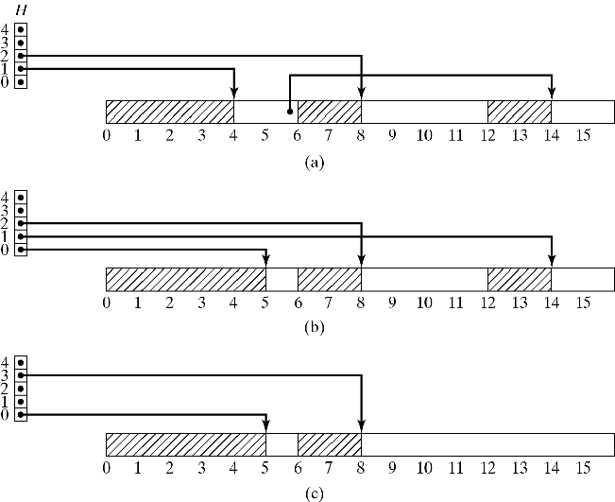
The Buddy System
Sizes: 1, 2, 4, 8, 16
3 blocks allocated
& 3 holes left
Block of size 1 allocated
Block 12-13 released
Figure 7-9
CS 374

Slide 17
Consider what happens to the following Buddy system on a request for a size one chunk of RAM:
4
3
2
1
0
0 1 2 3 4 5 6 7 8 9 10 11 12 13 14 15
Question on following slide…
CS 374

Slide 18
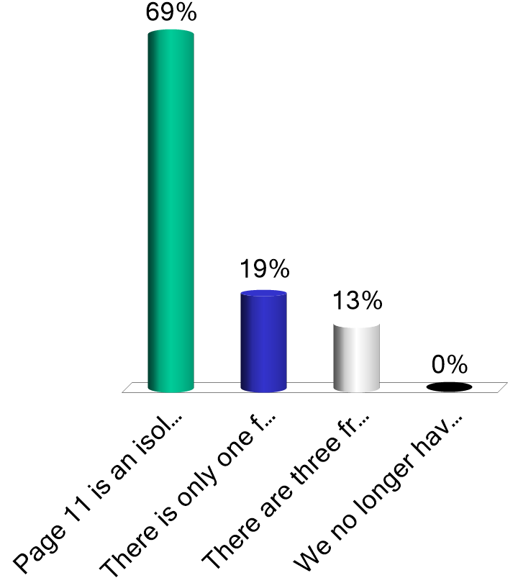
Which of the following exists after the request is serviced:
Page 11 is an isolated single free page
There is only one free list size with any members
There are three free list sizes with members
We no longer have a size 4 block available
CS 374

Slide 19
Now what happens to the following Buddy system after a release of the final size 4 chunk of RAM:
4
3
2
1
0
0 1 2 3 4 5 6 7 8 9 10 11 12 13 14 15
Question on following slide…
CS 374

Slide 20
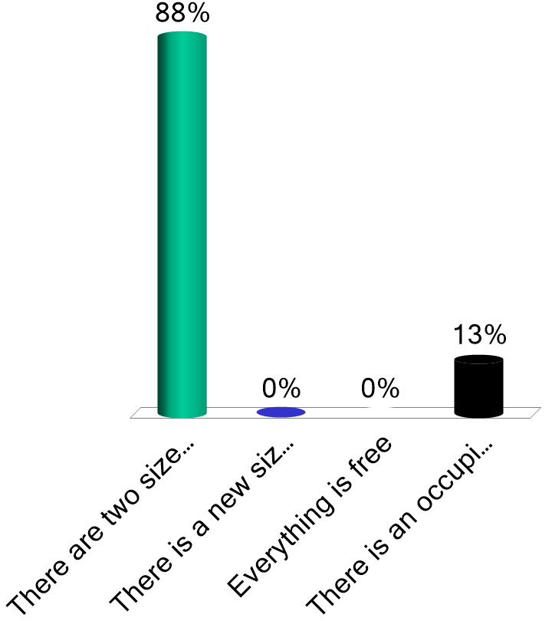
Which is true?
There are two size 4 chunks available
There is a new size 6 chunk available
Everything is free
There is an occupied chunk of size 6
CS 374

Slide 21
Allocation Strategies
Problem: Given a request for n bytes, find hole ≥ n
Constraints:
  Maximize memory utilization
  (minimize “external fragmentation”)
  Minimize search time
Search Strategies:
  First-fit: Always start at same place. Simplest.
  Next-fit: Resume search. Improves distribution of holes.
  Best-fit: Closest fit. Avoid breaking up large holes.
  Worst-fit: Largest fit. Avoid leaving tiny hole fragments
First Fit is generally the best choice
CS 374

Slide 22
Measures of Memory Utilization
50% rule (Knuth, 1968):
#holes = p × #full_blocks/2
  p = probability of inexact match (i.e., remaining hole)
In practice:
  p = 1. It’s impossible to get exact matches.
  and so
  Of the total number of (occupied) blocks and holes,
  1/3 are holes
But how much memory is wasted?
(average) hole_size is not the same as
(average) block_size
CS 374

Slide 23
Measures of Memory Utilization
How much memory isn’t used?
  Utilization depends on k = hole_size/block_size
  In fact, taking p=1, unused_memory = k/(k+2)
  Intuition:
    k→∞: unused_memory→1 (100% empty)
    k=1: unused_memory→1/3 (50% rule)
    k→0: unused_memory→0 (100% full)
  What determines k?
  The block size b relative to total memory size M
    Determined experimentally via simulations:
      When b≤ M/10, k=0.22 and unused_memory≈ 0.1
      When b=M/3, k=2 and unused_memory≈ 0.5
Conclusion: M must be large relative to b
CS 374

Slide 24
Dealing with Insufficient Memory
Memory compaction (see next slide)
  How much and what to move?
Swapping
  Temporarily move process to disk
  Requires dynamic relocation
Overlays (see last slide)
  Allow programs large than physical memory
  Programs loaded as needed
  according to calling structure.
CS 374

Slide 25
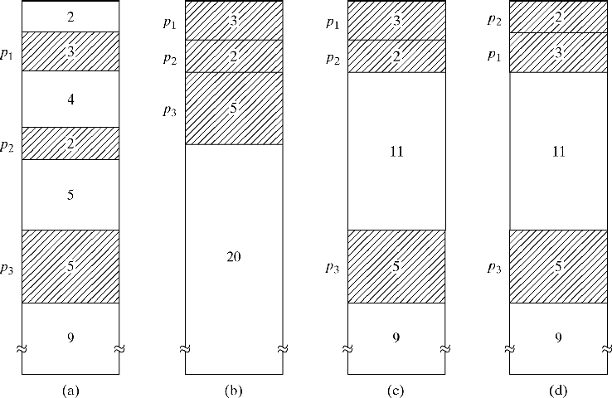
Dealing with Insufficient Memory
Memory compaction
Figure 7-10
Initial Complete Partial Minimal Movement
CS 374

Slide 26
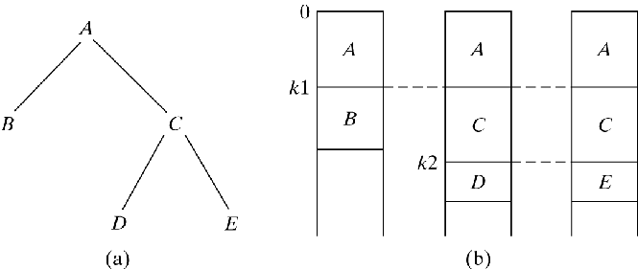
Dealing with Insufficient Memory
Overlays
  Allow programs large than physical memory
  Programs loaded as needed
  according to calling structure
Figure 7-11
CS 374

