Slide 1
8. Virtual Memory
8.1 Principles of Virtual Memory
8.2 Implementations of Virtual Memory
Paging
Segmentation
Paging With Segmentation
8.3 Memory Allocation in Paged Systems
Global Page Replacement Algorithms
Local Page Replacement Algorithms
Load Control and Thrashing
Evaluation of Paging

Slide 2
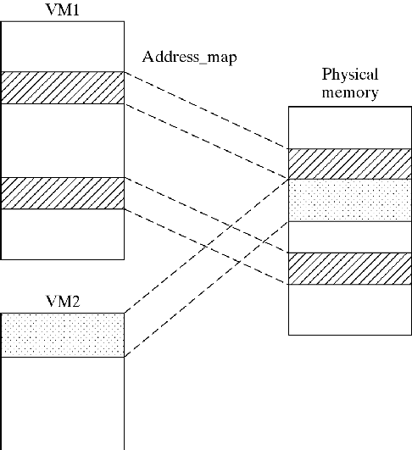
Principles of Virtual Memory
For each process, the system creates the illusion of large contiguous memory space(s)
Relevant portions of Virtual Memory (VM) are loaded automatically and transparently
Address Map translates Virtual Addresses to Physical Addresses
Figure 8-11

Slide 3
Principles of Virtual Memory
Paged Virtual Memory (single segment):
One area of 0..n-1 words
Divided into fix-size pages
Segmented Virtual Memory (multiple segment):
Multiple areas of up to 0..n-1 (words)
Each holds a logical segment (e.g., function, data structure)
Each is contiguous or divided into pages

Slide 4
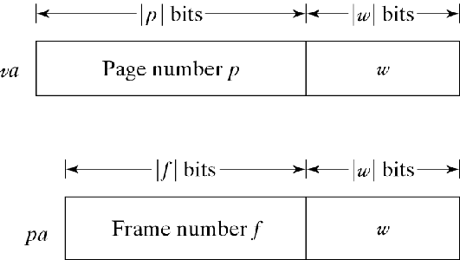
VM Implementation via Paging
VM is divided into fix-size pages (page_size=2^{|w|})
PM (physical memory) is divided into (2^{|f|}) page frames (frame_size=page_size=2^{|w|})
System loads pages into frames and translates addresses
Virtual address: va = (p,w)
Physical address: pa = (f,w)
|p|, |f|, and |w|
|p| determines number of pages in VM, 2^{|p|}
|f| determines number of frames in PM, 2^{|f|}
|w| determines page/frame size, 2^{|w|}
Figure 8-2

Slide 5
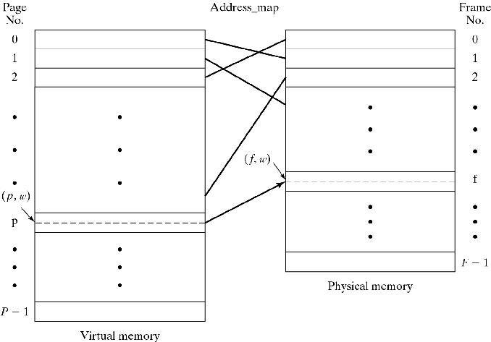
Paged Virtual Memory
Virtual address: va = (p,w) Physical address: pa = (f,w)
2^{|p|} pages in VM; 2^{|w|} = page/frame size; 2^{|f|} frames in PM
Figure 8-3

Slide 6
Paged VM Address Translation
Given (p,w), how to determine f from p ?
One solution: Frame Table,
One entry, FT[i], for each frame FT[i].pid records process ID FT[i].page records page number p
Given (id,p,w), search for a match on (id,p) f is the i for which (FT[i].pid, FT[i].page)=(id,p)
That is,
address_map(id,p,w) {
pa = UNDEFINED;
for (f=0; f<F; f++)
if (FT[f].pid==id && FT[f].page==p) pa=f+w;
return pa;
}

Slide 7
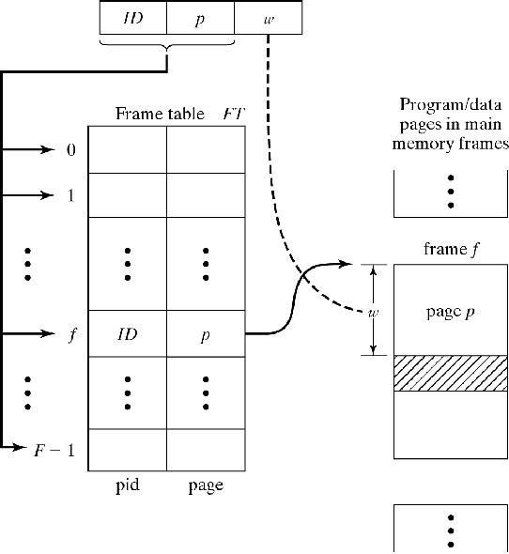
Address Translation via Frame Table
address_map(id,p,w) {
pa = UNDEFINED;
for (f=0; f<F; f++)
if (FT[f].pid==id && FT[f].page==p) pa=f+w;
return pa;
}
Drawbacks
Costly: Search must be done in parallel in hardware (newer versions use software hash tables)
Sharing of pages difficult or not possible
Figure 8-4

Slide 8
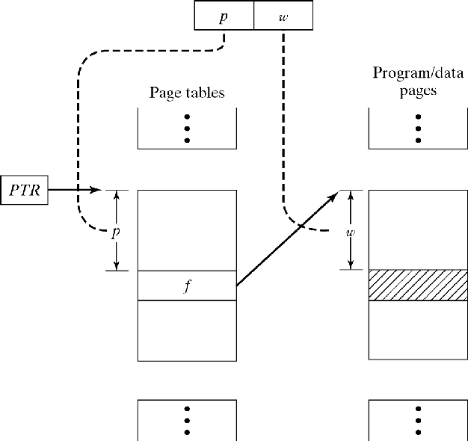
Page Table for Paged VM
Page Table (PT) is associated with each VM (not PM)
PTR points at PT at run time
p’th entry of PT holds frame number of page p:
*(PTR+p) points to frame f
Address translation:
address_map(p, w) {
pa = *(PTR+p)+w;
return pa }
Drawback: Extra memory access for any write
Figure 8-5

Slide 9
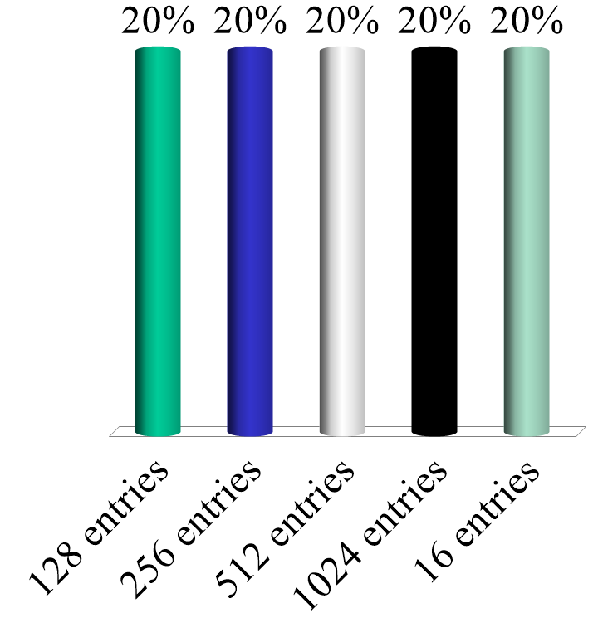
Let the page size in words = 256, and the word size for the architecture be 16 bits. The size of the page table (number of entries) is?:
128 entries
256 entries
512 entries
1024 entries
16 entries

Slide 10
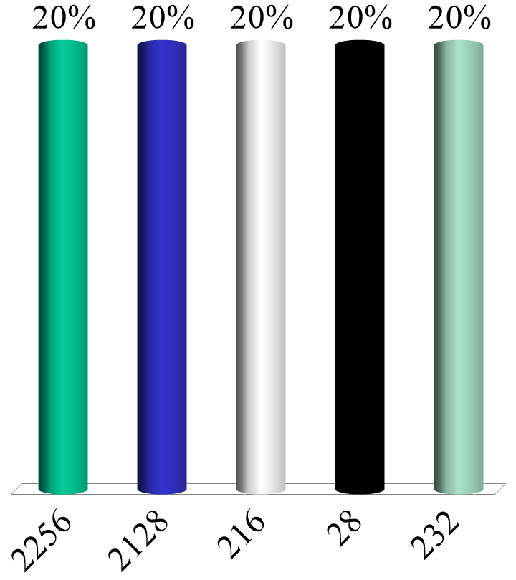
Let the page size in words = 256, and the word size for the architecture be 16 bits. The size of virtual memory is how many words (assume word addressing)?:
2²⁵⁶
2¹²⁸
2¹⁶
2⁸
2³²

Slide 11
Demand Paging
All pages of VM can be loaded initially
Simple, but maximum size of VM = size of PM
Pages are loaded as needed: “on demand”
Additional bit in PT indicates a page’s presence/absence in memory
“Page fault” occurs when page is absent
address_map(p, w) {
if (resident(*(PTR+p))) {
pa = *(PTR+p)+w; return pa; }
else page_fault;
}

Slide 12
Internal Fragmentation and Page Size
To reduce internal fragmentation, it is helpful to realize that as page sizes shrink, so does internal fragmentation
Why? Because on average, we expect the last page of each segment to be half full
But there is a cost: page table sizes increase
This is a classic tradeoff
Compare with external fragmentation from the last chapter…

Slide 13
VM using Segmentation
Multiple contiguous spaces (“segments”)
More natural match to program/data structure
Easier sharing (Chapter 9)
va = (s,w) mapped to pa (but no frames)
Where/how are segments placed in PM?
Contiguous versus paged application

Slide 14
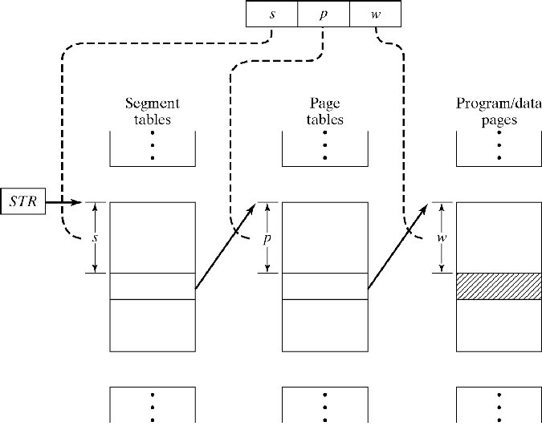
Paging with segmentation
Each segment is divided into fix-size pages
va = (s,p,w)
|s| determines # of segments (size of ST)
|p| determines # of pages per segment (size of PT)
|w| determines page size
pa = *(*(STR+s)+p)+w Drawback: 2 extra memory references
Figure 8-7

Slide 15
Memory Allocation with Paging
Placement policy: Any free frame is OK
Replacement: must minimize data movement
Global replacement:
Consider all resident pages (regardless of owner)
Local replacement
Consider only pages of faulting process
How to compare different algorithms:
Use Reference String (RS): r₀ r₁ ... r_{t} …
r_{t} is the number of the page referenced at time t
Count number of page faults

Slide 16
Global page replacement
Optimal (MIN): Replace page that will not be referenced for the longest time in the future
Time t | 0| 1 2 3 4 5 6 7 8 9 10
RS | | c a d b e b a b c d
Frame 0| a| a a a a a a a a a d
Frame 1| b| b b b b b b b b b b
Frame 2| c| c c c c c c c c c c
Frame 3| d| d d d d e e e e e e
IN | | e d
OUT | | d a
Problem: Reference String not known in advance

Slide 17
Global Page Replacement
Random Replacement
Simple but…
Does not exploit locality of reference
Most instructions are sequential
Most loops are short
Many data structures are accessed sequentially

Slide 18
Global page replacement
FIFO: Replace oldest page
Time t | 0| 1 2 3 4 5 6 7 8 9 10
RS | | c a d b e b a b c d
Frame 0|>a|>a >a >a >a e e e e >e d
Frame 1| b| b b b b >b >b a a a >a
Frame 2| c| c c c c c c >c b b b
Frame 3| d| d d d d d d d >d c c
IN | | e a b c d
OUT | | a b c d e
Problem:
Favors recently accessed pages but
Ignores when program returns to old pages

Slide 19
Global Page Replacement
LRU: Replace Least Recently Used page
Time t | 0| 1 2 3 4 5 6 7 8 9 10
RS | | c a d b e b a b c d
Frame 0| a| a a a a a a a a a d
Frame 1| b| b b b b b b b b b b
Frame 2| c| c c c c e e e e e d
Frame 3| d| d d d d d d d d c c
IN | | e c d
OUT | | c d e
Q.end | d| c a d b e b a b c d
| c| d c a d b e b a b c
| b| b d c a d d e e a b
Q.head | a| a b b c a a d d e a

Slide 20
Global page replacement
LRU implementation
Software queue: too expensive
Time-stamping
Stamp each referenced page with current time
Replace page with oldest stamp
Hardware capacitor with each frame
Charge at reference
Replace page with smallest charge
n-bit aging register with each frame
Shift all registers to right at every reference
Set left-most bit of referenced page to 1
Replace page with smallest value

Slide 21
Global Page Replacement
Second-chance algorithm
Approximates LRU
Implement use-bit u with each frame
Set u=1 when page referenced
To select a page:
If u==0, select page
Else, set u=0 and consider next frame
Used page gets a second chance to stay in PM
Algorithm is called “clock” algorithm:
Search cycles through page frames

Slide 22
Global page replacement
Second-chance algorithm
… 4 5 6 7 8 9 10
… b e b a b c d
… >a/1 e/1 e/1 e/1 e/1 >e/1 d/1
… b/1 >b/0 >b/1 b/0 b/1 b/1 >b/0
… c/1 c/0 c/0 a/1 a/1 a/1 a/0
… d/1 d/0 d/0 >d/0 >d/0 c/1 c/0
… e a c d

Slide 23
Global Page Replacement
Third-chance algorithm
Second chance algorithm does not distinguish between read and write access
Write access more expensive
Give modified pages a third chance:
u-bit set at every reference (read and write)
w-bit set at write reference
to select a page, cycle through frames, resetting bits, until uw==00:
uw → uw
1 1 0 1
1 0 0 0
0 1 0 0 * (remember modification)
0 0 select

Slide 24
Global Page Replacement
Third-chance algorithm Read->10->00->Select Write->11->01->00*->Select
… 0 | 1 2 3 4 5 6 7 8 9 10 .
… | c a^{w} d b^{w} e b a^{w} b c d .
>a/10 |>a/10 >a/11 >a/11 >a/11 a/00* a/00* a/11 a/11 >a/11 a/00*
… b/10 | b/10 b/10 b/10 b/11 b/00* b/10* b/10* b/10* b/10* d/10
… c/10 | c/10 c/10 c/10 c/10 e/10 e/10 e/10 e/10 e/10 >e/00
… d/10 | d/10 d/10 d/10 d/10 >d/00 >d/00 >d/00 >d/00 c/10 c/00 .
… IN | e c d
… OUT | c d b

Slide 25
Local Page Replacement
Measurements indicate that Every program needs a “minimum” set of pages
If too few, thrashing occurs
If too many, page frames are wasted
The “minimum” varies over time
How to determine and implement this minimum”?

Slide 26
Local Page Replacement
Optimal (VMIN)
Define a sliding window (t,t+τ)
τ is a parameter (constant)
At any time t, maintain as resident all pages visible in window
Guaranteed to generate smallest number of page faults

Slide 27
Local page replacement
Optimal (VMIN) with τ=3
Time t | 0| 1 2 3 4 5 6 7 8 9 10
RS | d| c c d b c e c e a d
Page a | -| - - - - - - - - x -
Page b | -| - - - x - - - - - -
Page c | -| x x x x x x x - - -
Page d | x| x x x - - - - - - x
Page e | -| - - - - - x x x - -
IN | | c b e a d
OUT | | d b c e a
Guaranteed optimal but
Unrealizable without Reference String

Slide 28
Local Page Replacement
Working Set Model: Use Principle of Locality
Use trailing window (instead of future window)
Working set W(t,τ) is all pages referenced during the interval (t–τ,t)
At time t:
Remove all pages not in W(t,τ)
Process may run only if entire W(t,τ) is resident

Slide 29
Local Page Replacement
Working Set Model with τ=3
Time t | 0| 1 2 3 4 5 6 7 8 9 10
RS | a| c c d b c e c e a d
Page a | x| x x x - - - - - x x
Page b | -| - - - x x x x - - -
Page c | -| x x x x x x x x x x
Page d | x| x x x x x x - - - x
Page e | x| x - - - - x x x x x
IN | | c b e a d
OUT | | e a d b .
Drawback: costly to implement
Approximate (aging registers, time stamps)

Slide 30
Local Page Replacement
Page fault frequency (pff)
Main objective: Keep page fault rate low
Basic principle of pff:
If time between page faults ≤ τ, grow resident set by adding new page to resident set
If time between page faults > τ, shrink resident set by adding new page and removing all pages not referenced since last page fault

Slide 31
Local Page Replacement
Page Fault Frequency with τ=2
Time t | 0| 1 2 3 4 5 6 7 8 9 10
RS | | c c d b c e c e a d
Page a | x| x x x - - - - - x x
Page b | -| - - - x x x x x - -
Page c | -| x x x x x x x x x x
Page d | x| x x x x x x x x - x
Page e | x| x x x - - x x x x x
IN | | c b e a d
OUT | | ae bd

Slide 32
Load Control and Thrashing
Main issues:
How to choose the amount/degree of multiprogramming?
When level decreased, which process should be deactivated?
When new process reactivated, which of its pages should be loaded?
Load Control = Policy setting number & type of concurrent processes
Thrashing = Excessively moving pages between main and secondary memory

Slide 33
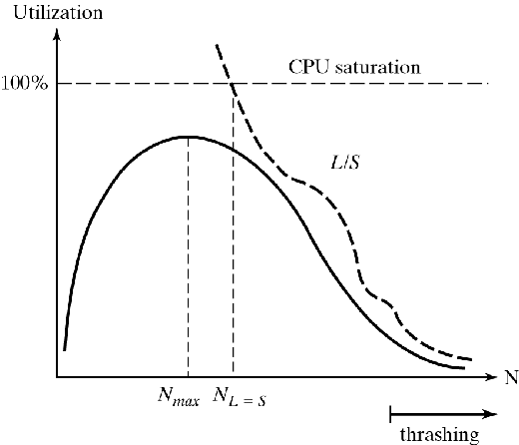
Load Control and Thrashing
Choosing degree of multiprogramming
Local replacement:
Working set of any process must be resident
This automatically imposes a limit
Global replacement
No working set concept
Use CPU utilization as a criterion
With too many processes, thrashing occurs
Figure 8-11 L=mean time between faults S=mean page fault service time

Slide 34
Load Control and Thrashing
How to find N_{max}?
L=S criterion:
Page fault service S needs to keep up with mean time between faults L
50% criterion:
CPU utilization is highest when paging disk 50% busy (found experimentally)

Slide 35
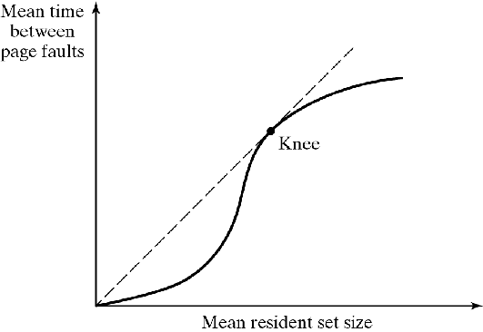
Load Control and Thrashing
Which process to deactivate
Lowest priority process
Faulting process
Last process activated
Smallest process
Largest process
Which pages to load when process activated
Prepage last resident set
Figure 8-12

Slide 36
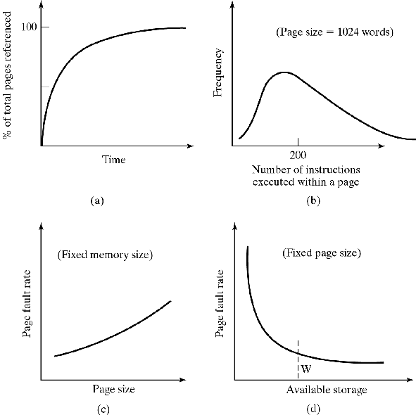
Evaluation of Paging
Experimental measurements:
(a): Prepaging is important
Initial set can be loaded more efficiently than by individual page faults
(b,c): Page size should be small, but small pages need
Larger page tables
More hardware
Greater I/O overhead
(d): Load control is important
Figure 8-13

Slide 37
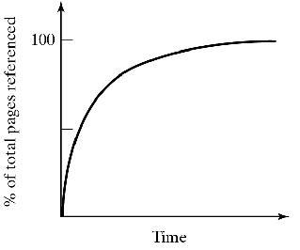
Evaluation of Paging
Prepaging is important
Initial set can be loaded more efficiently than by individual page faults
Figure 8-13(a)

Slide 38
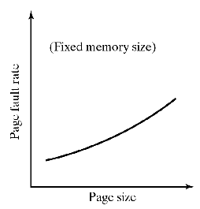
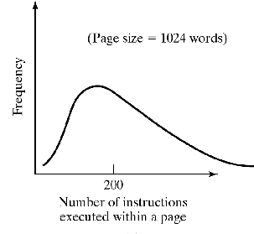
Evaluation of Paging
Page size should be small, but small pages need
Larger page tables
More hardware
Greater I/O overhead due to disc seek time
Figure 8-13(b)
Figure 8-13(c)

Slide 39
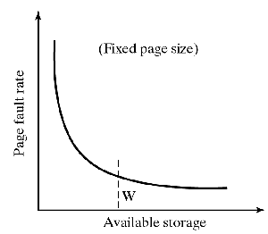
Evaluation of Paging
Load control is important
W = Minimum amount of memory to avoid thrashing.
Figure 8-13(d)

