Slide 1
MVPA

Slide 2
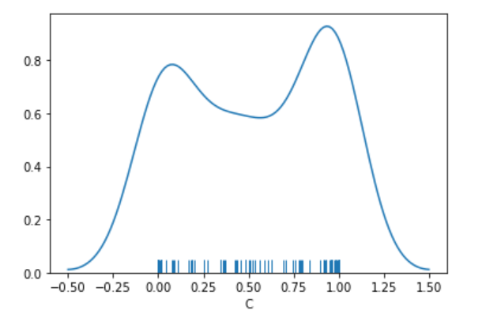
100 random permutations using data from MSC06 memory
Average=.52

Slide 3
Using all subs in a LOOCV across subs average accuracy scores
Mem=100
Mixed=99
Motor=97.5

Slide 4
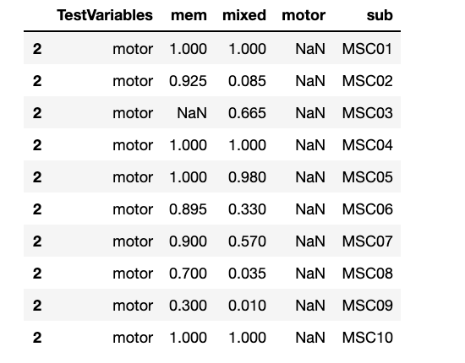
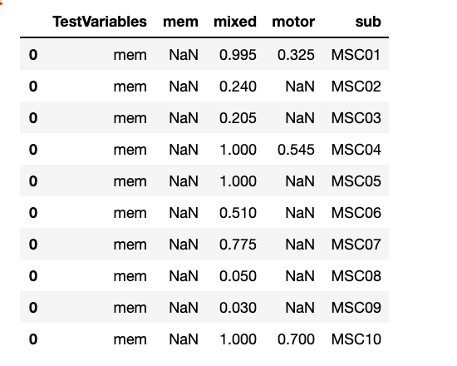
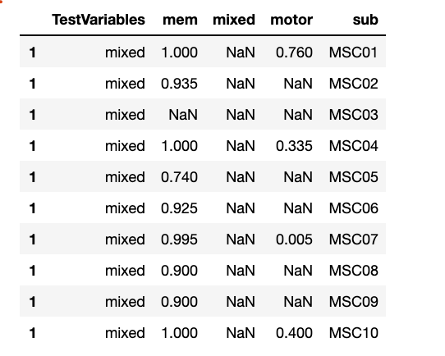
Within Sub
Test motor
Test memory
Test mixed

Slide 5
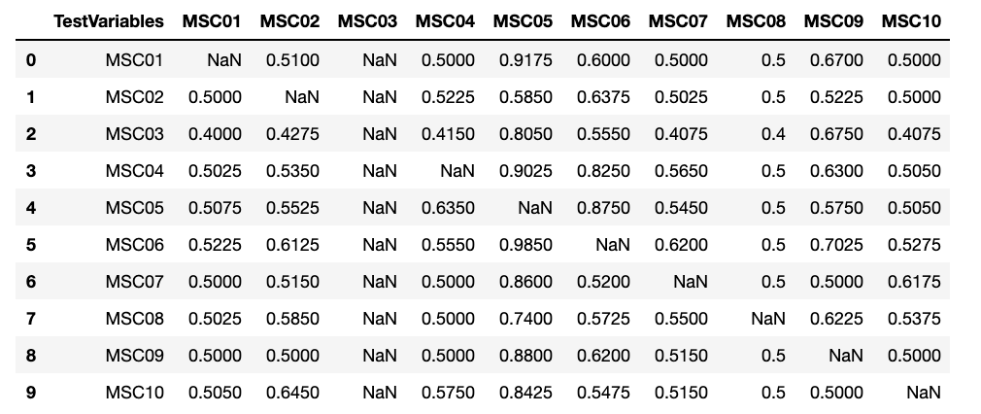
Between Sub
Memory

Slide 6
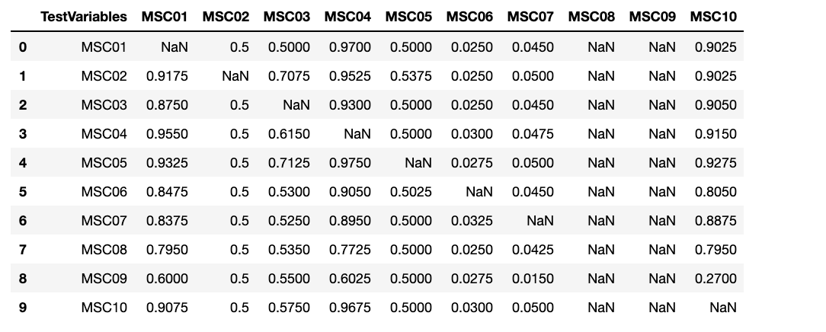
Between Sub
Motor

Slide 7
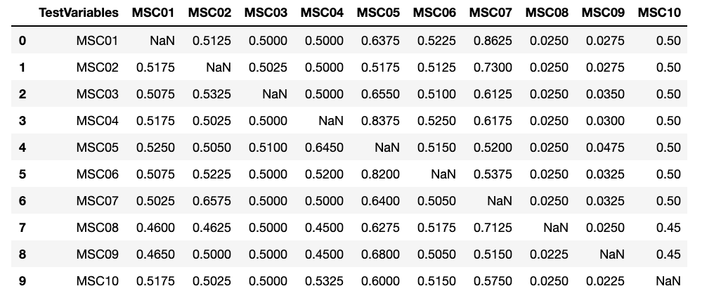
Between Sub
Mixed

