Slide 1
MVPA

Slide 2
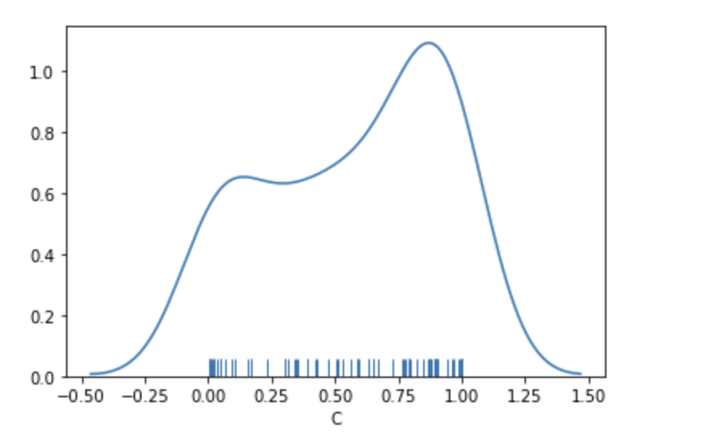
10 random permutations across 10 different subjects; train permuted label memory test mixed unpermuted
Average=.57

Slide 3
Training MSC02, 04, 05, 10; Testing MSC01, 03, 06, 07 in a LOOCV across subs average accuracy scores
Mem=70.3
Mixed=67.4
Motor=92.1

Slide 4
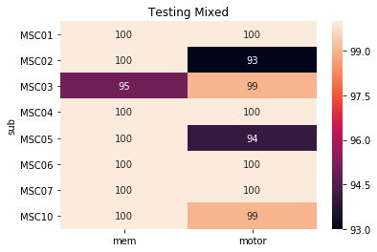
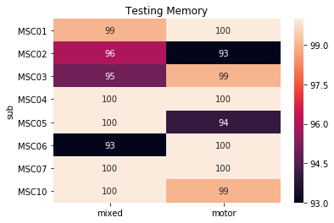
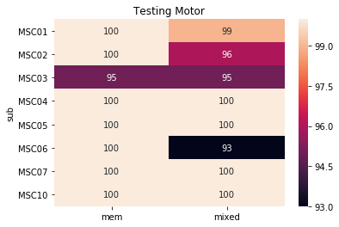
Within Sub

Slide 5
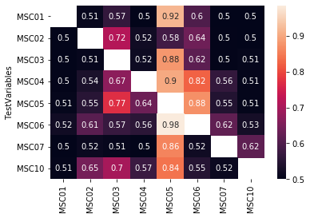
Between Sub
Memory

Slide 6
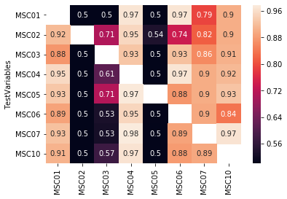
Between Sub
Motor

Slide 7
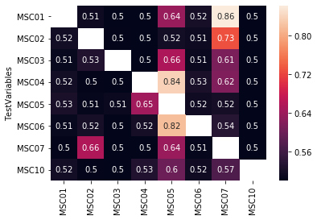
Between Sub
Mixed

Slide 8
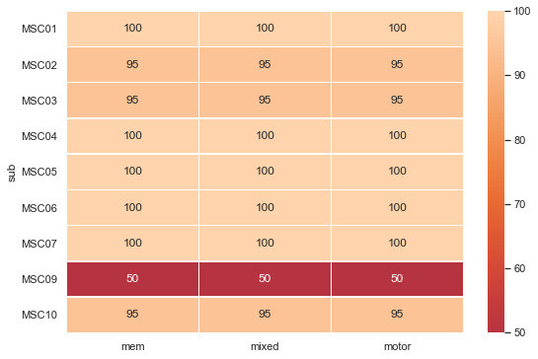
Leave out 1 day(testing set) 9 days (training set)

Slide 9
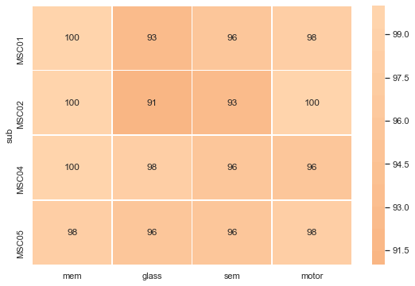
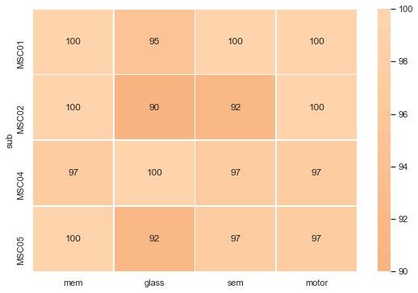
Split Time
Full
Split time into 3
Split time in half

Slide 10
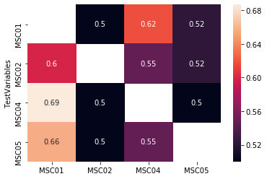
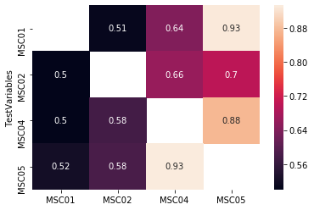
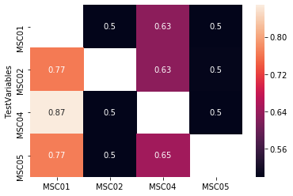
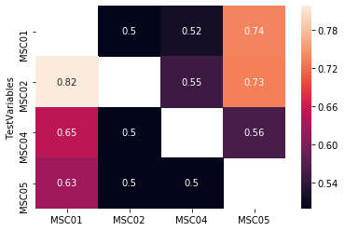
Time Split between subject
Mixed AllGlass
Memory
Motor
Mixed AllSemantic

Slide 11
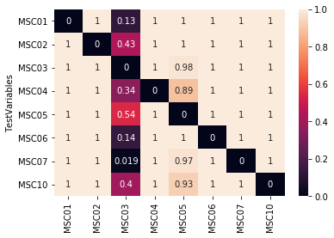
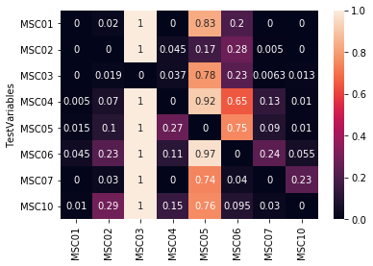
Between Subject Sensitivity Accuracy Memory
Average accuracy of all folds
Memory is the test fold
Rest is the test fold

Slide 12
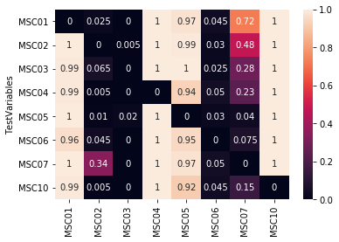
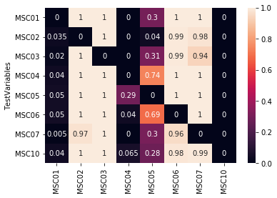
Between Subject Sensitivity Accuracy Mixed
Average Accuracy of all folds
Mixed is the test fold
Rest is the test fold

Slide 13
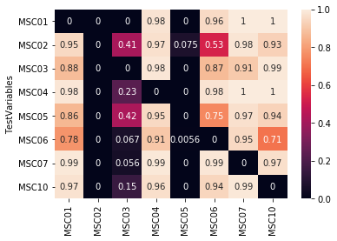
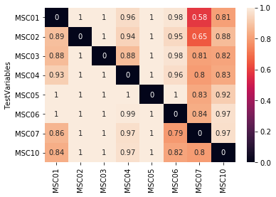
Between Subject Sensitivity Accuracy Motor
Average accuracy of all folds
Motor is the test fold
Rest is the test fold

Slide 14
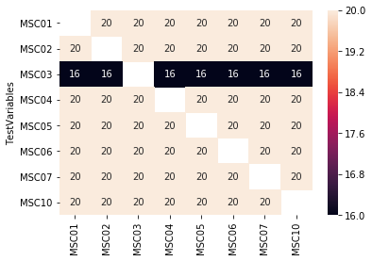
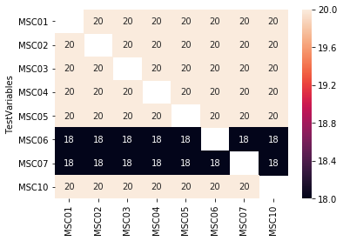
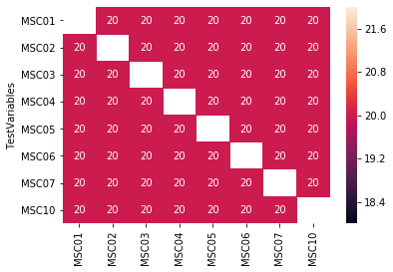
Amount of days per test subject kept in analysis
Memory
Motor
Mixed

Slide 15
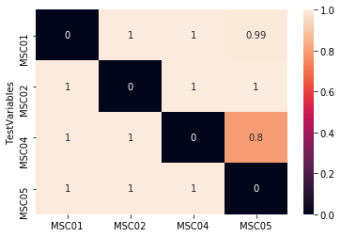
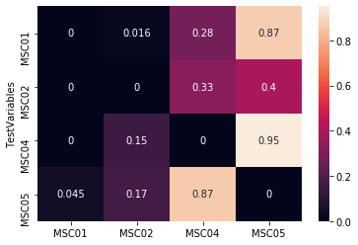
Between subject sensitivity timesplit
All average
Rest
Mem

Slide 16
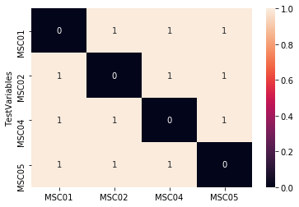
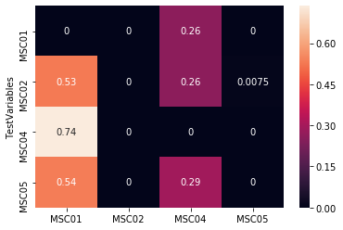
Between subject sensitivity timesplit
All average
Rest
Motor

Slide 17

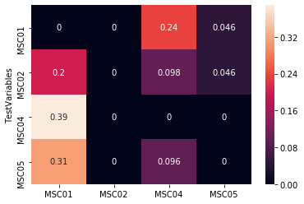
Between subject sensitivity timesplit
All average
Rest
AllGlass

Slide 18
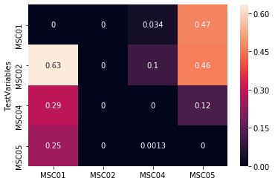
Between subject sensitivity timesplit
All average
Rest
AllSemantic

Slide 19
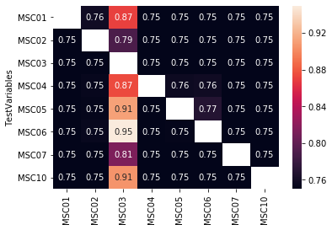
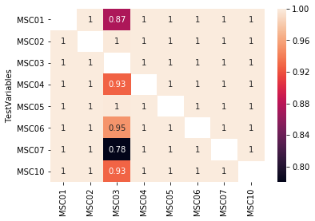
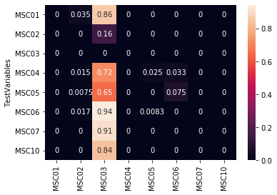
What if you used all the tasks in the training and testing set
All data
Task
Rest

Slide 20
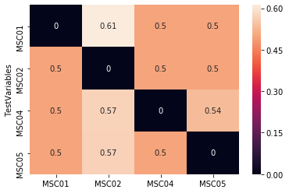
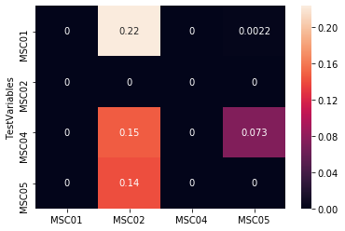
Using all tasks in the training and testing set and split up rest matrices to match
All
Task=mem(10), motor(10), mixed (10)
Rest=rest (30)
Task
Rest

Slide 21
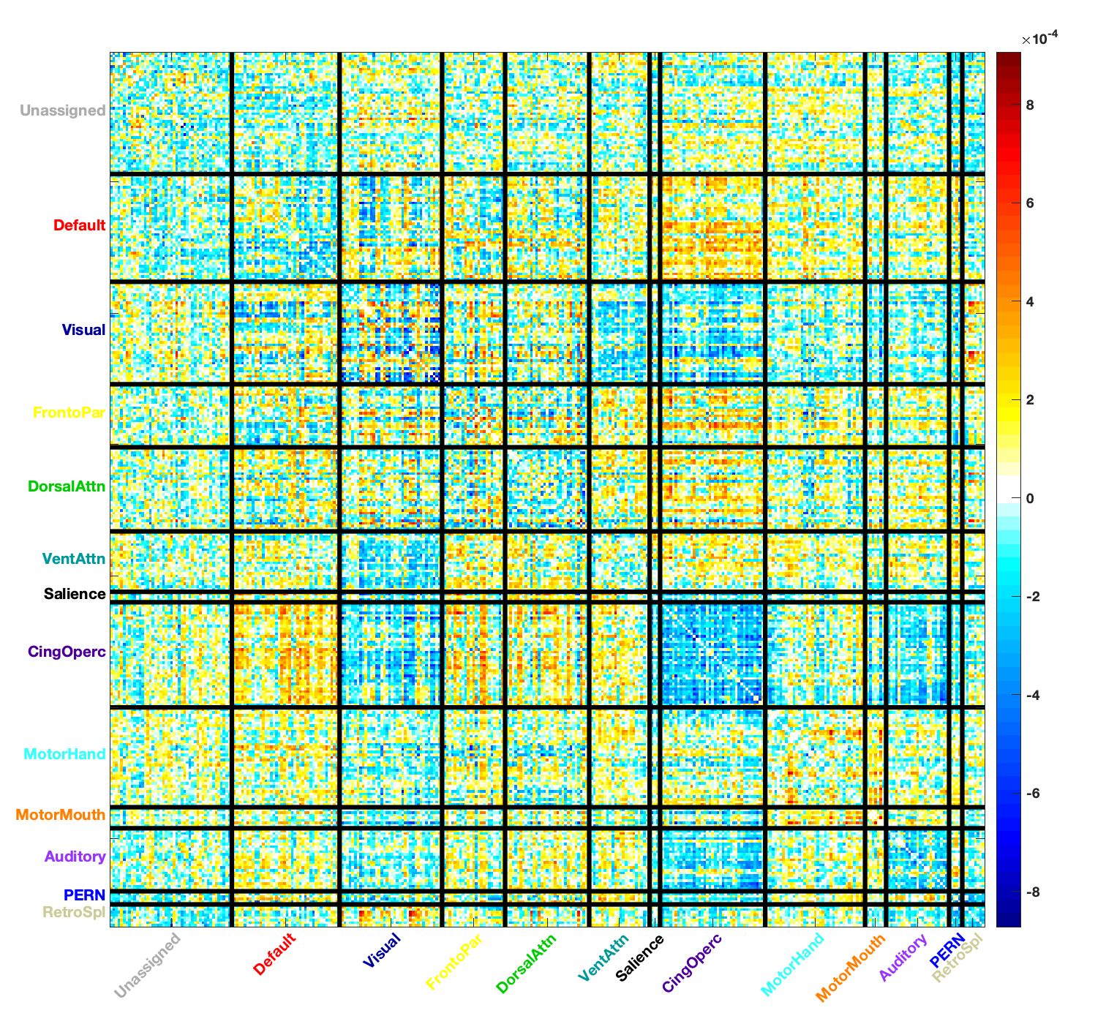
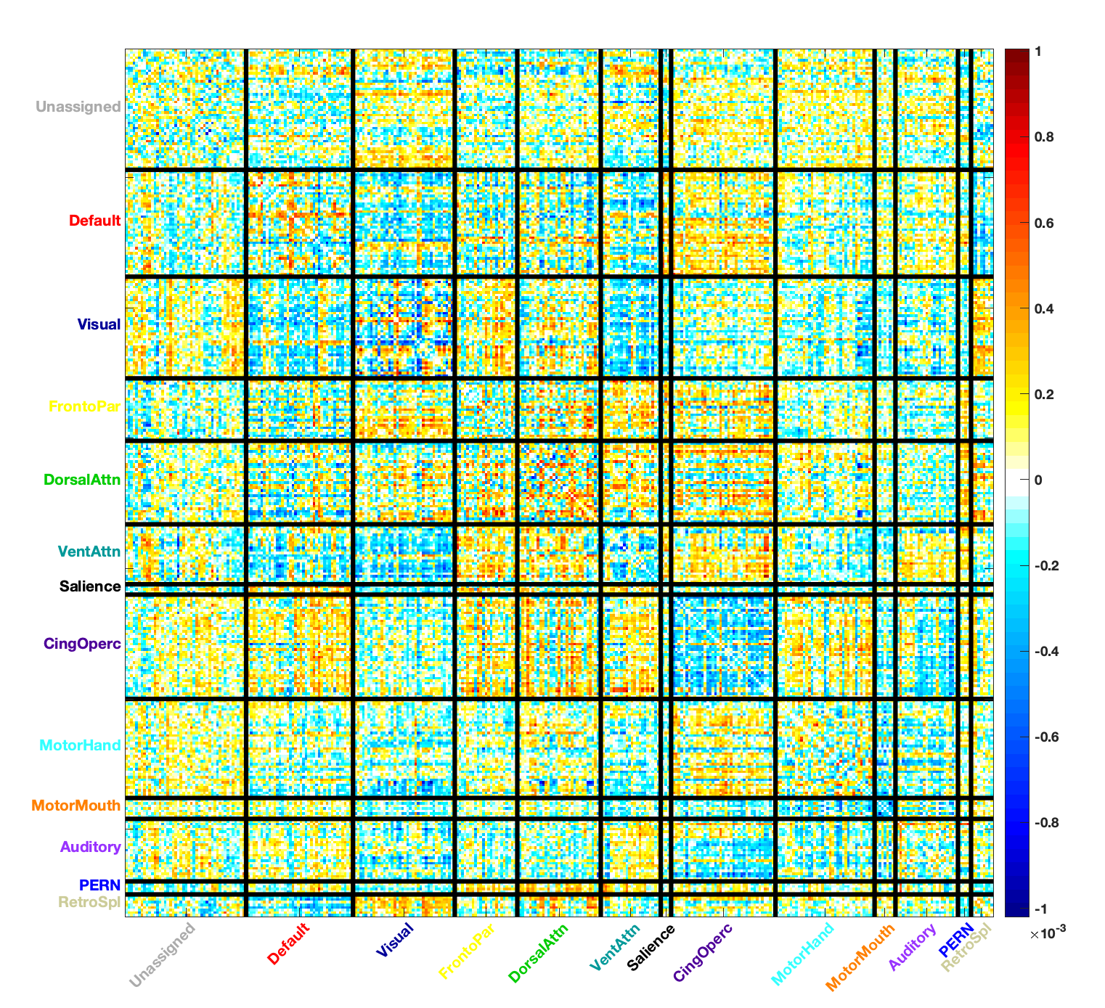
Feature Weights Memory
Train MSC01 Weights
Train MSC02 Weights

Slide 22
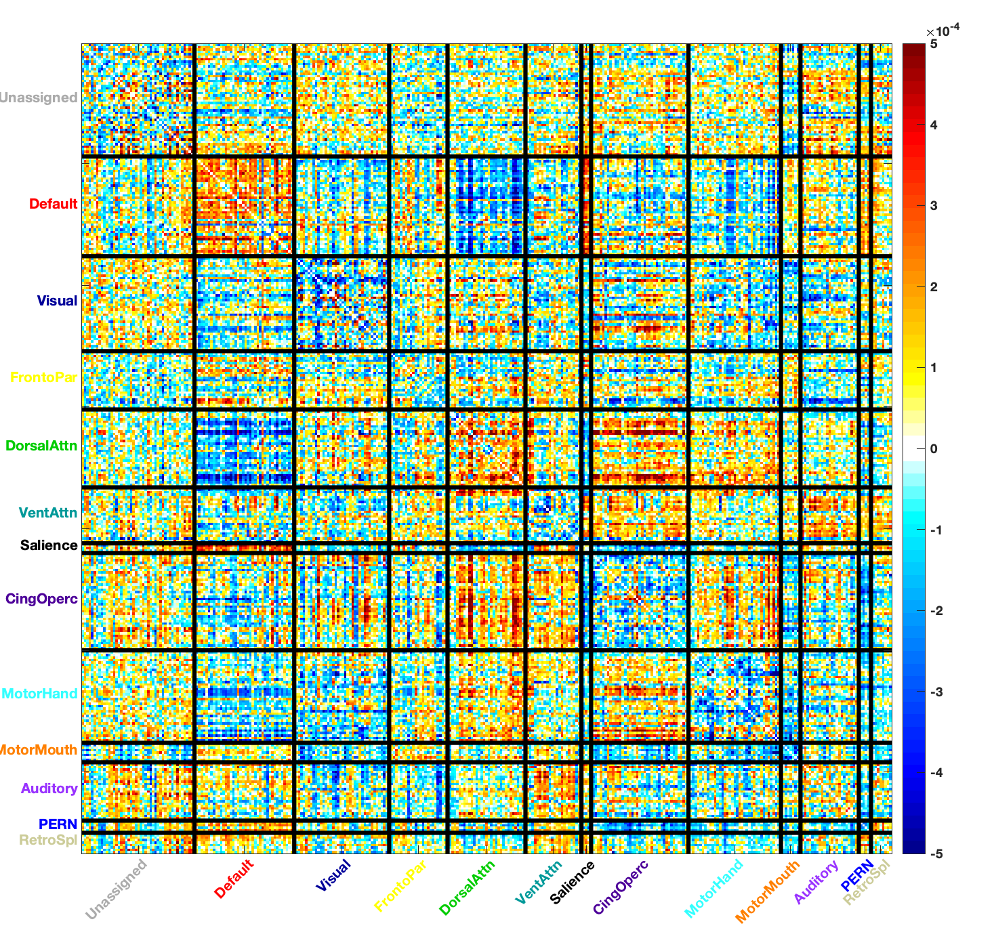
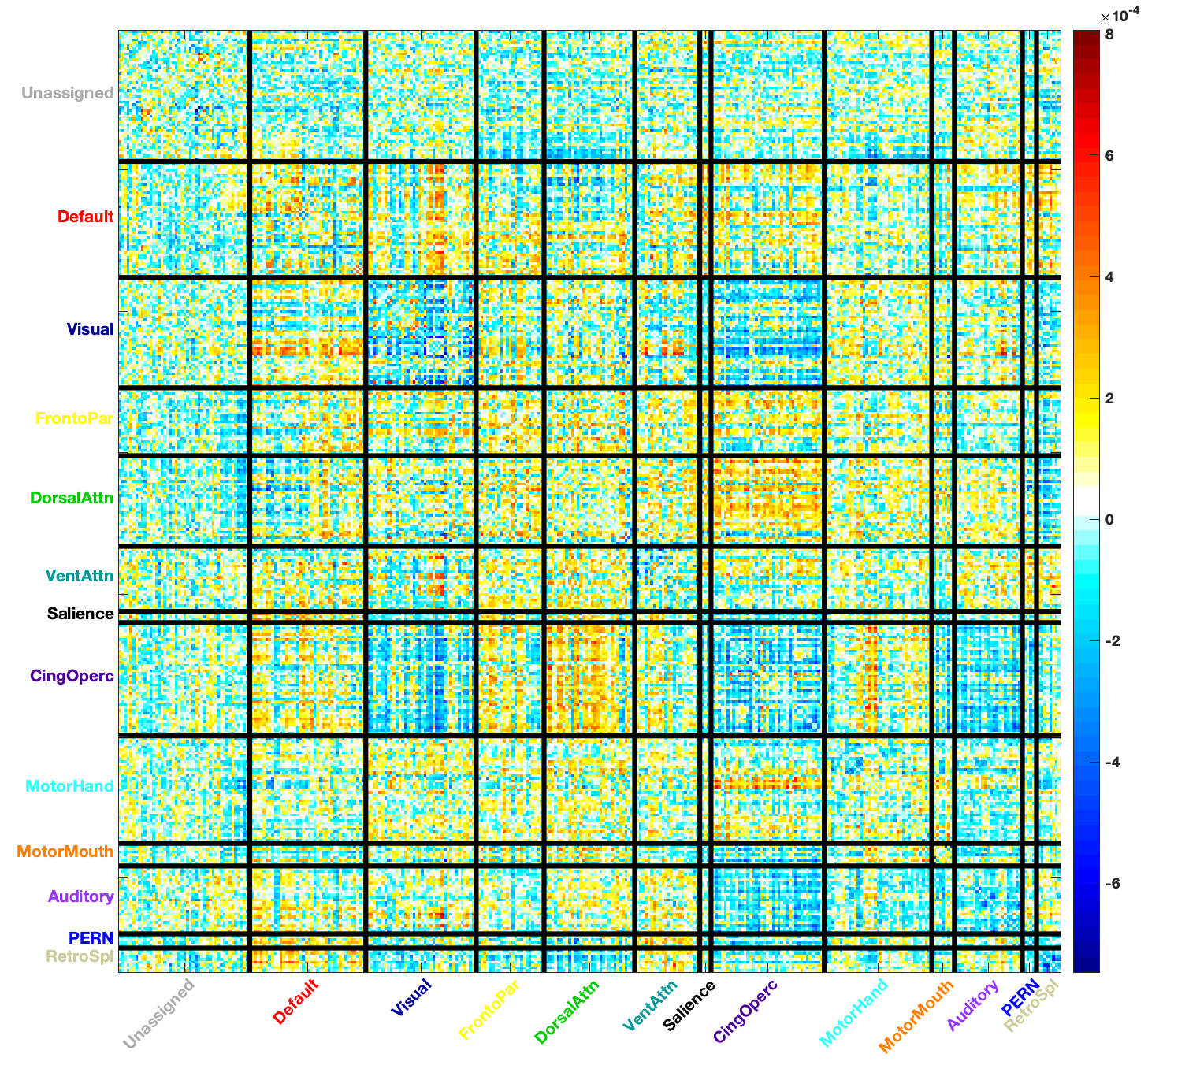
Feature Weights Motor
Train MSC01 Weights
Train MSC02 Weights

Slide 23
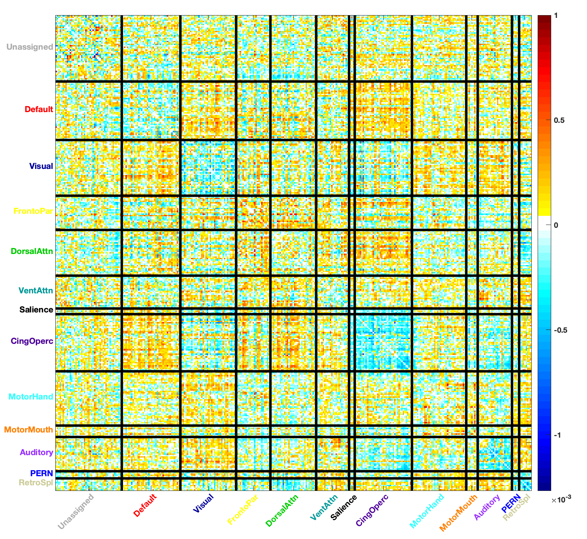
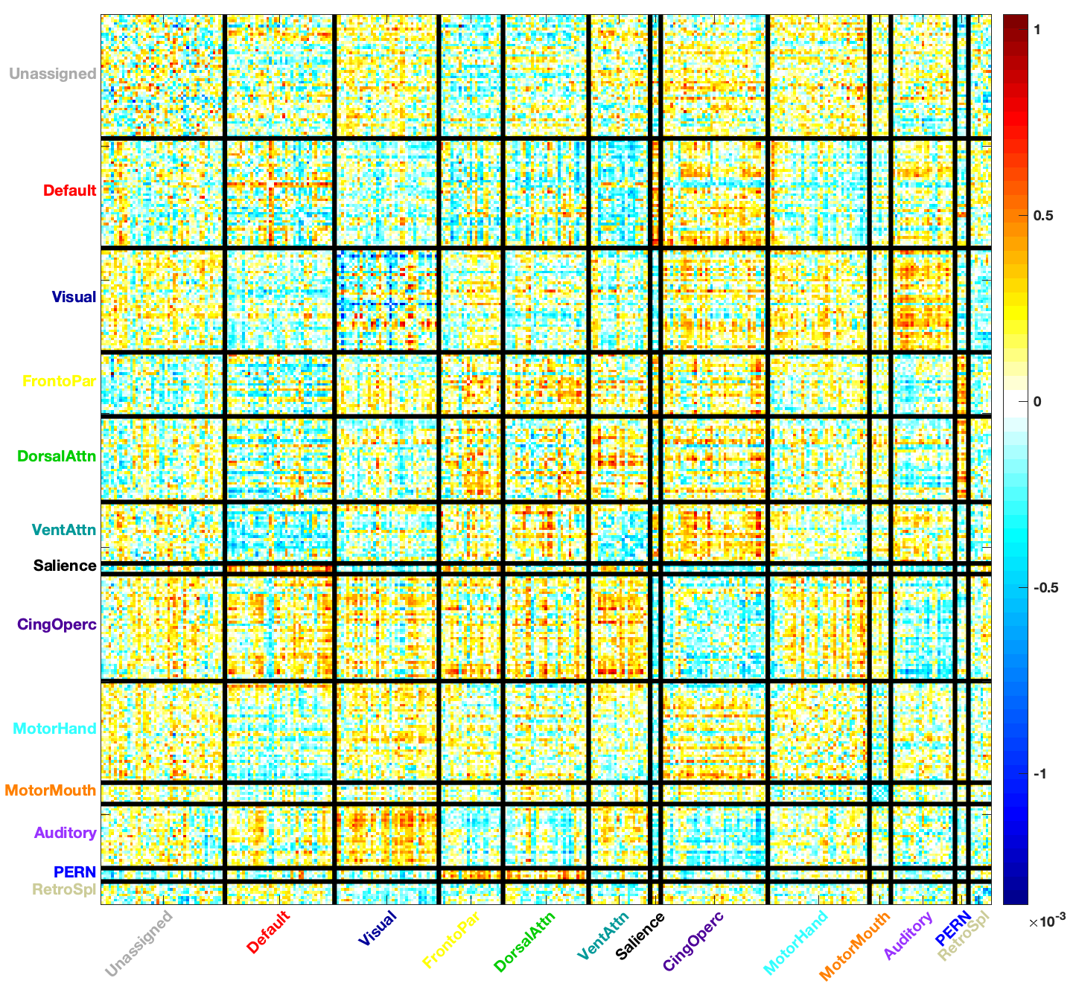
Feature Weights Mixed
Train MSC01 Weights
Train MSC02 Weights

