Slide 1
Log Regression
Between subject analysis

Slide 2
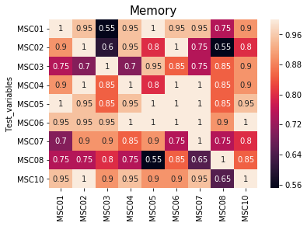

Slide 3
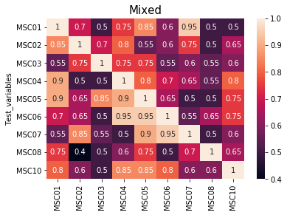

Slide 4
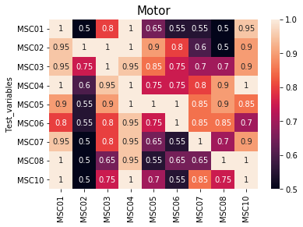

Slide 5
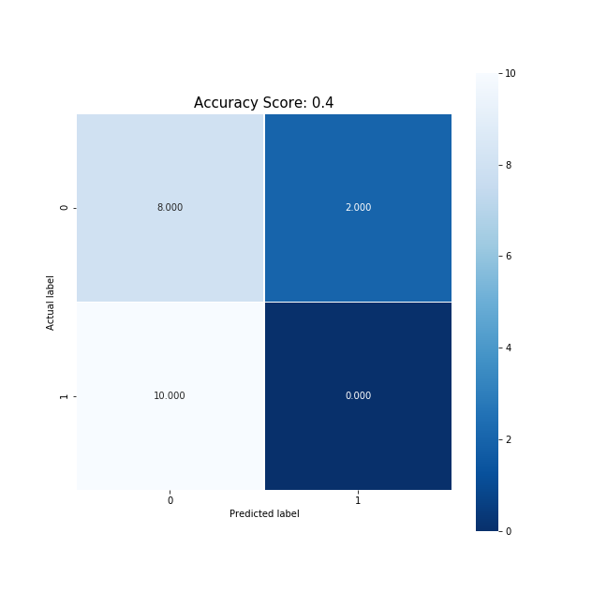
Train 2 Test 8 for mixed

Slide 6
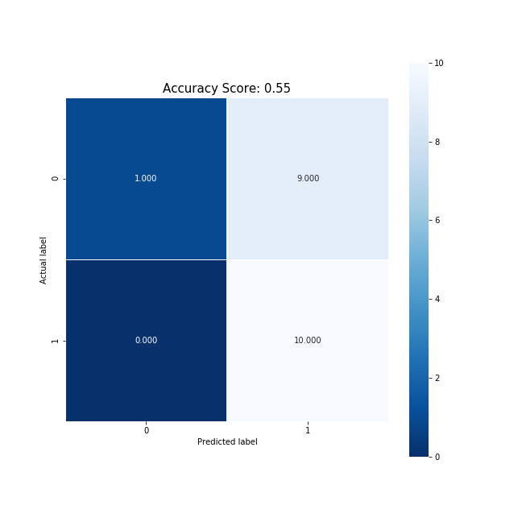
Train 3 Test 1 memory

Slide 7
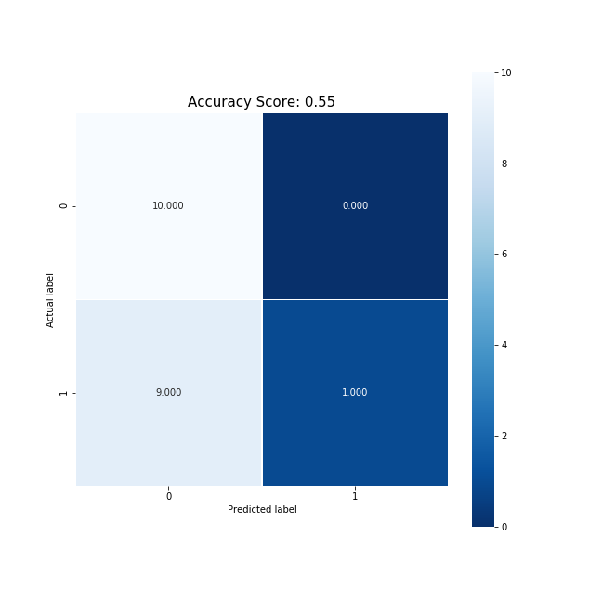
Train 2 Test 5 motor

Slide 8
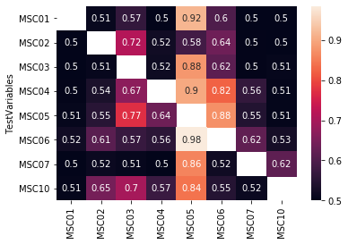
How do these compare to SVM acc between subs Memory
Log
SVM

Slide 9
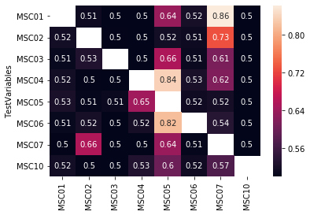
How do these compare to SVM acc between subs Mixed
SVM
Log

Slide 10
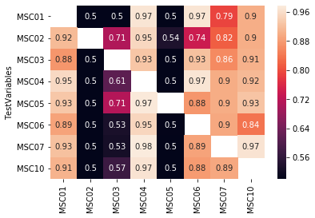
How do these compare to SVM acc between subs Motor
SVM
Log

