Slide 1
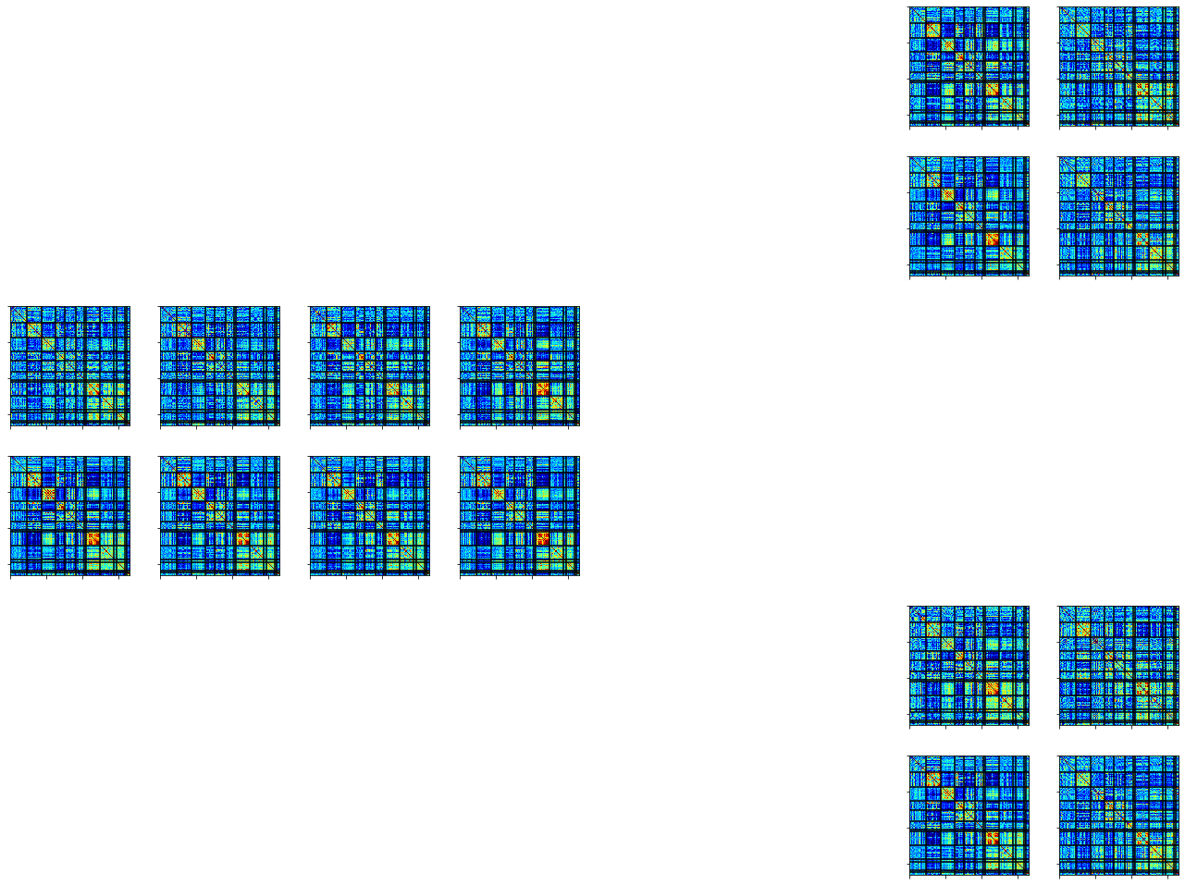
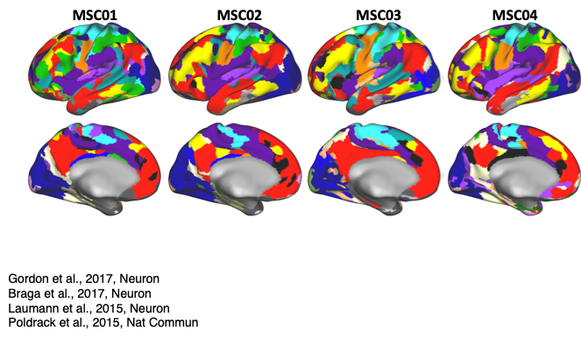
A.
All Task
Training
Test Across People
Train
Predict
MSC01
Test
MSC02
All Tasks
Rest
Session 1
Session 2
.…
Session 9
Session 10
B.
Single Task
Training
Test Across People
Train
Motor
Predict
Motor
MSC01
Test
MSC02
Motor
Rest
Session 1
Session 2
.…
Session 9
Session 10
C.
Across Task
Training
Test Across Task
Train
Motor
Predict
Memory
Motor
Memory
MSC01
MSC01
MSC01
Motor
Rest
Session 10
Session 1
Session 2
.…
Session 9

Slide 2
a
All Task
Training
Test Across People
Train
Predict
MSC01
Test
MSC02
All Tasks
Rest
Session 1
Session 2
.…
Session 9
Session 10
b
MultiClass
MSC01
Training
Test Across People
Train
Predict
Semantic
Test
MSC02
Coherence
Motor
Memory
Rest
Session 10
Session 1
Session 2
.…
Session 9
c
Single Task
Training
Test Across People
Train
Motor
Predict
Motor
MSC01
Test
MSC02
Motor
Rest
Session 1
Session 2
.…
Session 9
Session 10

