Slide 1
Machine learning approaches to understand individual differences in functional connectivity

Slide 2




Does variation between individuals influence classification?
Same subject, between task
Different subject same task
Different subject, different task

Slide 3
Can model choice influence results?
Support Vector Machine Learning
Logistic Regression
Ridge Regression

Slide 4
Support Vector Machine Learning

Slide 5
Logistic Regression

Slide 6
Ridge Regression

Slide 7

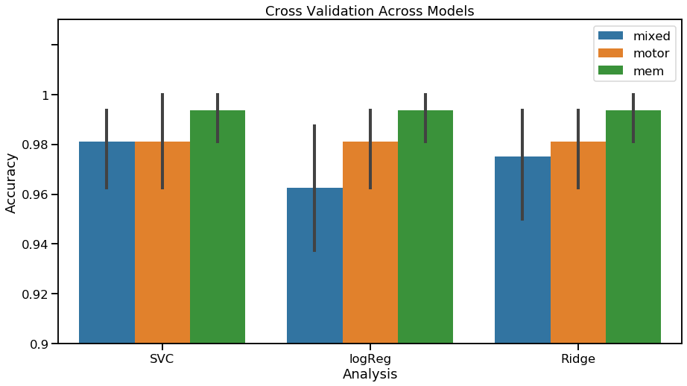
Internal Validation of Model
Cross Validation

Slide 8
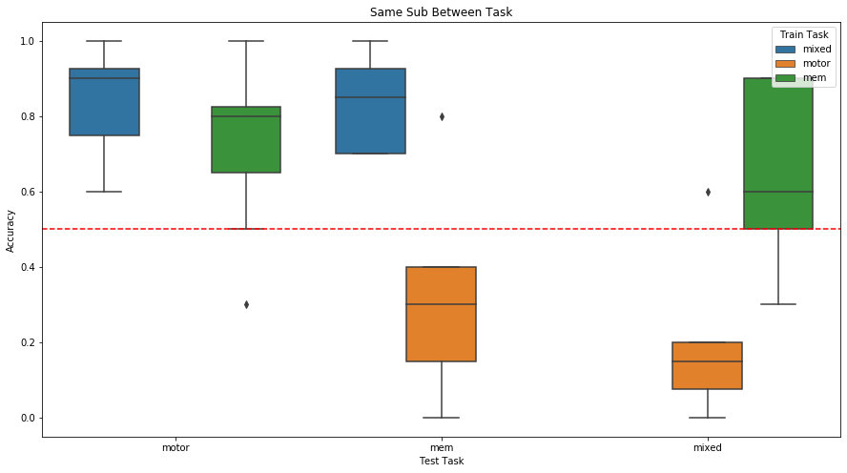
Same Subject, Between Task

Slide 9
Different subject same task

Slide 10
Different subject, different task

