Slide 1
Machine learning approaches to understand individual differences in functional connectivity

Slide 2




Does variation between individuals influence classification?
Same subject, between task
Different subject same task
Different subject, different task

Slide 3
Can model choice influence results?
Support Vector Machine Learning
Logistic Regression
Ridge Regression

Slide 4
Is there a tradeoff between quantity and quality?
Functional connectivity independent on time
Functional connectivity matched for time
Splitting up task conditions to yield more data

Slide 5
Support Vector Machine Learning

Slide 6
Logistic Regression

Slide 7
Ridge Regression

Slide 8

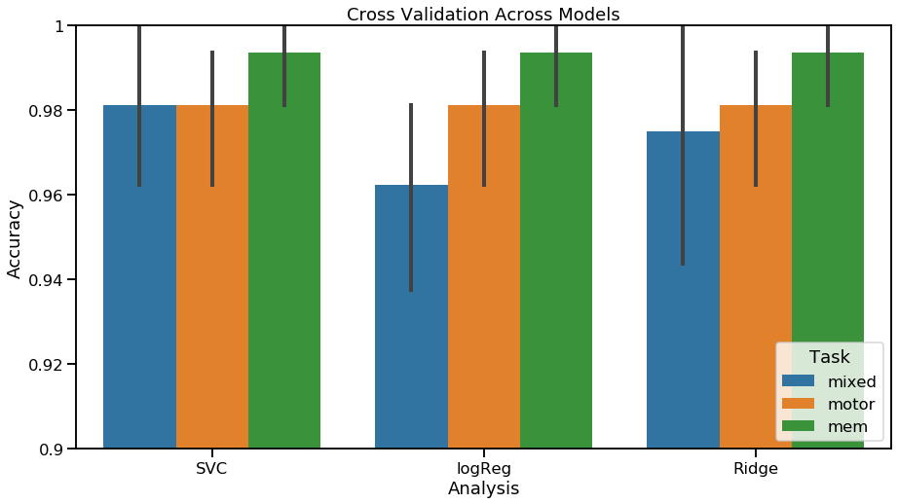
Internal Validation of Model
Cross Validation

Slide 9
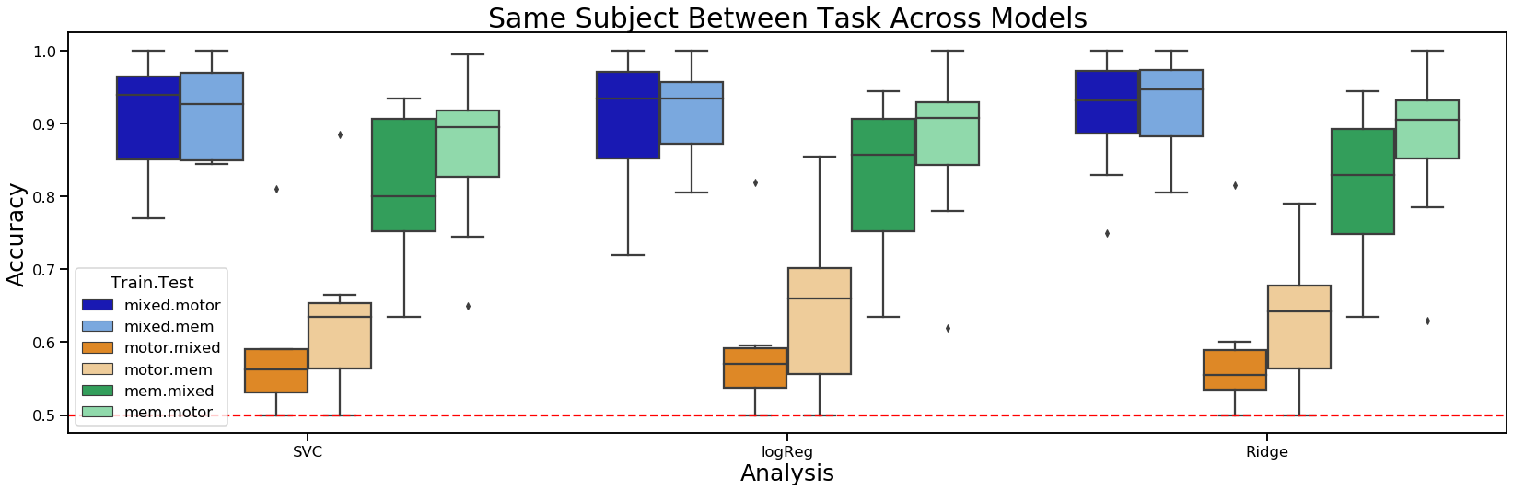
Same Subject, Between Task

Slide 10
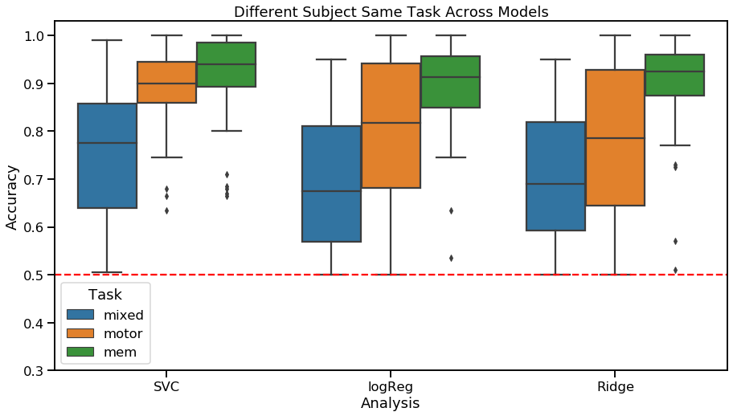
Different subject same task

Slide 11
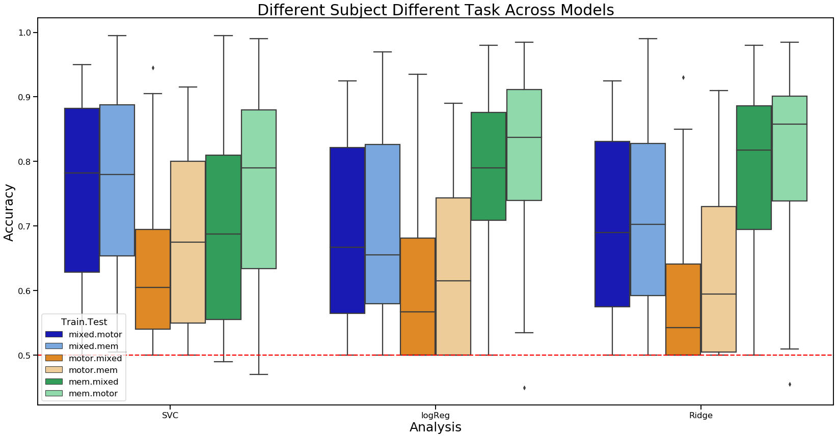
Different subject, different task

Slide 12
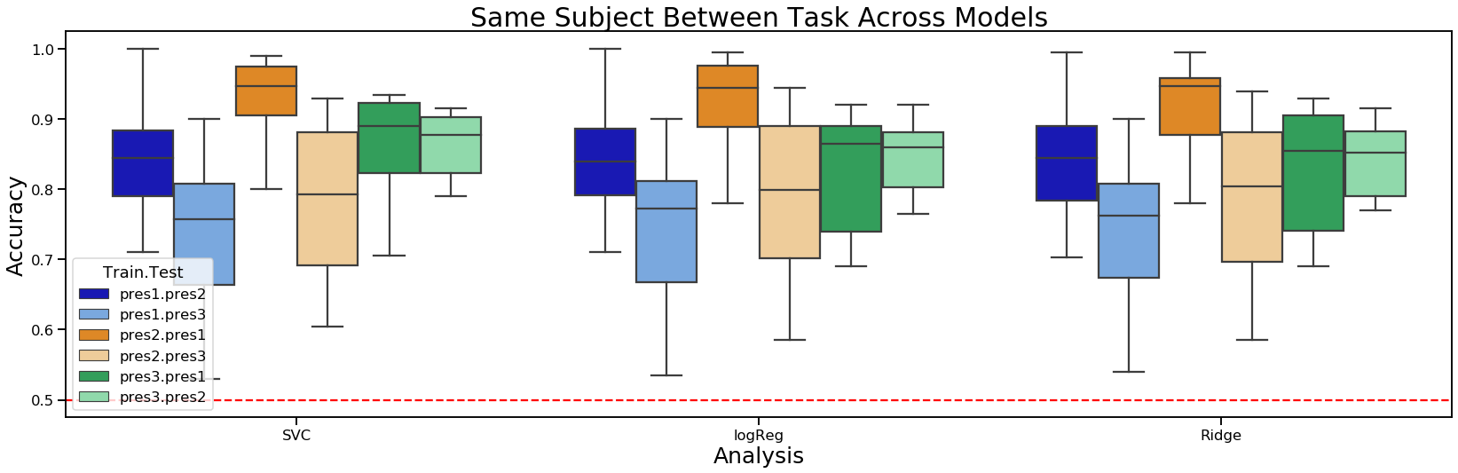
Memory split up
1
2

Slide 13

Functional Connectivity without condition indices
Motor
Memory
Mixed
Rest
Motor
Memory
Mixed
Rest

Slide 14
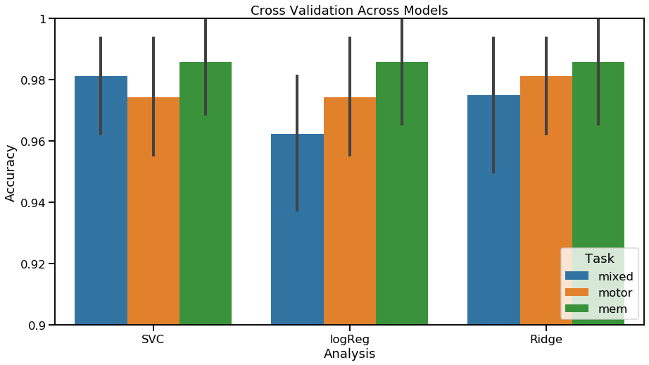
Internal Validation of Model

Slide 15
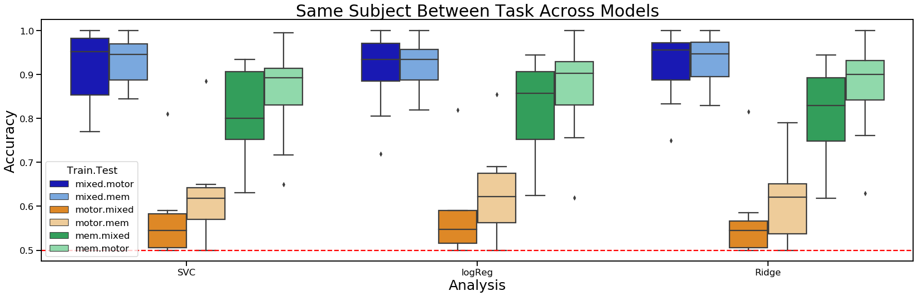
Same Subject, Between Task

Slide 16
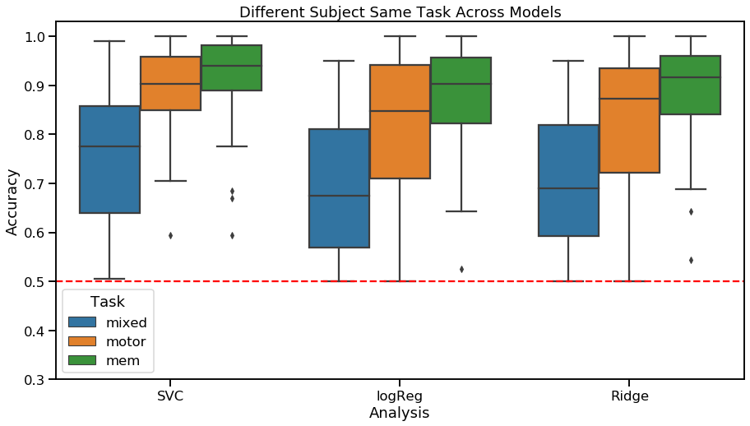
Different subject same task

Slide 17
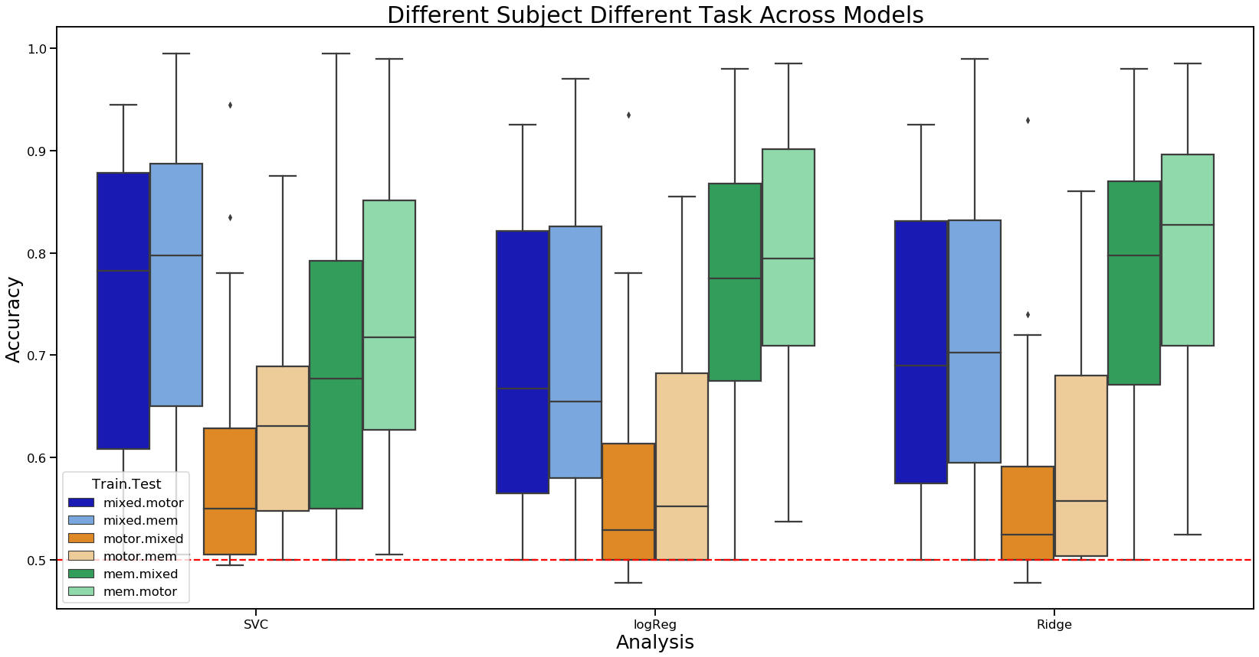
Different subject, different task

Slide 18
Hyperalignment
Within subject within task

Slide 19
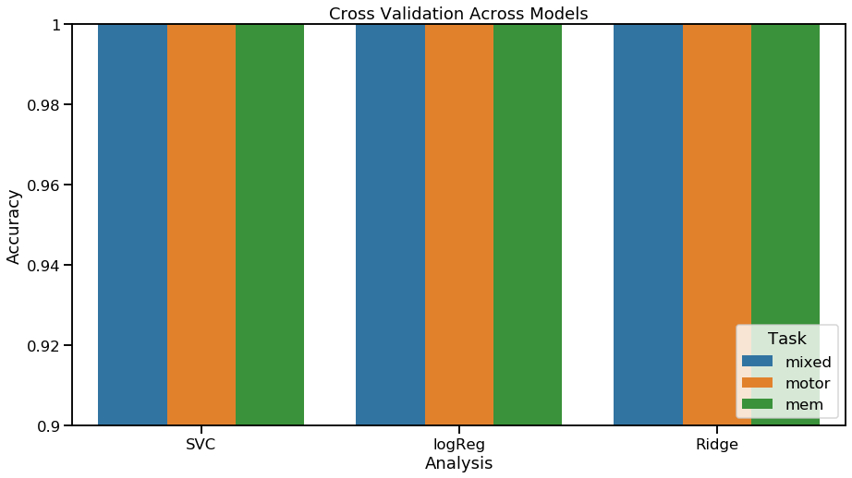
Cross-validation

Slide 20
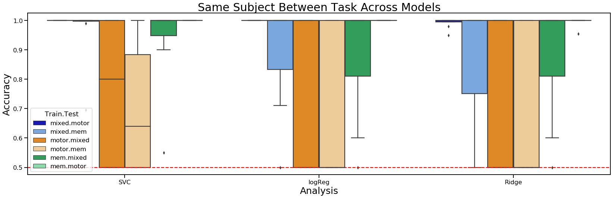
Same Subject, Between Task

Slide 21
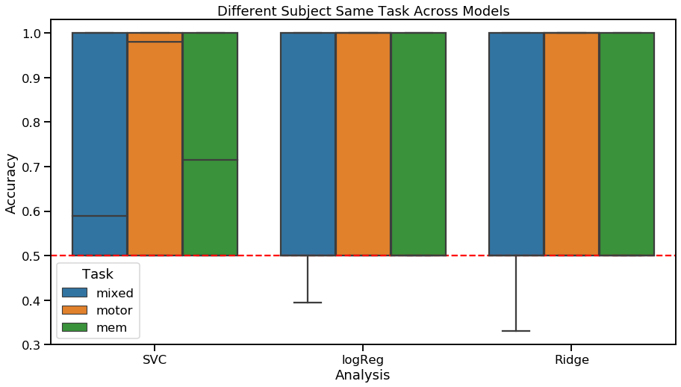
Different subject same task

Slide 22
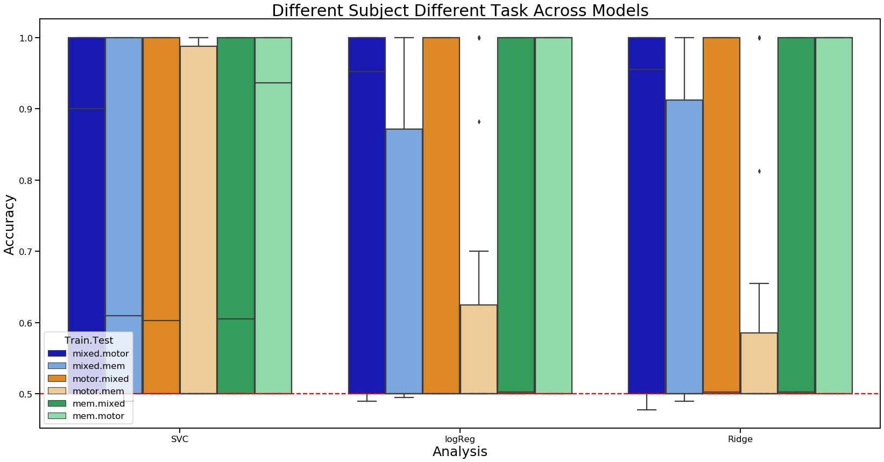
Different subject, different task

