Slide 1
Log Regression
Between subject analysis

Slide 2
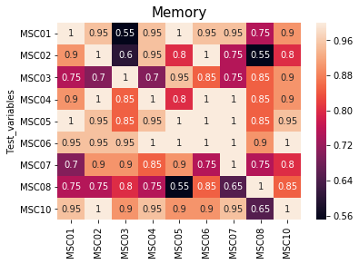

Slide 3
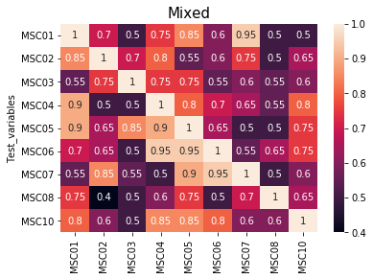

Slide 4
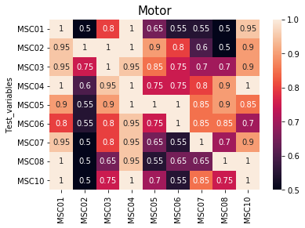

Slide 5
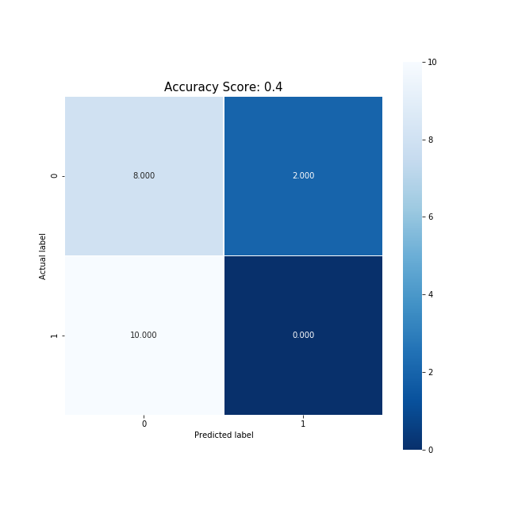
Train 2 Test 8 for mixed

Slide 6
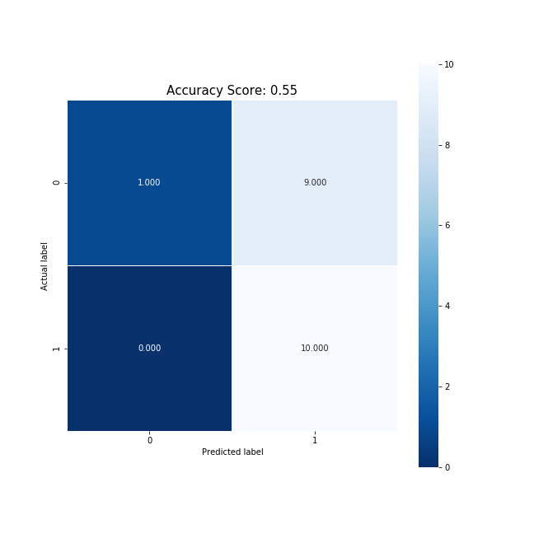
Train 3 Test 1 memory

Slide 7
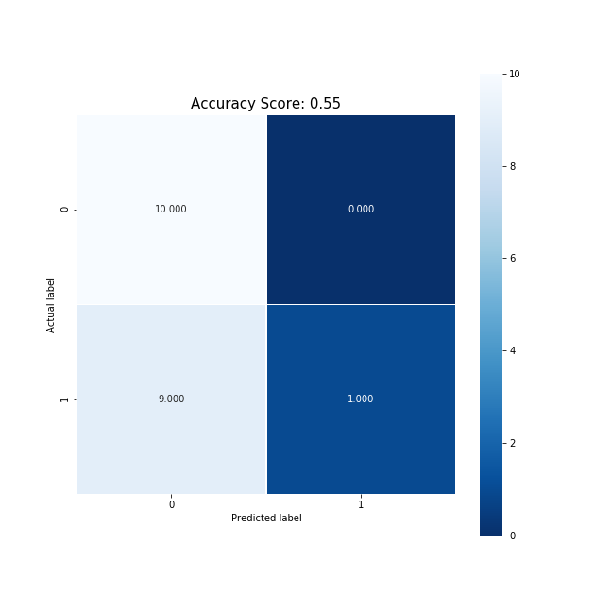
Train 2 Test 5 motor

Slide 8
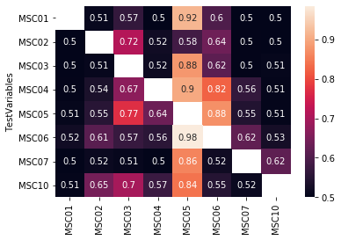
How do these compare to SVM acc between subs Memory
Log
SVM

Slide 9
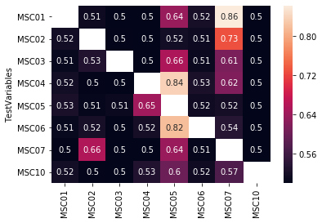
How do these compare to SVM acc between subs Mixed
SVM
Log

Slide 10
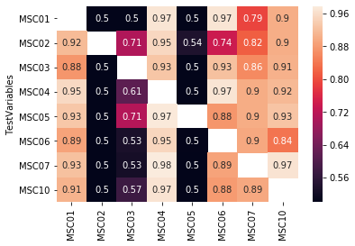
How do these compare to SVM acc between subs Motor
SVM
Log

Slide 11
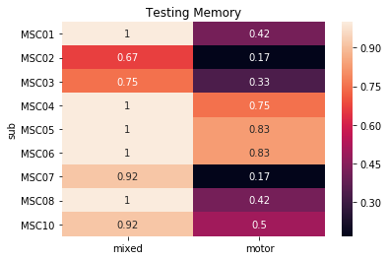
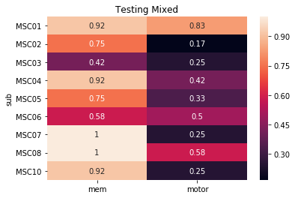
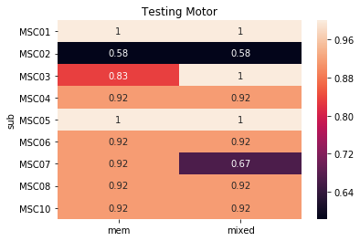
Log Regression Within Subject Randomly keeping 2 days of rest for testing

Slide 12
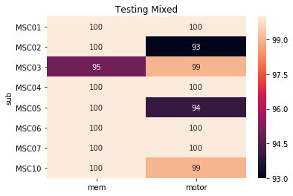
How does this compare to SVM
SVM
Log

Slide 13
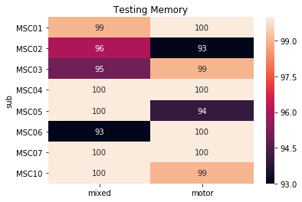
How does this compare to SVM
SVM
Log

Slide 14
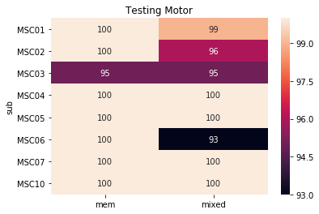
How does this compare to SVM
SVM
Log

