Slide 1
MVPA

Slide 2
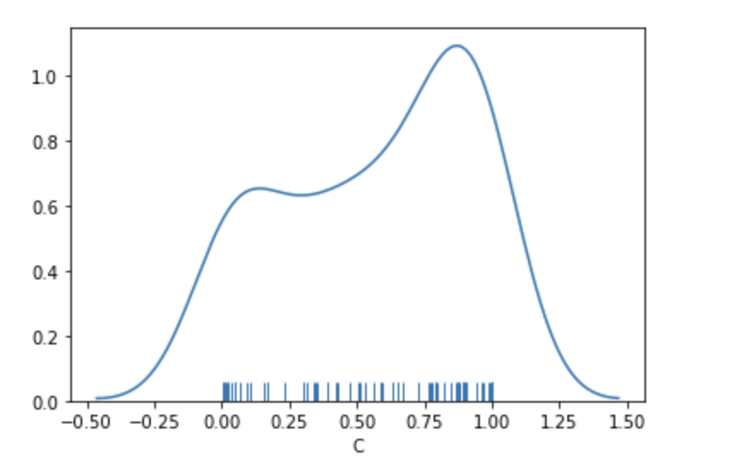
10 random permutations across 10 different subjects; train permuted label memory test mixed unpermuted
Average=.57

Slide 3
Training MSC02, 04, 05, 10; Testing MSC01, 03, 06, 07 in a LOOCV across subs average accuracy scores
Mem=70.3
Mixed=67.4
Motor=92.1

Slide 4
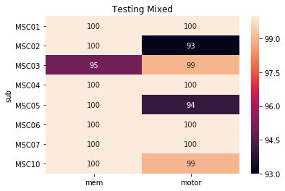
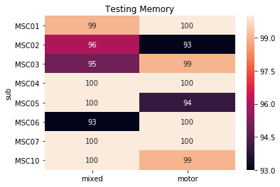
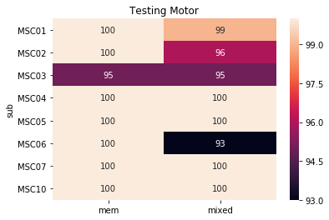
Within Sub

Slide 5
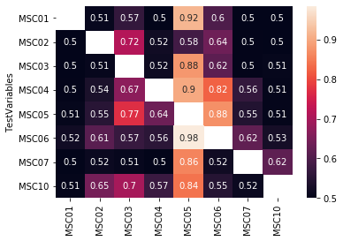
Between Sub
Memory
Old Script
New Script

Slide 6
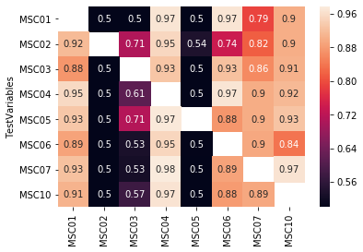
Between Sub
Motor
Old Script
New Script

Slide 7
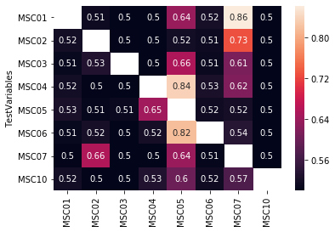
Between Sub
Mixed
Old Script
New Script

Slide 8
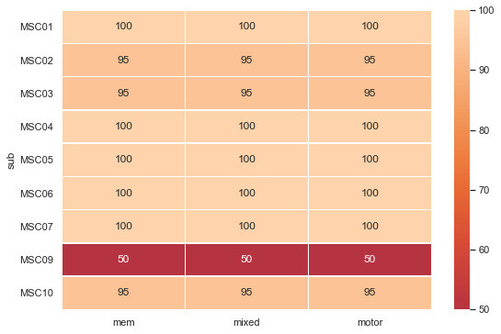
Leave out 1 day(testing set) 9 days (training set)

Slide 9
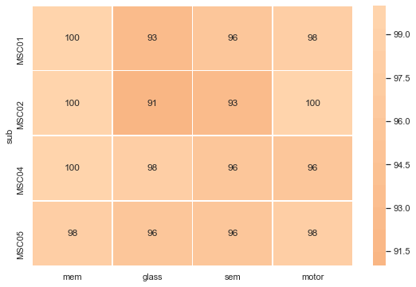
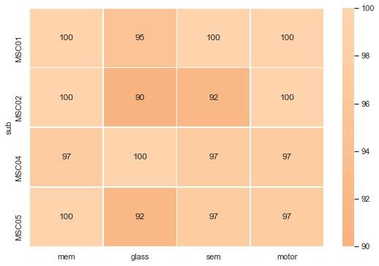
Split Time
Full
Split time into 3
Split time in half

Slide 10
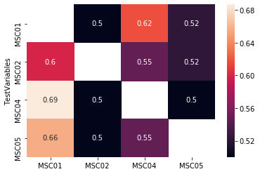
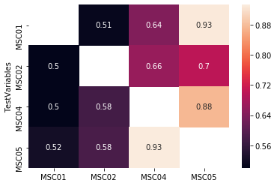
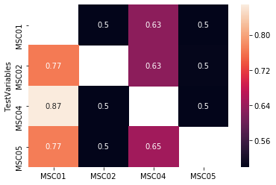
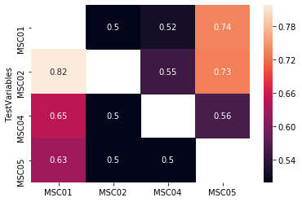
Time Split between subject
Mixed AllGlass
Memory
Motor
Mixed AllSemantic

