Slide 1
Machine learning approaches to understand individual differences in functional connectivity

Slide 2




Could variation between individuals influence classification?
Same subject, between task
Different subject same task
Different subject, different task

Slide 3
Can model choice influence results?
Support Vector Machine Learning
Logistic Regression
Ridge Regression

Slide 4
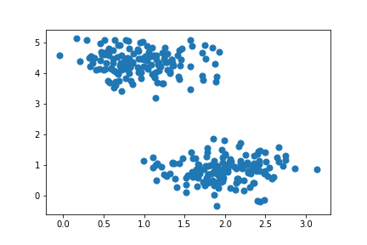
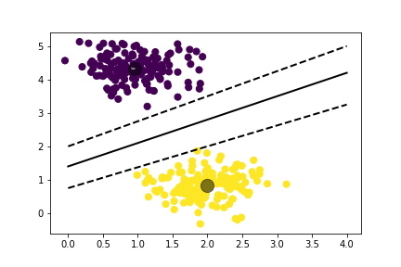
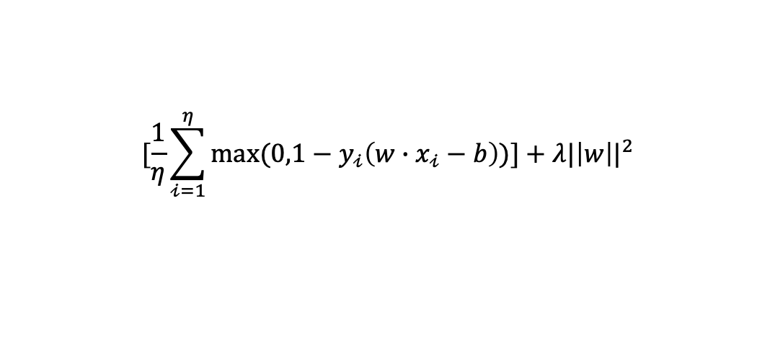
Support Vector Machine Learning
Locate optimal hyperplane in a multi-dimensional space to classify between groups
Find the soft margin;
Optimized using Hinge Loss Function
$$[\frac{1}{η}\sum_{𝒾=1}^{η}{max⁡(0,1−y_{𝒾}\left(w∙x_{𝒾}−b\right))}]+λ{|\left|w\right||}^{2}$$
Maximum margin
Optimal hyperplane
Notes:
Hyperplanes are decision boundaries that help classify data. Data falling on either side of the hyperplane are classified to a specific group. The hyperplane dimensions depend on the number of features used. The more features used, the higher the dimensional space. Support vectors are points that lie closer to the hyperplane and influence the position and orientation of the hyperplane. Support vectors are used to maximize the margin of the classifier. SVM takes the output of a linear function and if the output is greater than 1 we classify with one group, if the output is -1 we classify with the other group. The reinforcement range of values acts as a margin. Hinge loss function helps maximize the margin. This function calculates the loss value if the predicted value and actual value are not the same (ie the classifier was incorrect). A regularization parameter is added to the model. The regularization parameter helps balance maximum margin and loss by finding gradients to update our weights.

Slide 5
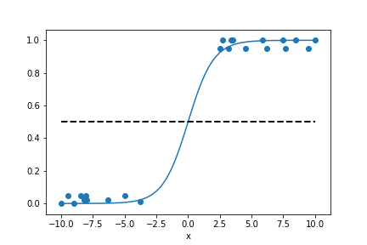
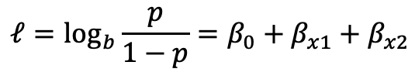
Logistic Regression
Compute sum of weights and input into a sigmoid function to map values between 0 and 1
Parameters are calculated using maximum likelihood
These parameters are used to calculate the probability used for classification
L2 penalty-squared magnitude of coefficient is the penalty term to the loss function
$$ℓ=\log_{b}{\frac{p}{1−p}=β_{0}+β_{x1}+β_{x2}}$$
Notes:
Log Regression works by applying a sigmoid function to the output of a linear regression model. The values are between 0 and 1. If the weighted sum of inputs is greater than zero, the predicted class is 1 and so on. The decision boundary separating the classes is found by setting the weighted sum of inputs to 0. A cost function is applied to penalize the model for misclassification.

Slide 6
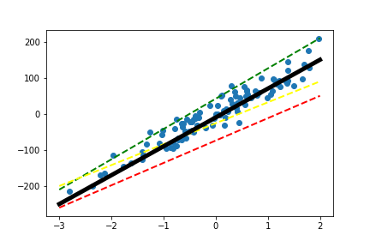


Ridge Regression
Adjusting the model coefficients through regularization ($λ$)
$${\hat{β}}^{ridge}={}_{β∈ℝ}^{argmin}{|\left|y=XB\right||{}_{2}^{2}{+λ|\left|B\right||\begin{matrix}2 \\ 2\end{matrix}}}$$
Notes:
Ridge regression is a biased estimator. Ridge is helpful in that it can account for independent variables that may be highly collinear. This is done by adjusting the model coefficients through a regularization parameter (lambda). Ridge regression makes adjustments to determine the best bias variance tradeoff with the data. Linear regression would normally work to minimize bias without accounting for variance. Ridge however would work towards biasing the modeling in order to try and minimize variance.

Slide 7

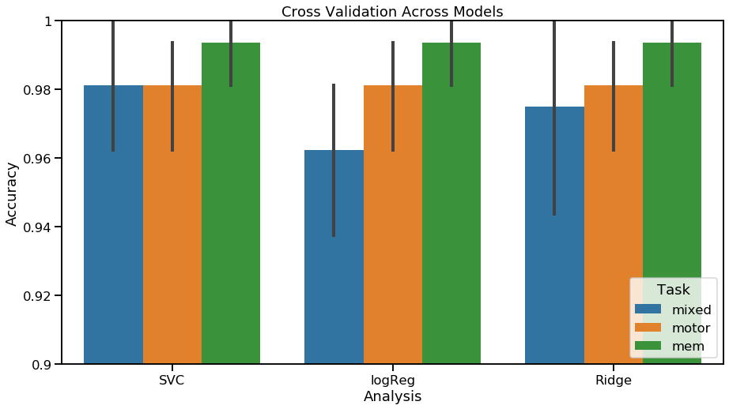
Internal Validation of Model
Cross Validation

Slide 8
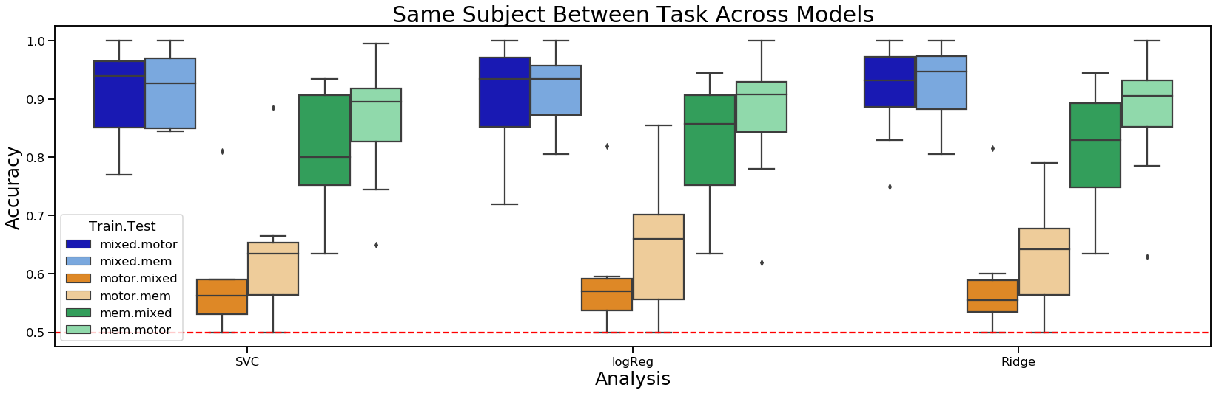
Same Subject, Between Task

Slide 9
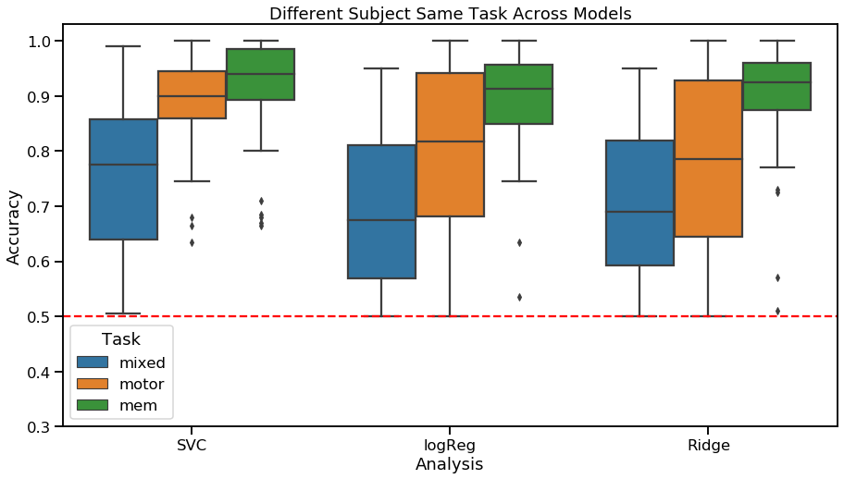
Different subject same task

Slide 10
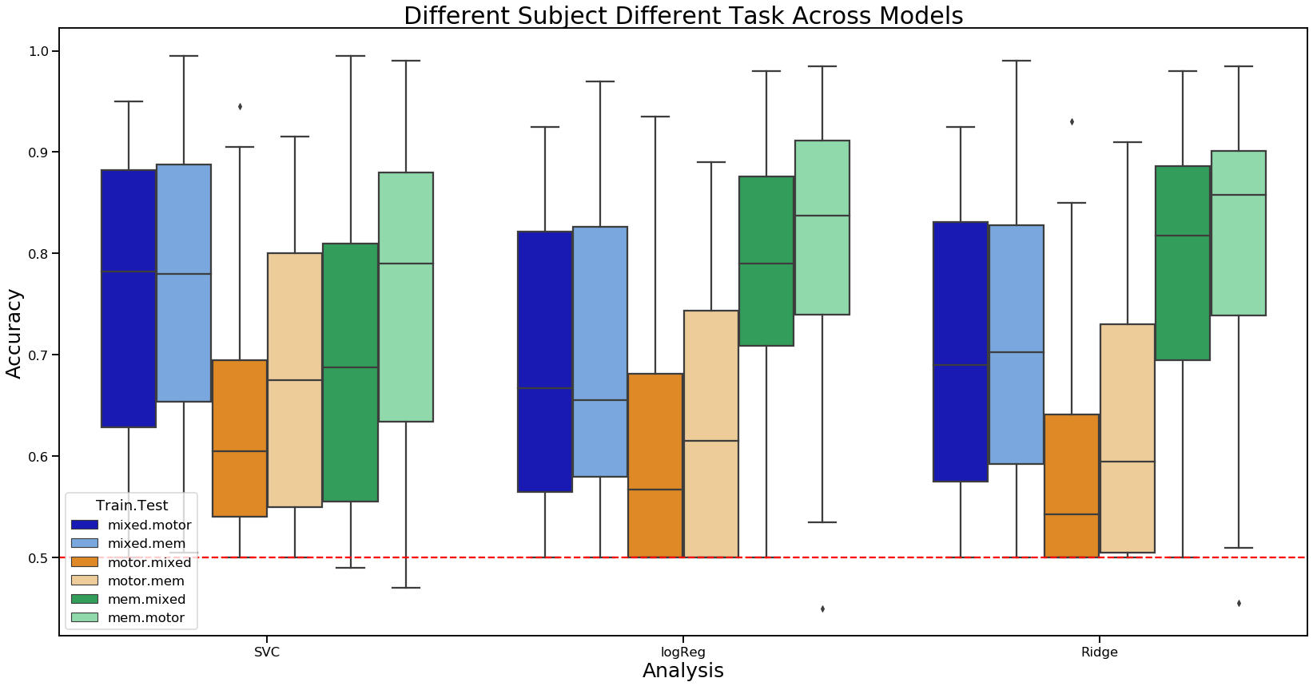
Different subject, different task

Slide 11
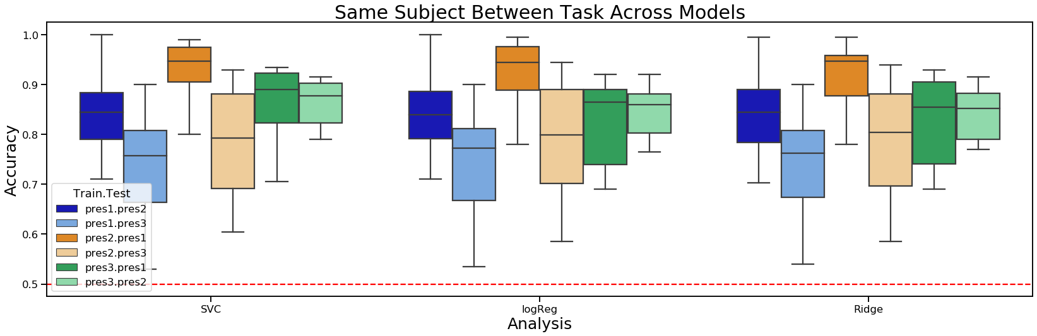
Memory split up
1
2

Slide 12

Functional Connectivity without condition indices
Motor
Memory
Mixed
Rest
Motor
Memory
Mixed
Rest
Notes:
Using just the tmasks instead of the more conservative fc measures

Slide 13
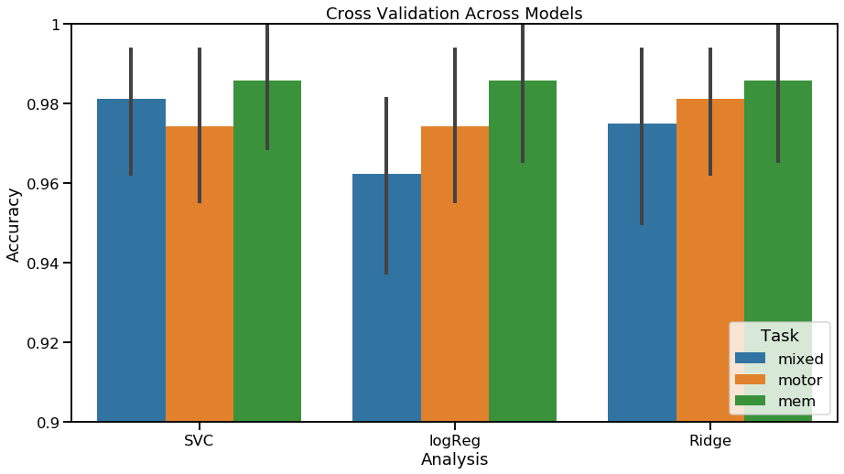
Internal Validation of Model

Slide 14
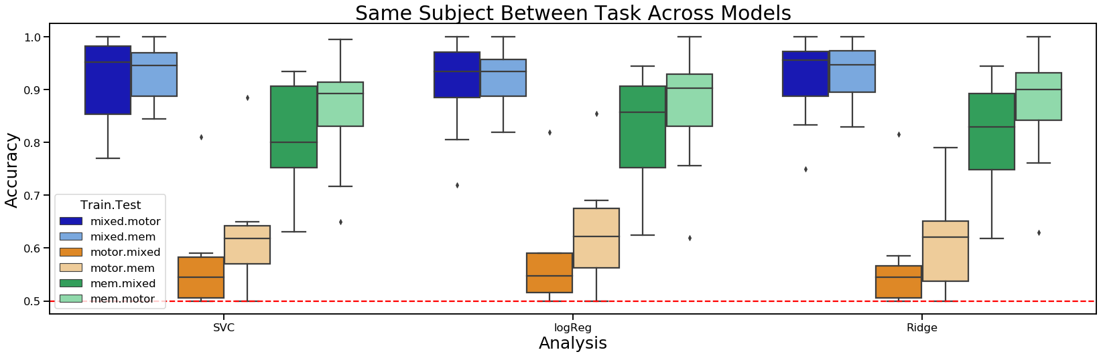
Same Subject, Between Task

Slide 15
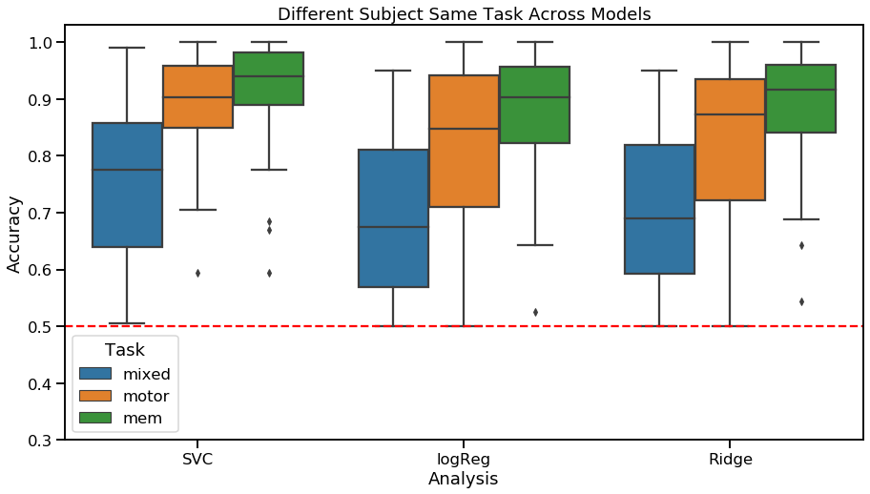
Different subject same task

Slide 16
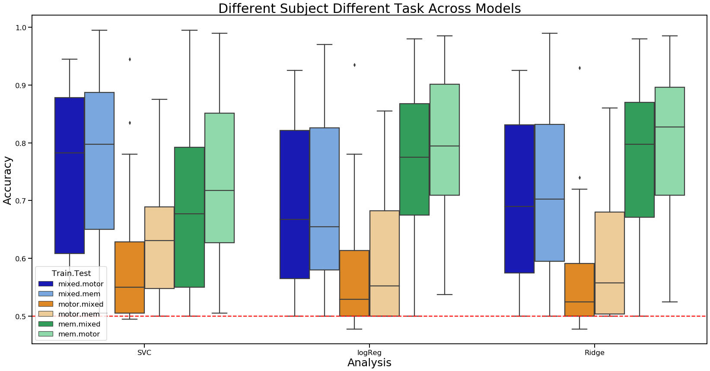
Different subject, different task

Slide 17
Feature Selection by Functional Network
Could some networks be more individual specific and result in greater performance?

Slide 18
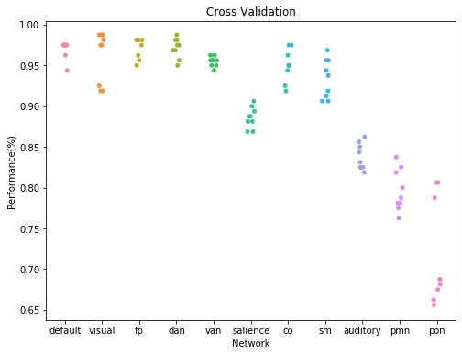
All Tasks All Models

Slide 19
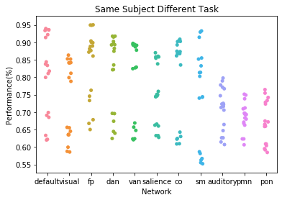

Slide 20
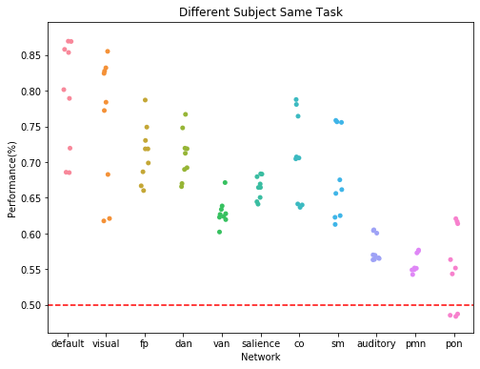

Slide 21
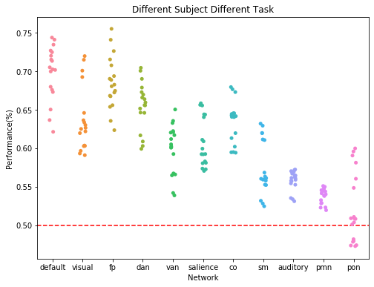

Slide 22
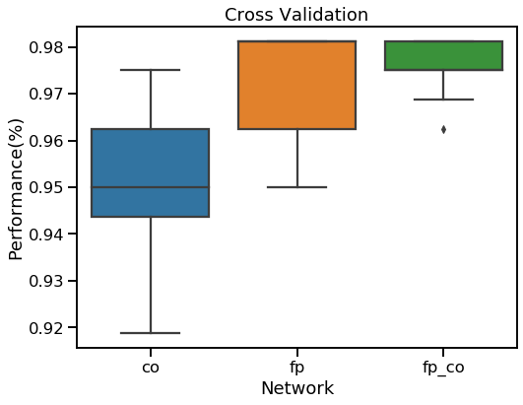
Comparisons of CO and FP

Slide 23
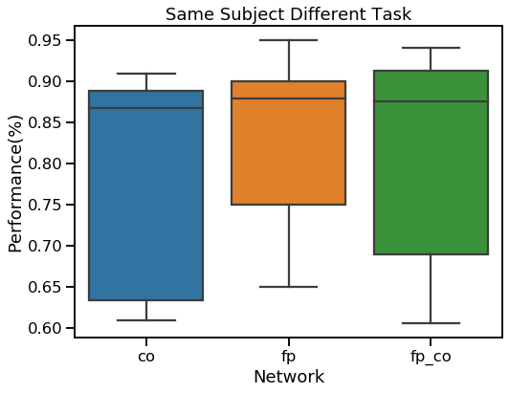

Slide 24
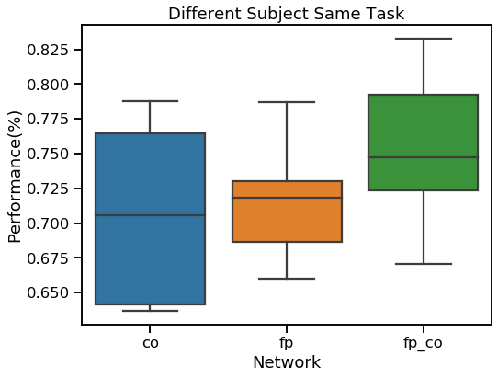

Slide 25
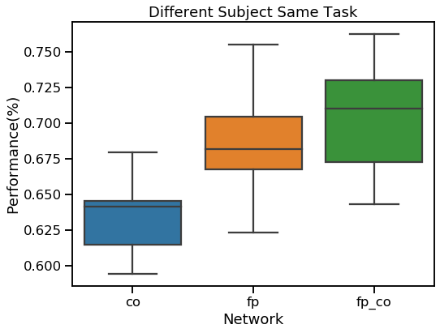

Slide 26
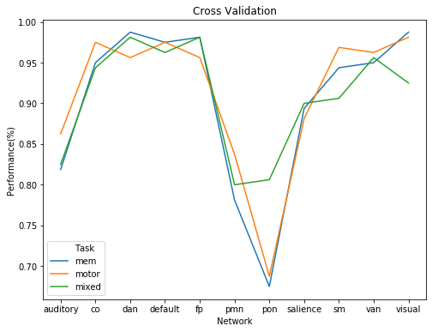
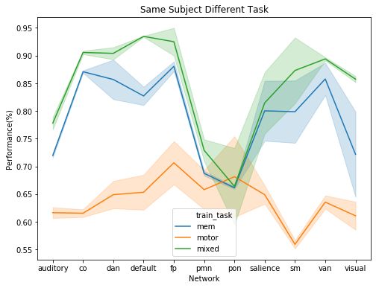
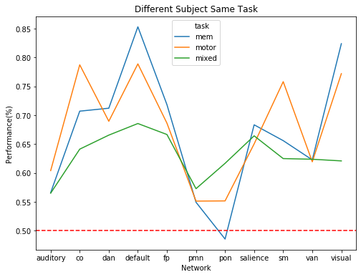
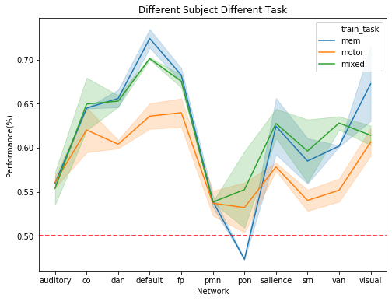
Ridge Regression

Slide 27
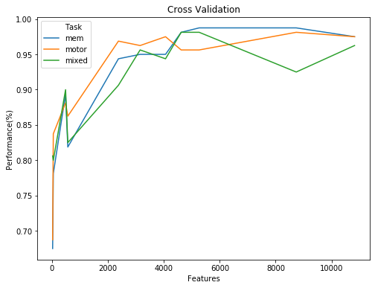
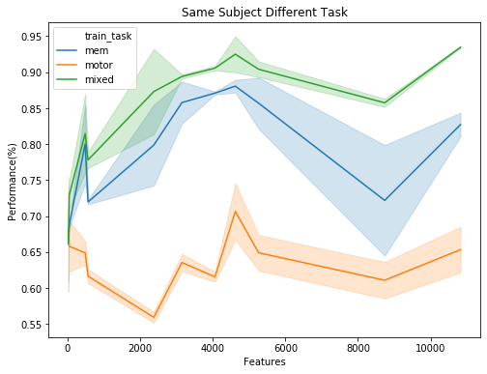
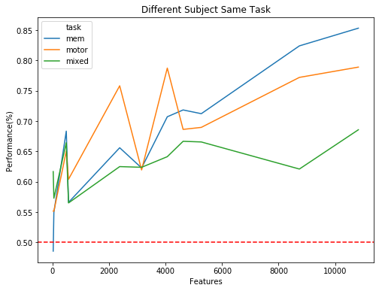
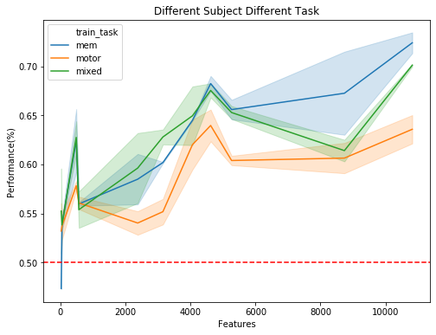
Number of Features per Network and performance

Slide 28
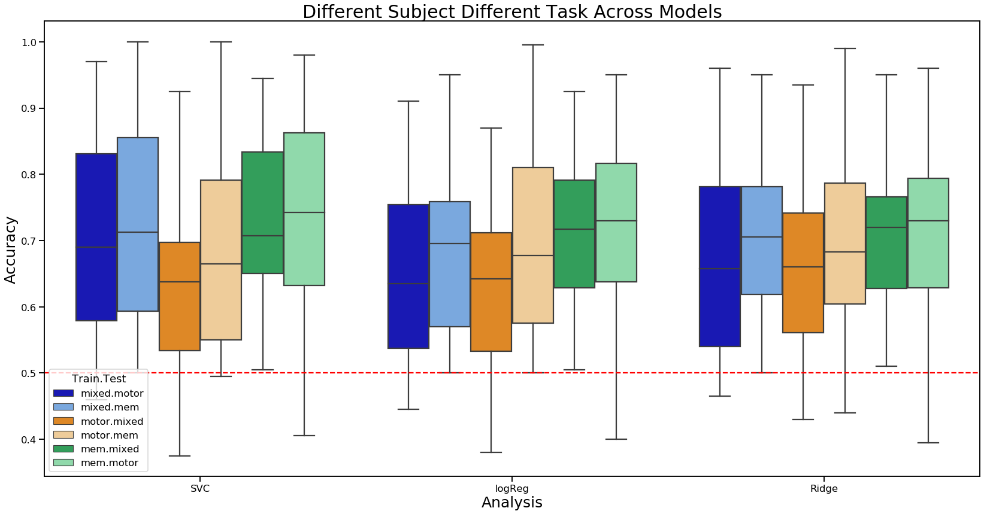
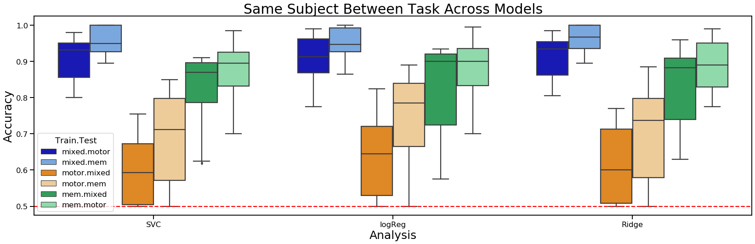
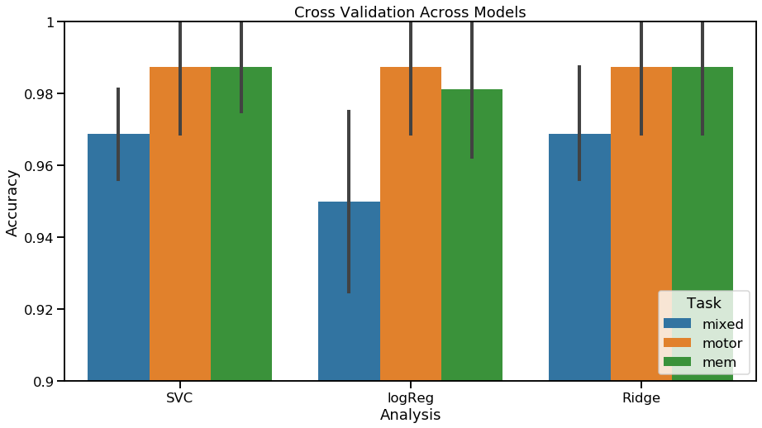
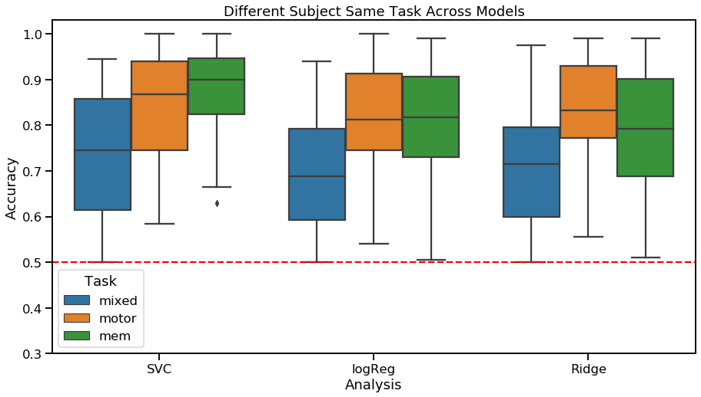
Only taking blocks of networks

Slide 29
Feature Manipulation

Slide 30
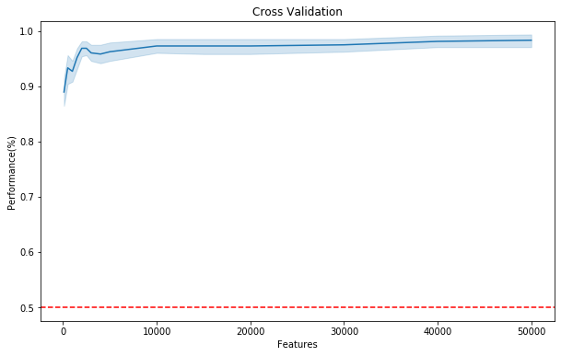
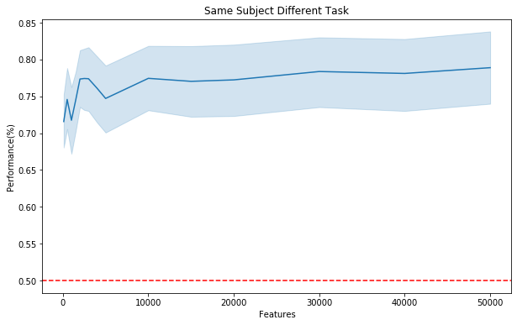
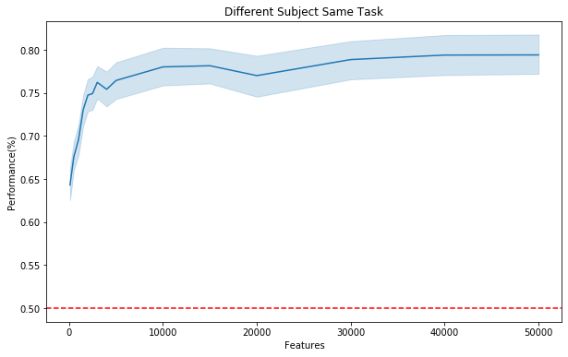
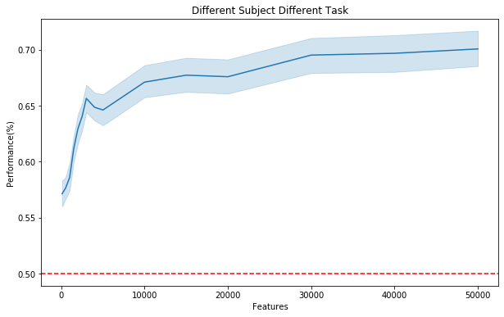
Subset datasets by number of features. Ridge regression only
Notes:
On average it would seem that using within subject yielded higher performance independent of number of samples while examining different subjects did start out much lower

Slide 31
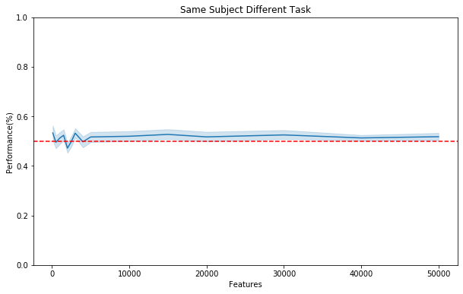
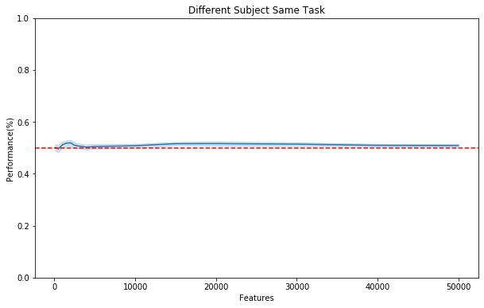
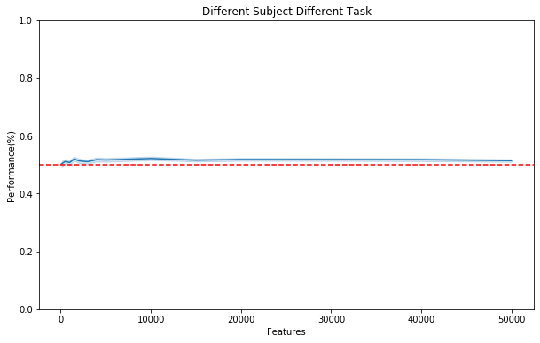
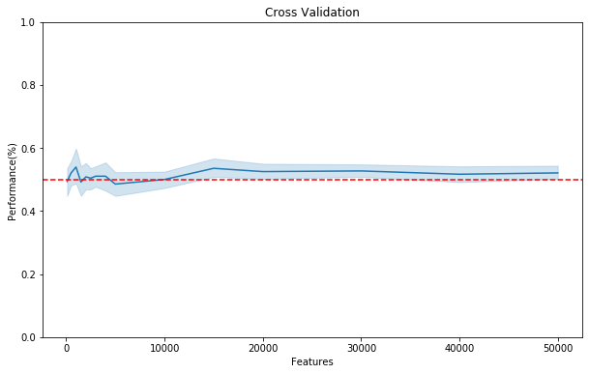
Randomly sample features
Notes:
Ridge only

Slide 32
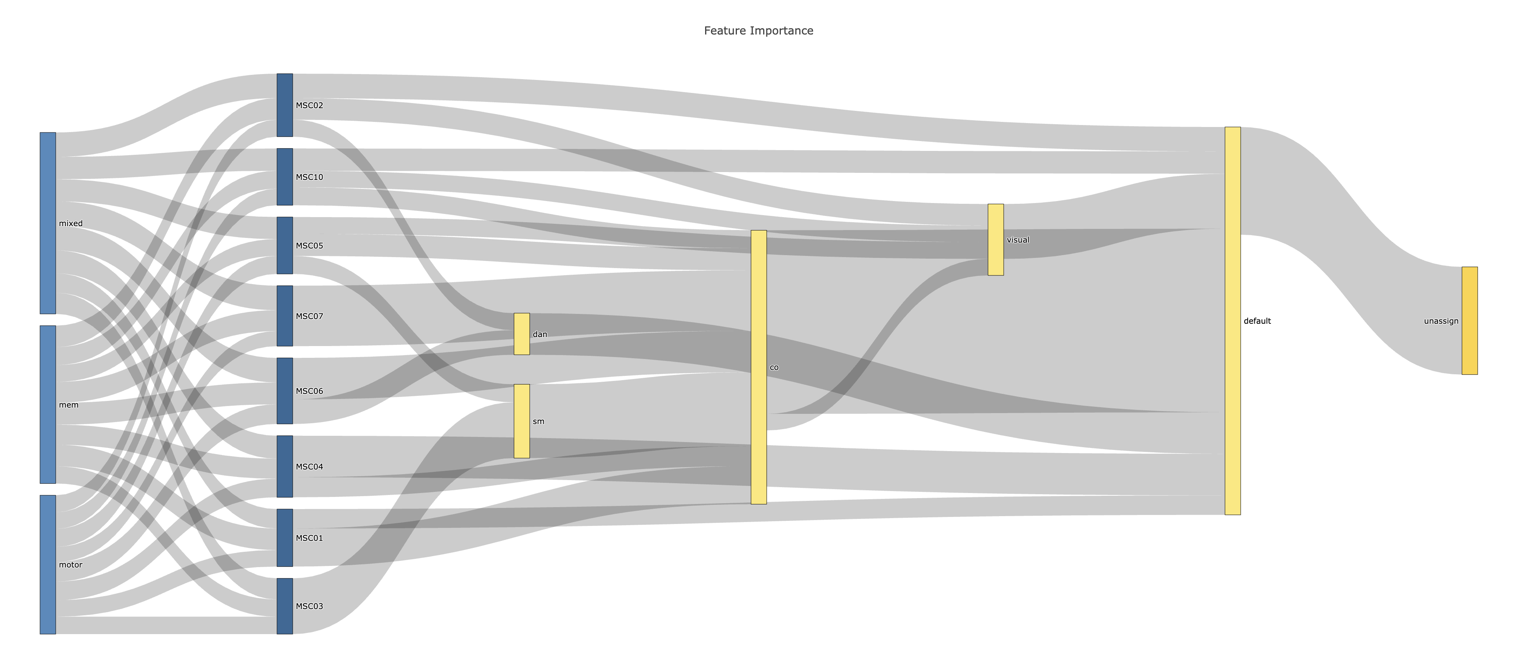
Notes:
Ridge only. Regular mL script but instead of taking each fold just take the whole dataset and fit to the model and then take the absolute value of the coefficients and revert back into the 333x333 matrix form. Groupby sum the regions and for each subject in each task take the largest total sum. Then store all the subs for all the tasks and plot into a sanky diagram. This diagram would suggest that a lot of the models rely on default mode network and CO network based on the total sum of feature weights.

