Slide 1
MVPA

Slide 2
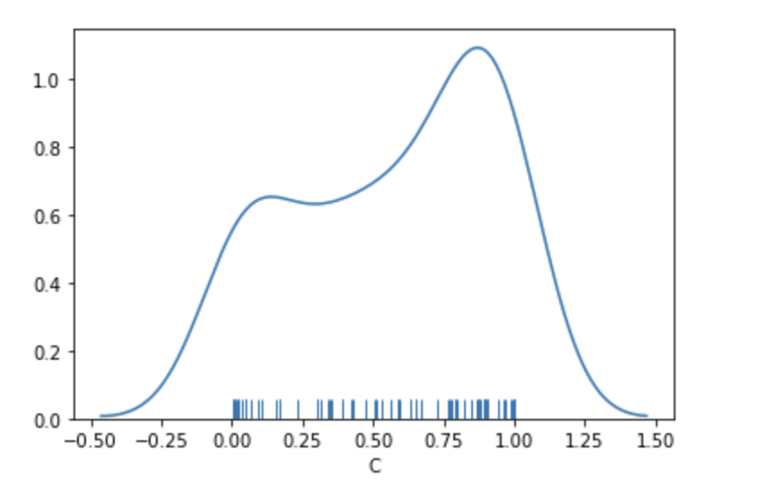
10 random permutations across 10 different subjects; train permuted label memory test mixed unpermuted
Average=.57

Slide 3
Training MSC02, 04, 05, 10; Testing MSC01, 03, 06, 07 in a LOOCV across subs average accuracy scores
Mem=70.3
Mixed=67.4
Motor=92.1

Slide 4
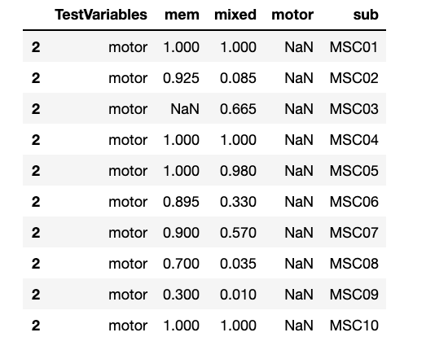
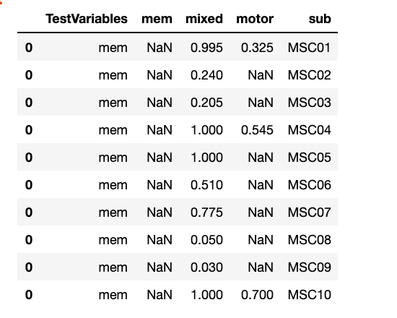
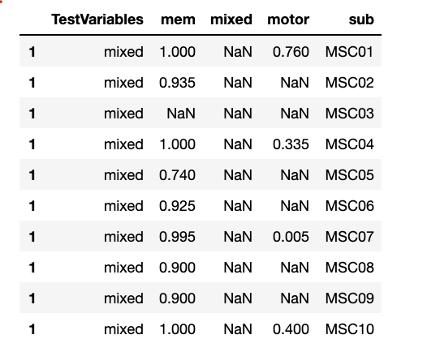
Within Sub
Test motor
Test memory
Test mixed

Slide 5
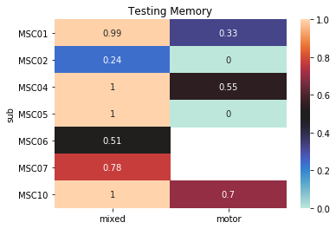
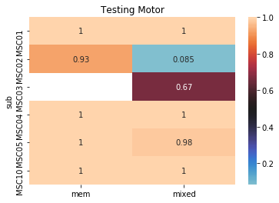
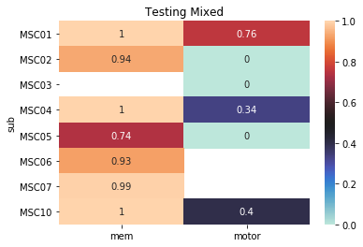
Within Sub
Subjects were removed due to NaNs in testing data

Slide 6
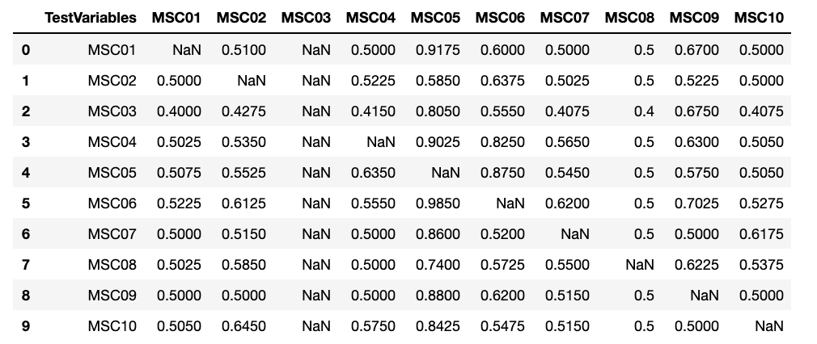
Between Sub
Memory

Slide 7
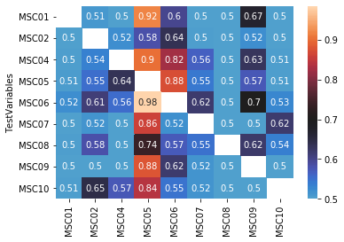
Between Sub
Memory
Removed MSC03 missing data

Slide 8
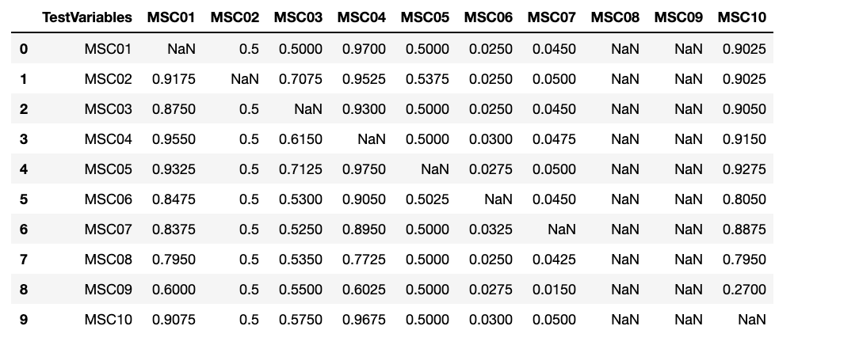
Between Sub
Motor

Slide 9
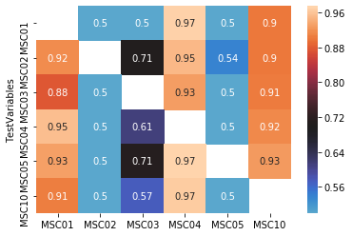
Between Sub
Motor
Removing MSC06, 07, 08 09 missing data

Slide 10
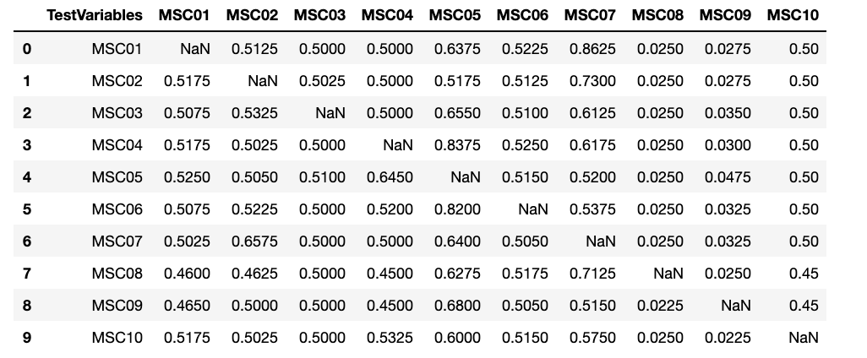
Between Sub
Mixed

Slide 11
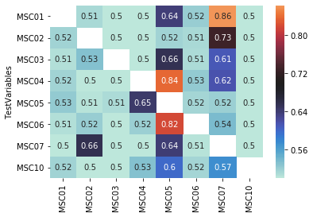
Between Sub
Mixed
Removed MSC08 and MSC09 due to NaN’s during training/testing

Slide 12
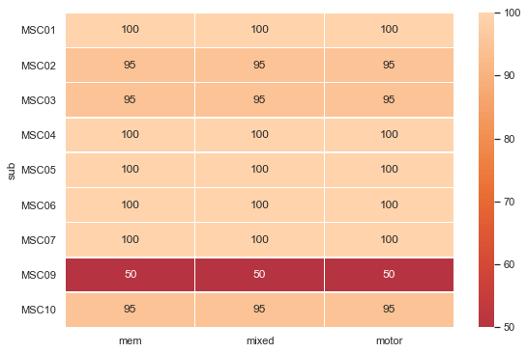
Leave out 1 day paired

