Slide 1
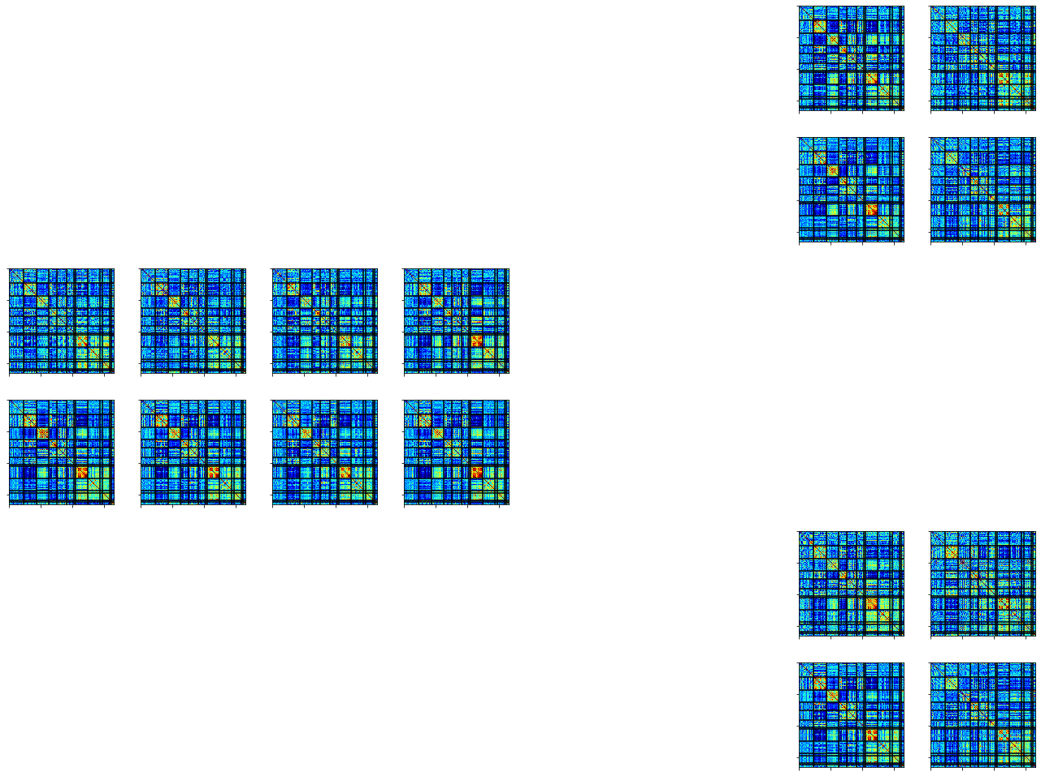
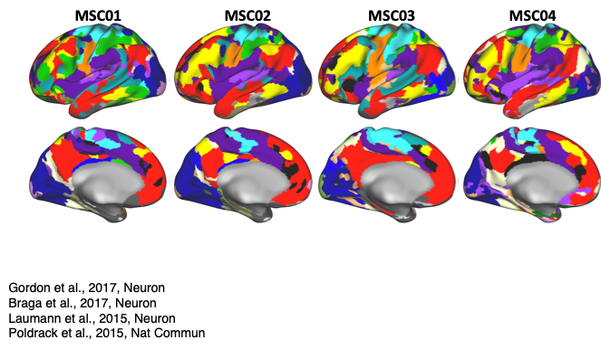
A.
All Task
Training
Test Across People
Train
Predict
MSC01
Test
MSC02
All Tasks
Rest
Session 1
Session 2
.…
Session 9
Session 10
B.
Split Task
Training
Test Across People
Train
Task A
Predict
Task A
MSC01
Test
MSC02
Task A
Rest
Session 1
Session 2
.…
Session 9
Session 10
C.
Across Task
Training
Test Across Task
Train
Task A
Predict
Task B
Task A
Task B
MSC01
MSC01
MSC01
Task A
Rest
Session 10
Session 1
Session 2
.…
Session 9

