Slide 1
Machine learning approaches to understand individual differences in functional connectivity

Slide 2




Does variation between individuals influence classification?
Same subject, between task
Different subject same task
Different subject, different task

Slide 3
Can model choice influence results?
Support Vector Machine Learning
Logistic Regression
Ridge Regression

Slide 4
Is there a tradeoff between quantity and quality?
Functional connectivity independent on time
Functional connectivity matched for time

Slide 5
Support Vector Machine Learning

Slide 6
Logistic Regression

Slide 7
Ridge Regression

Slide 8

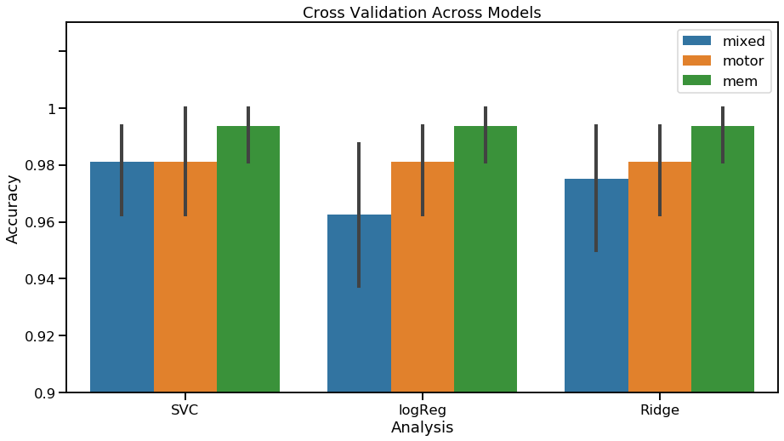
Internal Validation of Model
Cross Validation

Slide 9
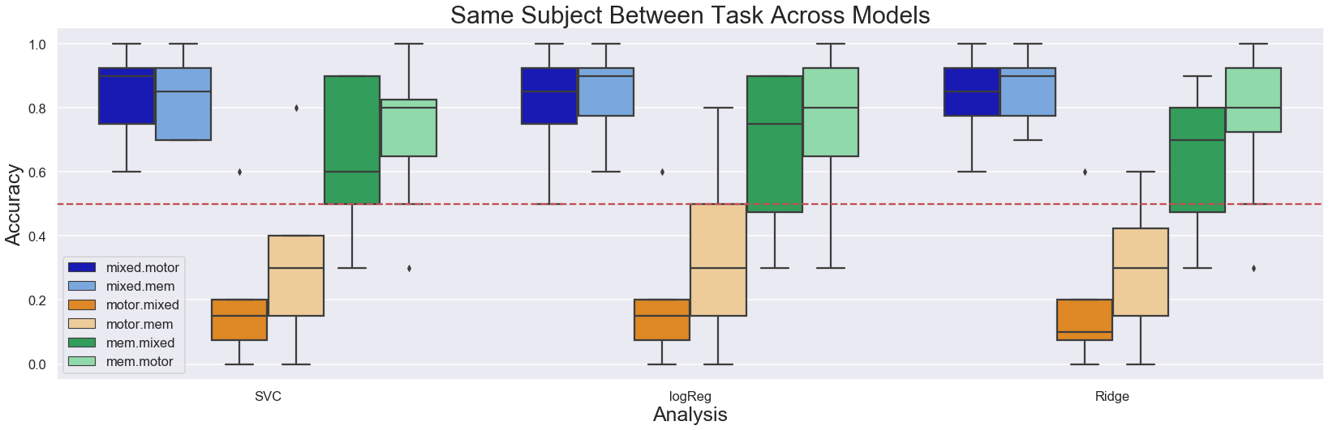
Same Subject, Between Task

Slide 10
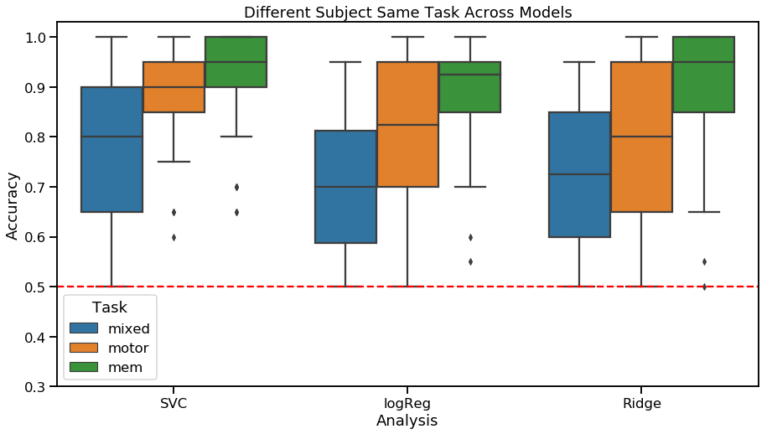
Different subject same task

Slide 11
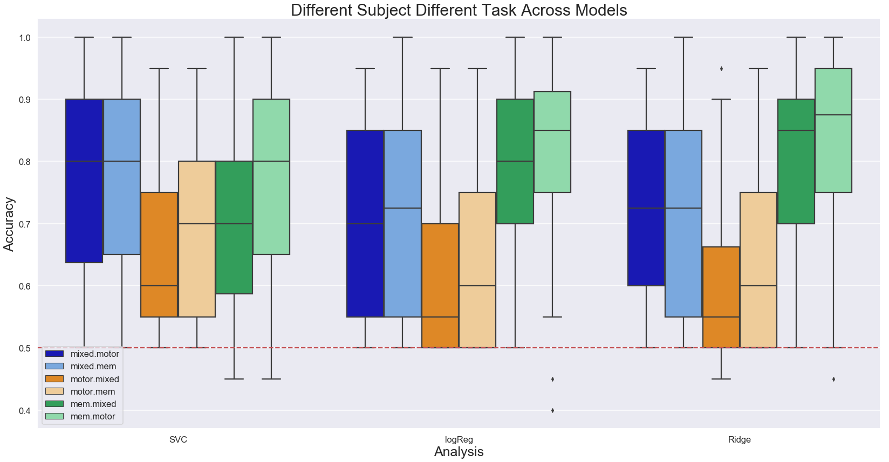
Different subject, different task

