Slide 1
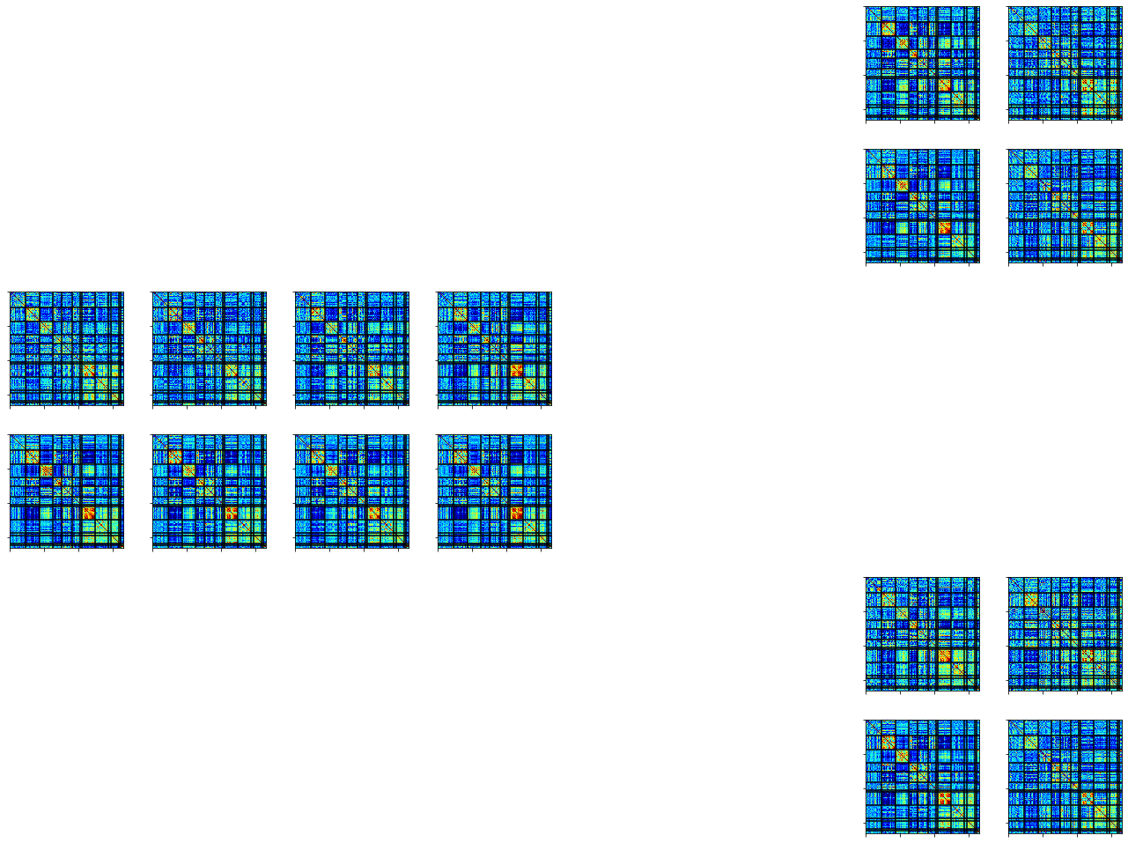
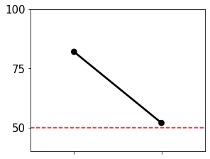
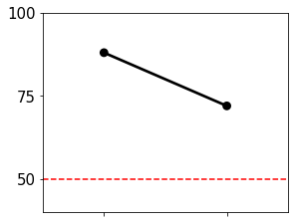
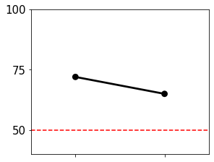
A.
Training
B.
Testing
MSC05
Task A
MSC04
Task A
Test
Task A
Rest
MSC04
MSC05
MSC04
MSC04
Task B
Rest
Rest
Task A
Task B
Session 10
Session 1
Session 2
…
MSC04
MSC05
Task B
Session 3
Session 9
Session 10
Task B
Rest
MSC04
MSC05

Slide 2
A.
Training
B.
Testing
C.
Evaluate
MSC04
Test
MSC04
MSC05
Task A
Task A
Task A
Accuracy %
Rest
MSC04
MSC05
MSC04
MSC05
MSC04
Rest
Task B
Accuracy %
Session 1
Session 2
…
Session 10
Session 3
Session 9
Session 10
Rest
Task A
Task B

