Slide 1
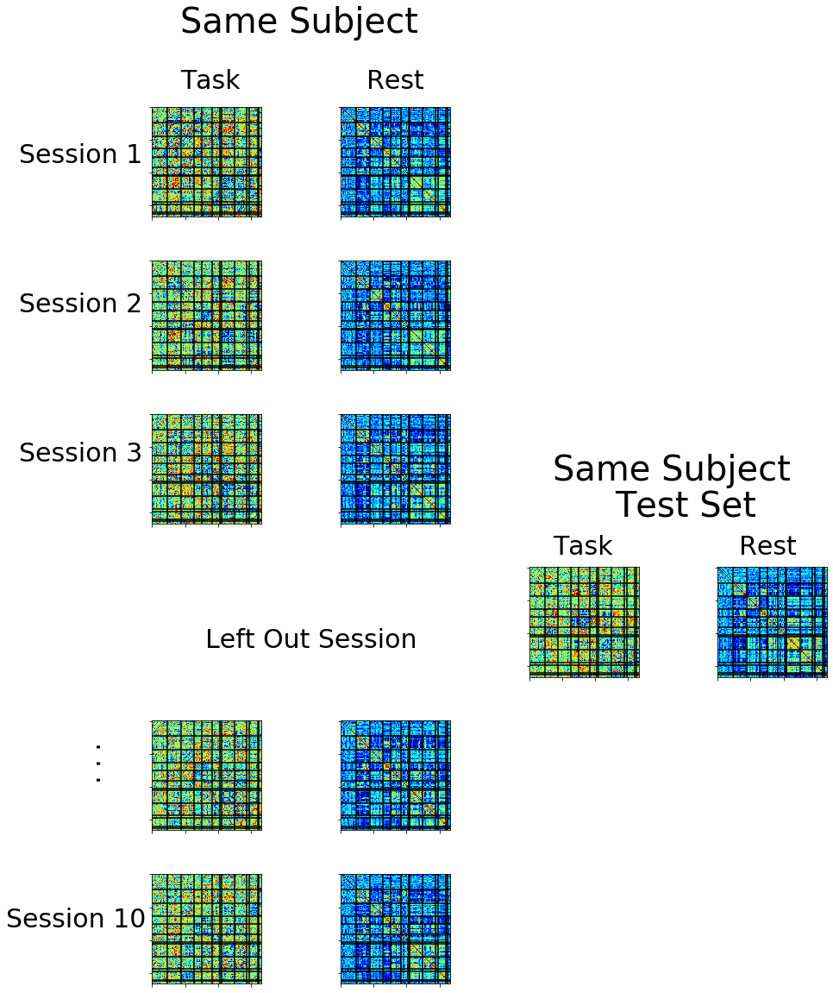
A.
Midnight Scan Club
B.
10 Subjects {MSC01, MSC02,…MSC10)
10x Sessions
Training Dataset
Fold 2
Fold 10
Fold 1
. . .
MSC01
Individualized Classifiers
MSC02
MSC03
MSC10
…
C.1
Within Subject Generalizability
C.2
Between Subject Specificity
C.3
Between Subject Generalizability
Same Subject Different Task Test Sets
Different Subject Same Task Test Sets
Different Subject Different Task Test Sets
Classify
Memory
Classify
MSC02
Classify
Memory
Motor
MSC03
Motor

Slide 2
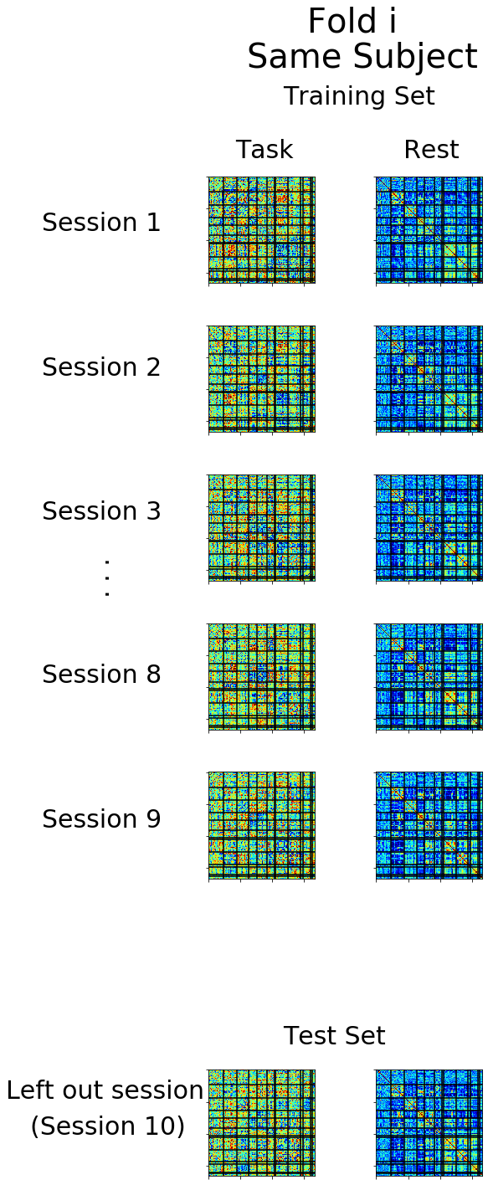
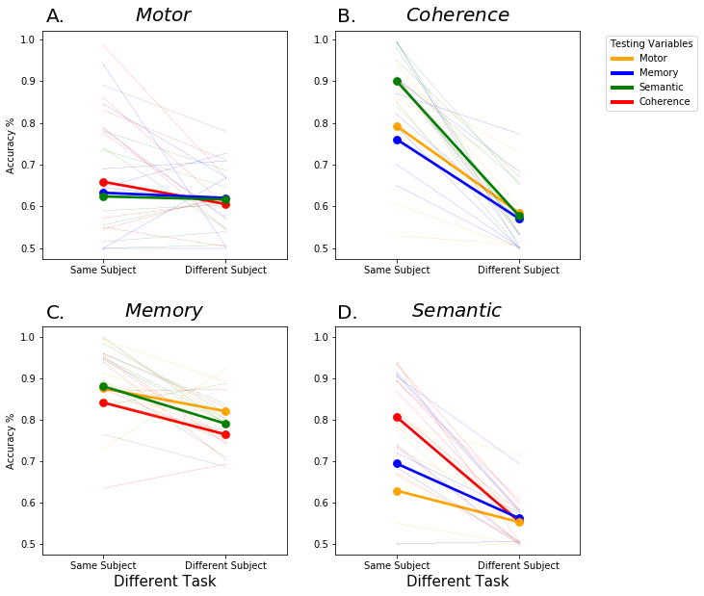
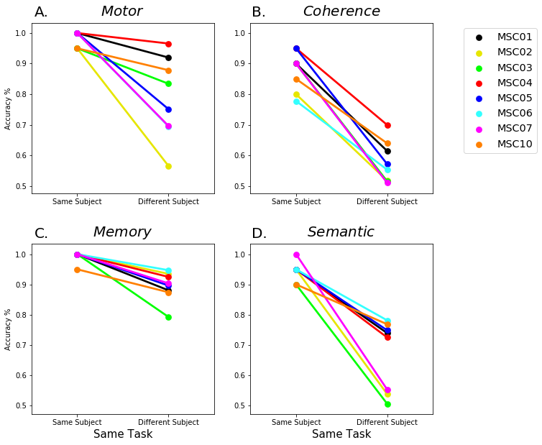
A.
Midnight Scan Club
Fold
Different Subject Same Task Test Sets
Individual Specific Analysis
4 Tasks x 10 Sessions x 10 Subjects
Semantic -MSC02
Memory
Motor
Semantic
Coherence
Classify
Semantic -MSC03
Semantic -MSC04
Testing Task FC
Testing Rest FC
Classify
Task Generalizable Analysis
Training Task FC
Training Rest FC
Testing Task FC
Testing Rest FC
Training Dataset
Fold 10
...
Fold 3
Fold 9
Fold 1
Fold 2
Individualized Classifiers
MSC01
MSC02
MSC10
. . .

Slide 3
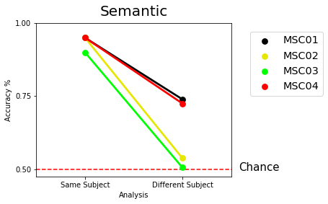
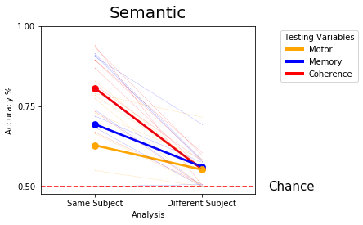
Midnight Scan Club
4 Tasks x 10 Sessions x 10 Subjects
Training Dataset
...
Fold 3
Fold 9
Fold 10
Fold 1
Fold 2
Memory
Motor
Semantic
Coherence
Individualized Classifiers
MSC01
MSC02
. . .
Individual Specific Analysis
MSC10
Fold
Different Subject Same Task Test Sets
Semantic -MSC02
Classify
Semantic -MSC03
Semantic -MSC04
Training Task FC
Training Rest FC
Testing Task FC
Testing Rest FC
Testing Task FC
Testing Rest FC
Task Generalizable Analysis
Classify

