Slide 1
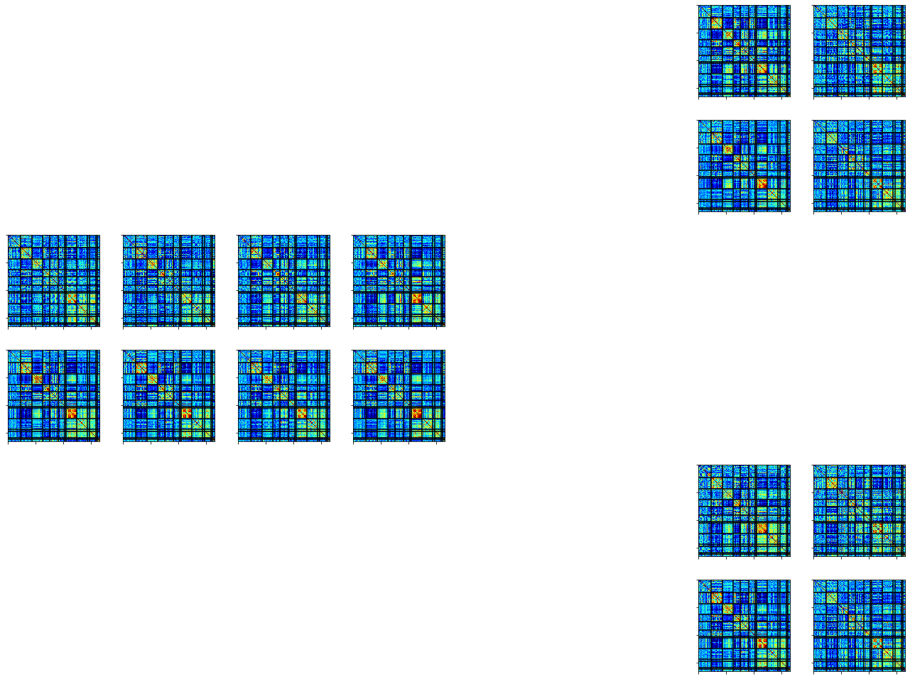
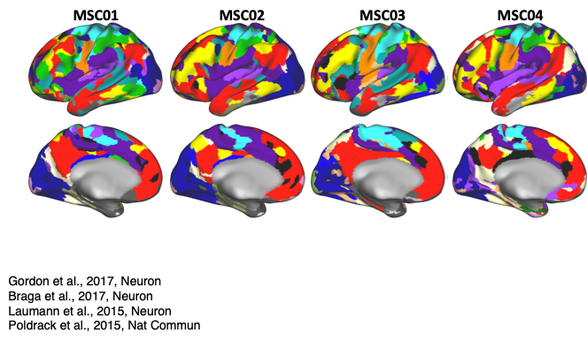
A.
Test Across People
All Task
Training
Train
Predict
MSC01
Test
MSC02
All Tasks
Rest
Session 1
Session 2
.…
Session 9
Session 10
B.
Single Task
Training
Test Across People
Train
Motor
Predict
Motor
MSC01
Test
MSC02
Motor
Rest
Session 1
Session 2
.…
Session 9
Session 10
Across Task
C.
Training
Test Across Task
Train
Motor
Predict
Memory
MSC01
Motor
Memory
MSC01
MSC01
Motor
Rest
Session 10
Session 1
Session 2
.…
Session 9

Slide 2
a
All Task
Training
Test Across People
Train
Predict
MSC01
Test
MSC02
All Tasks
Rest
Session 1
Session 2
.…
Session 9
Session 10
b
MultiClass
Training
Test Across People
MSC01
Train
Predict
Semantic
Test
MSC02
Coherence
Motor
Memory
Rest
Session 10
Session 1
Session 2
.…
Session 9
c
Single Task
Training
Test Across People
Train
Motor
Predict
Motor
MSC01
Test
MSC02
Motor
Rest
Session 1
Session 2
.…
Session 9
Session 10

Slide 3
a
Training
Test
MSC01
MSC01
MSC02
All Tasks
Rest
Session 1
Session 2
.…
Session 9
Session 10
b
Training
Test
MSC01
Semantic
MSC01
MSC02
Coherence
Motor
Memory
Rest
Session 10
Session 1
Session 2
.…
Session 9
c
Training
Test
MSC01
MSC01
MSC02
Motor
Rest
Session 1
Session 2
.…
Session 9
Session 10

Slide 4
Training
Test
a
MSC01
MSC01
MSC02
All Tasks
Rest
Session 1
Session 2
.…
Session 9
Session 10
b
MSC01
Semantic
MSC01
MSC02
Coherence
Motor
Memory
Rest
Session 10
Session 1
Session 2
.…
Session 9
c
MSC01
MSC02
MSC01
Motor
Rest
Session 1
Session 2
.…
Session 9
Session 10

Slide 5


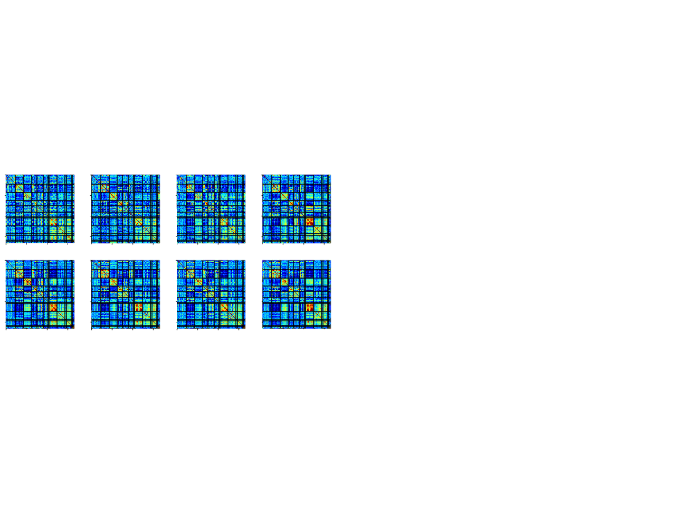
Training
Test
a
MSC01
MSC01
MSC02
All Tasks
Rest
Session 1
Session 2
.…
Session 9
Session 10
Session 10
b
MSC01
Semantic
MSC01
MSC02
Coherence
Motor
Memory
Rest
Session 10
Session 10
Session 1
Session 2
.…
Session 9
c
MSC01
MSC02
MSC01
Motor
Rest
Session 1
Session 2
.…
Session 9
Session 10
Session 10

Slide 6
Training
Test
a
MSC01
MSC01
MSC02
All Tasks
Rest
Session 1
Session 2
.…
Session 9
Session 10
Session 10
b
MSC01
MSC02
MSC01
Motor
Rest
Session 1
Session 2
.…
Session 9
Session 10
Session 10
c
MSC01
Semantic
MSC01
MSC02
Coherence
Motor
Memory
Rest
Session 10
Session 10
Session 1
Session 2
.…
Session 9

