Slide 1
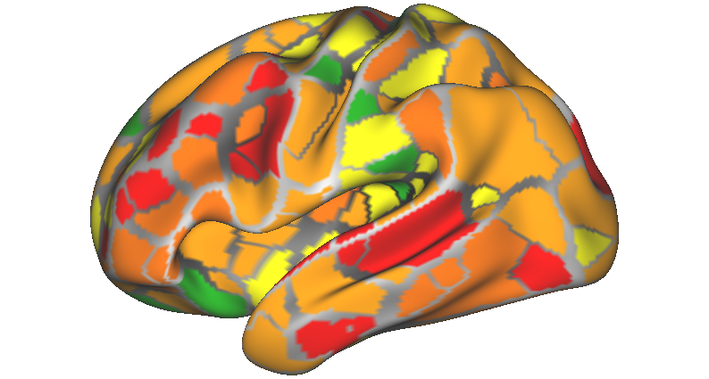
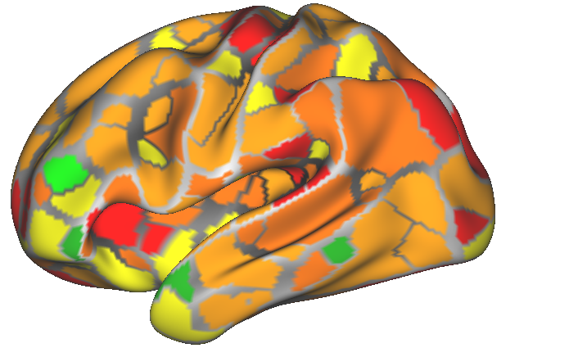
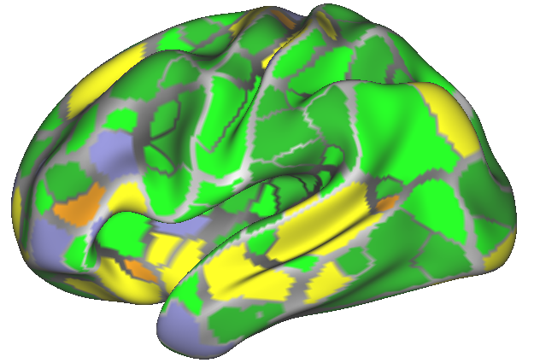
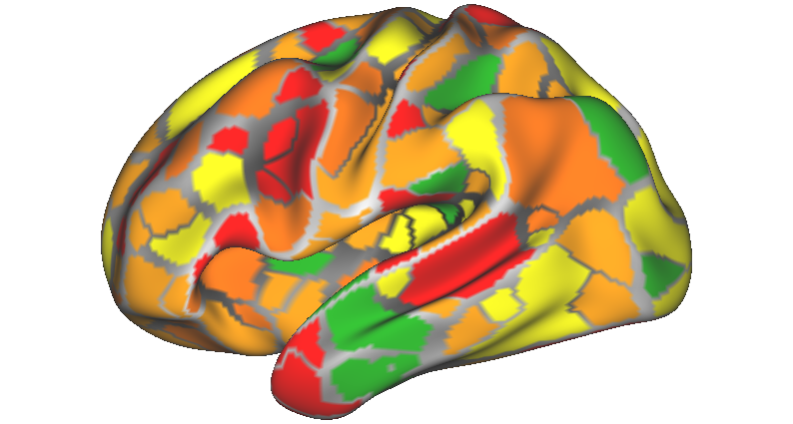
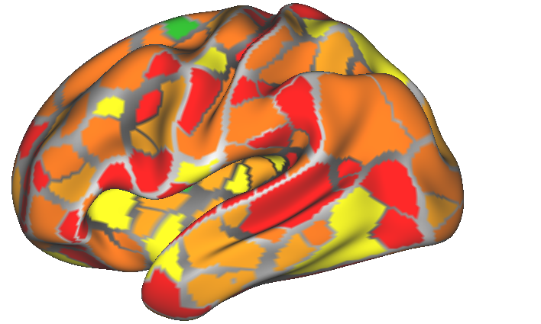
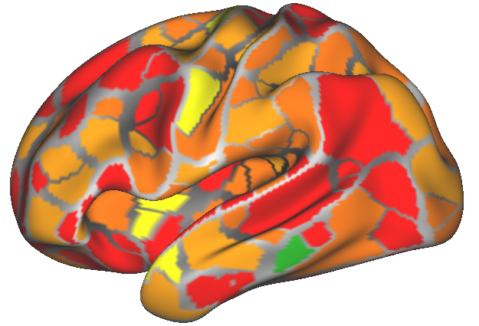
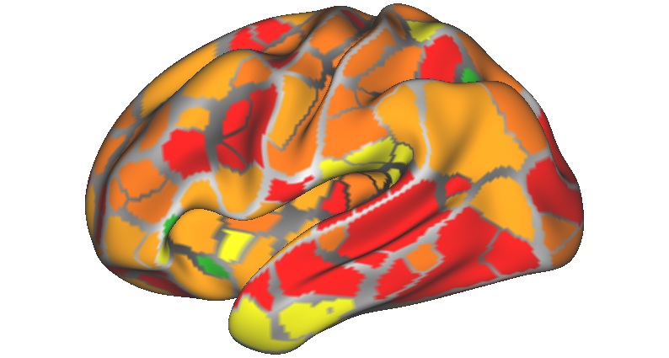
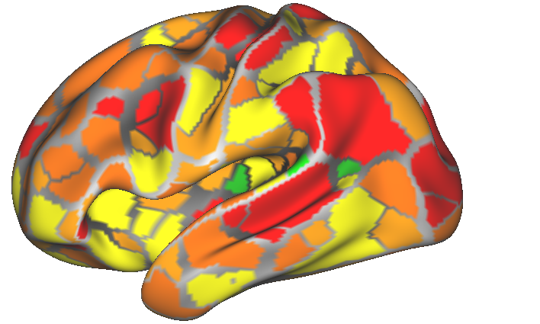
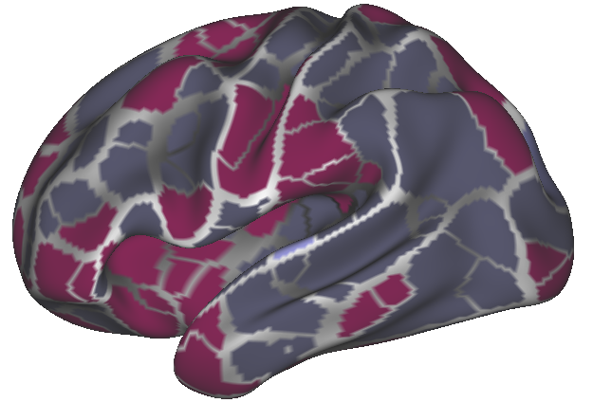
Presentation 1 v 2 Feature Weights
MSC01
MSC02
MSC03
MSC04
MSC05
MSC06
.1
MSC07
MSC10
Groupwise
.02
Feature
Weights

Slide 2
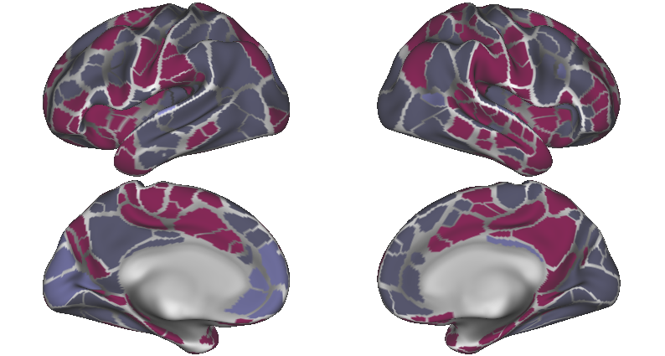
Groupwise
.1
.02
Feature
Weights

Slide 3
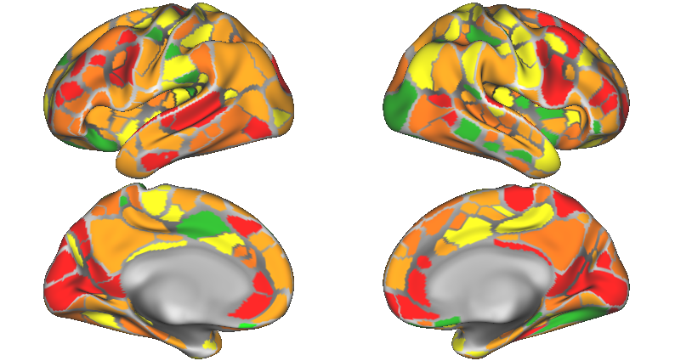
MSC01
.1
.02
Feature
Weights

Slide 4
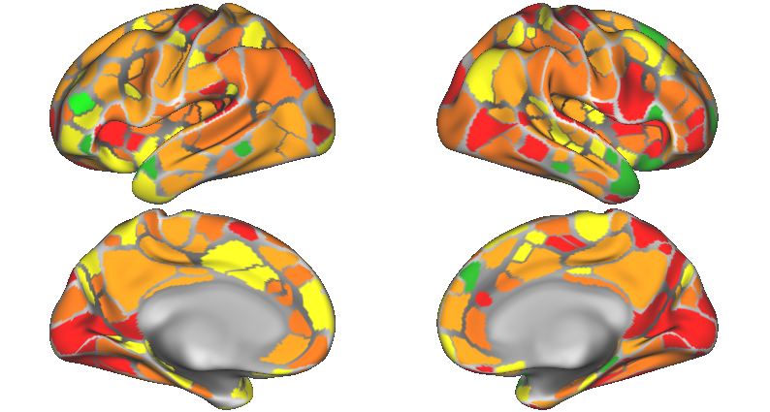
MSC02
.1
.02
Feature
Weights

Slide 5
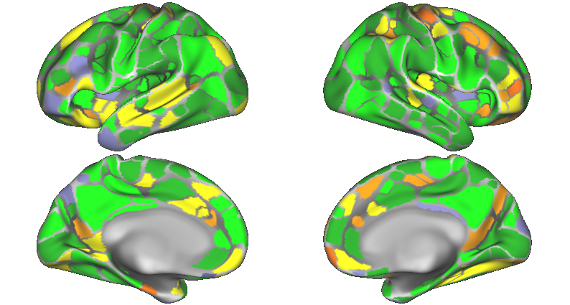
MSC03
.1
.02
Feature
Weights

Slide 6
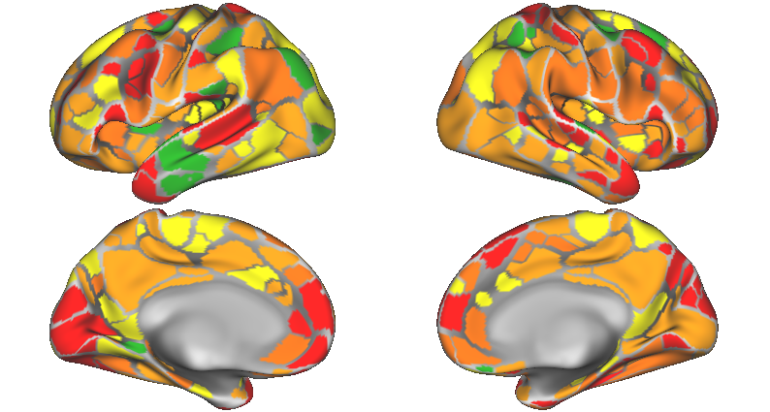
MSC04
.1
.02
Feature
Weights

Slide 7
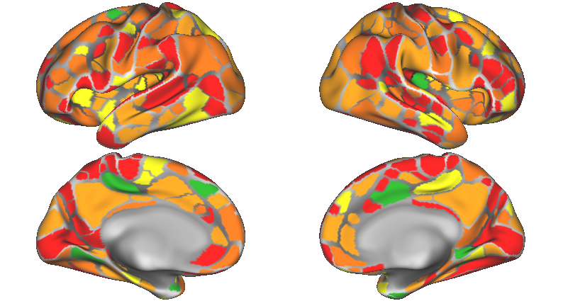
MSC05
.1
.02
Feature
Weights

Slide 8
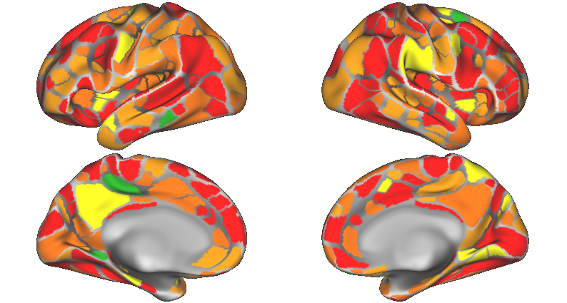
MSC06
.1
.02
Feature
Weights

Slide 9
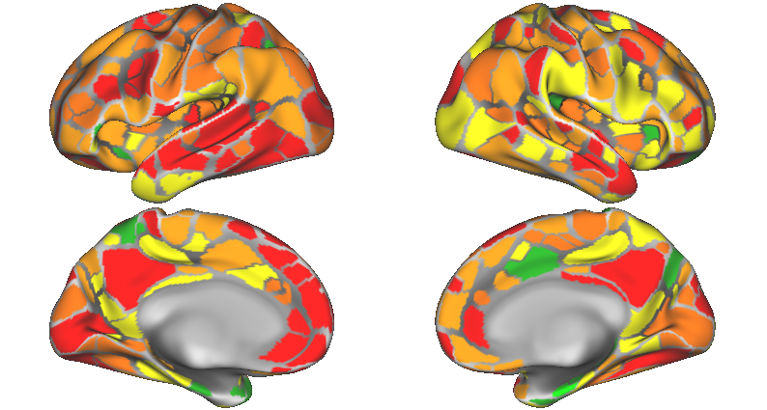
MSC07
.1
.02
Feature
Weights

Slide 10
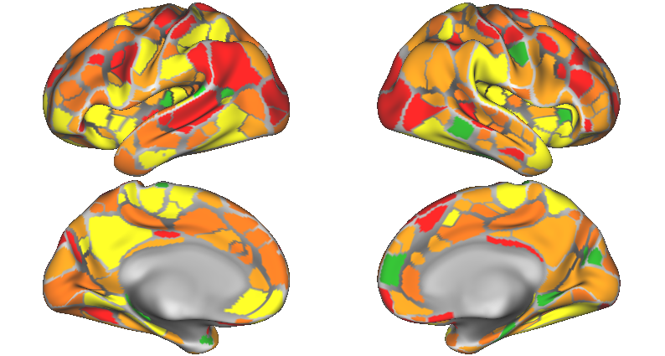
MSC10
.1
.02
Feature
Weights

