Slide 1
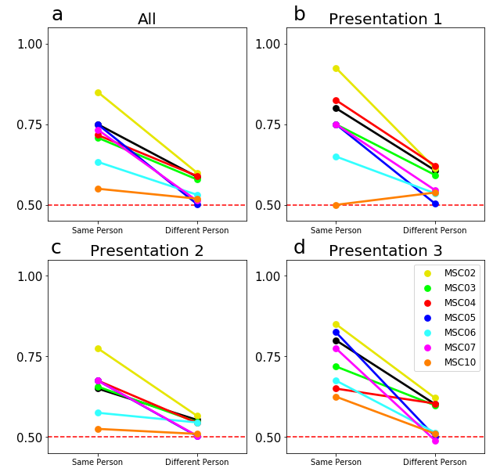
Binary classification across similar task conditions. Here we present average accuracy when training the classifiers to discriminate among similar conditions from the memory task, specifically contrasting blocks with the first, second, or third repetition of presented stimuli. Notably, in all conditions participants were viewing the same stimuli and performing the same task (a categorization judgement); the only difference between conditions was the number of previous repetitions of the stimuli (Gordon, et al 2017). All functional connectivity classifiers were able to discriminate these conditions above chance (p<.001), but as in other analyses the within participant classification significantly outperformed between participant classification (p<.001) even for these task conditions with high similarity.

