Slide 1
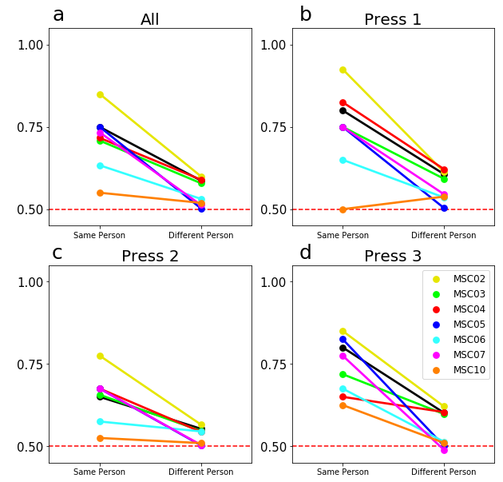
Binary classification across similar task conditions. Here we present average accuracy when training the classifiers to discriminate different conditions from the memory task (press 1 v. press2). Each classifier was significantly able to decode different task conditions in both the same and new participants, but performed consistently better for the same person (p<.001). (a) Averaging performance of binary classifiers (i.e. average of performance when training Press 1 v. Press 2; Press 1 v. Press 3; Press 2 v. Press 3). (b) Average performance of classifier when trained with Press 1 v. either Press 2 or Press 3, (c) Press 2 v. Press 1 or Press 3, and (d) Press 3 v. Press 1 or Press 2.

