Slide 1
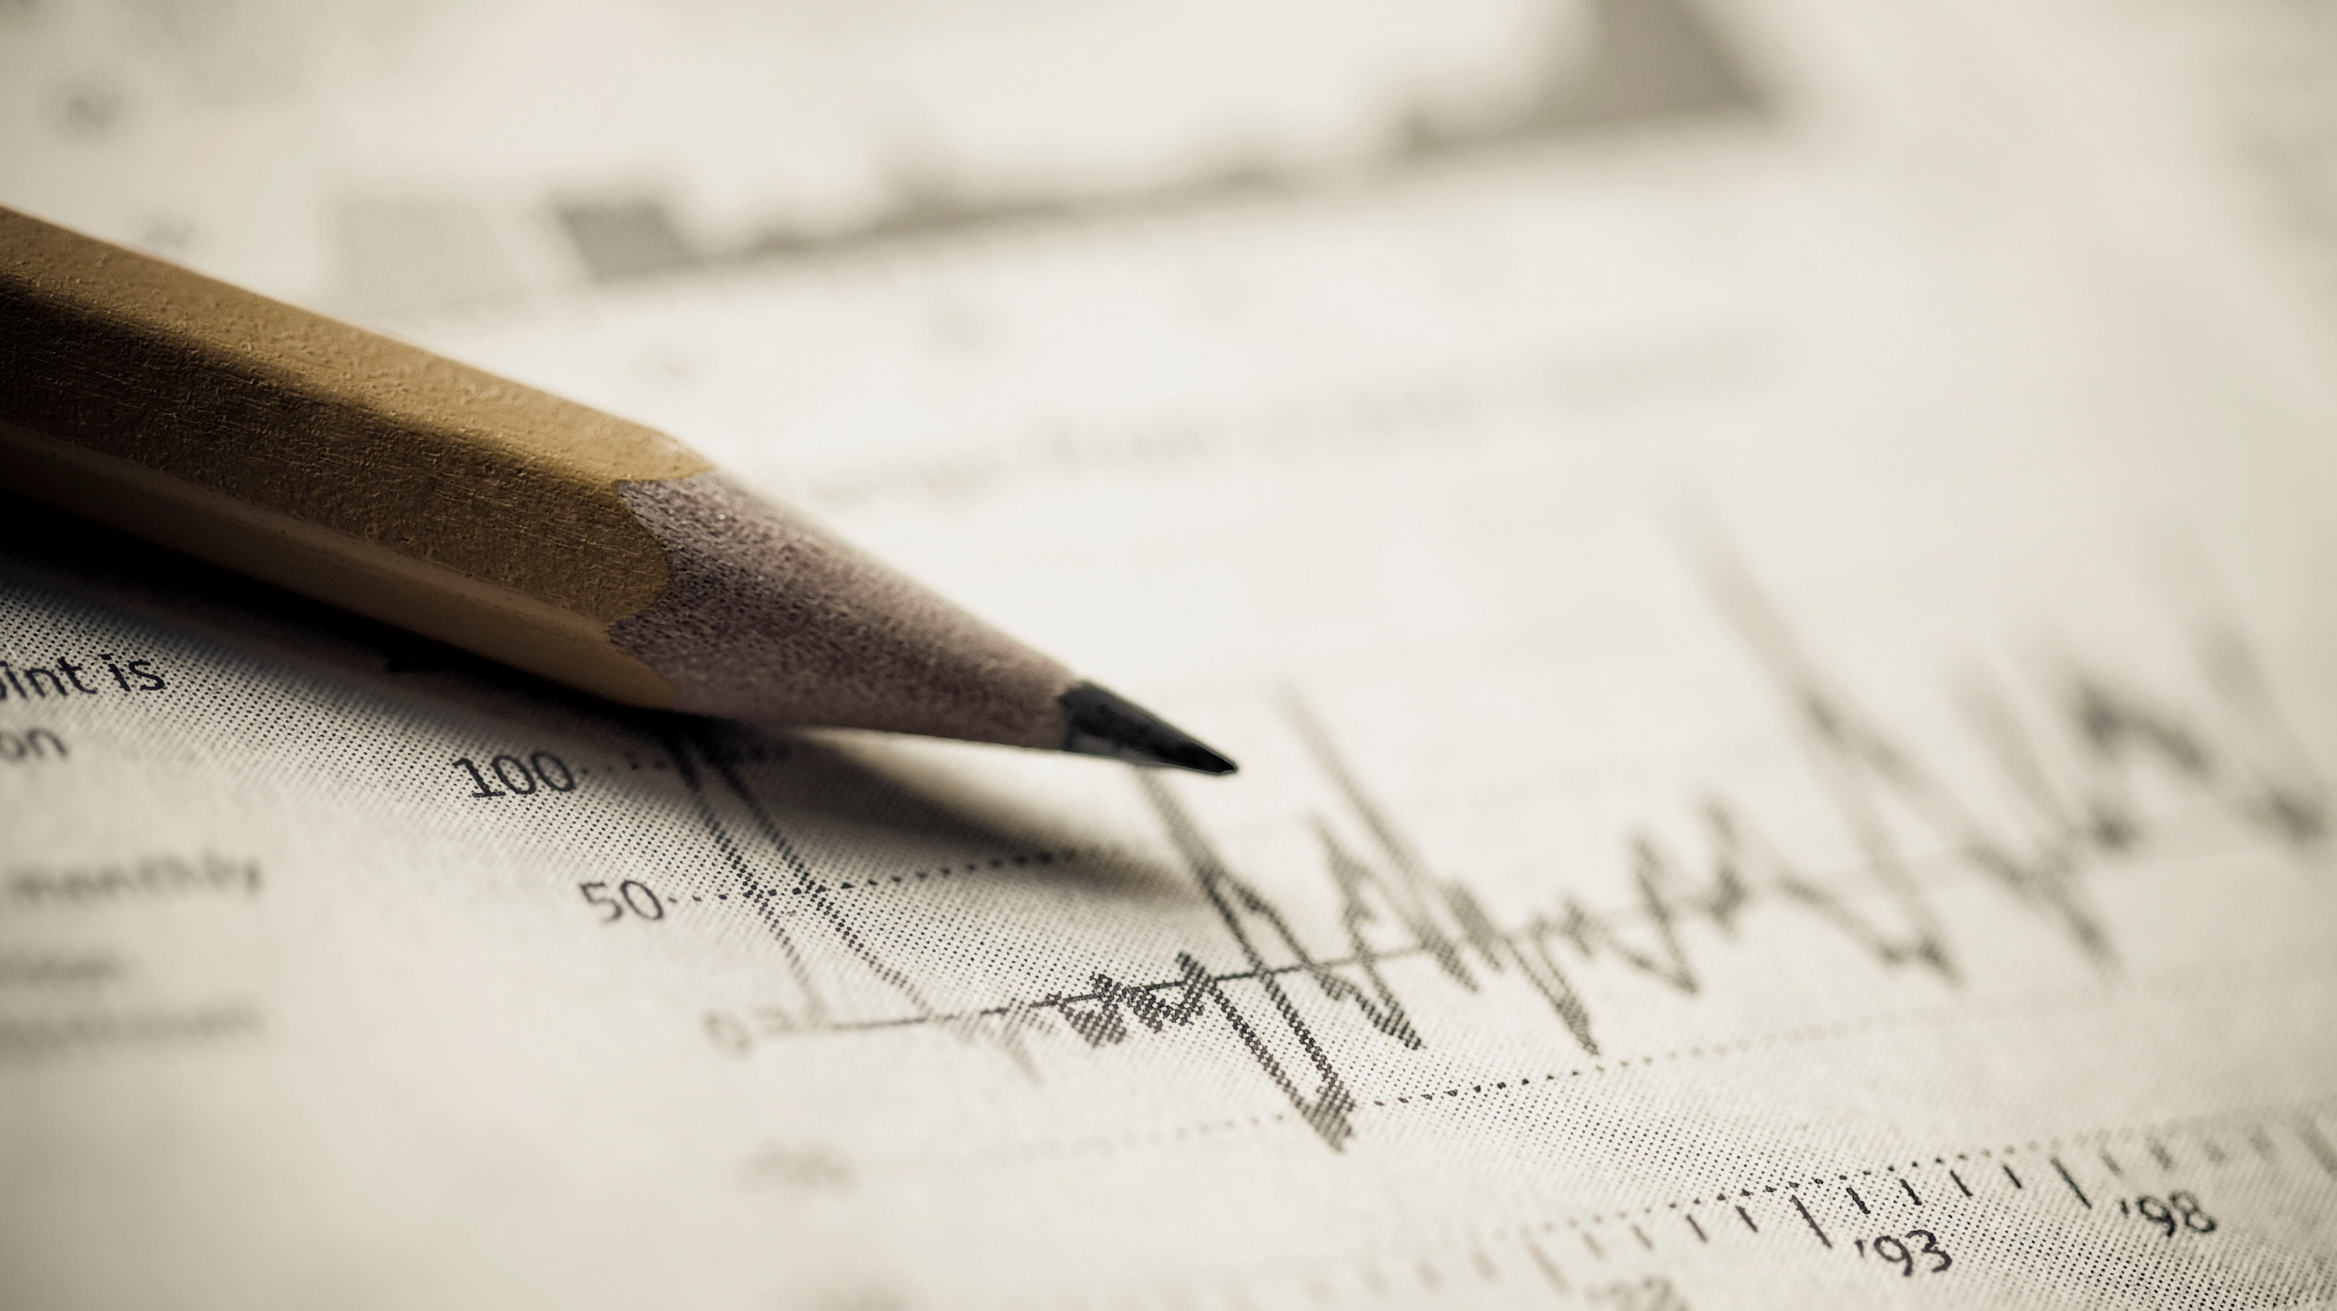
Team Parasite
Iiit Pune hackathon

Slide 2
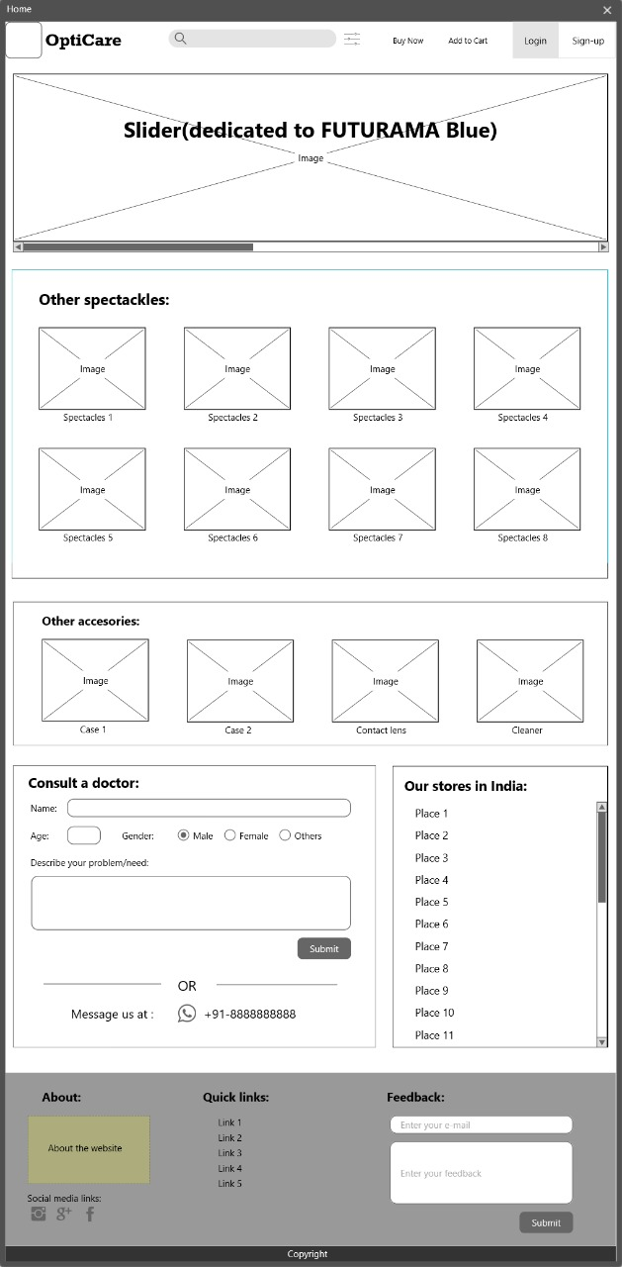
BASIC SKELTON
The wire frame provided by us in the First round is still our basic layout for our website and we tend to follow the same plan as proposed before
Many of the features proposed from round one are added and implemented in the
project-
Basic skeleton of the project is ready
Website Logo was designed
Slider with 4 images are added to the project which is dedicated to the Futurama
Navigation bar is created to make it a little more user friendly and easier to use
Search bar is designed and updated constantly on it to make it better
The basic code for consult a doctor is ready and update according to bugs to make
it more user friendly.
No change from document submitted in round one .
Our next step will be to develop the program to filter the search but we are currently
facing some difficulty making it work
Locations of the stores will be added and feature to redirect to google maps to the
location will be added
Java script will be added to the html page.

Slide 3
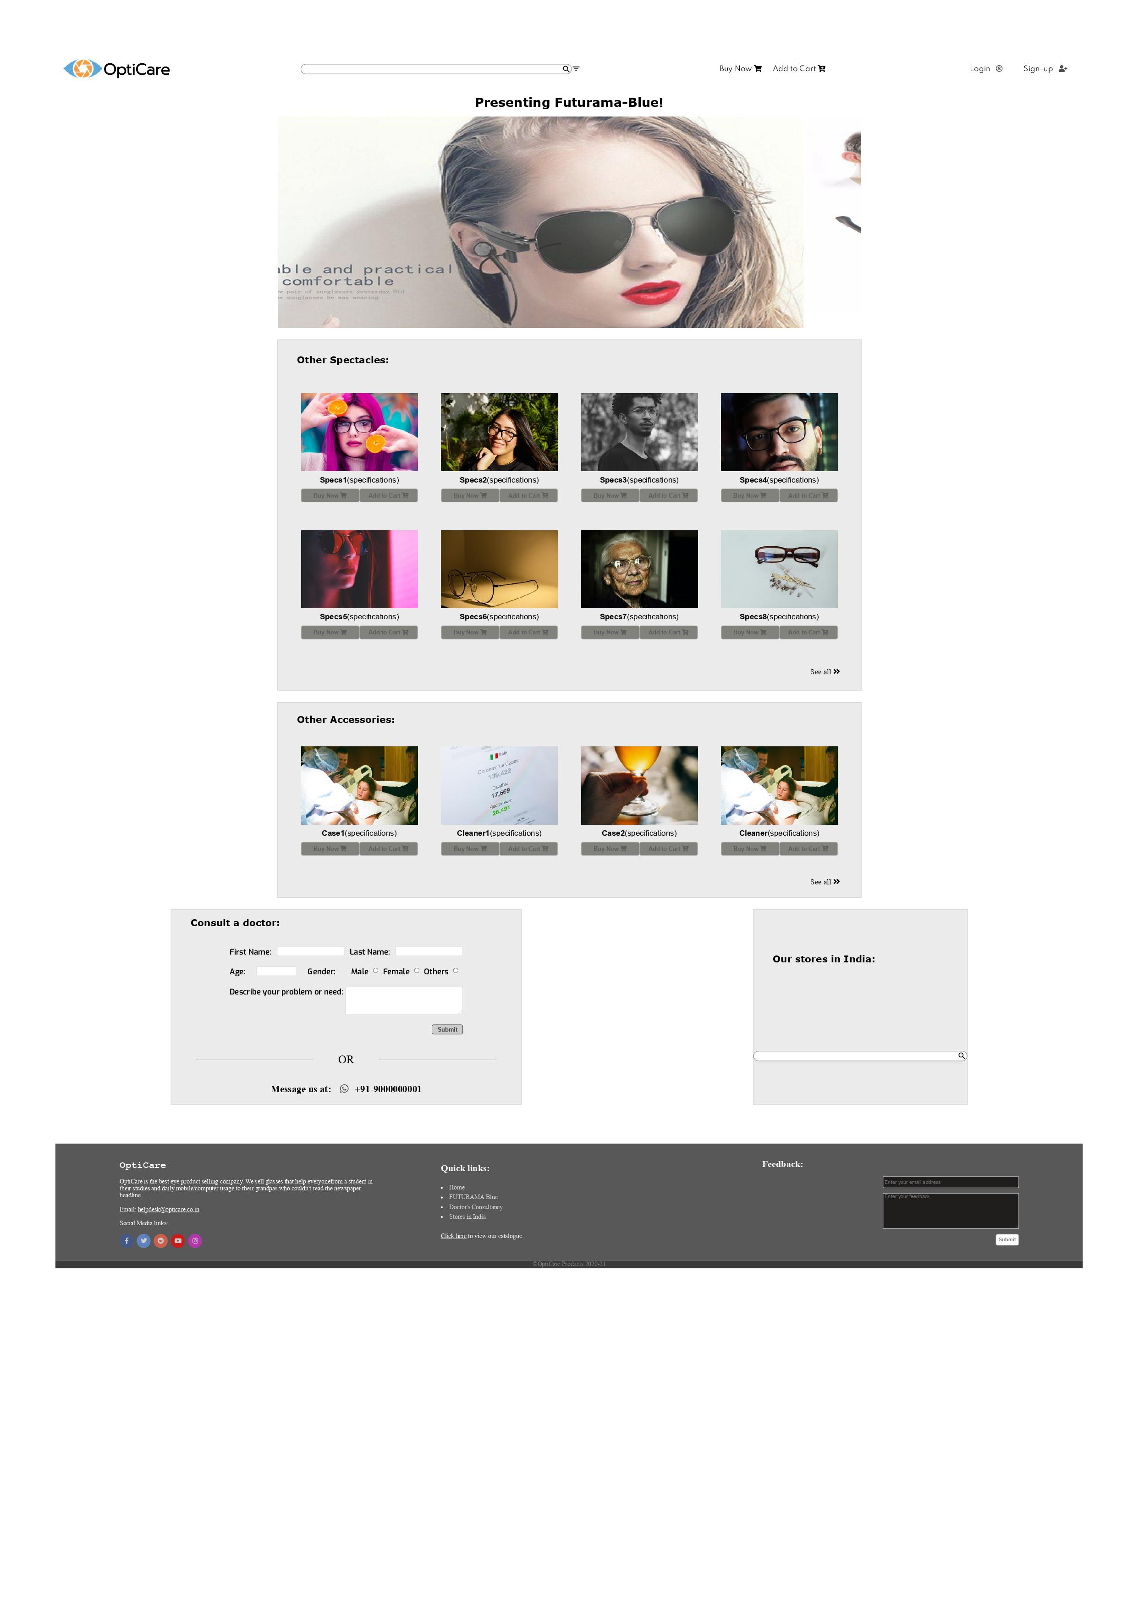
HOME PAGE
Basic layout of the home page
Navigation bar
Slider
Division showing our other spectacles
Division showing our other accessories
Locations of store feature
Consult as doctor feature

