Slide 1
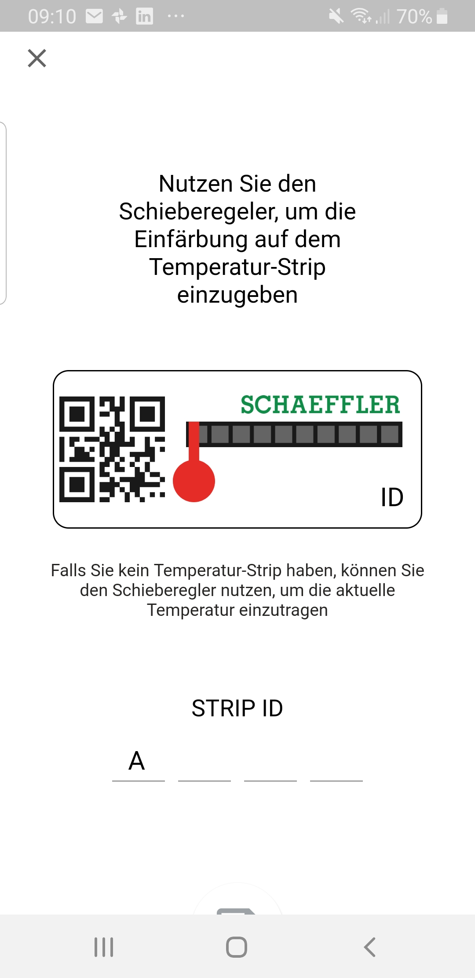
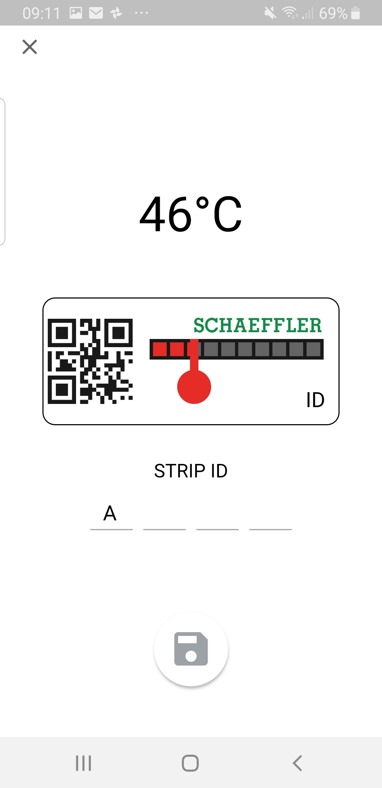
Issues:
User-unfriendly, no automation, error prone

Slide 2
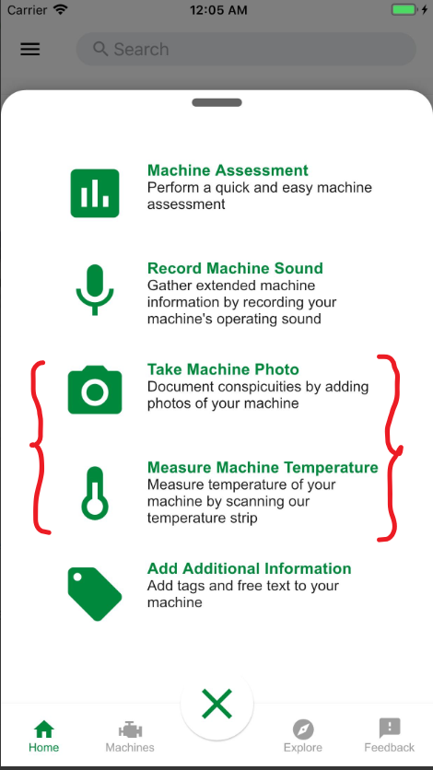
Our Approach:
- Use smartphone camera to take a photo of the temperature strip
- automatically detect the temperature degree without any additional UI
- Avoid reading error of measurement with a reliable image detection

Slide 3
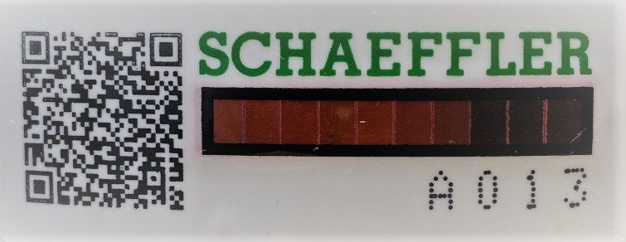
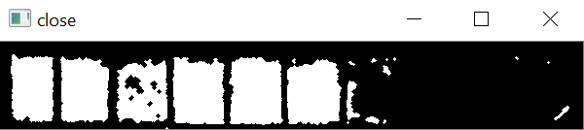
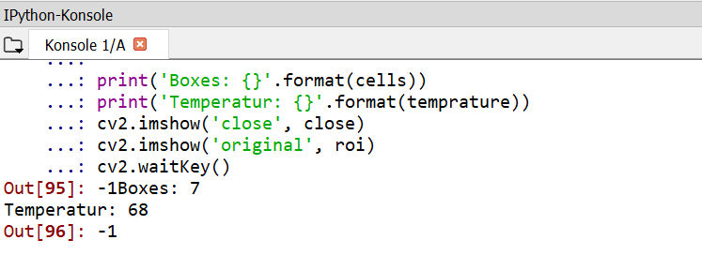
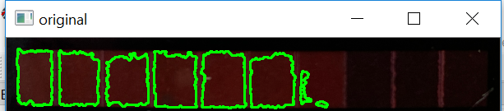
How it works:
Step 1:
Step 3:
Step 2:
Step 4:
Step 3:

Slide 4

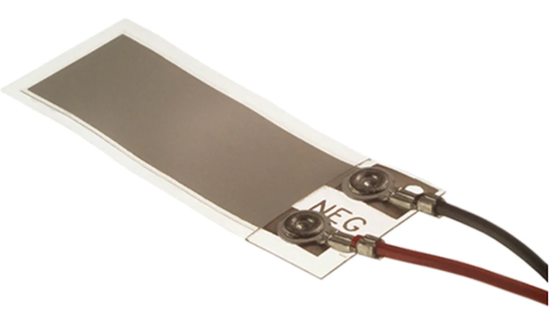
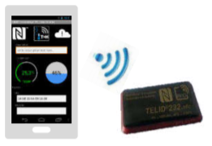
Future improvements:
Further debugging
Vibration detection with LEDs and Piezo-sensor
Usage of RFID Temperature tag

