Slide 1
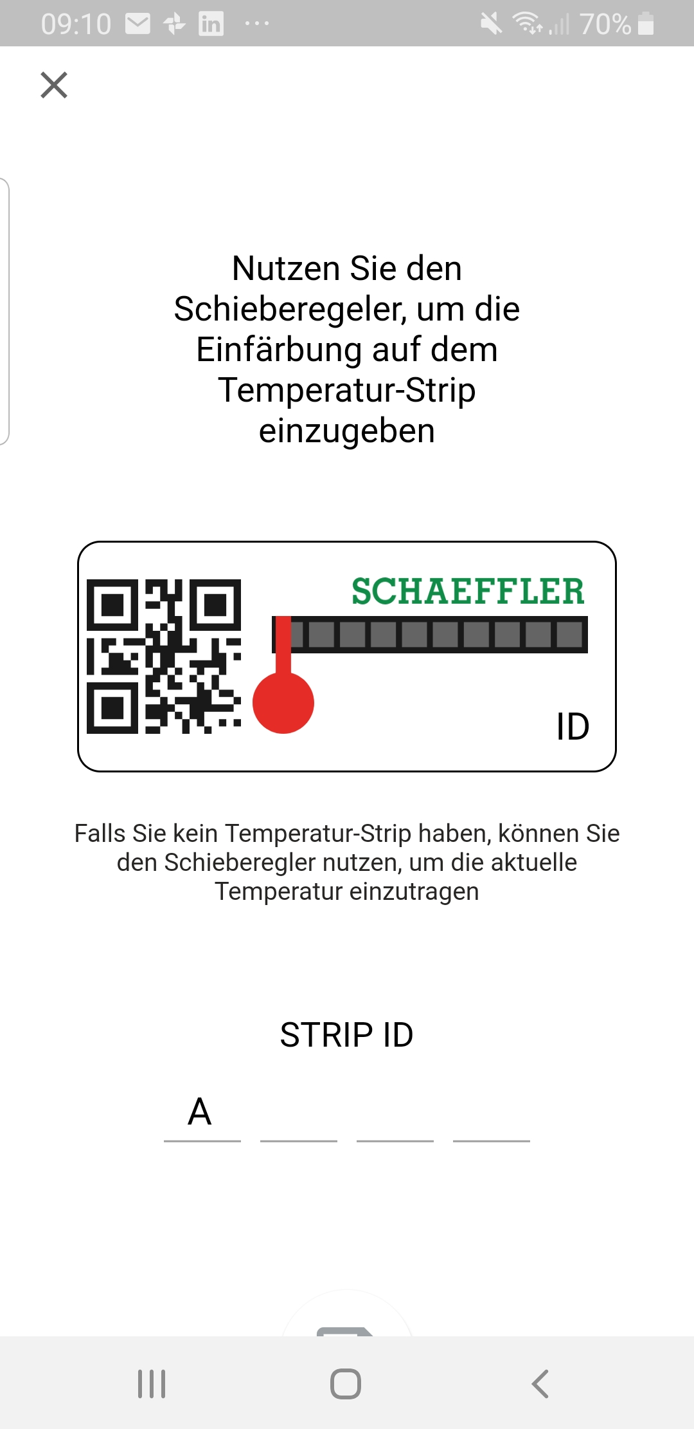
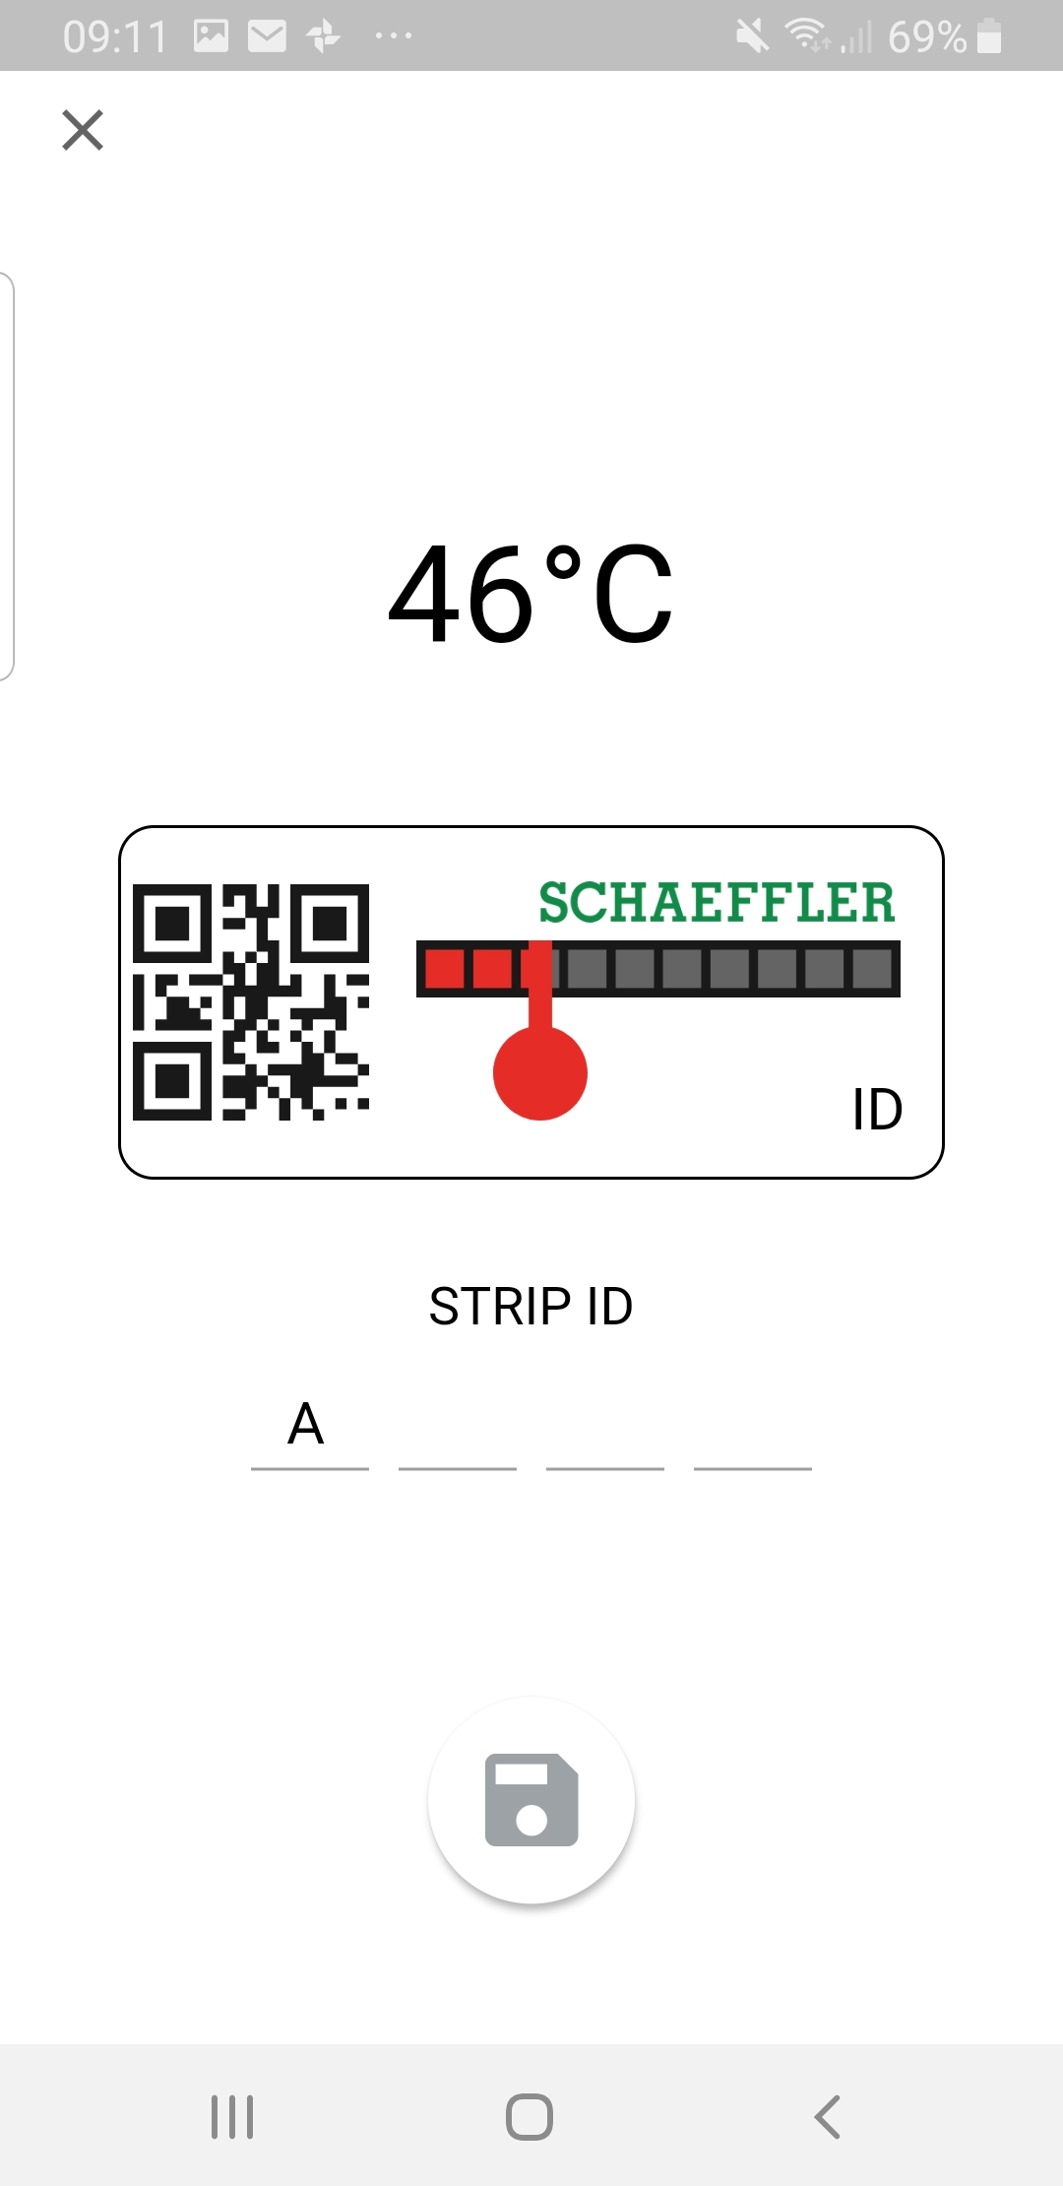
Issues:
User-unfriendly, no automation, error prone

Slide 2
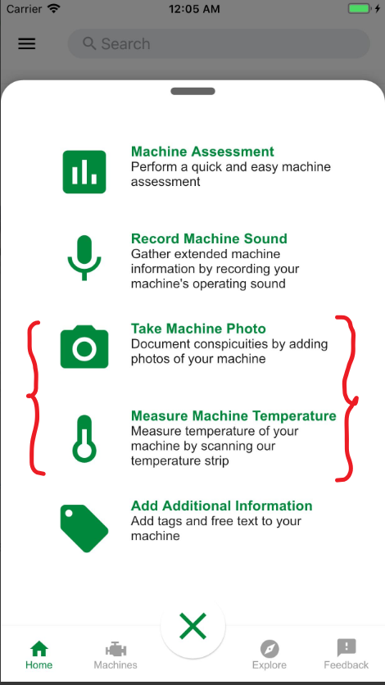
Our Approach:
- Use smartphone camera to take a photo of the temperature strip
- automatically detect the temperature degree without any additional UI
- Avoid reading error of measurement with a reliable image detection

