Slide 1
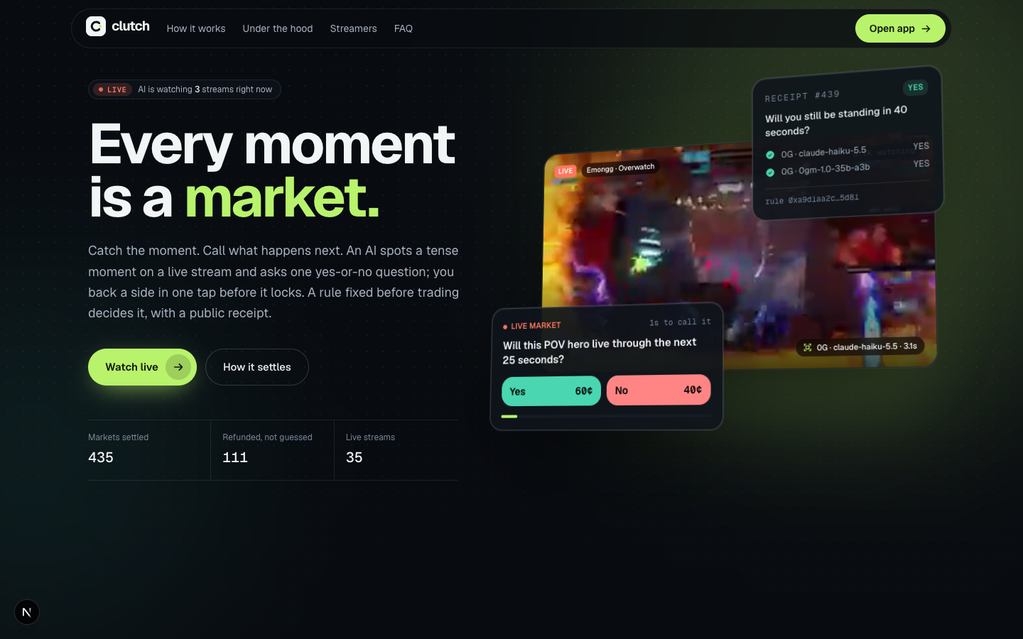
c
clutch.
Every moment
is a market.
An AI watches live streams, opens a yes-or-no market the moment something is about to happen, and two independent models settle it in seconds.
Live on Base Sepolia · github.com/Gravyie/Clutch
UNISWAP V4 · 0G PRIVATE COMPUTER · WORLD ID
Notes:
Hook, ten seconds: millions of people already bet on live streams with Twitch channel points, and the person on camera decides who wins. Clutch lets an AI open the market and two different AIs settle it, with real money and a public receipt.

Slide 2
Viewers already bet on streams. Someone on the stream decides who wins
THE PROBLEM
Twitch Predictions
CRSHMARKET
A habit built into the player. But the streamer writes every question by hand and clicks the winner. Channel points only, one prediction at a time, no proof.
Real money, 60-second markets, $10M+ traded in its first months. The main criticism: people close to the stream can steer outcomes, with no auditable record.
Clutch: nobody on the stream writes the market or calls the result.
Notes:
Demand is proven twice: Twitch built predictions into its player, and CRSHMARKET raised a seed round on 60-second livestream markets. Both share one flaw: someone close to the stream writes the market and decides the result. That is what we remove.

Slide 3
Live attention and live markets are both at records
WHY NOW
31.7B
$50.6B
73%
hours of livestreams watched in Q3 2026, a record
traded on Kalshi and Polymarket in July 2026 alone
of March Madness prediction volume was traded live, during the games
Live, in-the-moment markets are where the volume is, and nobody serves the long tail of live streams.
Sources: Streams Charts, Q3 2026 livestreaming landscape · combined Kalshi + Polymarket monthly volume, July 2026 · Citizens via Blockworks Research
Notes:
Three numbers. People watch more live video than ever. Prediction markets moved fifty billion dollars in one month. And most of that money moves while the event is happening. Nobody serves the millions of live streams outside major sports.

Slide 4
THE SOLUTION
The AI opens the market.
You call it.
Two AIs settle it.
Any Twitch, Kick or YouTube stream, or a Lichess game. 30 to 60 second markets, a public receipt for every result, and nobody on the stream decides anything.
Notes:
The whole product in one line. The streamer does nothing: the AI watches every channel at once, and only opens a market on a number that is on screen and that opponents or chance control.

Slide 5
Life of a market, in about a minute
HOW IT WORKS
1
2
3
4
5
6
Watch
Open
Trade
Lock
Settle
Receipt
A vision model on 0G reads the score, kill feed and every number on the HUD
The agent picks a contested number, fixes the rule and prices it; the rule hash goes onchain
Viewers tap Yes or No; an LMSR curve in a Uniswap v4 hook prices every trade
Trading closes; the window starts after the stream-delay buffer, so nobody bets on what they've seen
A second model family reads its own frames. Agree: pay. Disagree or missing: refund
Rule, both verdicts, frames, 0G request IDs and the evidence root, public
Notes:
Walk the six steps quickly. The two that matter for judges: Lock, because the forward-only window is enforced in the hook, and Settle, because two different model families must agree or everyone is refunded.

Slide 6
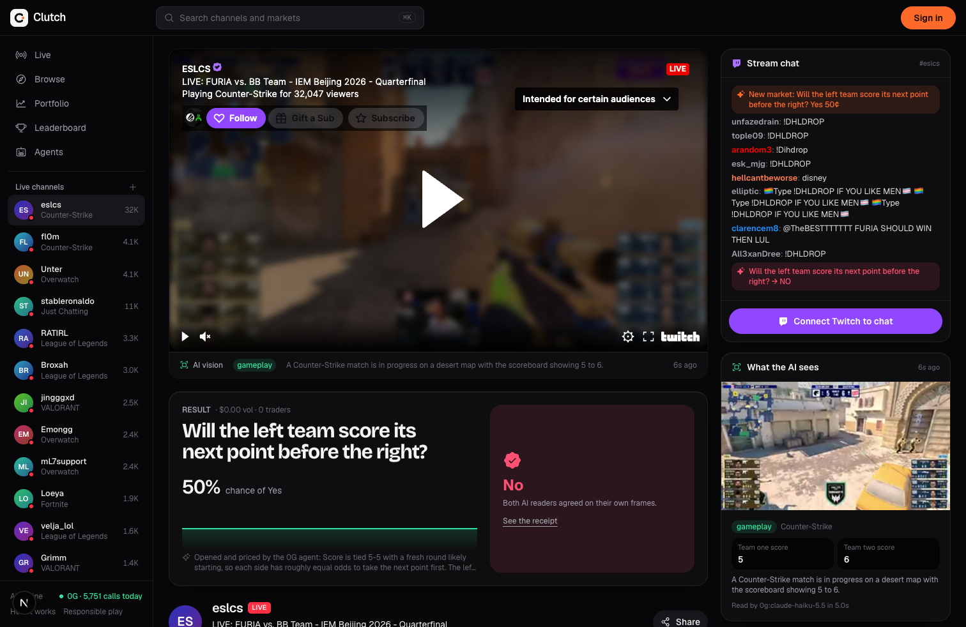
A real market on a real stream
PRODUCT, LIVE
32K viewers
ESL Counter-Strike, IEM Beijing quarterfinal, live on Twitch
5–5 on the scoreboard
The AI read the score and opened “Will the left team score its next point before the right?”
Settled NO
Both readers agreed on their own frames; the market opened and settled inside the stream’s own chat
Notes:
This is a screenshot from our running build, not a mockup. Left: the stream with its market. Right: the streamer's real Twitch chat with our market events inline, and what the AI saw. If the venue network allows, switch to the live app here.

Slide 7
Sign in and you’re trading
THE VIEWER’S FLOW
01
02
03
04
Sign in
Tap Yes
Watch it settle
Get paid
Email, Google or a wallet. A wallet, a starter pass and free test funds appear on their own.
One tap, no pop-up. Paying in ETH swaps and bets in a single transaction.
The panel tracks the live number the market settles on, second by second.
Winnings land in your balance at settlement. Nothing to claim.
Real people get more. One World ID check unlocks free funds every day, a place on the leaderboard and a higher limit, once per person.
Notes:
We studied consumer trading apps like fomo: one balance in dollars, two buttons, no claim step. Everything that isn't needed for the first trade is an upgrade, not a gate.

Slide 8
Fair by construction, not by promise
INTEGRITY
No peeking
No single judge
windowStart < lockTime + latencyBuffer reverts in the hook. A market can’t be about a moment anyone has already seen.
Two model families, separate frames, separate connections. No data means no verdict: the market voids and refunds.
No throwing it
No trust needed
Clutch never opens markets the person on camera controls, like whether they survive. Only scores, rounds and races opponents decide.
Every result has a receipt: the committed rule, both readings, frames, 0G request IDs and an evidence root onchain.
Notes:
This is where we differ from every competitor. No peeking: enforced in the contract. No single judge: two different AIs. No throwing it: we simply don't open markets the streamer controls. No trust needed: every result has a public receipt.

Slide 9
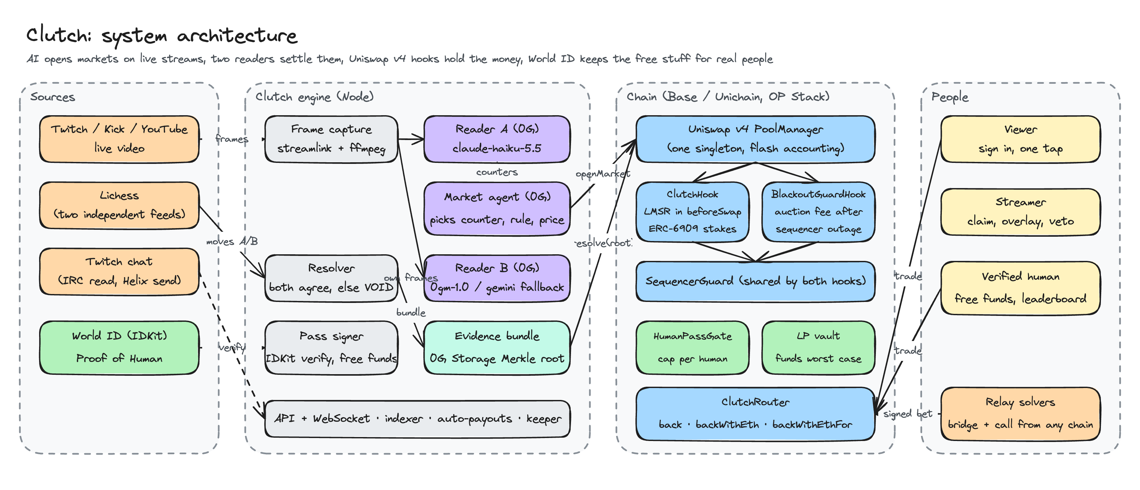
Sources, engine, chain, people
ARCHITECTURE
Notes:
Left to right. The engine captures frames; reader A on 0G lists every number on the HUD; the agent opens a market onchain. Reader B, a different model, reads its own frames, and the resolver settles only if both agree. Onchain, each market is a Uniswap v4 pool behind ClutchHook; both of our hooks share one SequencerGuard.

Slide 10
Every market is a Uniswap v4 pool
UNISWAP V4 · BUILD WITH UNISWAP
ClutchHook
Blackout Guard
One tap from ETH
Replaces the curve with an LMSR in beforeSwap, so a 40-second market has a price at second zero. Stakes are ERC-6909 claims; an LP vault funds the exact worst case up front.
A sequencer-aware fee hook on the ETH/USDC pool: after an L2 outage it runs a 40-block fee auction so LPs keep the stale-price arbitrage. ClutchHook voids any market the outage overlapped.
backWithEth swaps through the Blackout pool and buys shares in the market pool inside one unlock. Flash accounting nets the USDC: no approval, one transaction.
39 Foundry tests · 512-run solvency fuzz · one-tap ETH bet live on Base Sepolia
Notes:
Without v4 we would write custody, accounting and routing ourselves, and nothing would make the funding swap and the bet atomic. The forward-only rule lives in the hook: a market about a moment anyone has already seen cannot even be opened.

Slide 11
The AI is the market maker
0G · BUILD WITH 0G PRIVATE COMPUTER
Reader A (claude-haiku-5.5) reads the HUD and opens markets
Reader B (0gm-1.0, Gemini fallback) settles from its own frames
Viewers “call a market” on their own 0G credits
Every receipt carries the 0G request IDs
11,600+
0G inference calls in one day of testing
< $0.0003
Without 0G, no market ever opens or settles.
per frame read, under a hard daily budget
Notes:
Two different model families, separate frames, separate connections. If a reader has no data, it has no verdict and the market voids with a full refund. The operator can switch platform inference off and on, so credits are only spent while markets are live.

Slide 12
Rewards go to real people
WORLD ID · BEST USE OF IDKIT
What | Any wallet | Verified human
Free test funds | $25, once | $100 every day, per person
Leaderboard | Not ranked | Ranked, all wallets as one
Daily limit | $10 per wallet | $100 per person, enforced onchain
Live streams are watched by people, so the free stuff is for people. Proof of Human is the minimum credential for “has this person had theirs today?” Trading itself only needs a sign-in.
Verified server-side · RP-signed requests · cancel = nothing issued
Notes:
Free stakes and prizes are exactly what bot farms take. One Proof of Human check, keyed by nullifier, gives one daily refill and one leaderboard row per person, however many wallets they use. Demo: ask for starter funds twice, get refused, verify, claim the daily refill. World does not stop rigging and we don't claim it does; market design does.

Slide 13
Running on real streams and a public chain
PROOF
1,900+
1 in 7
40+
markets opened and settled by the agent in testing
voided and refunded instead of guessed
live channels tracked across games and chess
DEPLOYED ON BASE SEPOLIA
ClutchHook 0x6826872452e7Eea21D8a022E8533CEA0F4236888
BlackoutGuardHook 0x3794E8F320449518086cd8dBE9CdD34B20601080
ClutchRouter 0x1B1F8484a4d2D54fFAAC2Ee9AAFb5B2F77352959
Notes:
Our own numbers, on test funds. The voids matter: when the two readers disagree or a frame is missing, everyone gets their money back. That's the design working, not a failure. The contracts are live on Base Sepolia, and a one-tap ETH bet has gone through both hooks there.

Slide 14
WHAT’S NEXT
Base and Unichain mainnet, deposits from any chain via Relay
Chat-to-trade: “!yes 5” in Twitch chat from a linked wallet
Streamers earn a share of every market’s volume
Settlement on independent oracle nodes; evidence on 0G Storage
The next moment is already loading.
github.com/Gravyie/Clutch
TEAM
[Name · role] [Name · role] [Name · role]
Notes:
Close on the live app. The ask: try it at our table. Sign in, and call the next play. Replace the bracketed team names before presenting.

