Slide 1

SMART INDIA HACKATHON 2026
TITLE PAGE
Problem Statement ID – 26164
Problem Statement Title – Enterprise Cryptographic Discovery & Analysis Tool (ECDAT)
Theme – Blockchain & Cybersecurity
PS Category – Software
Team ID – TBD
Team Name – Namo Coders

Slide 2
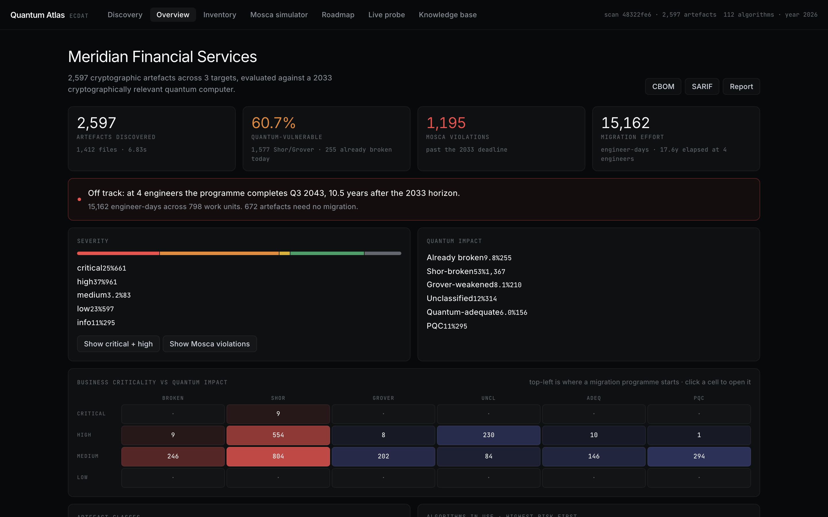
QUANTUM ATLAS — ECDAT
Namo Coders
▸ Clause i — catalogue everything: discovers algorithms, keys, certificates, protocols, libraries, hardware modules and cloud services across apps, products and infra; every finding carries file:line evidence.
▸ Clause ii — quantum risk assessment: 112-algorithm knowledge base classifies Shor-broken / Grover-weakened / safe; Mosca X+Y>Z flags harvest-now-decrypt-later data and systems prone to quantum attack.
▸ Clause iii — classify: every artefact typed by class, lifetime (cert windows → path signals → defaults, capped + disclosed) and business criticality, with Mosca risk categories.
▸ Clause iv — recommend alternatives: constraint-aware advisor proposes PQC / hybrid replacements scored on risk profile, wire/latency and CPU cost across 8 workload profiles.
▸ Deliverables: standardised CBOM report with versions + modes (CycloneDX 1.6, SARIF, Markdown) plus an interactive GUI to visualise scan, risks and results — and a CI gate so new crypto debt is blocked.
Overview: KPIs, severity mix, criticality × impact heatmap — live product

Slide 3
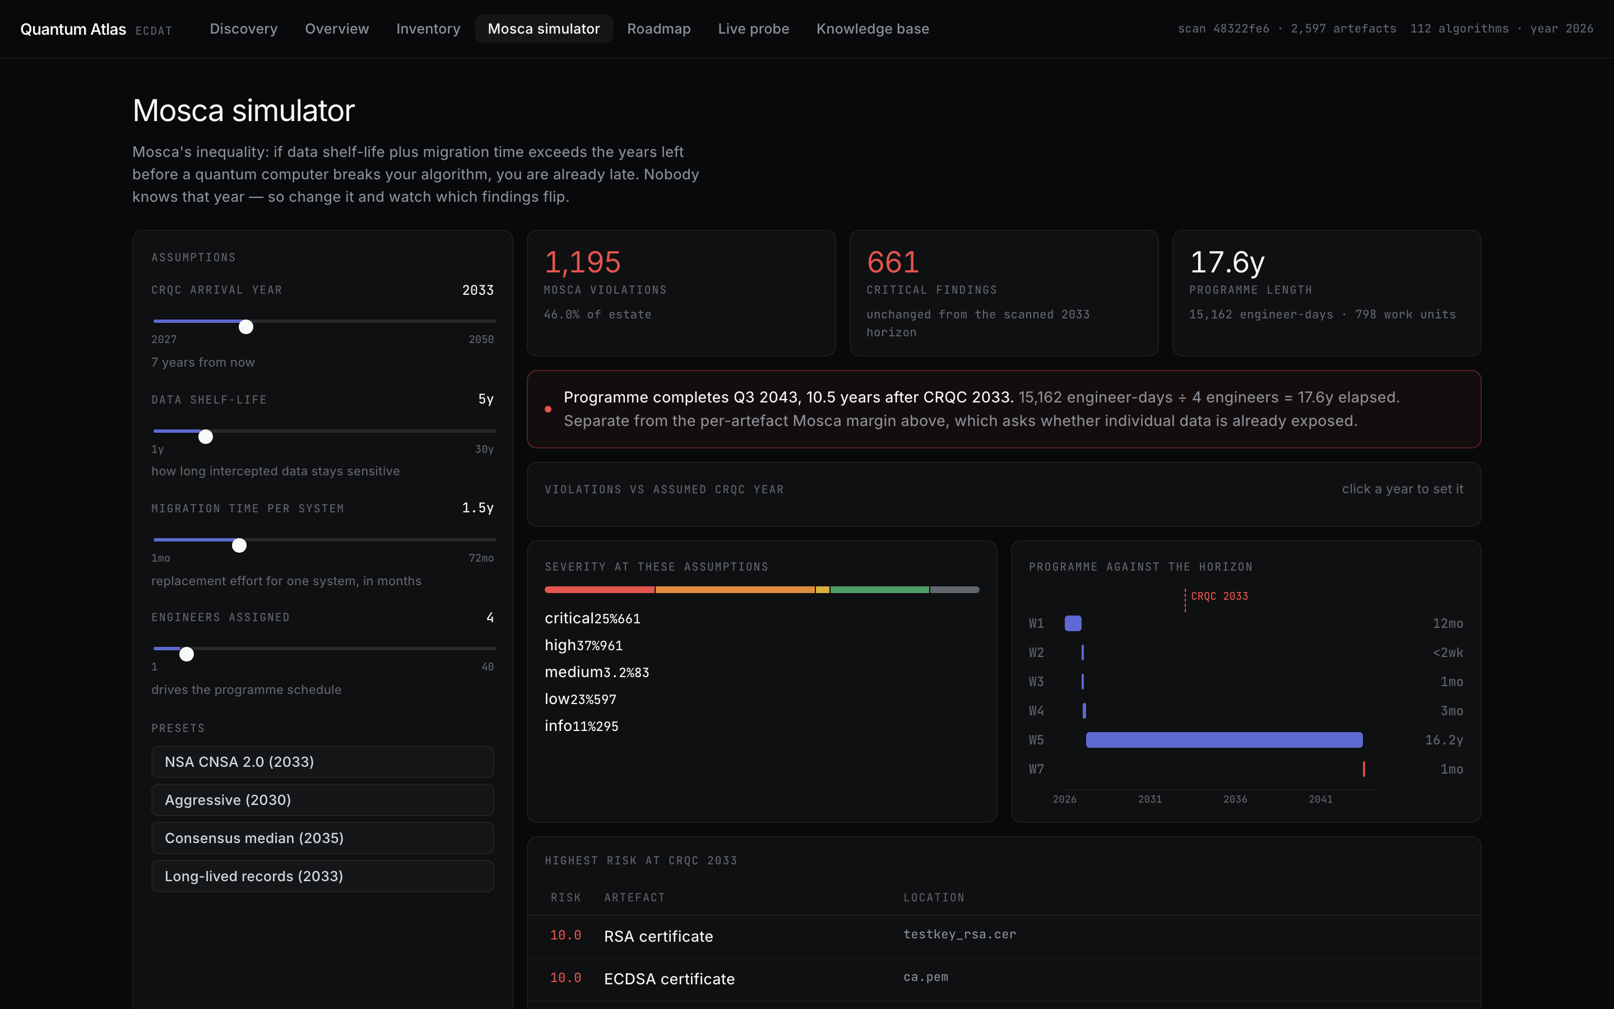
TECHNICAL APPROACH
Namo Coders
▸ Discovery (backend/atlas): Python/FastAPI ScanEngine; 8 scanners — ~90 source regexes over 16 languages, tolerant X.509 + key parsing, manifests/IaC, docker-tar walk (no daemon), binary markers, live TLS prober.
▸ Risk (pure functions): impact → shelf-life → Mosca → 0–10 severity → recommendation; re-simulation over stored JSON, never a rescan.
▸ Console: React 19 + Vite, SSE finding stream, hand-rolled SVG charts; prod bundle served same-origin; CLI (10 cmds) + REST API share the engine.
▸ Quality: 200+ backend tests incl. CycloneDX/SARIF schema conformance; clean typecheck; verified CI exits both ways.
Mosca simulator: sliders, presets, violations curve — live product

Slide 4
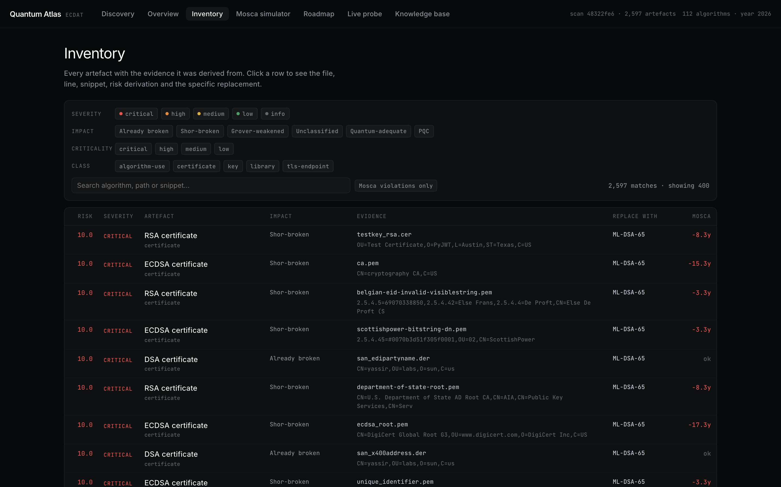
FEASIBILITY AND VIABILITY
Namo Coders
▸ Proven at scale: demo bank estate — 101 artefacts, 34 files, sub-second; real OSS repos (paramiko, pyca/cryptography, pyjwt) — 2,597 artefacts, 1,412 files, 6.8s.
▸ Proven on the wire: cloudflare.com negotiates X25519MLKEM768 hybrid PQC with a classical ECDSA P-256 cert — measured, not assumed.
▸ Risk → mitigation: CRQC date unknowable → simulator + sensitivity curve instead of a hardcoded year; recall limits → tolerant parsers, OID preservation, stated gaps; local-only today → auth + path allow-listing before exposure.
Inventory: faceted artefacts with evidence drawer — live product

Slide 5
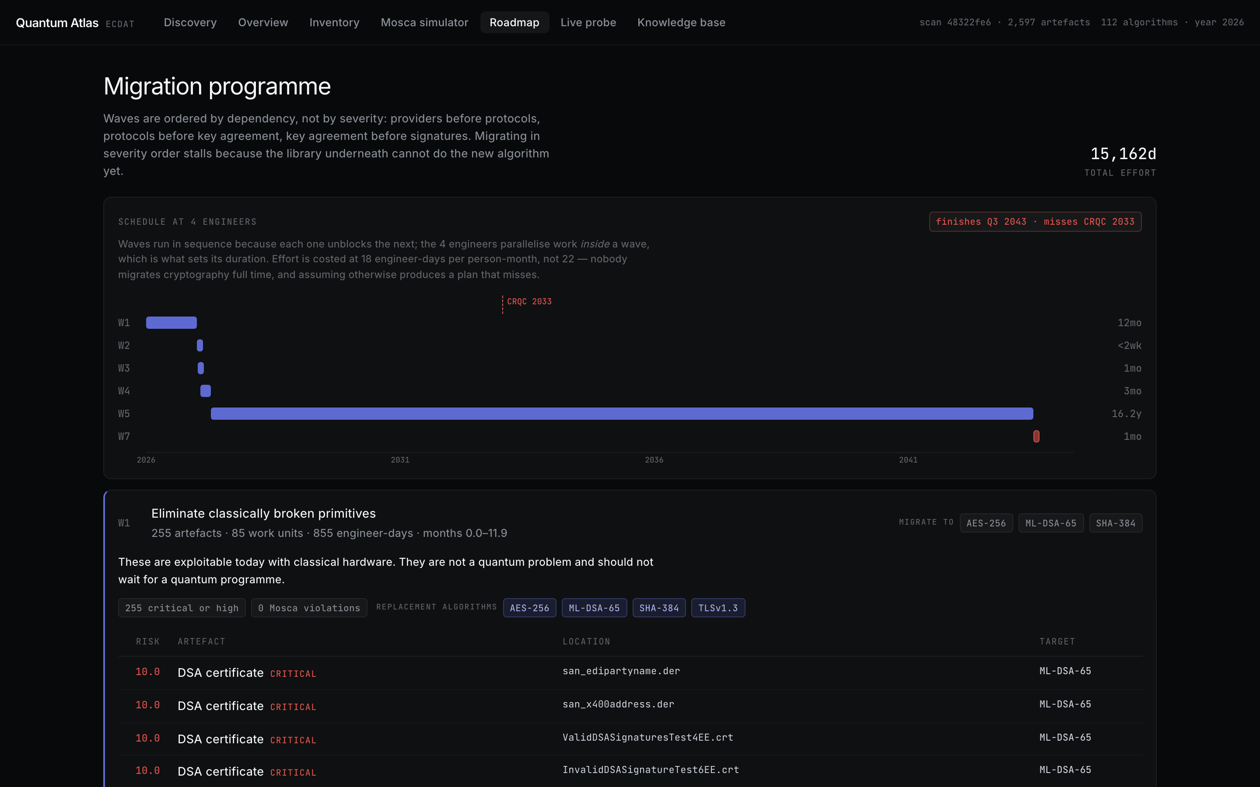
IMPACT AND BENEFITS
Namo Coders
▸ For NTRO / mission estates: estate-wide crypto inventory with per-team attribution; HNDL triage before the CRQC; funded waves with finish-vs-horizon verdicts (demo: 1,443 engineer-days, 10 violations).
▸ Compliance + prevention: assessed against CNSA 2.0, NIST IR 8547, SP 800-131A; CI gate stops new crypto debt; PQC pilot service passes the critical gate.
▸ Strategic benefit: quantum-readiness roadmap for financial and national infrastructure — mythology-free, assumption-explicit, auditable.
Roadmap: dependency-ordered waves vs CRQC horizon — live product

Slide 6
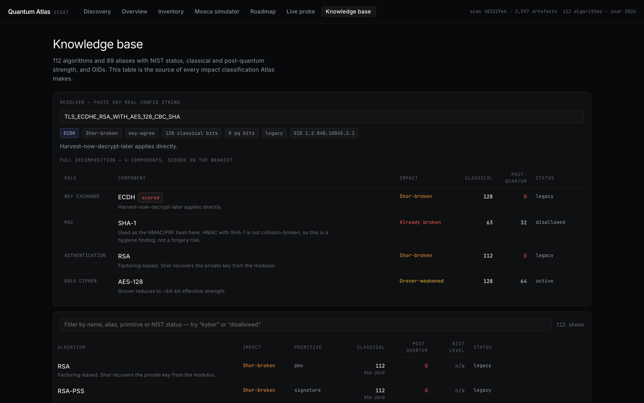
RESEARCH AND REFERENCES
Namo Coders
▸ Threat model: Mosca & Piani — Quantum Threat Timeline (X+Y>Z); NIST IR 8547 (draft); NSA CNSA 2.0; NIST SP 800-131A Rev.2.
▸ PQC standards: FIPS 203 (ML-KEM), FIPS 204 (ML-DSA), FIPS 205 (SLH-DSA); hybrid deployments (X25519MLKEM768) as observed live.
▸ Output standards: CycloneDX 1.6 CBOM (OWASP); SARIF 2.1.0 (OASIS); evaluated code: paramiko, pyca/cryptography, pyjwt.
Knowledge base: 112 algorithms + cipher resolver — live product

