Slide 1
DOCKER
AN INTRODUCTION
https://github.com/Grax32/Docker-Demo
david.walker@bakertilly.com
Notes:
Welcome

Slide 2


OUR FOCUS
Building a local debugging environment
Running container versions of server software such as SQL Server, Redis, etc
Customize the prebuilt containers
Containerize your application
Constructing a local offline network with your application and supporting servers
Notes:
Focus

Slide 3
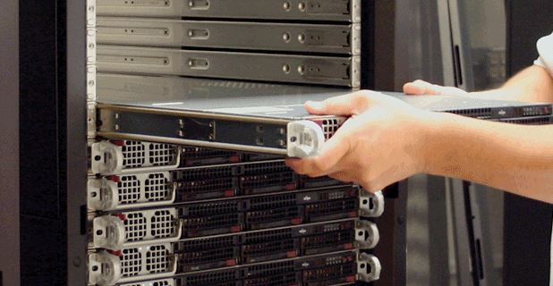
Back in the Dark Ages
This Photo by Unknown author is licensed under CC BY-SA-NC.
Notes:
Hosting on Full Servers: Initially, applications were hosted directly on physical servers.
Each server ran a single operating system, and multiple applications were often hosted on the same server.
This required significant hardware resources and scaling meant purchasing and installing additional servers

Slide 4
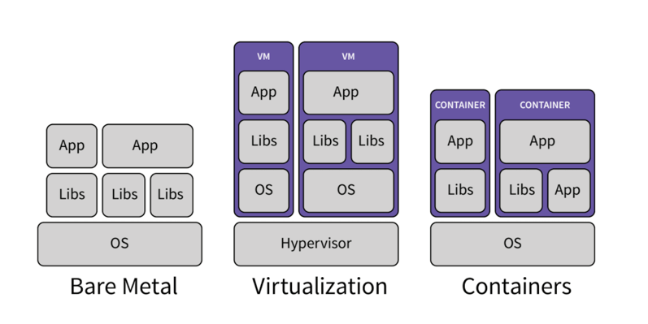
Hosting Options
Dedicated Server (aka Bare Metal)
Virtual Server
Container
Notes:
The next phase was to create virtual machines
Virtual Machines (VMs):
A hypervisor software allowed multiple virtual machines to run on a single physical server, each with its own operating system and application stack.
This provided better resource utilization and isolation between applications, but each virtual machine has significant overhead
Containers: Containers are basically a lightweight form of virtualization.
They package applications and their dependencies into isolated units, called containers, that share the same operating system kernel. The standard kernel for most containers is the Linux kernel, so applications that you want to containerize should run on Linux.
Unlike VMs, containers do not require a separate operating system instance for each application, leading to more efficient resource usage and faster startup times.
Containers are portable and can run consistently across different environments, from development to production. It is possible to build an image once and copy it to environments for testing purposes and then deploy the same image to production.

Slide 5
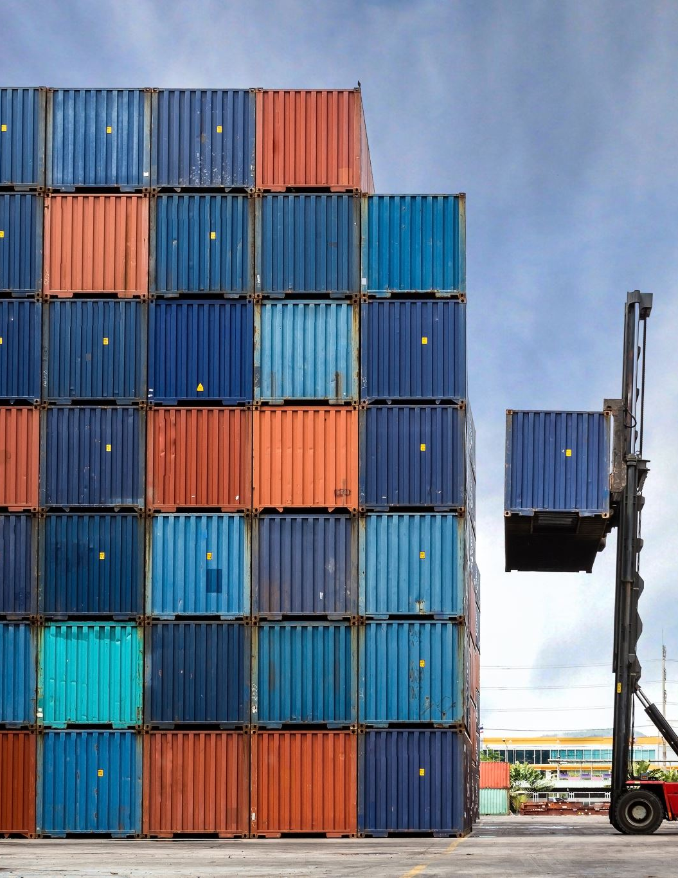
Container
A container is a lightweight, standalone, executable package that contains everything needed to run a piece of software, including the code, runtime, libraries, and dependencies.
Containers are isolated from each other and share the underlying operating system kernel.

Slide 6
Terminology
Container: Everything needed to run a piece of software, including configuration
Image: Combination of layers of files needed to create a container
Network: A set of containers that have connectivity to each other
Cluster: A cluster is a set of nodes that run a containerized application
Notes:
Today we will start by demonstrating how to start containers from available images,
then we will move on to creating images based on existing images,
We will then create images based on an application we have developed
And the we will create and start up a network consisting of our application and a database server
Because the focus today is on the desktop, we aren’t going to touch clustering or cloud topics except to say that once you create an image, it contains everything needed to run your application.

Slide 7

Desktop Solutions
Docker Desktop
Rancher Desktop
Notes:
My client is very committed to Docker both in the development environment and their hosted environment.
On the client machine, I have a Docker Desktop license and we use Docker Desktop during the development process.
Installing Docker Desktop is just a download and install process and is free for private individuals but use by companies with more than 250 employees requires a paid license.
Tom Puch brought to my attention that Rancher Desktop is also available and free. I haven’t had the opportunity to try it, so today we will be focused on Docker Desktop.

Slide 8
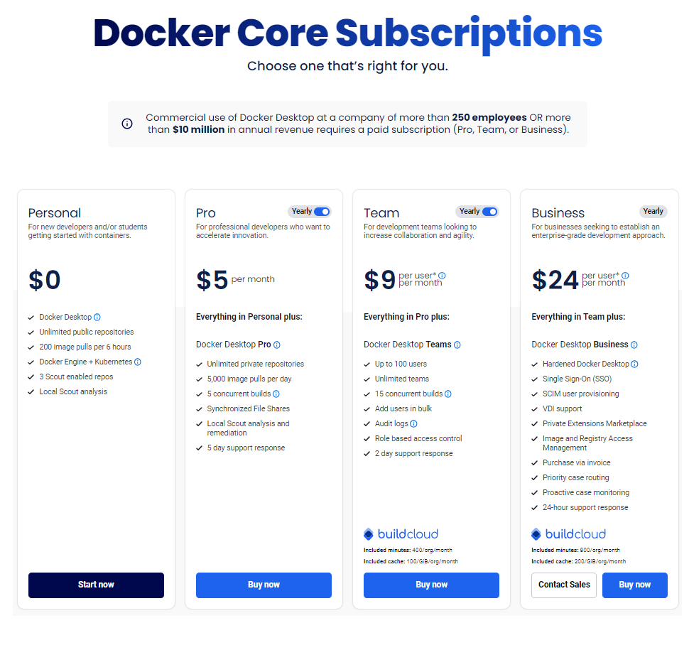
Notes:
Basic point is, the docker desktop people want money

Slide 9
Run SQL Server
C:\> docker pull mcr.microsoft.com/mssql/server:2022-latest
C:\> docker run -e "ACCEPT_EULA=Y" -e "MSSQL_SA_PASSWORD=YourStrong@Passw0rd" -p 1433:1433 --name sql1 --hostname sql1 -d mcr.microsoft.com/mssql/server:2022-latest
Notes:
I’m sure that many of you recall the process of installing SQL Server either on your local machine or on a dedicated server for development tasks.
However, with Docker images, the need for manual installation is eliminated.
There's no requirement for additional installations, no need for system reboots, and you don't need to use the same instance of sql server for multiple purposes
In fact, you might find you want to run Sql Server 2019 for one project and Sql Server 2022 for a different one.

Slide 10
Create your own SQL Server Container
# Use the SQL Server 2022 base image from Microsoft
FROM mcr.microsoft.com/mssql/server:2022-latest
# Set the environment variables for SQL Server
ENV ACCEPT_EULA=Y
ENV MSSQL_SA_PASSWORD=YourStrongPassword99@
# Create a directory for SQL scripts
WORKDIR /usr/src/sql
# Copy the SQL file to the container
COPY initialize-my-database.sql .
COPY --chmod=+x init-db-during-build.sh .
USER mssql
# Start the db server and run the SQL script
RUN ./init-db-during-build.sh
# Expose the SQL Server port
EXPOSE 1433
# Start SQL Server when the container starts
ENTRYPOINT [ "/opt/mssql/bin/sqlservr" ]
dockerfile

Slide 11
Create your own SQL Server Container
C:\dev\docker-demo\ms-sql-server> docker build . -t custom-sql-server
C:\dev\docker-demo\ms-sql-server> docker run -d --name custom-sql-server -p1492:1433 custom-sql-server
Notes:
docker build
The dot refers to the current directory. Docker will look in this directory for a dockerfile and this will be the working directory that files are copied from into the docker image we are building
The dash T lets us mark the image with a tag so that we can find it later to run or delete

Slide 12

What is the command used to build a Docker image from a Dockerfile?
docker create
docker run
docker build
docker compose
docker pull

Slide 13
Containerize your Application
dockerfile
FROM mcr.microsoft.com/dotnet/sdk:8.0 AS build-env
WORKDIR /App
# Copy everything
COPY . ./
# Build and publish a release
RUN dotnet publish web-site.csproj -c Release -o out
# Build runtime image
FROM mcr.microsoft.com/dotnet/aspnet:8.0
WORKDIR /App
COPY --from=build-env /App/out .
ENTRYPOINT ["dotnet", "web-site.dll"]

Slide 14
In general, your app needs to run on what operating system to work in a Docker image?
Windows
Linux
OS/2
AmigaOS
Stryker

Slide 15
Compose a Network
version: "2.1"
services:
ms-sql-server:
build:
context: ./ms-sql-server
dockerfile: ./dockerfile
ports:
- 1438:1433
web-site:
build:
context: ./web-site
dockerfile: ./dockerfile
ports:
- 9000:8842
docker-compose.yml

Slide 16
Compose a Network
C:\dev\docker-demo> docker compose build
C:\dev\docker-demo> docker compose up
Notes:
Connect to http://localhost:9000 to show web
Connect to localhost,1438 to show data
The other thing to note is that I used the same image for in our command earlier but with a different port number, so we actually are running 2 sql servers with the same data, but on different ports

Slide 17
Where can I run docker images (check all that apply)?
Windows Desktop
Linux Desktop
AWS
Azure
Google Cloud
Raspberry Pi
All of the above

Slide 18
Questions?

