Slide 1
Estimate Trajectory Duration of Industrial Robot Arm with Machine Learning

Slide 2
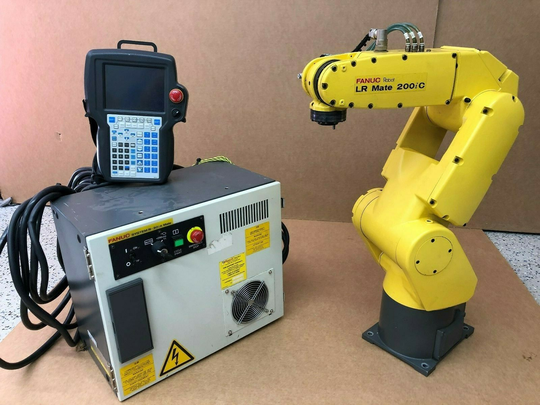

Slide 3
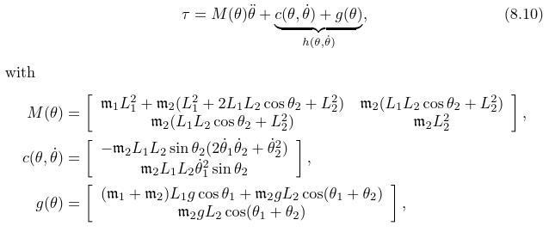
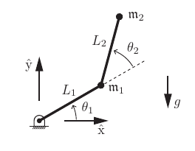
Dynamics equations

Slide 4
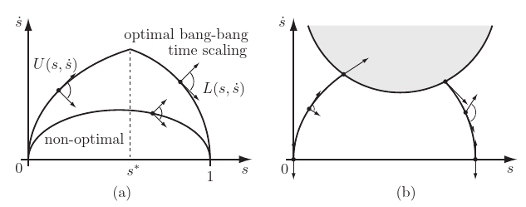
Time optimized trajectory

Slide 5
Basics about the project
Data from real robots, organized and cleaned before using.
Using pytorch
12 Input
1 Output
Mean Absolute Error

Slide 6
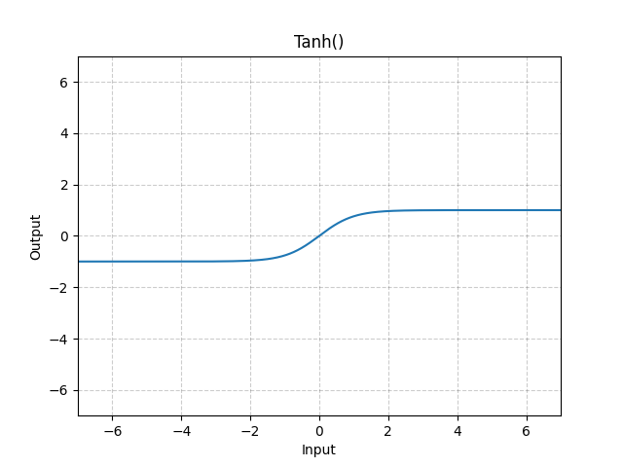
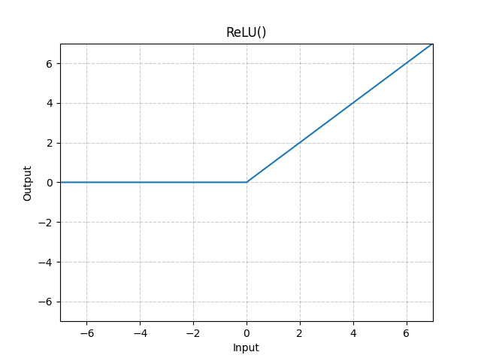

Slide 7
Linear only
(0): Linear(in_features=12, out_features=24, bias=True)
(1): Linear(in_features=24, out_features=18, bias=True)
(2): Linear(in_features=18, out_features=8, bias=True)
(3): Linear(in_features=8, out_features=1, bias=True)

Slide 8
Adding Tanh
(0): Linear(in_features=12, out_features=56, bias=True)
(1): Tanh()
(2): Linear(in_features=56, out_features=50, bias=True)
(3): Tanh()
…
(16): Linear(in_features=20, out_features=15, bias=True)
(17): Tanh()
(18): Linear(in_features=15, out_features=10, bias=True)
(19): Tanh()
(20): Linear(in_features=10, out_features=1, bias=True)

Slide 9
Tanh with ReLU
(0): Linear(in_features=12, out_features=56, bias=True)
(1): Tanh()
(2): Linear(in_features=56, out_features=50, bias=True)
(3): Tanh()
…
(16): Linear(in_features=20, out_features=15, bias=True)
(17): Tanh()
(18): Linear(in_features=15, out_features=10, bias=True)
(19): ReLU()
(20): Linear(in_features=10, out_features=1, bias=True)

Slide 10
Mix in LeakyReLU
(0): Linear(in_features=12, out_features=66, bias=True)
(1): Tanh()
(2): Linear(in_features=66, out_features=59, bias=True)
(3): Tanh()
(4): Linear(in_features=59, out_features=53, bias=True)
(5): LeakyReLU(negative_slope=0.01)
(6): Linear(in_features=53, out_features=47, bias=True)
…
(17): Tanh()
(18): Linear(in_features=17, out_features=11, bias=True)
(19): ReLU()
(20): Linear(in_features=11, out_features=1, bias=True)

Slide 11
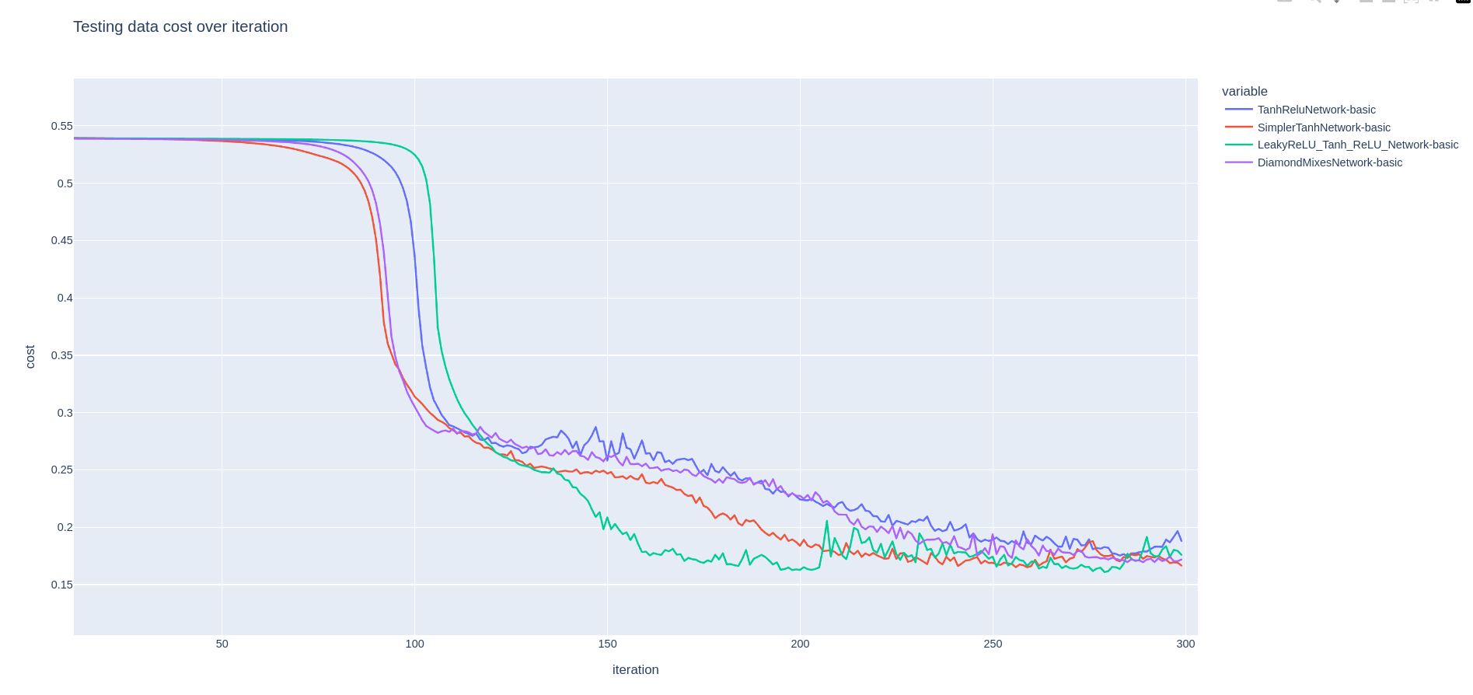

Slide 12
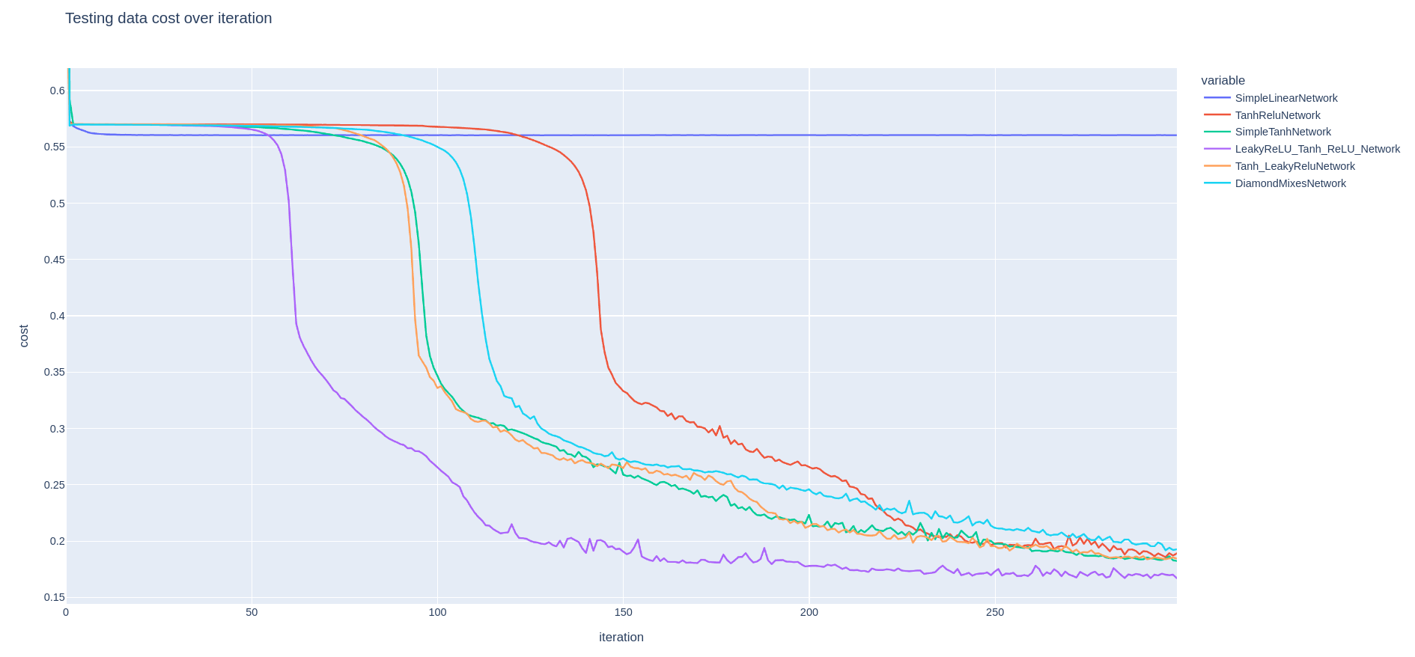

Slide 13
Conclusion
The machine learning approach can certainly generate useful prediction for motion duration.

Slide 14
Future works
Using larger datasets with more complex models.
Adding feature transform to input.

