Slide 1
Data Fest Report

Slide 2
## [1] 10007 185 ## DATE STATUS QLANG DEM_GENDER DEM_AGE ## 1 2017-09-28 18:13:25 3 1 1 18 ## 2 2017-10-18 18:46:34 3 1 1 18 ## 3 2017-09-29 06:58:50 3 1 1 24 ## 4 2017-10-03 17:58:19 3 1 1 16 ## 5 2017-10-25 21:09:49 3 1 1 21 ## 6 2017-10-17 07:03:58 3 1 1 23

Slide 3
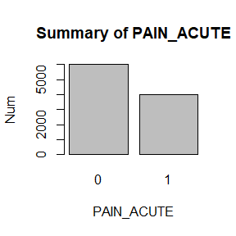

Slide 4
## 0 1 ## 6006 4001

