Slide 1
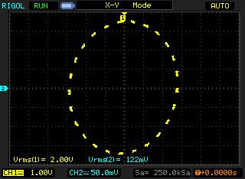
b=174mV
a=2.90V

Slide 2
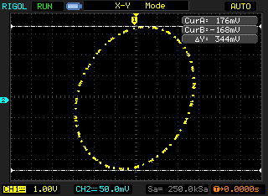
b=172mV
a=2.90V

Slide 3
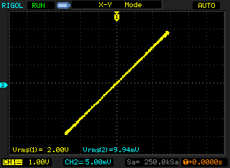
b=14.5mV
a=2.90V

