Slide 1
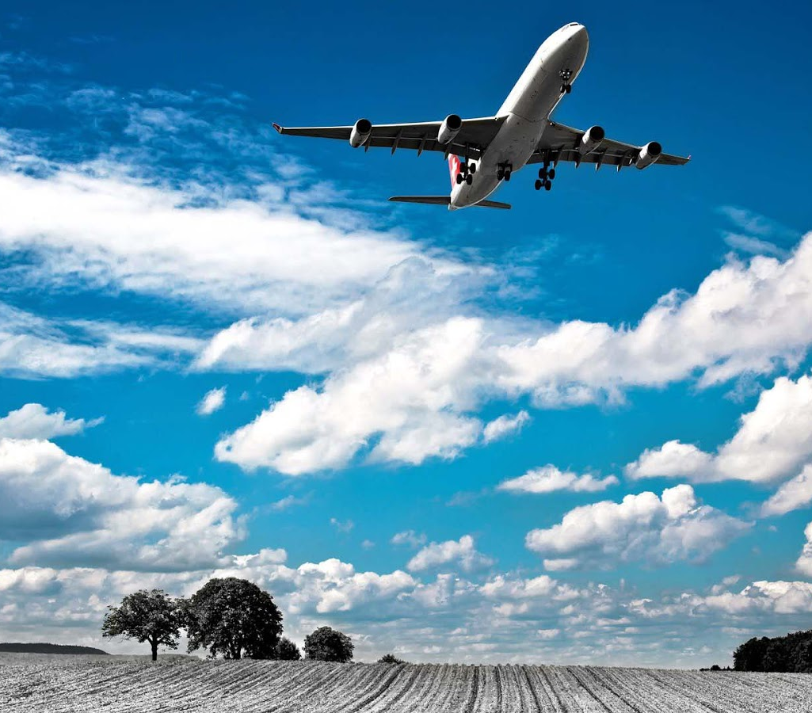
Airline Satisfaction
Presented by Aidan Erickson
This Photo by Unknown Author is licensed under CC BY-NC-ND

Slide 2
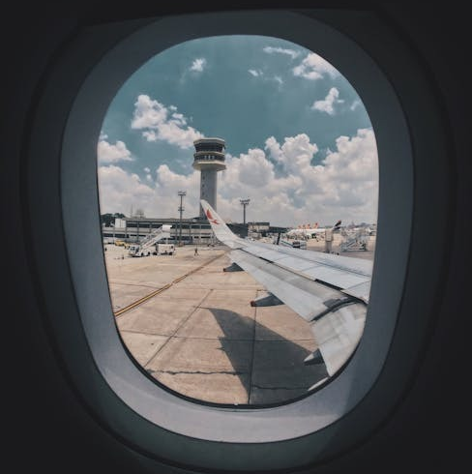
Agenda
Business Problem
Predictive Modeling
Initial Findings
Model Results
Model Validation
Roadblocks
Conclusion & Next Steps

Slide 3
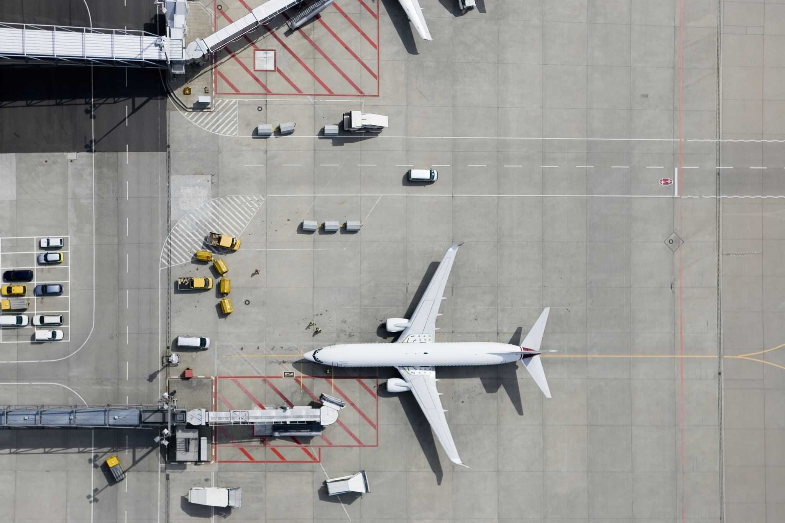
Business Problem
Customer dissatisfaction will lead to reduced service usage, a declining share mix, and revenue losses
Ho (null): There’s no significant relationship between arrival or departure delays and customer satisfaction.
Ha (alt): Arrival or departure delays negatively impact on customer satisfaction.
Ho2: There’s no significant difference in satisfaction among the customer classes.
Ha2: Customer satisfaction differs among the three classes.

Slide 4
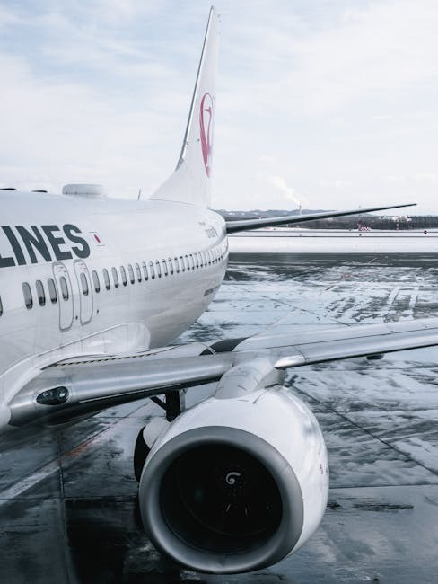
Predictive modeling
Linear Regression:
Determines which variables will predict customer satisfaction
Binary Logistic Regression:
Predicts likelihood of a customer being satisfied or not
Helps prioritize improvements for independent variables
Notes:
Logistic regression will help us address the business problem by answering these questions
Will arrival or departure delays have a greater impact?
Which classes are more satisfied?

Slide 5
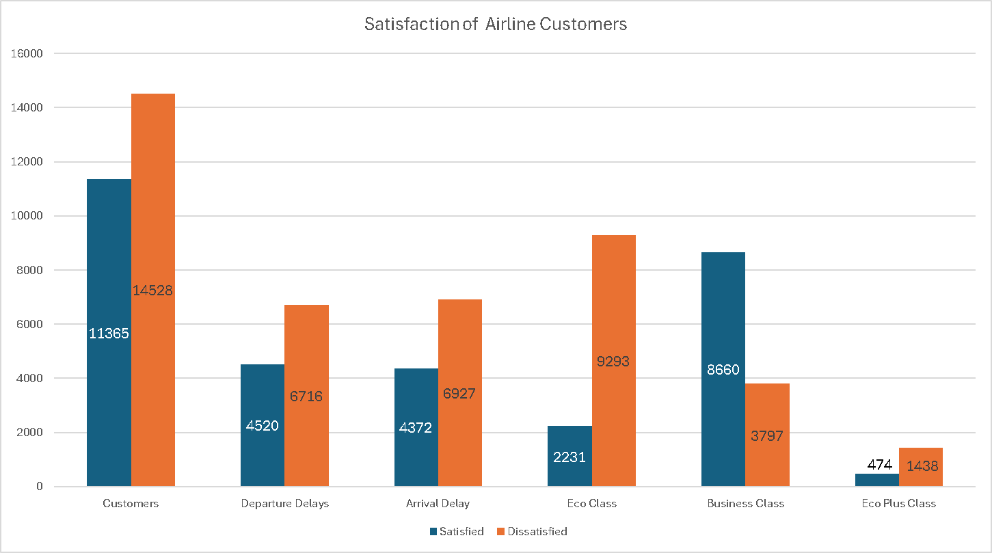
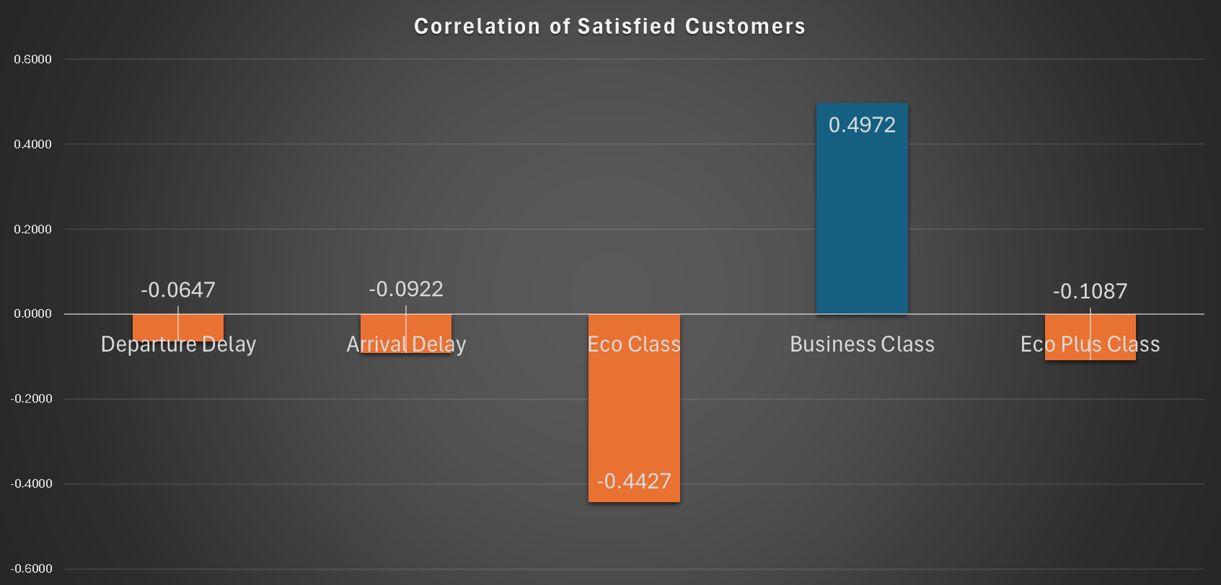
Initial Findings
Count Chart
Business class is the most satisfied
Eco and Business class make up ~92% of customers
Correlation Chart
Arrival delay has a greater effect on dissatisfaction than departure
Eco and Eco Plus classes are generally dissatisfied
Classes have a larger influence than delays
Notes:
Quickly looking at the data before inputting it into thebinary logistic regression model we see that…
The Eco class has the greatest dissatisfaction, and the business class has the most. They make up 92% of the customers
Over half the custoemrs are dissatisfied
Compared to the delays, classes have a greater influence on satisfaction

Slide 6
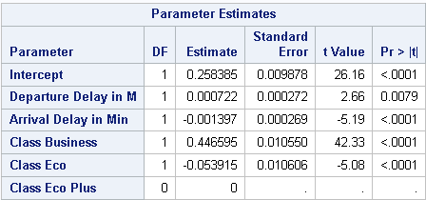
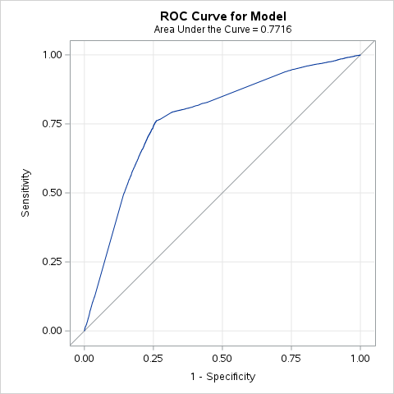
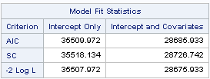


Model Results
Notes:
Linear regression:
P-values indicate that all the independent variables are significant besides departure delays
“The intercept represents the predicted outcome for an Eco Plus passenger with zero delays. If the passenger is in Business class instead, the predicted outcome increases by 0.44 units, all else equal.”
The AIC for the intercept and covaraites being lower than the intercept only, indicates that the independent variables are good predictors for satisfaction
- With an AUC of 77.16%, this model correctly classifies 77% of the random outcomes

Slide 7

Model Evaluation
AIC (generally lower is better)
- Intercept: 35509
- Intercept & Covariates: 28685
AUC (Area Under the Curve)
- An AUC between 0.7-0.8 indicates good discrimination
Correct vs Best model?
Addresses hypotheses
AIC can be improved
It does indicate that the independents are good predictors
Notes:
AIC:
Generally a lower AIC score indicates that the model is better than just the dependent variable.
The independent covariates are meaningfully improving the models ability to predict satisfaction (the independent variable)
AIC can be improved by finding other meaningful predictors.
AUC indicates model is performing well. It’s reliable enough to support decisions.

Slide 8
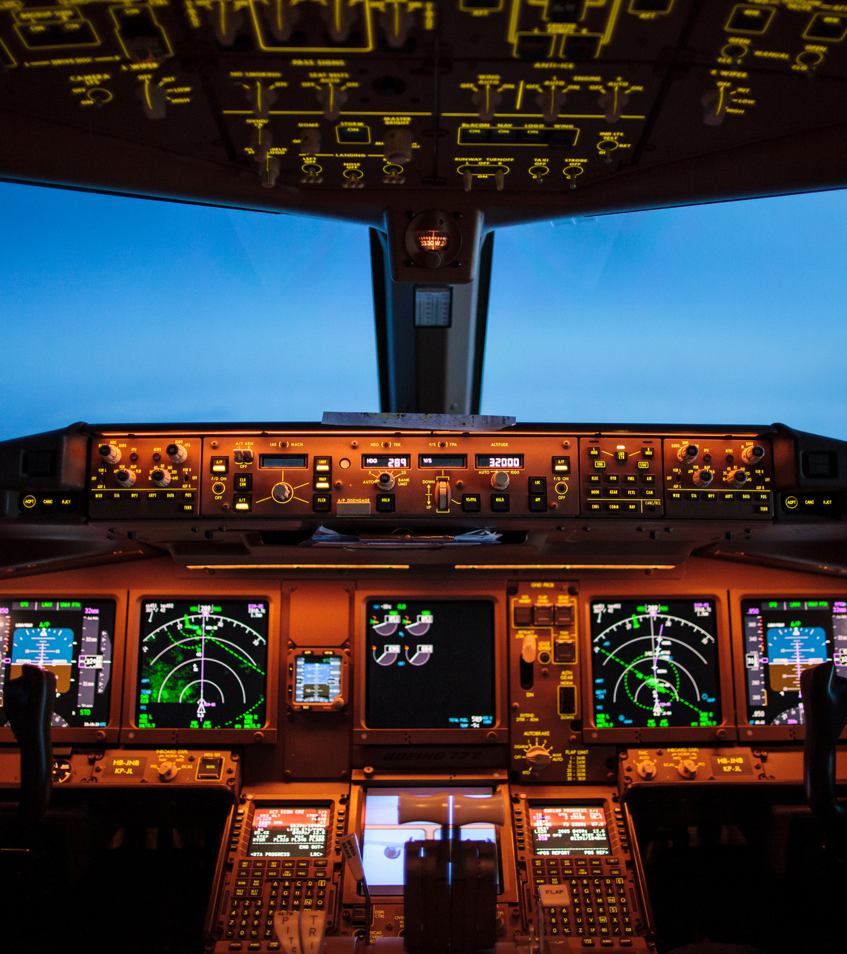
Roadblocks & Considerations
Adding more variables?
Including rows with missing values?
Multicollinearity
Notes:
Adding more variables for the sake of improving the model? Even though it doesn’t address the hypotheses. Best model vs Correct model
Including the results from linear regression when they were the same conclusions as binary logistic regression.
When two variables such as delays are highly correlated or similar they can make it difficult to determine the individual effect of each predictor on the outcome, leading to unreliable or unstable coefficient estimates.

Slide 9
Conclusion
Next Steps
Implementation Recommendations
Improve experience for Eco Plus class
Focus on remedies for minimizing delays, prioritize minimizing arrival vs departure delays
Start recording returning customers versus new customers
Create A/B testing to address class differences, delays, and staff training
Increase staff training to have a greater impact on Eco Plus customers
Test different approaches to communicating delays
Extending departure delay vs having an arrival delay
Provide a free account to customers to sign up for. Maybe provide rewards as an incentive
Create distinct marketing messages for the three classes
Notes:
Identify what is working well for the business class and implement it with the Eco Plus Class.
Future models will benefit from addressing returning customer

Slide 10

Q & A

