Slide 1
KNN
陈素

Slide 2
KNN
What is KNN Classification
The Way it Works
Algorithm & Detail Process
Advantages & Disadvantages
Homework

Slide 3
What is KNN Classification
The K-nearest-neighbor (KNN) algorithm measures the distance between a query scenario and a set of scenarios in the data set.
KNN can be used for both classification and regression predictive problems
Keywords:
Lazy Learning
Instance-based Learning
Supervised Learning
Required:
An integer K
A set of labeled examples (training data)
A metric to measure“closeness”

Slide 4
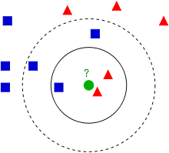
The Way it Works
Let’s take a simple case to understand this algorithm.
From Wikipedia:
if K==3:
belong to
if K==5:
belong to

Slide 5
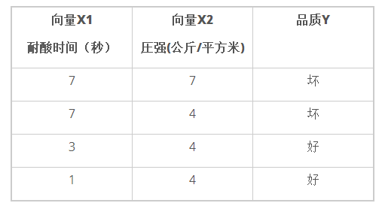
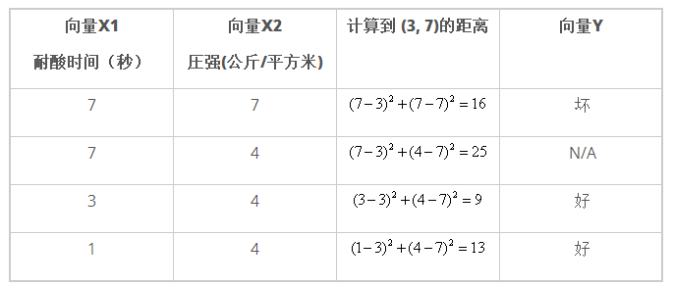
Example
Suppose we need to judge the quality of the paper towel, we can draw out two vectors to measure it.
X1 = 3 and X2 = 7？
(3,7)&K=3

Slide 6
Algorithm
Step1
Determine K
Step2
Calculate the distances between the new input and all the training data
Step5
Determine the category on majority vote.
Step4
Gather the categories of these neighbors
Step3
Sort the distance and determine k nearest neighbors based on the k-the minimum distance

Slide 7
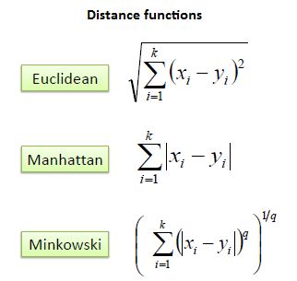
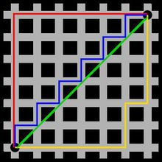
Algorithm
d(i,j)=|x_{i}-x_{j}|+|y_{i}-y_{j}|

Slide 8
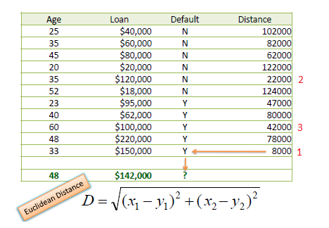
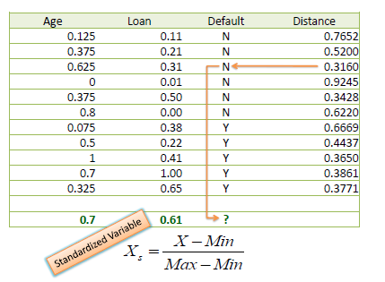
Detail Process
Normalization: v' = （v - v_{min}）/ (v_{max} - v_{min})
K=1

Slide 9
Advantages & Disadvantages
Advantages
Disadvantages
Main disadvantage is a lazy learner, it does not learn anything from the training data and simply uses the training data itself for classification.
For large training sets, requires large memory
Simple algorithm.
Works well on basic recognition problems

Slide 10
Representing Article
Issues
Discriminant Adaptive Nearest Neighbor Classification Trevor Hastie and Rolbert Tibshirani. IEEE TRANSACTIONS ON PAITERN ANALYSIS AND MACHINE INTELLIGENCE, VOL. 18, NO. 6, JUNE 1996 http://www.stanford.edu/~hastie/Papers/dann_IEEE.pdf
K value
Distances function
The weight of training data
Performance problem
Keep the accuracy while reduce the quantity of the training data

Slide 11
Homework
Iris dataset：3 kind of Iris flowers (Setosa, Versicolour and Virginica) with 4 attributes: sepal length, sepal width, petal length and petal width
Training Data(80%)
Accuracy？
Testing Data(20%)
可以参考的工具：python scikit-learn工具包
KNN原理-实现(KD树)：http://blog.csdn.net/dark_scope/article/details/15809445

Slide 12
Homework
下载地址：http://ac.ica.stc.sh.cn/algorithm/Knn.zip
时间：周日晚上24点之前（学号+姓名+编写语言）
提交格式：和training data的数据集格式一样

Slide 13
Q & A

