Slide 1




Antidepressant Prescribing Analysis in England
Using Excel to Analyse NHS Prescribing Data
PRESENTED BY:
ALEXANDRIA NOIKOVITCH
UNIVERSITY OF PORTSMOUTH GRADUATE (2024)
PERFORMED USING EXCEL-LANGUAGE

Slide 2
A DISCUSSION OVERVIEW
This project analysed NHS antidepressant prescribing data from December 2024 across England. The analysis explored prescribing trends, regional variation, and differences between prescribing volume and cost.
Project Aims
Identify the most prescribed antidepressants
Compare prescribing volume and cost
Explore regional prescribing patterns
Generate insights using NHS data
Introduction
&
Project Aims
Dataset:
27 antidepressants
8 NHS regions
1,120 rows of prescribing data

Slide 3

Data Cleaning & Preparation
The dataset was checked and cleaned before analysis to improve accuracy and consistency.
Cleaning Steps:
The data was cleaned, analysed, and visualised using Excel/Google Sheets to create clear insights from NHS prescribing data.
Key Dataset Information:
1,120 rows
6 columns
No missing values detected

Slide 4
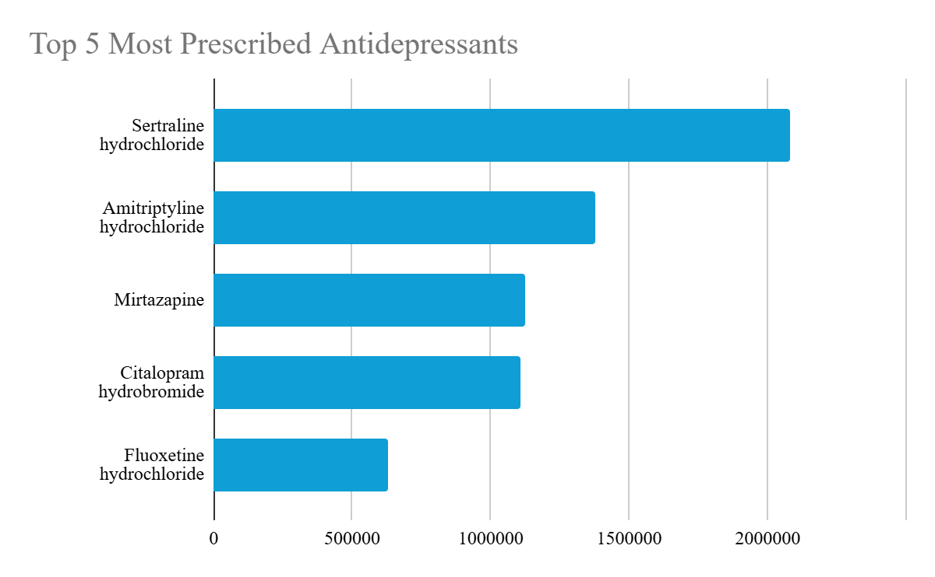
Top 10 Most Prescribed Antidepressants
In December 2024, sertraline hydrochloride was the most prescribed antidepressant in England, with key findings:
• Sertraline had the highest prescribing volume.
• Amitriptyline ranked second.
• A notable drop in prescriptions followed the top five drugs.
Most prescriptions were concentrated among a few antidepressants.

Slide 5

A total of 7.82 million antidepressant items were prescribed nationally during December 2024.
Key Insights:
Antidepressant prescribing levels were very high across England
This highlights growing demand for mental health support
Prescribing data can help the NHS understand healthcare demand and plan resources more effectively
National Prescribing Volume

Slide 6
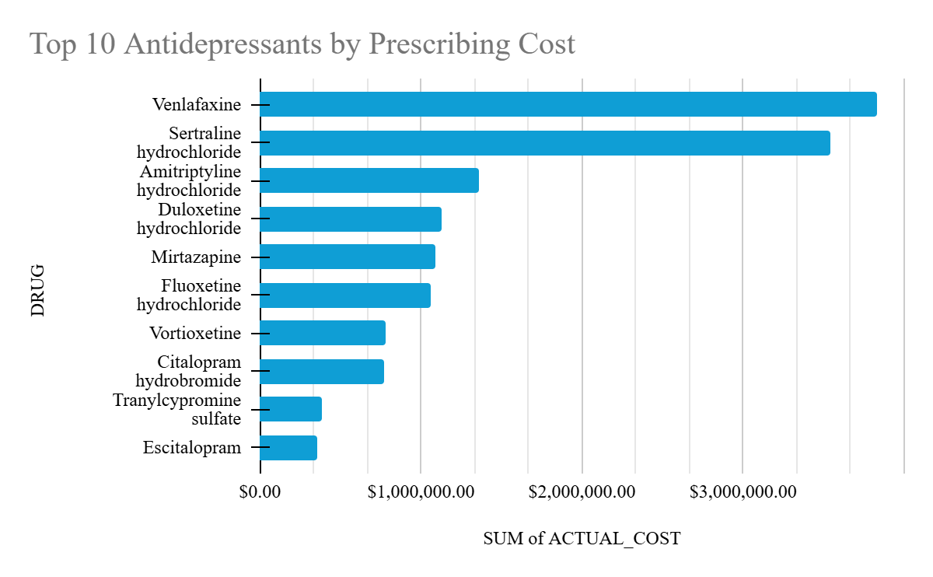
Prescribing Cost Analysis
Some antidepressants are costly despite low usage.
Key Findings:
• Venlafaxine had the highest cost.
• Sertraline showed high usage and cost.
• Costs and usage don't always align.
Key Insights:
More prescriptions don't mean higher costs; some drugs are pricier per prescription.

Slide 7
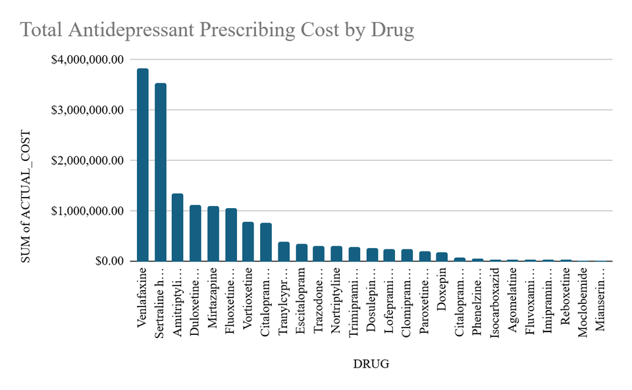
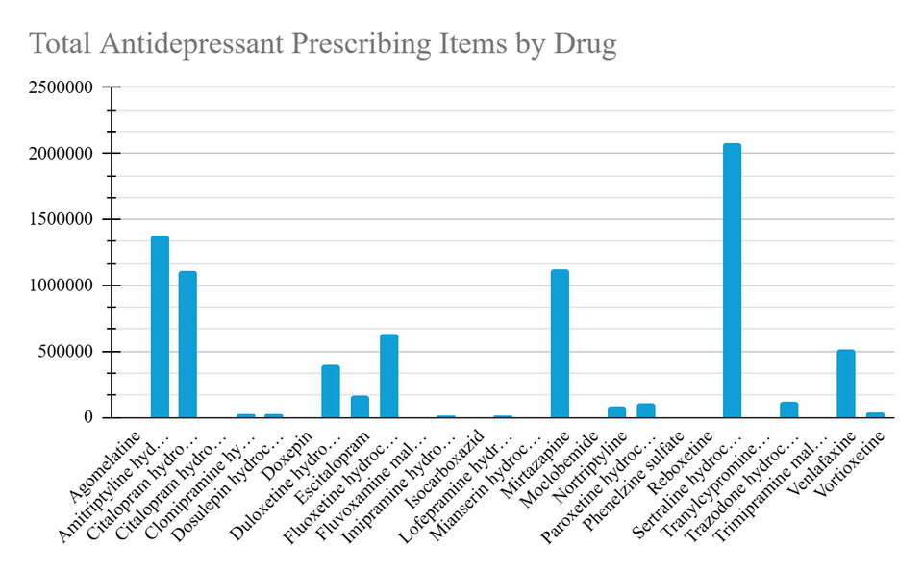
Comparing Prescribing Volume and Cost
The analysis showed variations in antidepressant prescribing volume and cost:
Key Findings:
• High prescription frequency linked to lower costs.
• Some less-prescribed drugs had higher costs.
• Sertraline had both high volume and cost.
Implications:
These findings may affect NHS spending and resource planning due to the significant differences in medication pricing and prescribing patterns.

Slide 8
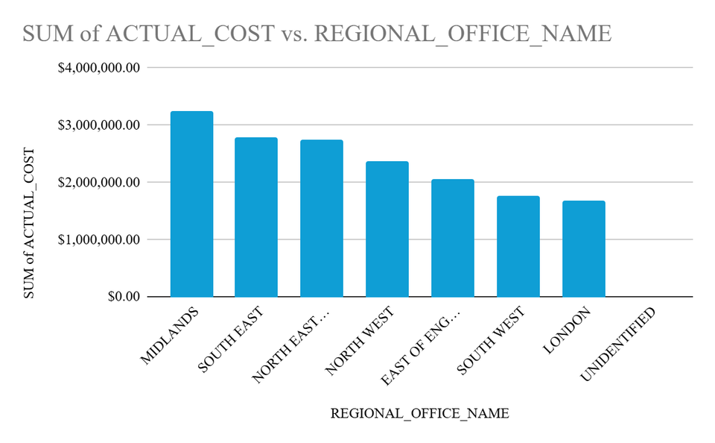
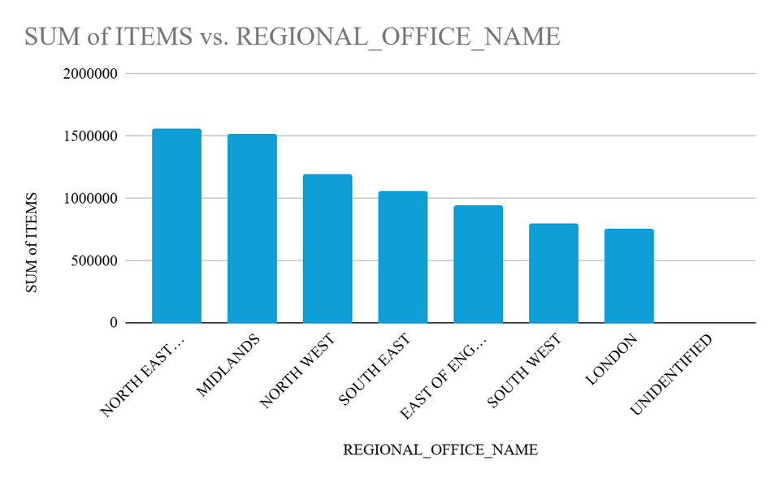
Regional Prescribing Analysis
Antidepressant prescribing in England's NHS varies by region:
Highest volume: North East and Yorkshire
Highest cost: Midlands
Lower totals: London
Regional differences may indicate variations in population size, prescribing practices, and mental health needs.

Slide 9
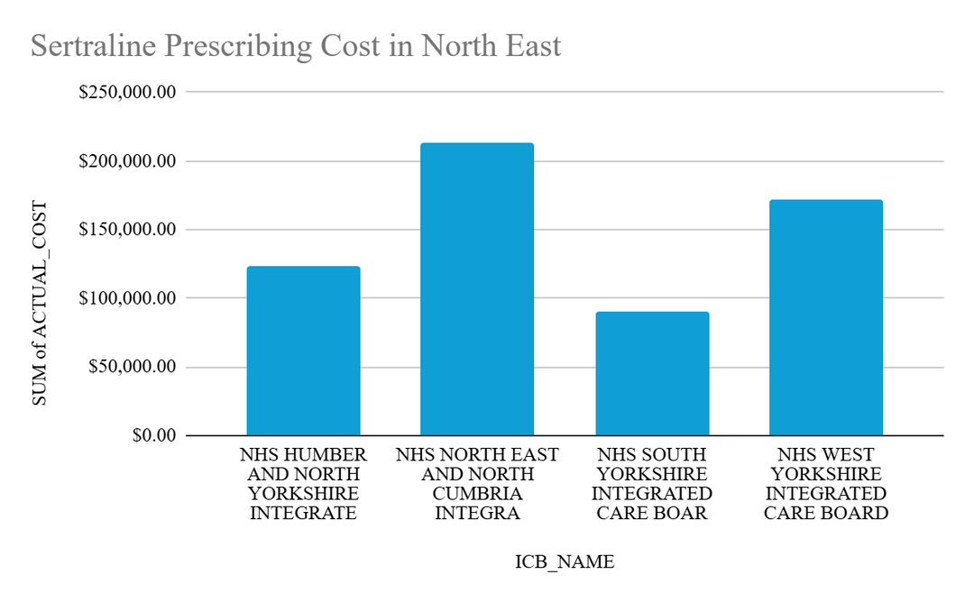
Sertraline prescribing costs in the North East varied among Integrated Care Boards (ICBs), highlighting:
Significant cost differences
Uneven prescribing patterns
Regional variations in NHS activity
Key Insight: NHS prescribing data aids healthcare planning by pinpointing areas with high medication demand and spending.
Sertraline Regional Analysis

Slide 10
Recomendations
MONITOR TRENDS
COMPARE REGIONS
IMPROVE SUPPORT
PLAN RESOURCES
REVIEW COSTS
Continue monitoring antidepressant prescribing trends across England
Investigate regional differences in prescribing volume and cost
Support early mental health intervention services
Use prescribing data to improve healthcare planning and resource allocation
Explore opportunities for cost-effective prescribing where appropriate

Slide 11
Conclusion
This analysis of NHS prescribing data revealed trends in antidepressant use in England. Key findings include:
Sertraline is the most prescribed antidepressant.
Prescribing volume and costs vary among different drugs.
There are regional differences in prescribing across England.
The Midlands has the highest prescribing costs.
Final insight: Healthcare data can guide the NHS in identifying trends, planning, and enhancing patient care.

