Slide 1
CS 4263 Software Engineering I
Dr. Rafal Jabrzemski

Slide 2
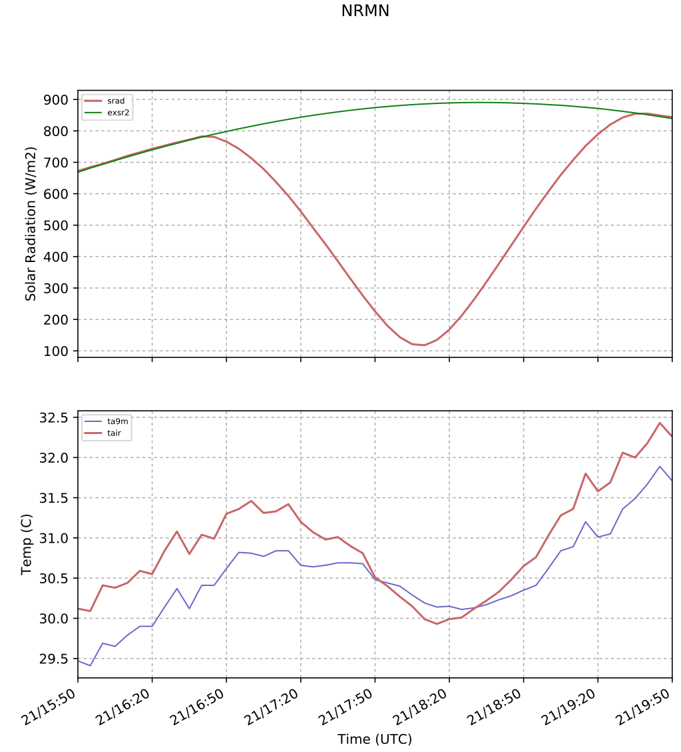

Slide 3
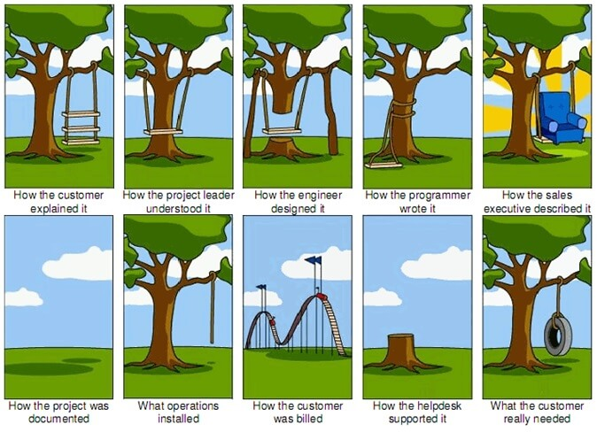
Clipped from:
http://blog.lansa.com/wp-content/uploads/tree-swing-project-management-large.jpg

Slide 4
This Course
Senior Capstone: Software Engineering
1
This course will combine everything you have learned so far and give you a chance to practice Real World development.
2
The goal is to maximize your hiring potential and minimize the number of surprises you encounter on your first job.
3

Slide 5
What you will Learn
How to be a Professional Software Engineer
Project Management Principles
Waterfall
Agile
Real-World Programming
Coding Standards
Design Patterns
How to not get fired or tank a company
Learning New Languages
C#
Software Development Tools
Work/Bug Tracking software
Source Code Management

Slide 6
Expectations
You will arrive at this meeting/class on time every Monday and Wednesday unless directed otherwise by the University.
You will set your own Working Hours along with your team in order to deliver your work on time, which will require 10 – 20 hours per week of work.
I will assign work to each team along with expected delivery dates:
These dates are setup to ensure that the final project can be delivered on time.
Any delays will reduce the scope of the end product and reduce the likelihood of its success.
I expect you to notify me early of any potential delays.

Slide 7
Course Resources
Textbooks:
A Concise Introduction to Software Engineering (Undergraduate Topics in Computer Science) 2008th Edition
by Pankaj Jalote (Author)
Email: Course updates will be sent via email only. You are expected to check your email at least once a day.

Slide 8
School Work
This course will have a certain amount of school work. This work is to be done individually and will follow Academic Misconduct guidelines. Late work will not be accepted for a grade.
Types:
Homework
Homework is for you to assess your understanding of the concepts.
Exams
Exams are clearly not part of a normal work environment, but are required here to ensure each individual has learned the specified material.

Slide 9
Professional Work
This course will also have Projects, which are meant to mimic real-world programming.
Projects are group activities. I expect everyone to work together on this and follow the professional guidelines about using external resources. Specifically:
Do not post anything about your work online. This would breach confidentiality and IP contracts in a real job. (Exception: Github)
Do not use any work from the internet that is not licensed for public use. This would result in your company being sued and potentially losing ownership of your product.
Failing to meet your project deadlines will risk having your project fail when it goes to market. As an intern, this would reduce your chance of getting to work on exciting projects or get a full-time position. As a student, this will reduce your grade.

Slide 10
Grading
Category | Value
Participation (1 pt per day) | 25
Homework (2 pts each) | 10
Project Phases (3 pts each) | 15
Mid-Term Exam | 15
Final Exam | 15
360-Review | 5
Final Panel | 15
Total | 100
Scale
A | 90+
B | 80 - 89
C | 70 - 79
D | 60 - 69
F | 0 - 59

Slide 11
Participation
10% of the grade
Grading Note: Academic Misconduct Applies

Slide 12
Feedback
Graduating Seniors
You will have the opportunity to tell some very important people how you feel about the CS Program, including this course.
Please be honest, clear, and mature.
I want to make every moment of this course beneficial to you and your future employers, but that is not realistic. This course and real world jobs will all have days when you would rather be anywhere else.
Keep track of what works for you and what didn’t and tell The Powers That Be about what needs to change.
Just like your future managers: You won’t hurt my feelings if you don’t like me or how I run this course, but you do have to listen to me for the next two semesters.

Slide 13
Beginnings
Two NATO conferences in 1968 and 1969
Realization that building products is different that adding knowledge to engineering science or mathematics

Slide 14
Definition by Brian Randell
“multiperson development of multiversion programs”

Slide 15
Definition by Fred Brooks
In addition to the previous definition
“Combining separately written programs and “productizing” them-that is, making them suitable for use by people who had not written them.”

Slide 16
Capabilities needed to do this
https://cacm.acm.org/magazines/2018/6/228033-an-interview-with-dave-parnas/fulltext

Slide 18
Project Management
There are lots of ways to get a project from beginning to end.
Methods are often adjusted to fit the specific needs of each team/company
The main goal:
For everyone to know how we are going to work together to get a project through each phase of the development process

Slide 19
Project Management Factors
Number of Projects
Size of Teams
Number of roles each individual plays
How much information needs to be tracked
How quickly the company can/needs to be able to pivot
Geographical Location of Team

Slide 20
Waterfall
Summary: “Everyone goes over the falls together and there’s no going back.”
Five Sequential Phases, each separated by a Stop-Gate
Requirements
Design
Implementation
Verification
Maintenance (Not actually a phase, just where all projects go)

Slide 21
Waterfall Expectations
Number of Projects
Numerous
Size of Teams
Large
Number of roles each individual plays
One
How much information needs to be tracked
All of it
How quickly the company needs to be able to pivot
Slowly
Geographical Location of Team
Can be very dispersed

Slide 22
Application to Projects
We will be going through each of these phases together
After each stop-gate, we will progress to the next phase
After the Requirements phase: No additional functional requirements may be added
After the Design phase: No new technical requirements may be added
After the Implementation phase: No more features may be implemented
After the Verification phase: No more formal QA
Maintenance Phase: FOREVER

Slide 23
Software Process Models – Waterfall Improved
Requirements lead to design, but in turn, design process can lead to changes in requirements

Slide 24
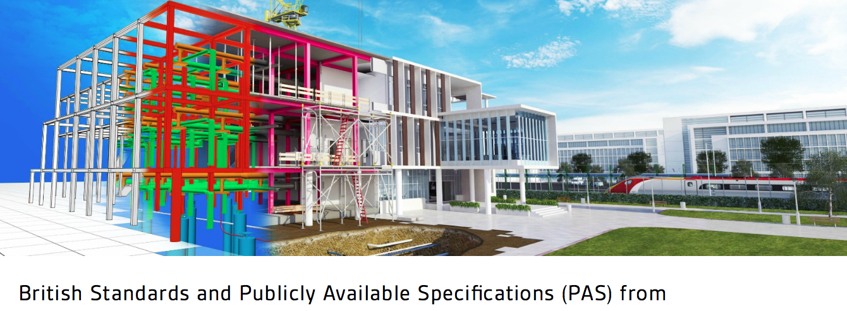
Building metaphor image from http://bim-level2.org/en/standards/

Slide 25
Questions

