Slide 1
Exercise A Point 1
Stack
no local
AR
moon
arg1
arg2
AR
main
ref
arr
1501
1100
1601
no args

Slide 2
Exercise A Point 2
Stack
no local
AR
jupiter
x
no local
AR
mars
arg1
arg2
1400
ref
AR
main
arr
1700
1100
1602
p
no args

Slide 3
Exercise B Point 1
Stack
no local
AR
Cplx::setRealPart
arg
666
this
AR
main
num1
imagM
-999
realM
666
no args

Slide 4
Exercise B Point 2
Stack
no local
AR
Cplx::getRealPart
this
no local
AR
global_print
n
AR
main
num1
imagM
-999
realM
666
no args

Slide 5
Exercise B Point 3
Stack
no local
AR
Cplx::Cplx
imagM
34
realM
5
this
num2
imagM
5
realM
34
AR
main
num1
imagM
-999
realM
666
no args

Slide 6
Exercise B Point 4
Stack
local
imagM
-5
AR
Cplx::Subract
realM
-34
other
this
num2
imagM
-994
realM
700
AR
main
p
imagM
-999
num1
realM
666
no args

Slide 7
Exercise D Point 1
String Constant Area
(Static)
Stack
Heap
no local
AR
DynString::DynString
‘a’
‘b’
‘c’
‘d’
‘/0’
s
this
AR
main
storageM
‘a’
‘b’
‘c’
‘d’
‘/0’
a
lengthM
4
no args

Slide 8
Exercise D Point 2
String Constant Area
(Static)
Stack
Heap
no local
AR
DynString::DynString
‘a’
‘b’
‘c’
‘d’
‘/0’
s
storageM
this
lengthM
4
‘f’
‘i’
‘l’
‘m’
‘/0’
Q: Does abcd get deleted here? Or does it just chill till end of program
b
‘f’
‘i’
‘l’
‘m’
‘/0’
AR
main
storageM
‘a’
‘b’
‘c’
‘d’
‘/0’
a
lengthM
4
no args

Slide 9
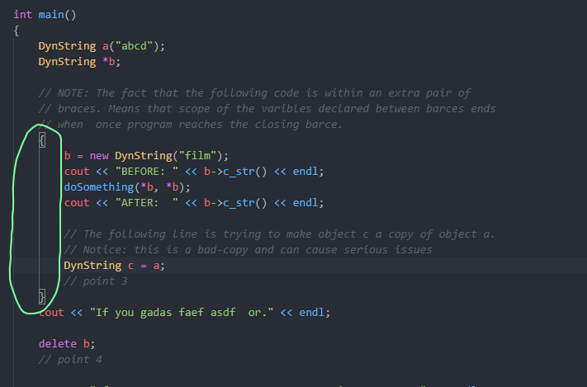
Exercise D Point 3
String Constant Area
(Static)
Stack
Heap
Q: is this what happens when we have a = c
c
storageM
‘a’
‘b’
‘c’
‘d’
‘/0’
lengthM
4
storageM
‘f’
‘i’
‘l’
‘m’
‘/0’
lengthM
4
Q: Does abcd and film get deleted here? Or does it just chill till end of program
b
‘M’
‘i’
‘l’
‘m’
‘/0’
AR
main
storageM
‘a’
‘b’
‘c’
‘d’
‘/0’
a
lengthM
4
no args
Q: do we have to draw anything on the diagram to account for these braces here?

Slide 10
Exercise D Point 4
String Constant Area
(Static)
Stack
Heap
Is this good for after delete b happens?
‘a’
‘b’
‘c’
‘d’
‘/0’
Unsafe Memory
‘f’
‘i’
‘l’
‘m’
‘/0’
b
AR
main
storageM
‘a’
‘b’
‘c’
‘d’
‘/0’
a
lengthM
4
no args

Slide 11
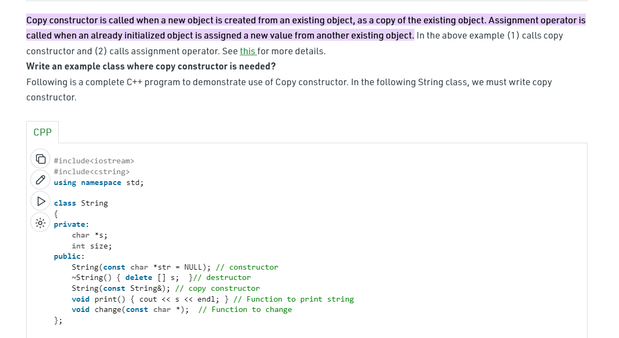
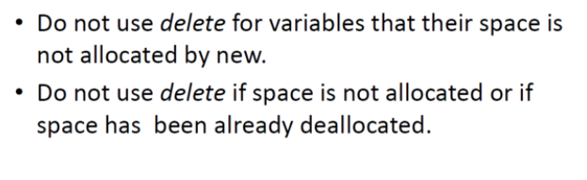
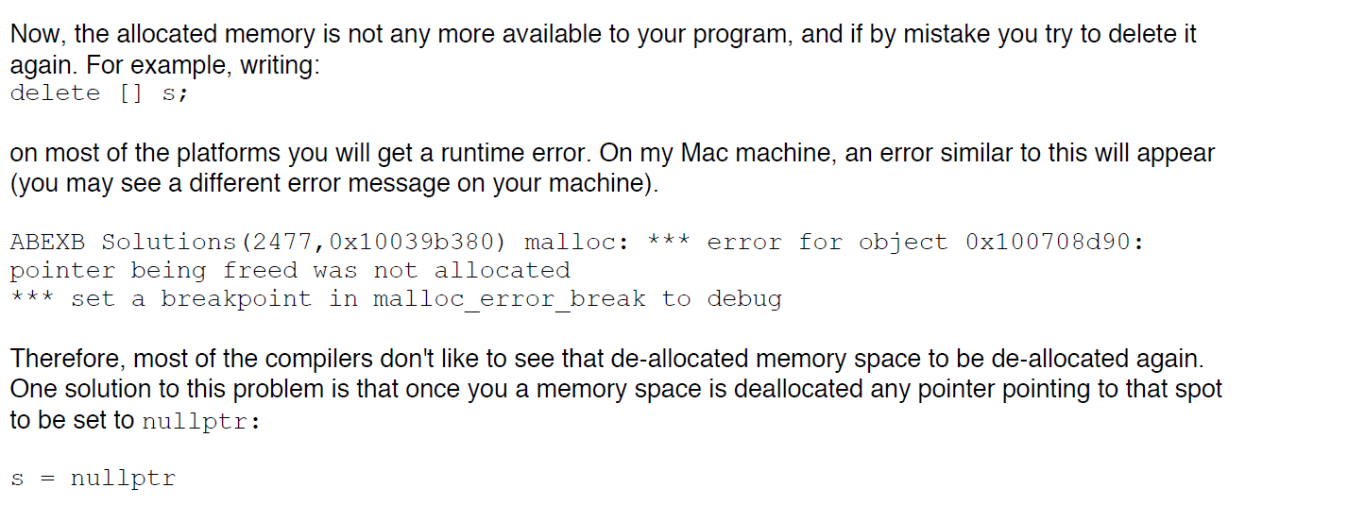
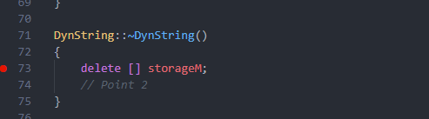
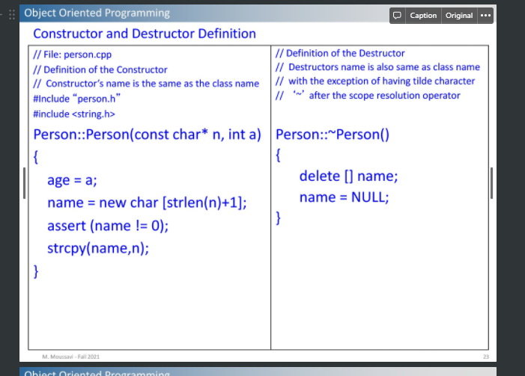
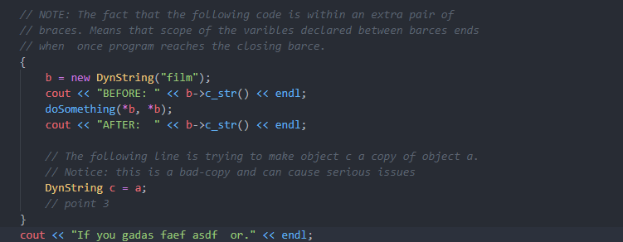
https://www.geeksforgeeks.org/copy-constructor-in-cpp/#:~:text=Copy%20constructor%20is%20called%20when,value%20from%20another%20existing%20object.
1. At point four in the main function, how many times the constructor of class DynString is called?
By the time we get to point 4, the main constructor will have been called 2 times. One time each for the variables a, and b. It should be noted that when variable c is created, the default copy constructor will be called, which C++ creates for us (as discussed here (https://www.geeksforgeeks.org/copy-constructor-in-cpp/#:~:text=Copy%20constructor%20is%20called%20when,value%20from%20another%20existing%20object.) (ask professor if this answer is correct, and if we should say constructor is called 2 or 3 times)
2. At point four how many times the destructor of the class DynString is called?
By the time we get to point 4, the destructor will have been called twice. First it is called for c, since the variable c ceases to exist outside of the curly braces it was created in. The second time the destructor is called is during is when the “delete b” line of code is executed.
3. Overall how many times in total the destructor of the class DynString will be called in this program?
By the time we get to the end of the program, the destructor of DynString is called 3 times, once for a, b, and c each.
4. Answer the question that is noted in the main function: What is going wrong after you press the return key in the main function?
I believe the issue that arises is a result of using the delete statement on b, when b is a pointer. In the class notes, it is stated that you should “not use delete for variables that their space is not allocated by new.”
Is the error something to do with not setting strageM = nullptr? Or is it that we use delete on b and b is a pointer? The thing is I don’t actually get an error on my computer
Honestly ya it seems like 2 issues… shouldn’t use delete on b and should maybe have wrote storageM = nullptr
When you say the scope of the variable declared between braces ends when program reaches closing brace, what does that mean in the case of b? because b doesn’t seem to be changed after the brace ends…

