Slide 1

Graydon Hall and Jared Kraus Group 2
Fantasy Football Analytics
https://www.google.com/url?sa=i&url=https%3A%2F%2Fwww.espn.com%2Ffantasy%2Ffootball%2F&psig=AOvVaw2lcN_N79dRFhDSzwhnjtlV&ust=1623795795092000&source=images&cd=vfe&ved=0CAIQjRxqFwoTCPDbm_qUmPECFQAAAAAdAAAAABAD

Slide 2
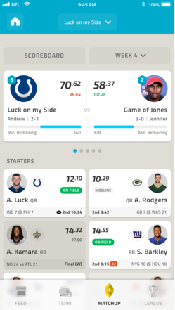
What is Fantasy Football?
Get a league of 10 friends
Draft a team (1 QB, 2 WR, 2 RB, 1 TE etc)
Play someone else's team each week.
Team with most points wins

Slide 3
Our Dataset

Slide 4
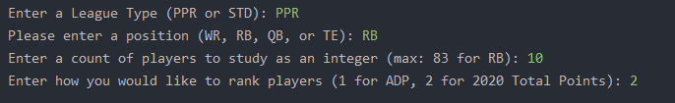
User Input
League Type
Position
Count of Players
Ranking System

Slide 5
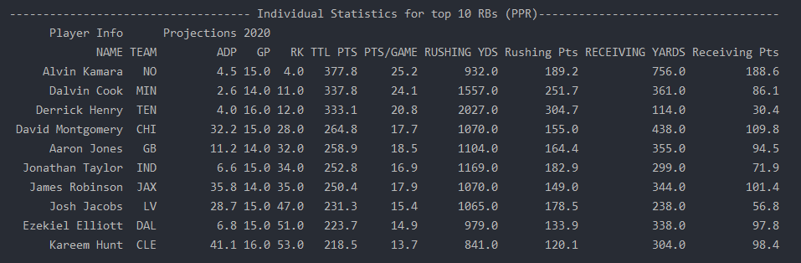
Individual Player Statistics
Players to target in upcoming drafts

Slide 6
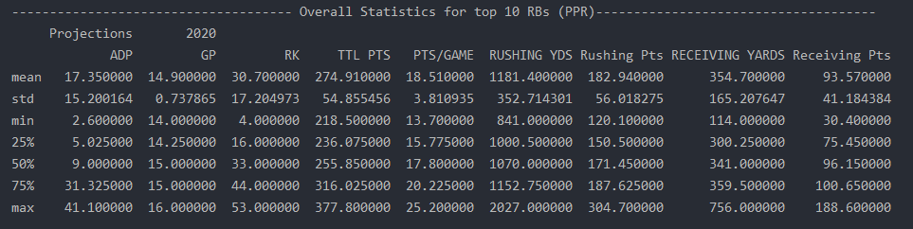
Overall Position Statistics
Helps determine value of players relative to rest of position group

Slide 7
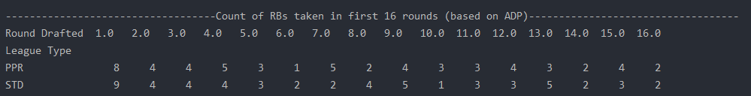
Count of Position Taken Each round
When should I be drafting this position?

Slide 8
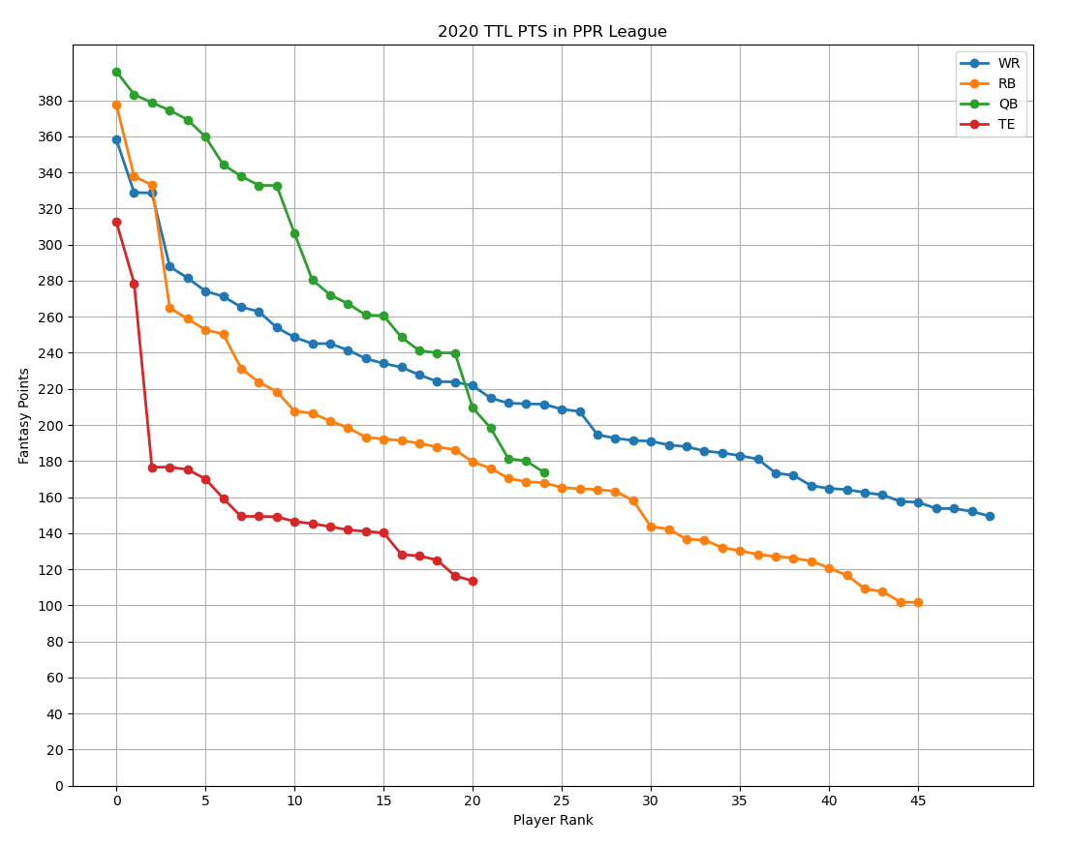
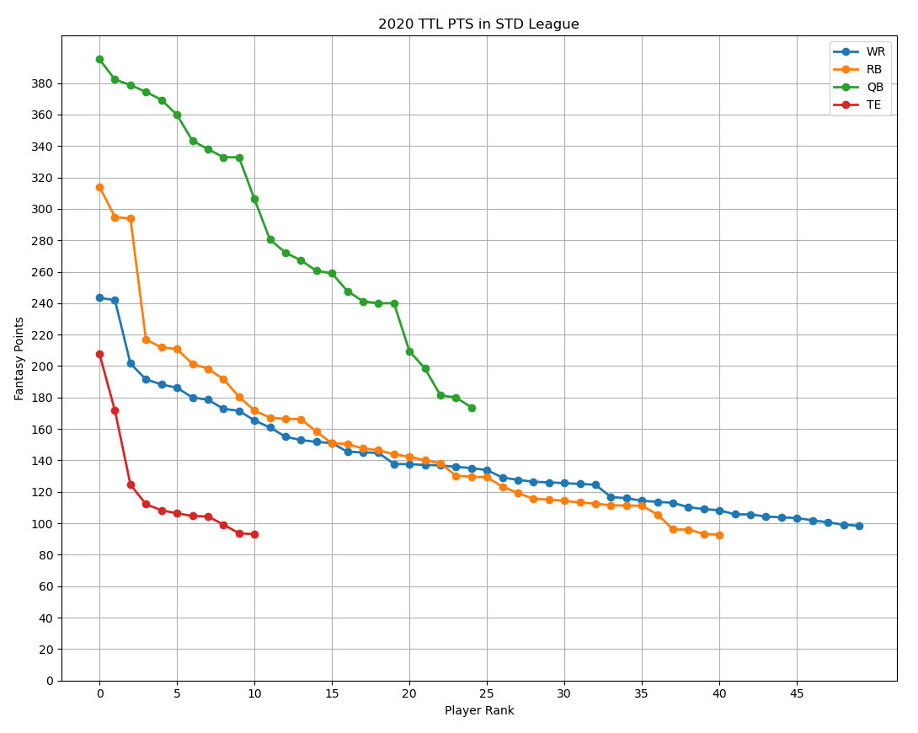
2020 Total Points

Slide 9
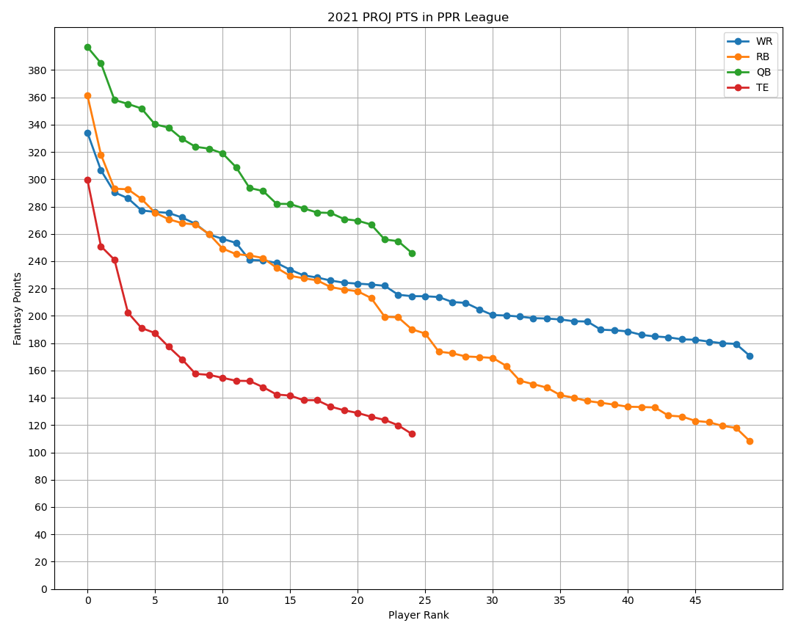
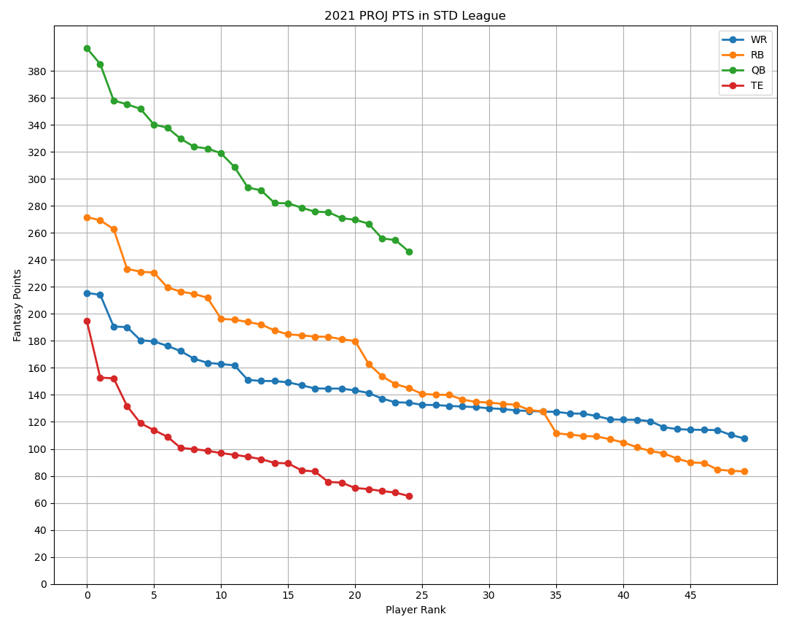
2021 Projected Pts
TE Draft: Top 3 or wait (Kelce, Kittle, Waller)
RB declines steeper than WR

Slide 10
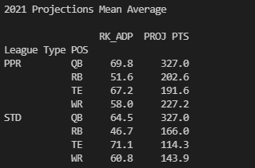
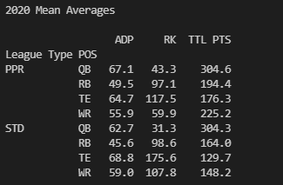
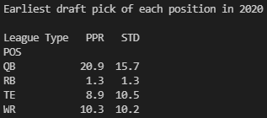
Positional Comparison Tables

Slide 11
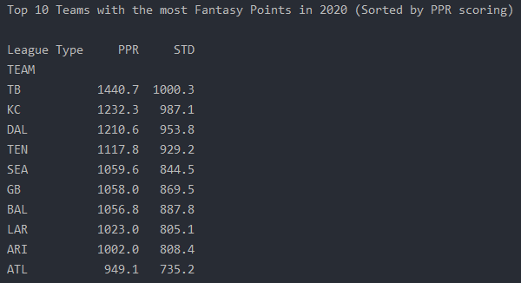
Team Comparison Table
Top 10 teams based on pts
Sorted by PPR scoring

Slide 12
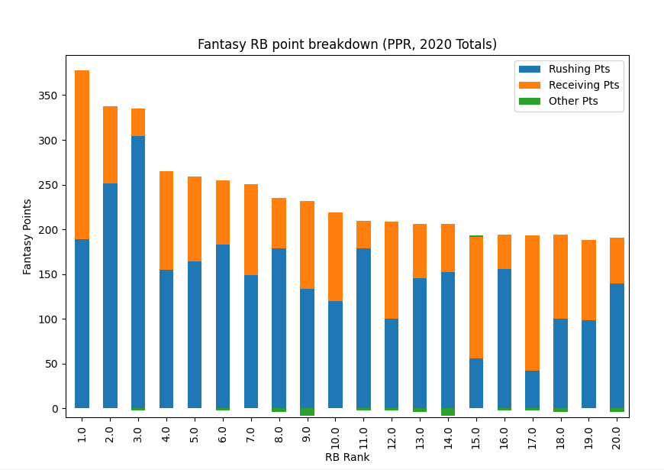
RB Point Breakdown
Mix of passing and rushing points

Slide 13
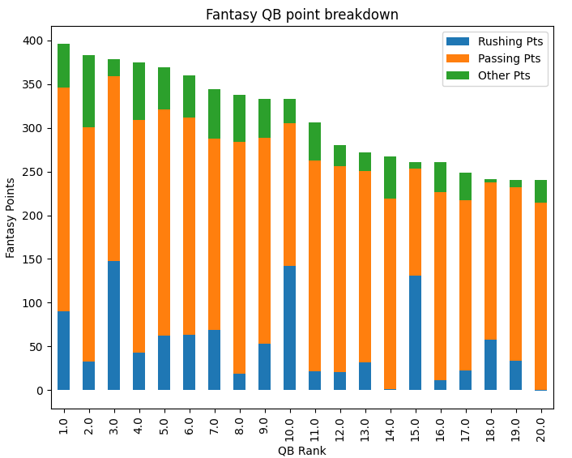
QB Point Breakdown
Good Fantasy QBs:
Typically add value through rushing
Trivia: Guess 3 exceptions?
(PPR, 2020 Totals)

