Slide 1

Group presentation 1
Graydon Hall, Jared Kraus, Alex Leakos

Slide 2

Problem overview
Use case being solved:
Sentiment Analysis on movie reviews
Broken down into two categories using simple classification:
Positive (+)
Negative (-)

Slide 3
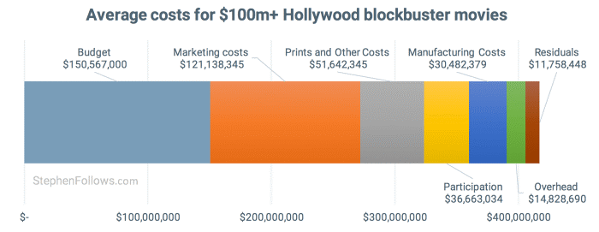
Problem overview
Importance of the Problem
CASE 1 : MOVIE STUDIO
Allocation of marketing budget – marketing > 1/3 total cost of a major studio movie
Digital advertising is more tailored – and drives a disproportionate amount of revenue
Increase in efficiency contributes directly to the bottom line
Apply the model to gauge interest on specific movies, or genres, or traction on social media channels
Decide on current and future budget allocation
Plan for content to create in the future
Notes:
- Model for classifying reviews could be applied to data sources where sentiment is not captured (ie no rating system)
- note advertising in internet is growing 4% in 2007 – 15% in 2018
- Digital media drove 46% of movie box office revenue, despite making up just 14% of studio marketing budgets, according to findings of new research from Neustar shared with Marketing Dive.
Allocation of marketing budget – marketing > 1/3 total cost of a major studio movie
In 2018 digital media drove 46% of movie box office revenue, despite making up just 14% of studio marketing budgets
Increase in efficiency contributes directly to the bottom line
Apply the model to gauge interest on specific movies, or genres, or traction on social media channels
Information to decide where to allocated marketing spend in the future – or on the current campaign
Maybe there are certain platforms where the movie is received more positively – or certain areas (better word, but like FB groups) where the movie is performing well, advertisers could then target similar groups on the platform
Collecting information on where a movie receives the most traction, could also allow advertisers to refine their spend on other platforms (TV, other social media, etc), targeting audience with similar characteristics as the groups where reviews were positive
- https://www.marketingdive.com/news/digital-represents-14-of-movie-ad-budgets-but-drives-46-of-revenue-study/544253/

Slide 4
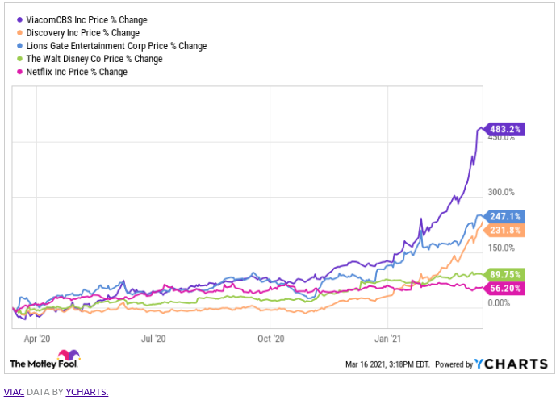
Problem overview
Importance of the Problem
CASE 2 : STOCK ANALYSIS
Stock price of publicly traded companies is tied to the public success of movie releases and new show popularity
Short term traders want an information edge
Long term investors need to know the trajectory of a company
Applying this model across platform gives advanced notice on performance
Build a historic trend of performance – specifically for streaming companies
Predict subscriber churn and growth ahead of investor meetings
Notes:
Stock price of publicly traded companies is tied to the success of movie releases
Do people like / dislike a movie ? If you're day trading on these stocks you need to gain sentiment of the public quickly
Applying this model across platforms would allow you to gain early insight on how a movie or tv show is performing
Gain a historic understand - for example have the most relevant Netflix shows been attracting new audiences? Creating subscribers stickiness? Driving people away – this is a better idea than day trading tbh
Predict subscriber churn and growth ahead of investor meetings

Slide 5
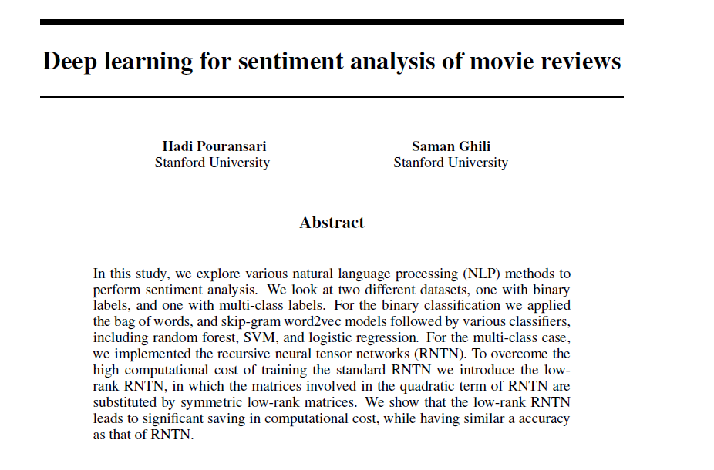
Original Paper
50,000 labelled, 50,000 unlabeled movie reviews
Goal: Predict positive or negative sentiment
Tested various classifiers and techniques to optimize results
https://cs224d.stanford.edu/reports/PouransariHadi.pdf

Slide 6
original paper OVERIEW
Original paper- binary classification:
STEPS:
Data pre processing
Feature vector: Bag of words and Word2Vec
Applied to Word2Vec: Averaging and Clustering
Classification: Random Forest, Logistic Regression, and SVM
Results ranged from 83.5% - 86.6%

Slide 7
Extension of original paper
NEW DATA:
1,000 new reviews collected from IMDB on recent movies
FEATURE VECTORIZATION:
TF-IDF
NEW MODELS:
Gradient Boosted Regression
Naïve Bayes
Ensemble of models
Notes:
Basic analysis is applied to dataset of 50,000 reviews (25,000 training, 25,000 testing)
The Dataset underwent the following:
Cleaning: Bag of words and Word2Vec
Feature vector: Averaging and Clustering
Classification: Random Forest, Logistic Regression, and SVM
Results from these simple classification methods ranged from 83.5% - 86.6%

Slide 8

Research Questions

Slide 9
Questions for
Analyzing the data
What is the best process to remove whitespace, punctuation and other non-alphabetical characters?
What is the best process to handle error within text?
What is the best process to handle different tenses within text?
What is the best method to tokenize text?
What words in a given text are helpful towards analysis and what words can be ignored (stop words)?
What are the most frequently used words in a movie review?
What is the best way to convert a sequence of words to numerical feature vectors?
BOW:
How many vocabulary words are needed? What are they?
Word2Vec:
What is the best method to turn many word vectors into one review vector?

Slide 10
Questions for
Preforming Machine Learning on The Data
Machine Learning with Word2Vec (hyper-parameter tuning):
What is the optimal context size?
What is the optimal number of dimensions for a word vector?
What binary classifier model is the best at predicting the sentiment of a given text?
What method to transform the text into a numerical feature vector performed the best?
Can adjusting regularization on the models be used to improve the performance?
What overall method produced the best prediction accuracy?
How did the models perform on newly added data?
Was there more error in the prediction of negative or positive reviews?
Was there any distinct causes for wrong predictions?

Slide 11
Stages of ML Development

Slide 12
Data Preprocessing
Apply Cleaning process to each review
Remove html tags (ex. <br>) via beatifulsoup
Regex – replace punctuation with spaces
Capitalization – make all lowercase
Tokenization – using NLTK built in functions.
Noisy text detection
Remove stop words
Correct typos (Levenshtein Distance)
Reduce words to their stem (ex. Loved -> love, using nltk.stem.porter )

Slide 13
Data Labeling
Dataset used in our paper, found on Kaggle https://www.kaggle.com/c/word2vec-nlp-tutorial/dataData
Labelling process for our own data
Reviews are scraped from IMDb using imdbpy library (https://imdbpy.readthedocs.io/en/latest/ )
Each group member will individually label each review
1000 new reviews will thus be added to the dataset.
Imdbpy library can be used to obtain raw reviews (https://imdbpy.github.io/)

Slide 14
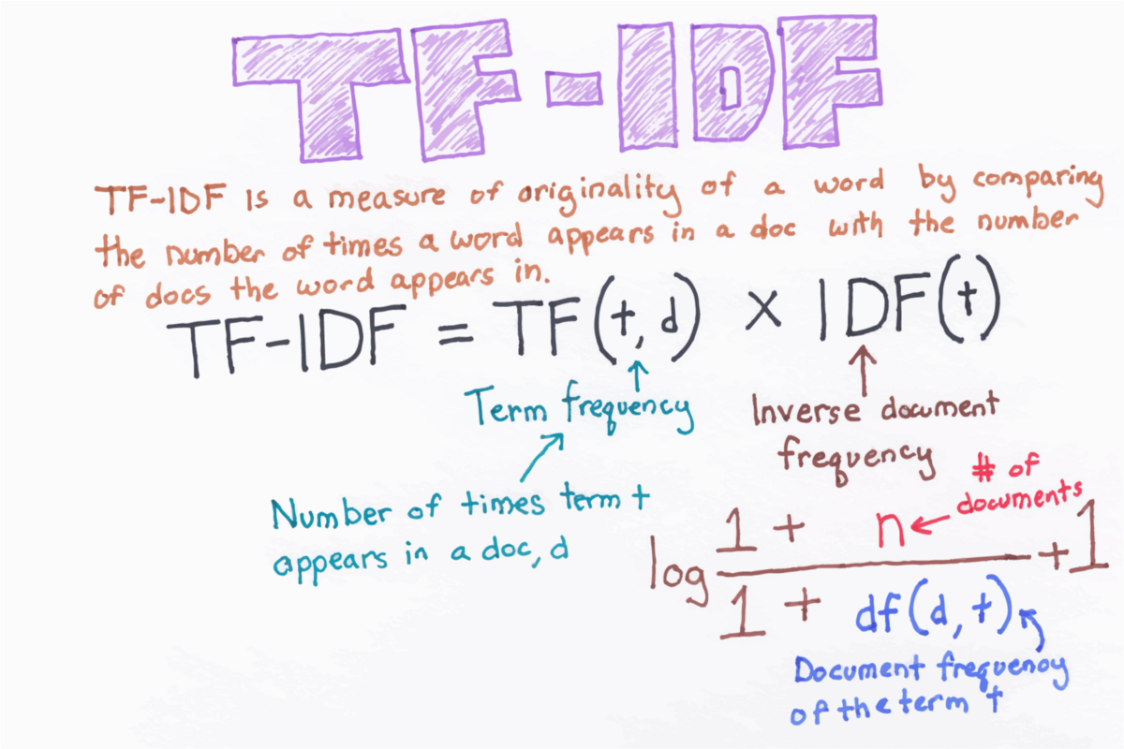
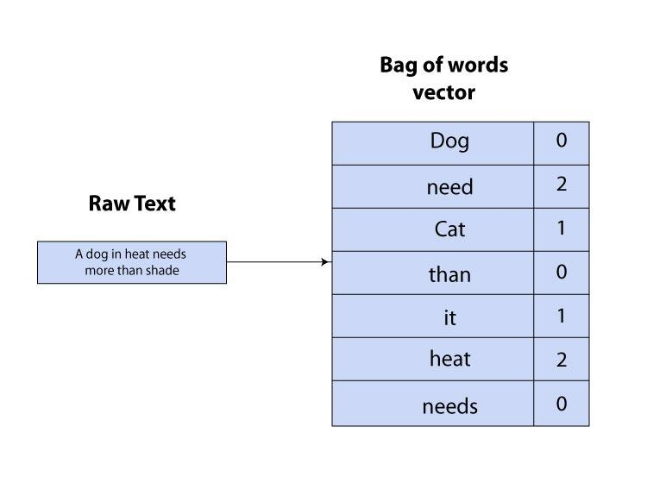
feature Extraction
Transform Paragraphs into vectors to be input into classifier
Create bag of words model
Utilize 5000 most frequent English words
Extension to paper:
consider replacing term frequency with TF-IDF
Also consider using Word2Vec.
https://towardsdatascience.com/tf-term-frequency-idf-inverse-document-frequency-from-scratch-in-python-6c2b61b78558
https://www.analyticssteps.com/blogs/an-optimum-approach-towards-the-bag-of-words-with-code-illustration-in-python

Slide 15
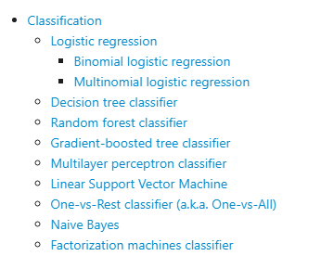
Classification
Classifiers Available through PySpark MLlib library
Feature vectors will be inputted into classifier
Reviews classified as positive or negative
Models used in Paper:
Random Forest Classifier
Logistic Regression
SVM
Models we will add to extend the paper
Gradient boosted tree classifier
Consider an ensemble of ensembles
Naïve Bayes
https://spark.apache.org/docs/latest/ml-classification-regression.html

Slide 16
Validation Of model performance
Compare testing results among different classifiers
Compare against results from paper
Highest obtained accuracy: 86.6 %
Word2Vec + Averaging + Random Forest Classifier

Slide 17
Optimization of ML model performance
Adjusting of hyper parameters in classifiers
Ex. Adjusting regularization parameters
Adjusting other hyperparameters as we learn more about each model
Testing out different feature extraction techniques
Bag of words
TF-IDF
Word2Vec

