Slide 1

ENSF 612 Presentation 2
By Alex Leakos, Jared Kraus, and Graydon Hall

Slide 2
1. Data Collection

Slide 3
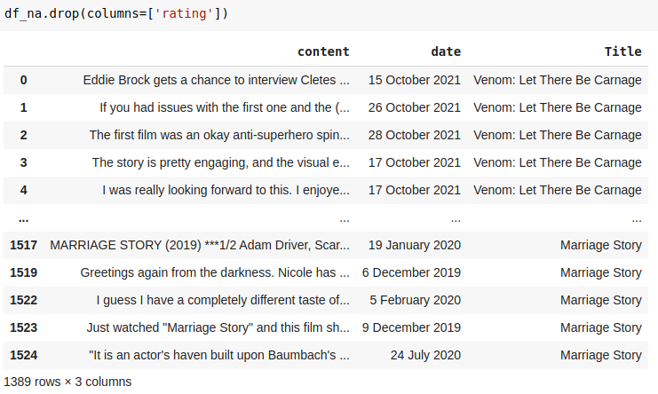
Collection Procedures
Used imdbpy to web scrape user reviews from movies from IMDB
Pulled from movies released from 2019 – 2021
No more than 30 reviews were scraped from each movie
Only the textual contents of each review was included

Slide 4
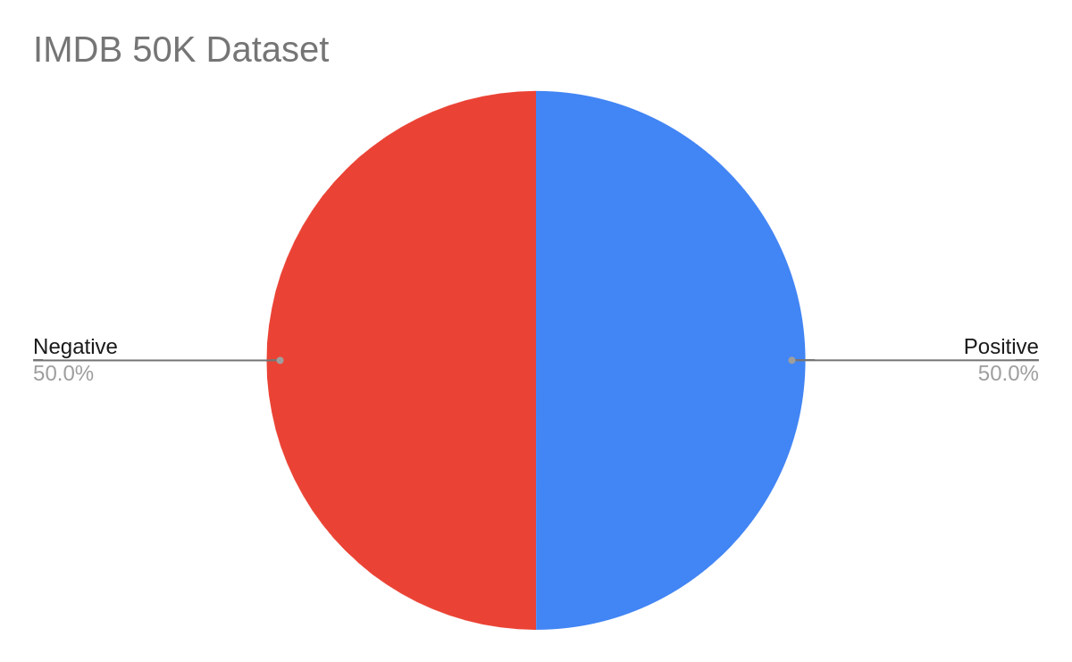
Original Benchmark
Analysis:
50.0% positive and 50.0% negative reviews so randomly guessing would yield 50% accuracy
Only strong sentiment was included within benchmark
Sentiment was determined by star ratings
Maximum 30 reviews / movie

Slide 5
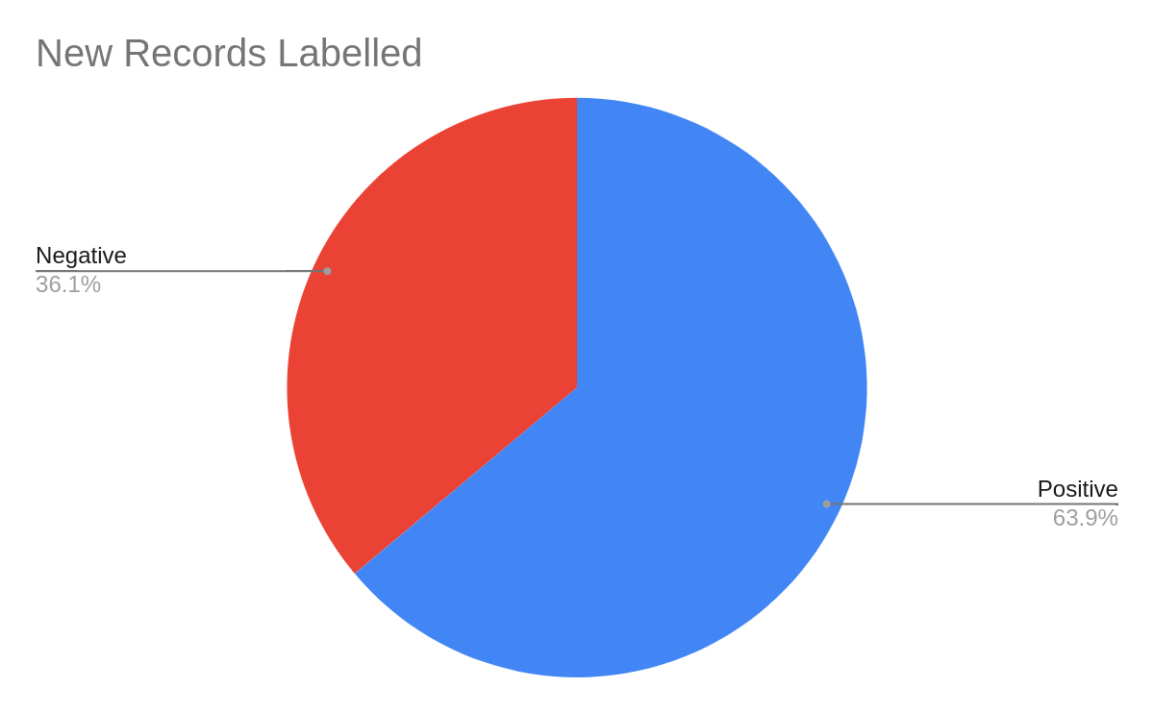
New Records
Analysis:
63.9% positive and 36.1% negative reviews
No discretion applied on polarity, all reviews classified as either positive or negative sentiment
No star ratings were used to determine sentiment
Maximum 30 reviews / movie

Slide 6
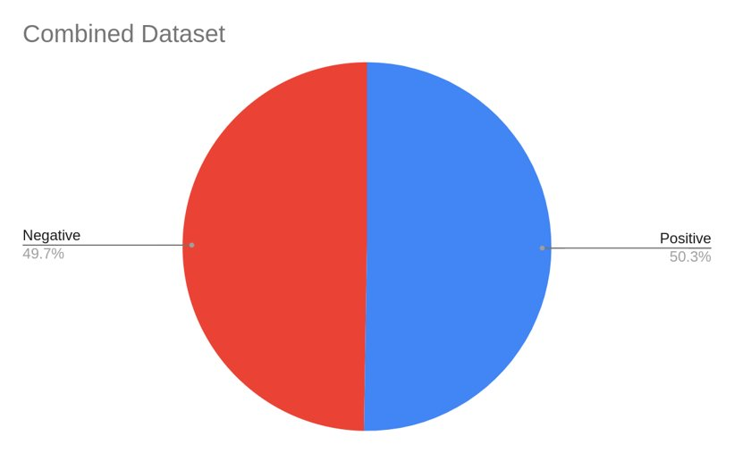
Extended Benchmark
Conclusion:
Did not limit ourselves to 50 / 50 split of positive negative
Original benchmark used "highly polarized reviews" vs new dataset using 1000 scraped reviews
Original benchmark used star ratings to classify vs new labeling using strictly sentiment
Notes:
1: In general the average rating for movies selected was > 7, indicating more postive sentiment
2: When completing out labeling we noticed there we quite a few with neutral or ambiguous reviews, this is where most descrepencies across our labels occurred
3: Again, there were some slightly ambiguous ratings whichh summarized the movie or included both postives and negatives – we stuggled to understand reviews like this that didn't included a conclusion

Slide 7
2. Quality of Data Labeling

Slide 8
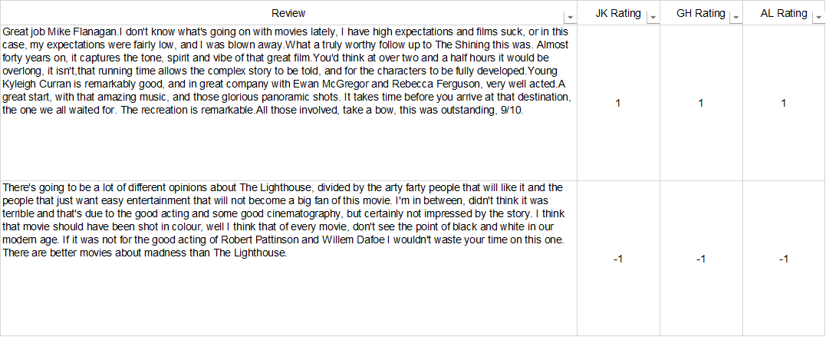
Labeling of Data
1 (positive review)
-1 (negative review)

Slide 9
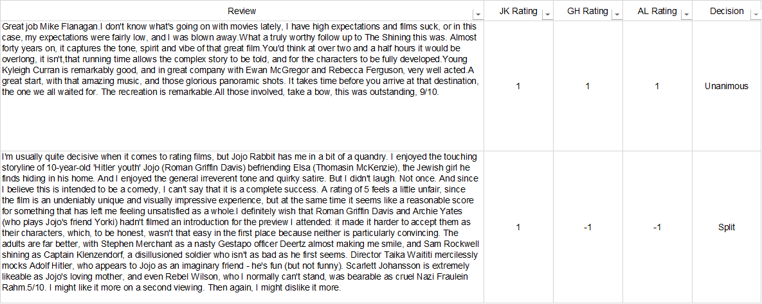
Unanimous vs Split Decisions

Slide 10
Reason for Split Decisions and Resolving Them

Slide 11
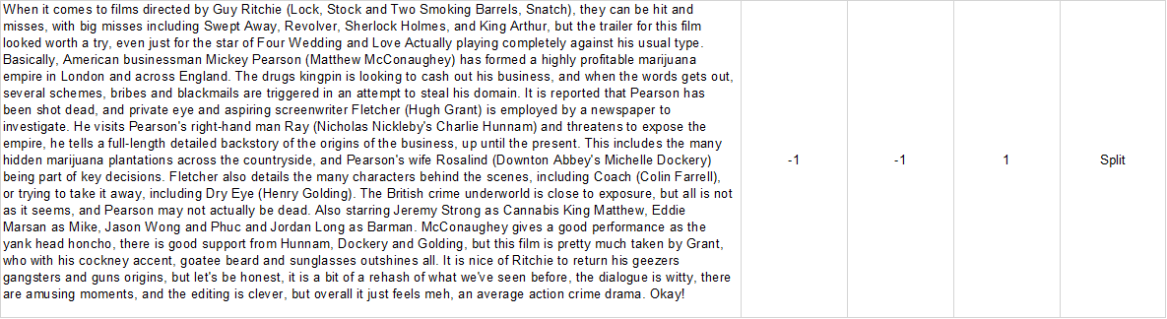
1. Review sentiment was vague and focused more on movie's plot.
Example:
Review explains the plot and says very little about if he liked it or not.
Resolution:
We took the majority of our three reviews for these ones.

Slide 12
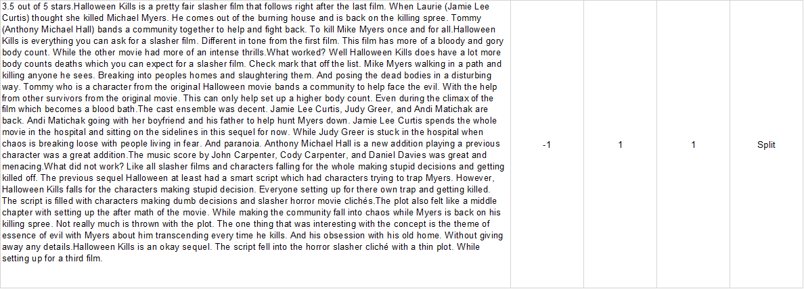
2. Review listed a lot of positives and negatives.
Example:
Author gives a long explanation of "What worked" and "What did not work".
Ends it with it was an "Okay Sequel".
Resolution:
We took the majority of our three reviews for these ones.

Slide 13
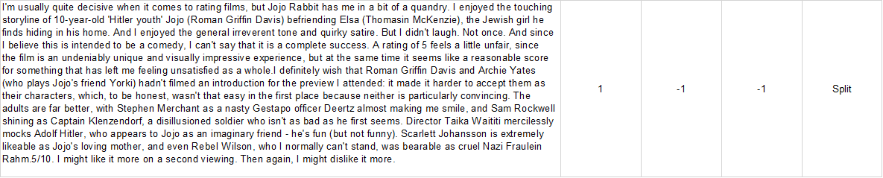
3. Author seemed indecisive if he enjoyed the film
Example:
The author was left in a "quandary" while rating this film.
Gives it a rating in the middle (5/10) but also says it might be unfair rating
Does not know if he will like it or dislike it more on a second viewing
Resolution:
We took the majority of our three reviews for these ones.

Slide 14
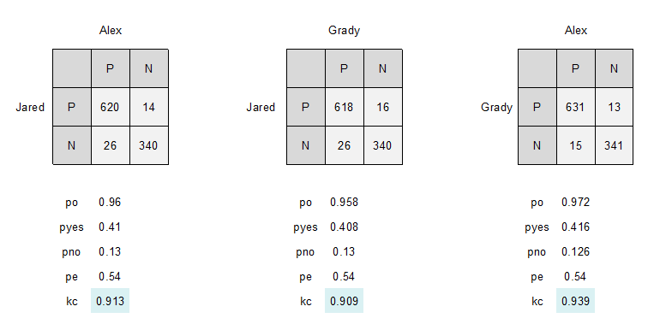
Split Decision Statistics
Out of 1000 reviews we disagreed on 55 (5.5%)
Cohen Kappa Results:

Slide 15
3. Quality of Data Preprocessing

Slide 16
Preprocessing steps we followed
- Overall kept approach generic
- Allows to easily be applied to other models later
Steps we followed:
1. BeatifulSoup Logic
- Remove URLS
- Remove code snippets
- Delete preformatted text

Slide 17
Preprocessing steps we followed
Steps we followed continued:
2. Make all words lowercase
3. Strip leading/trailing whitespace
4. Remove any punctuation using Regex
5. Stem words using SnowballStemmer
6. Tokenize words
7. Remove stop words
8. Remove words < 3 characters
9. Remove non-alphabetical words (ex. Numbers).

Slide 18
Preprocessing of target vector
- Target vector: gives movie review sentiment
- Either ‘positive’ or ‘negative’
- Must be converted to numerical values (1 and 0)
- Accomplished using StringIndexer()

Slide 19
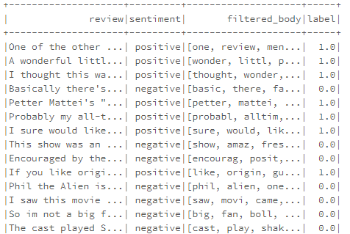
Final Pre-processed dataframe
- “Review” and “Sentiment”: original dataframe columns
- “filtered body”: pre-processed and tokenized review
- “label”: gives sentiment as a numerical value

Slide 20
4. Quality of Data Features

Slide 21
Bag of Words

Slide 22
Bag of Words
Initial step: create bag of words vectors
Input = pre-processed list of words (“filtered_body” column)
Output = term frequency vector
Functions used:
Used both HashingTF and CountVectorizer
Both perform same task, but in different ways
HashingTF:
Utilizes hashing trick (not reversible)
Possibility of collisions
Requires only a single data scan and no additional memory beyond original input and vector
CountVectorizer:
Is reversible
Requires additional scan over the data to build a model and additional memory to store vocabulary (index)
Determining which produces best results will be studied in further detail in final report

Slide 23
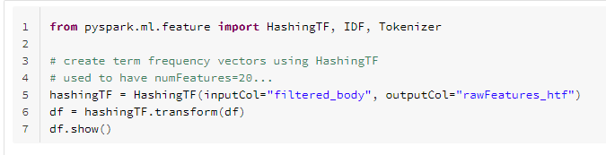
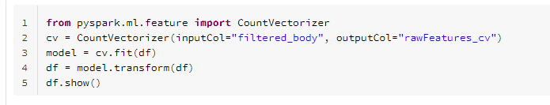
Bag of Words – Code

Slide 24
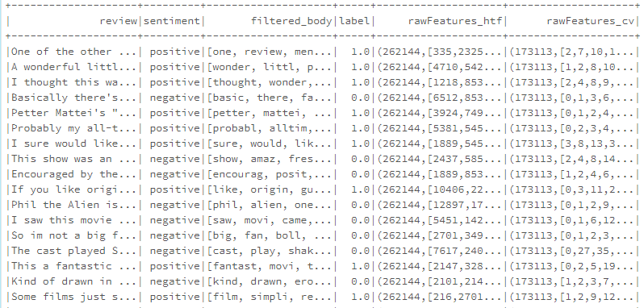
Bag of Words – Resulting Columns
Bag of words vector using HashingTF function
Bag of words vector using CountVectorizer function
Initial review and sentiment columns
Preprocessed review and label

Slide 25
TF-IDF

Slide 26
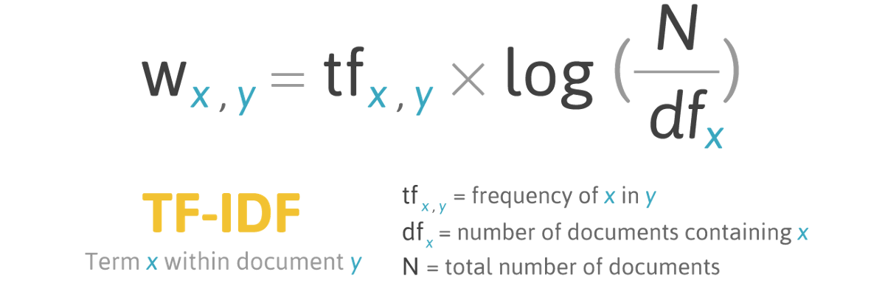
TF-IDF: Term Frequency-Inverse Document Frequency
Alternative to simple bag of words model
Instead of having simple term frequency, you have TF-IDF
Formula:
https://www.google.com/url?sa=i&url=https%3A%2F%2Fted-mei.medium.com%2Fdemystify-tf-idf-in-indexing-and-ranking-5c3ae88c3fa0&psig=AOvVaw3ii1Y-Od78Jx4CAcVCgKTY&ust=1636995683441000&source=images&cd=vfe&ved=0CAsQjRxqFwoTCPj_4qOqmPQCFQAAAAAdAAAAABAS

Slide 27
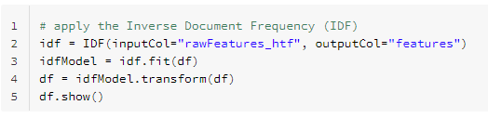
TF-IDF: Term Frequency-Inverse Document Frequency
TF-IDF: provides a measure of originality of a word
Does this by comparing the number of times a word appears in a document, with the number of docs the word appears in*
Use IDF() function
Input column = “rawFeatures_htf” (Bag of words vector using HashingTF)
Output column = “features”
Model accuracy using feature column from CountVectorizer instead will be studied later
*source: https://www.google.com/url?sa=i&url=https%3A%2F%2Ftowardsdatascience.com%2Ftf-term-frequency-idf-inverse-document-frequency-from-scratch-in-python-6c2b61b78558&psig=AOvVaw3ii1Y-Od78Jx4CAcVCgKTY&ust=1636995683441000&source=images&cd=vfe&ved=0CAsQjRxqFwoTCPj_4qOqmPQCFQAAAAAdAAAAABAY

Slide 28
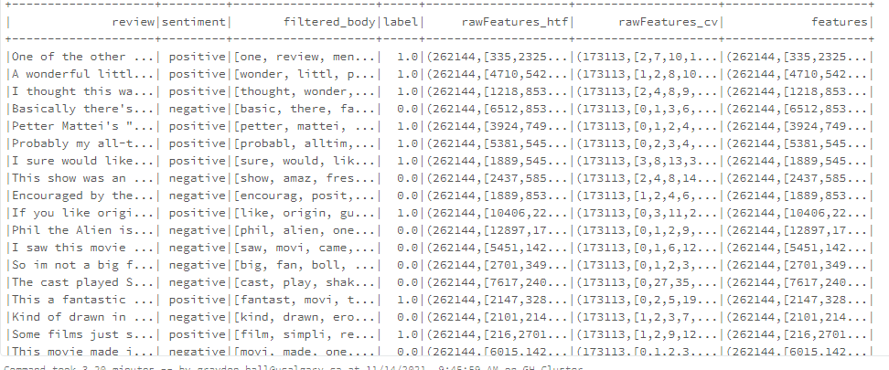
TF-IDF: Resulting Columns
Bag of words vector using HashingTF function
TF-IDF features vector

Slide 29
Word2Vec

Slide 30
Word2Vec Model
Pyspark has a very help "Word2Vec" library that was used to vectorized our reviews.
We used the following parameters to create a word2vec model:
VectorSize = 100
WindowSize = 5
Then fit it to our df with our preprocessed and tokenized reviews.

Slide 31
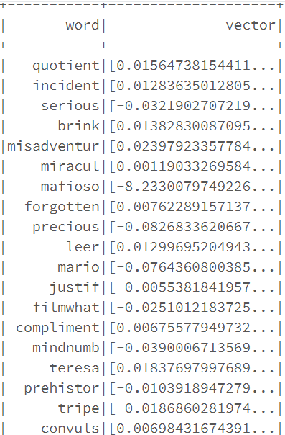
Word Vectors
Each word in the tokenized reviews is assigned a vector of size 100

Slide 32
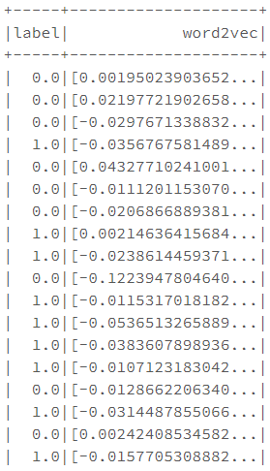
Review Vectors
To get the review vector, the vectors for every word in a review are averaged
We can then create a dataframe with the review vector and the assigned label

Slide 33
5. Train Models on Features

Slide 34
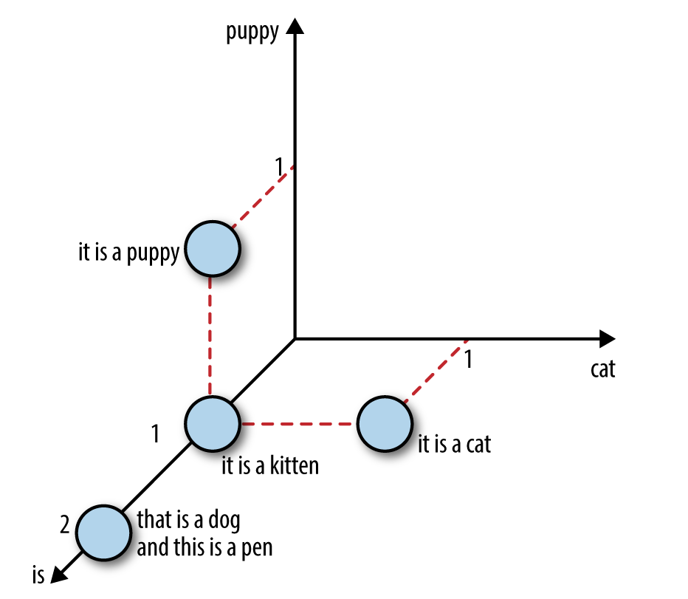
Feature Extraction and Normalization
After preprocessing:
Bag of Words:
Standard Scaler
Normalize for outliers
TF-IDF:
Takes into account the relative importance of words within a document
Word2Vec:
Using averaging so length of review does not skew results
Word2Vec diagram

Slide 35
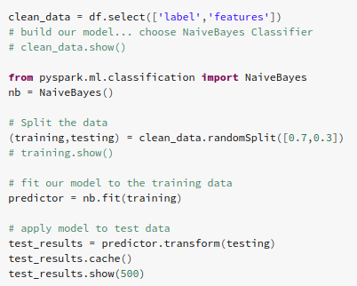
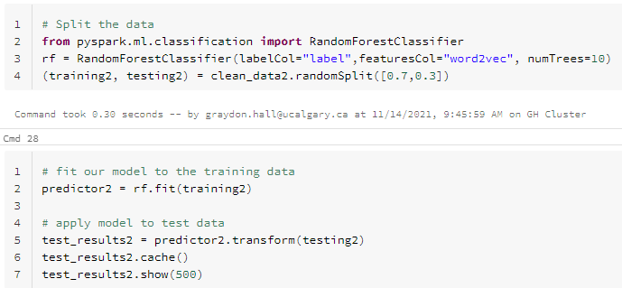
Model Pipeline
For all extracted features we then feed these vectors into our chosen models:
Naïve Bayes
Simple, we will use for benchmarking
Baseline: achieved 81% using TF-IDF vector as input
Random forest
Reduced variance
Easy to train and tune
Baseline: achieved 77% using Word2Vec vector as input
Gradient Boost
Learning rate can improve accuracy over Random Forest
XGBoost
More weight given to misclassified observations
May work better for unbalanced datasets like our movie reviews
Baseline test: Naïve Bayes model with TF-IDF input vector
Baseline test: Random Forest model with Word2Vec input vector

Slide 36
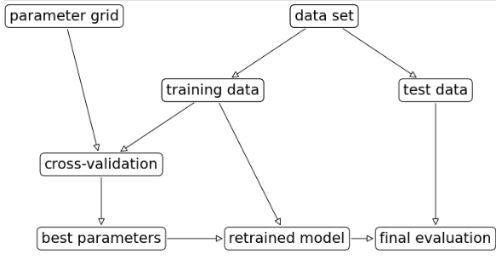
Hyperparameter Tuning
After finding candidates for our best models, we can then apply hyperparameter tuning methods:
Grid Search:
Try all combinations of preset values to find which combination works the best
Random Search:
Use random combinations to find the best model

Slide 37
Random Forest Classifier

Slide 38
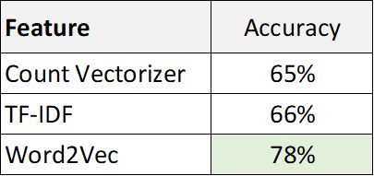
Feature Selection
Fit a RFC Model with numTrees=10 and maxDepth=5 on each feature

