Slide 1

ENSF 612 Presentation 3
By Alex Leakos, Jared Kraus, and Graydon Hall

Slide 2
Model Selection Workflow

Slide 3
Model Selection Workflow
The following standardized
NumTrees
Maximum depth of the tree
Parameters given: [100, 150, 200, 300]
CrossValidator: 200
TrainValidationSplit: 200
MaxDepth
Number of trees to train
Parameters given: [5, 10, 20, 30]
CrossValidator: 10
TrainValidationSplit: 10

Slide 4
Random Forest

Slide 5
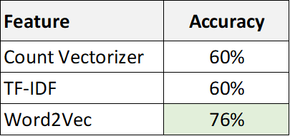
Feature Selection
Fit a base RFC Model on each feature to determine which one performed the best
numTrees=10
maxDepth=5

Slide 6
Hypertuning Parameters
Used ParamGridBuilder with CrossValidator to determine best parameters for model
numTrees and maxDepth had the largest impact on RFC accuracy:
NumTrees
Maximum depth of the tree
Parameters given: [200, 300, 400, 500]
CrossValidator: 400
TrainValidationSplit: 400
MaxDepth
Number of trees to train
Parameters given: [5, 10, 20, 30]
CrossValidator: 10
TrainValidationSplit: 10

Slide 7
Retrain Best Model
Base Model
RandomForestClassifier(numTrees=10, maxDepth=5)
Accuracy = 76%
Hypertuned Model
RandomForestClassifier(numTrees=150, maxDepth=10)
Accuracy = 84%
Reports Model (word2vec + RFC)
Accuracy = 84%

Slide 8
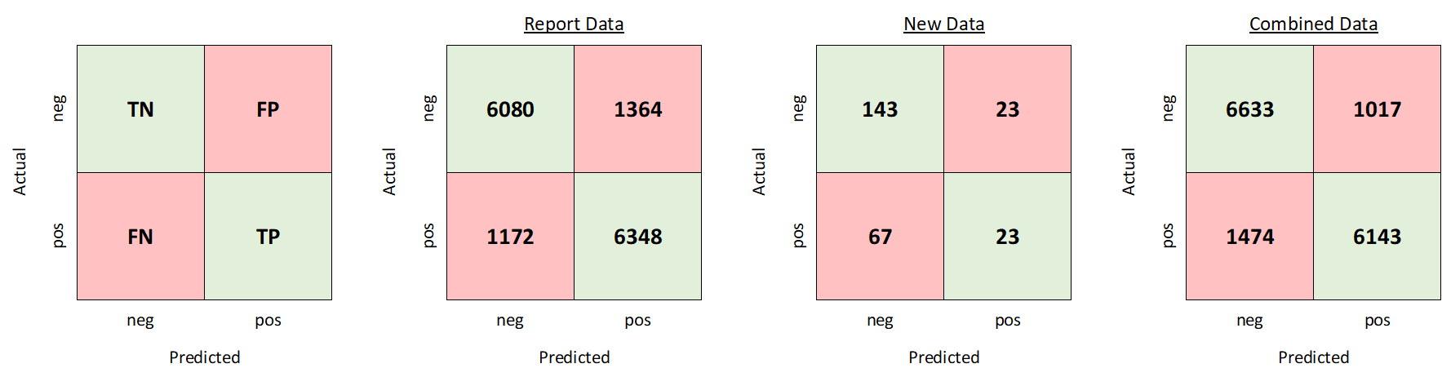
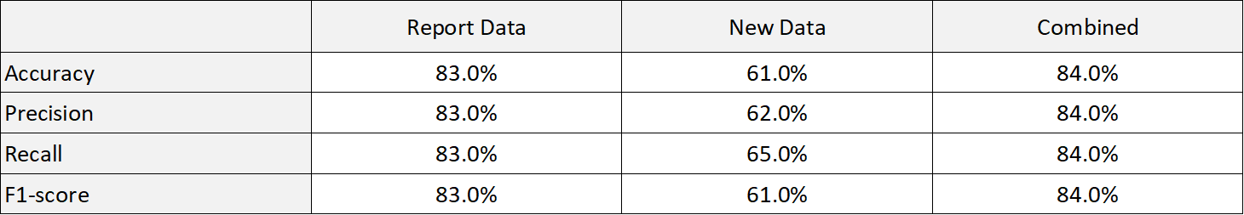
Dataset Comparison

Slide 9
Misclassification

Slide 10
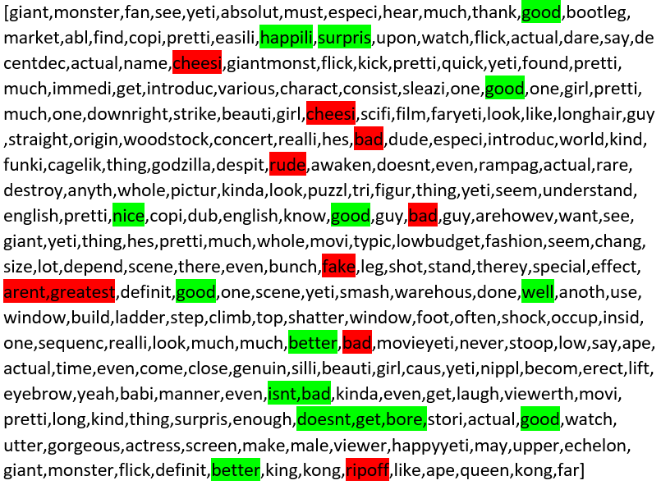
Conflicting Sent
Prediction:
Record Label: 0
Models Prediction: 1
Reason:
Conflicting sentiment word tokens
Example:
"good" is listed 5 times
"bad" is listed 3 times

Slide 11
Going Forward

Slide 12
Going Forward
Areas identified for future progress
Hyper tuning parameters with larger subset of data
Currently used 1000 rows due to computational limitations (Databricks community edition)
Trying additional models

