Slide 1

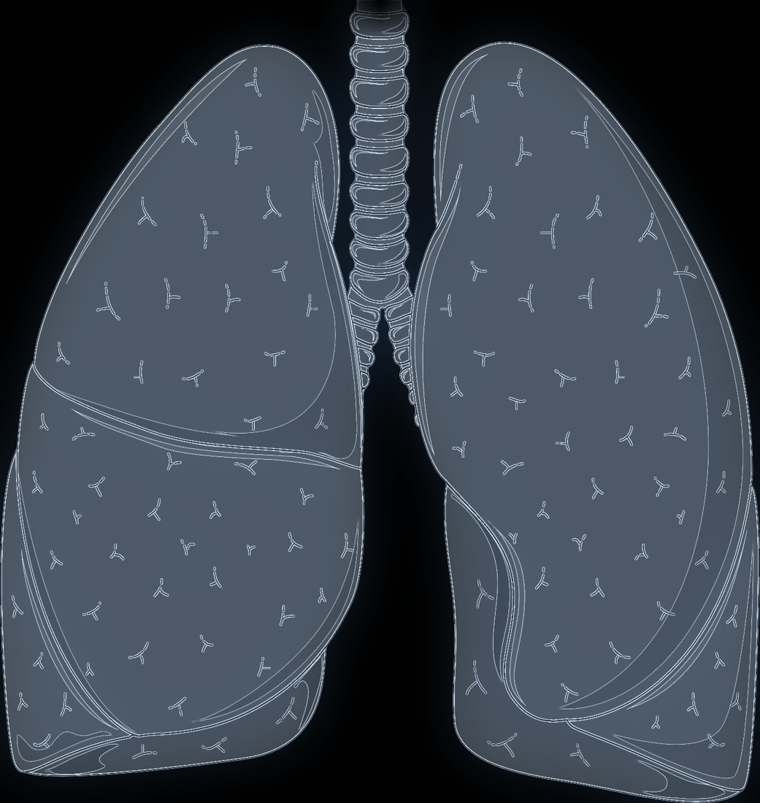
BN5212 · MIDTERM PROJECT
Physician-associated variation in chest X-ray prediction
RESEARCH QUESTION
Does including one attending physician’s cases in training change a model’s atelectasis predictions for that physician’s held-out patients?
01
02
03
04
Motivation
Data & labels
Method
Results & next steps
Prediction target: atelectasis as stated in the radiology report
Lung illustration adapted from Servier Medical Art · CC BY 4.0
Notes:
⏱ 15 秒 | 建议分段 1：第 1–3 页，约 100 秒 | 全套主讲 420 秒
EN script:
Hello everyone. We ask: if a chest X-ray model has seen one physician’s cases in training, does it perform differently on that physician’s new patients? Today we present a small paired pilot on real images.
中文要点：
开场点题：同一种胸片模型，训练时是否见过医生 A 关联的病例，会不会改变它在 A 的新病人上的表现。本次完成的是一次真实图像的小规模配对实验。医生编号只用于分组，不评价医生。
Sources: results/midterm_v1/README.md

Slide 2



01
PROBLEM & MOTIVATION
Labels come from reports, and reports come from physicians
So a model trained on report-derived labels could also absorb physician-associated patterns.
Labels are read from report text
CheXbert turns each radiology report into positive, negative, uncertain or not mentioned [2].
RESEARCH QUESTION
If training includes studies linked to physician A, does the model perform differently on A’s held-out patients?
Every report is linked to an attending physician
Case mix and wording (e.g. “likely atelectasis”) can differ from one physician to another.
Why it matters
Scores on familiar sources may overstate how a model does on new ones.
CNNs can pick up source-specific signals
Pneumonia CNNs generalised unevenly across hospitals and could even identify the source hospital [3].
Scope
A robustness check, not a judgement of physician quality.
[2] Smit et al., EMNLP 2020 [3] Zech et al., PLOS Medicine 2018
02
Notes:
⏱ 45 秒 | 建议分段 1：第 1–3 页，约 100 秒 | 全套主讲 420 秒
EN script:
Why might the physician matter? Chest X-ray labels are usually mined from radiology reports — here with CheXbert — rather than drawn on the image. Every report is linked to an attending physician, and case mix and wording, such as “likely atelectasis”, can differ between physicians. We also know CNNs pick up source-specific signals: Zech and colleagues found pneumonia models generalised unevenly across hospitals and could even recognise the source hospital. So we ask: if training includes physician A’s cases, does the model perform differently on A’s held-out patients? This is a robustness check, not a judgement of any physician.
中文要点：
动机链条：标签来自报告文本（CheXbert），每份报告关联一位主治医生，不同医生的病例构成与措辞可能不同；Zech 2018 发现肺炎模型跨医院表现不稳定，甚至能识别来源医院。由此提出研究问题。强调这是稳健性检查，不评价医生水平，也不推断因果。
Sources: arxiv.org/abs/2004.09167 ; doi.org/10.1371/journal.pmed.1002683

Slide 3


01
RELATED WORK
Prior work compares sites; we compare training exposure
Holding the test patients fixed removes test-set differences from the comparison.
Generalisation across sites
Labels from report text
Images, reports, providers
Zech et al., PLOS Medicine 2018 [3]
Smit et al., EMNLP 2020 [2]
MIMIC-CXR v2.1.0; Johnson et al., 2019 [1]
Pneumonia CNNs performed differently on other hospitals’ data and could recognise which hospital an image came from.
CheXbert labels 14 findings from report text as positive, negative, uncertain or blank (not mentioned).
De-identified radiographs with free-text reports; each study links to anonymised attending IDs.
Our angle: a paired, physician-level contrast
Seen · with A
Same recipe, validation set and 109 test studies. Training sets are matched on size, positives and views; one includes 46 of A’s studies, the other none.
Same test
Unseen · no A
[1] Johnson et al., Scientific Data 2019 [2] Smit et al., EMNLP 2020 [3] Zech et al., PLOS Medicine 2018
03
Notes:
⏱ 40 秒 | 建议分段 1：第 1–3 页，约 100 秒 | 全套主讲 420 秒
EN script:
Three lines of work shape our design. Zech et al. compared hospitals, so each comparison also changed the test population. CheXbert showed that report text can be turned into positive, negative, uncertain or blank labels at scale — that is how our targets are made. MIMIC-CXR provides the images, reports and anonymised provider links. Our angle is a paired contrast: two identical ResNet-18 models share the recipe, the validation set and the exact same test studies; the training sets are matched on size, positives and views, and differ in whether they include A’s studies — 46 versus none.
中文要点：
三条相关工作：跨医院泛化（Zech）、报告标签抽取（CheXbert）、影像-报告-医生关联数据（MIMIC-CXR）。我们的新意在于“配对”：同一测试集、同一验证集、同一训练配方；两组训练集在规模、阳性数和体位上匹配，区别在于是否包含 A 的检查（46 次 vs 0 次）。这样测试人群差异不会混进比较。注意其余非 A 病例并不完全相同，且只有一个种子，所以不能说“唯一差别”。
Sources: physionet.org/content/mimic-cxr/2.1.0 ; arxiv.org/abs/2004.09167 ; doi.org/10.1371/journal.pmed.1002683

Slide 4



02
DATA & LABELS
One course subset, 35 attending IDs, very uneven volume
Each study links one patient, its images, one report and an anonymised attending ID.
1,000
3,351
5,534
Studies per attending ID · top 12 of 35 (ranked)
patients
studies
images
INSIDE ONE STUDY
Frontal image → model input
One per study: PA preferred, otherwise AP
Report → atelectasis label
Used to make labels; never fed to the model
Attending ID → grouping only
Defines physician groups; never a model input
42%
10
23
of studies: top 3 IDs
IDs with ≥ 100 patients
IDs share the last 318 studies
D01–D12 are ranks by study count, not real identifiers. Course subset of MIMIC-CXR; counts from docs/DATA_AUDIT.md.
04
Notes:
⏱ 40 秒 | 建议分段 2：第 4–5 页，约 90 秒 | 全套主讲 420 秒
EN script:
Our data is the MIMIC-CXR course subset: 1,000 patients, 3,351 studies and 5,534 images. Each study links a patient, its images, one report and an anonymised attending ID. The model sees only one frontal image per study, PA preferred. The report provides the label, and the attending ID only defines groups. The 35 IDs are very uneven: the top three account for 42 percent of studies and only ten have at least 100 patients, so only a high-volume physician gives a usable test cohort.
中文要点：
课程子集 1,000 位病人 / 3,351 次检查 / 5,534 张影像；每次检查只选一张正面片（PA 优先，其次 AP）。报告只用于生成标签，医生编号只用于分组，都不输入模型。35 位主治医生工作量极不均衡：前三位占 42% 的检查，仅 10 位有 ≥100 位病人——只有高工作量医生才有足够的测试病人。D01–D12 是排名，不是真实编号。
Sources: docs/DATA_AUDIT.md ; docs/PROJECT.md

Slide 5




02
DATA & LABELS
The target is atelectasis as stated in the report
Automatic labels, human decisions where labellers disagreed, then fixed group rules.
CheXbert labels
272 human decisions
Conservative group rules
All 3,351 reports, four label states
222 labeller disagreements + 50 agreement spot-checks, split among our four members
“likely” → uncertain · “most likely” → positive · very mild volume loss not counted · unresolved conflicts excluded
FINAL REPORT LABEL · ALL 3,351 STUDIES
Explicit negative · 11 (0.3%)
Positive
731 (21.8%)
Uncertain
333
Not mentioned
2,276 (67.9%)
Target 1
Excluded
Target 0 · “not stated in the report”, not confirmed absence
Eligible after filtering
uncertain or ambiguous removed · frontal view needed
2,904 studies
940 patients
709 positive (24%)
1,728 / 1,176 AP / PA views
51 human decisions were changed by the rules (originals kept). Mechanically “not mentioned” reports were not re-reviewed; labels are not an image gold standard.
05
Notes:
⏱ 50 秒 | 建议分段 2：第 4–5 页，约 90 秒 | 全套主讲 420 秒
EN script:
Our target is atelectasis as stated in the report. CheXbert labelled all 3,351 reports. The four of us then made 272 decisions: 222 cases where two labellers disagreed, plus 50 agreement spot-checks. We applied fixed rules conservatively: “likely” is uncertain, “most likely” is positive, very mild volume loss is not counted, and unresolved conflicts are excluded. The result: 731 positive, 11 explicit negative, 333 uncertain and 2,276 not mentioned. Positives become 1, uncertain studies are dropped, and the rest become 0 — meaning “not stated”, not “disease absent”. After filtering, 2,904 studies from 940 patients remain.
中文要点：
标签流程：CheXbert 全量打标 → 四人完成 272 条判定（222 条分歧 + 50 条一致抽查）→ 按小组规则保守协调（likely 记不确定，most likely 记阳性，非常轻微 volume loss 不计入，难以解析的冲突排除）。51 条人工判定被规则调整，原判定保留。最终：阳性 731 / 明确阴性 11 / 不确定 333 / 未提及 2,276。训练目标：阳性=1，不确定排除，其余=0；0 表示报告未明确报出，不等于确定无病。筛选后可用 2,904 次检查 / 940 位病人 / 709 次阳性。
Sources: results/midterm_v1/summary.json ; docs/PROJECT.md

Slide 6
03
METHOD
Matched training sets, with and without physician A’s cases
Split by patient, match the training sets, share validation, and test both models on the same patients.
1
Split patients 60/20/20, no overlap
2
Build two matched training sets
3
Train ResNet-18 ×2, same recipe
4
Pick epochs on shared validation
5
Test both on A’s held-out patients
SET
STUDIES
linked to physician A
PATIENTS
POSITIVE
PA / AP
Seen training
46
256
167
59
110 / 146
Matched
size, positives and PA/AP views
includes physician A
Unseen training
256
171
59
110 / 146
excludes physician A (0 studies)
Shared validation
128
85
26
51 / 77
no A cases · selects epochs
Common test cohort
109
55
39
41 / 68
all from A’s held-out patients
A = attending ID with the most eligible patients, fixed before training. The 256 / 128 budget was set before any training or test evaluation; full-size sets (1,409 per group) are kept for the final. Training sets may share non-A studies; no patient crosses train / validation / test.
06
Notes:
⏱ 50 秒 | 建议分段 3：第 6–8 页，约 115 秒 | 全套主讲 420 秒
EN script:
This is the paired design. We split patients 60/20/20, so no patient appears in two sets. Physician A is the attending ID with the most eligible patients, fixed before any training. We then built two training sets of 256 studies with the same number of positives and the same PA and AP counts. The seen set keeps 46 of A’s studies; the unseen set has none. Both models choose their epoch on the same 128-study validation set, which excludes A, and both are tested on the same 109 studies from 55 of A’s held-out patients. This budget was fixed before training.
中文要点：
配对设计：按病人 60/20/20 划分（按病人是否有阳性分层，种子 20260927，病人不跨集合）。目标医生 A 按可用独立病人数最多选定，训练前确定，不按模型结果挑选。两组训练集各 256 次检查，阳性数和 PA/AP 完全一致；seen 含 A 的 46 次，unseen 为 0；独立病人数 167 / 171 未强制相等。共享验证集 128 次、不含 A，只用于选轮次。同一测试集为 A 的 109 次检查 / 55 位病人 / 39 次阳性。256/128 的规模在任何训练与测试评估前确定，原每组 1,409 次的完整清单留待期末，未按该规模训练。
Sources: results/midterm_v1/summary.json ; results/midterm_v1/README.md ; docs/PROJECT.md

Slide 7
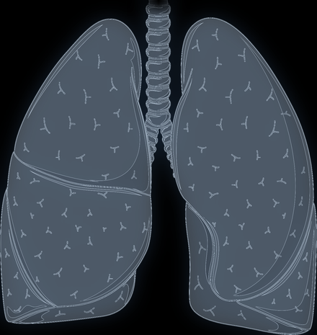

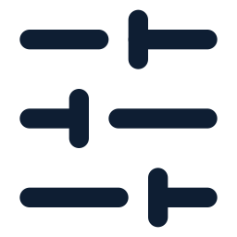

03
METHOD
An image-only ResNet-18, selected on validation only
Both models share the backbone and the training recipe; only their training sets differ.
ResNet-18: 4 stages × 2 residual blocks
Seen model
p
Unseen model
identical architecture and recipe
Frontal image
224 × 224
64 ch
56²
128 ch
28²
256 ch
14²
512 ch
7²
pool +
linear
sigmoid →
p(atelectasis)
Preprocessing
Training
Evaluation
DICOM rescale; invert MONOCHROME1
Clip to 0.5–99.5th percentile
Keep aspect ratio, pad to 224 × 224
ImageNet normalisation; no augmentation
ImageNet init; all layers fine-tuned
AdamW, lr 1e-4, weight decay 1e-4
Batch 32, mixed precision, 5 epochs
Keep epoch with lowest validation BCE
AUROC (primary), AUPRC, Brier score
Δ = seen − unseen on the same studies
95% CI: 1,000 patient-paired bootstraps
Test set never used for any choice
ResNet: He et al., CVPR 2016 [4]. The lung drawing is a schematic; the experiment used real frontal radiographs (not shown).
07
Notes:
⏱ 40 秒 | 建议分段 3：第 6–8 页，约 115 秒 | 全套主讲 420 秒
EN script:
Both models use the same image-only ResNet-18, initialised from ImageNet with all layers fine-tuned. Images are decoded from DICOM, contrast-clipped and padded to 224 by 224, without augmentation. We train with AdamW at learning rate 1e-4 and batch size 32 for five epochs, and keep the epoch with the lowest validation loss. AUROC is the primary metric, supported by AUPRC and Brier score. We report seen minus unseen, with 95 percent intervals from 1,000 patient-level bootstrap resamples; the test set is never used for choices.
中文要点：
模型：ImageNet 预训练 ResNet-18，只输入胸片，全参数微调。预处理：DICOM 解码与 rescale、MONOCHROME1 反转、0.5–99.5 百分位截断、保持比例缩放并补边到 224×224、ImageNet 归一化、无数据增强。AdamW，lr 1e-4，weight decay 1e-4，batch 32，AMP，5 轮；只按共享验证集 BCE 选轮次。主要指标 AUROC，辅以 AUPRC、Brier；差值 = seen − unseen，按病人配对 bootstrap 1,000 次得 95% 区间；测试集不参与任何选择。图中胸部为示意图，实验使用真实正面胸片。
Sources: code/README.md ; results/midterm_v1/run_config.json ; arxiv.org/abs/1512.03385

Slide 8
03
METHOD
Validation loss chose epoch 3 (seen) and epoch 4 (unseen)
Training loss kept falling; validation loss rose again after its minimum, so later epochs were not kept.
Seen (includes A)
Unseen (excludes A)
Training BCE
Shared validation BCE (no A cases)
Seen 0.712 → 0.048 Unseen 0.685 → 0.040
Kept: seen epoch 3 · 0.521 unseen epoch 4 · 0.597
BCE = binary cross-entropy (lower is better); note the different y-axis ranges. Validation excludes A and each curve is one run, so the curves select epochs; they do not compare the groups.
08
Notes:
⏱ 25 秒 | 建议分段 3：第 6–8 页，约 115 秒 | 全套主讲 420 秒
EN script:
Training loss fell steadily for both models. Validation loss bottomed out at epoch 3 for the seen model and epoch 4 for the unseen model, then rose, so those checkpoints were kept. These curves only select epochs: the validation set excludes A and each curve is one run.
中文要点：
训练损失两组都持续下降（0.712→0.048；0.685→0.040）。验证 BCE：seen 第 3 轮最低（0.521），unseen 第 4 轮最低（0.597），之后回升，所以保留这两个检查点。两图纵轴范围不同。验证集不含 A，且只有一个种子——曲线只用来选轮次；两条验证曲线高低不同也不能解读为组间差异。
Sources: results/midterm_v1/results.json (history = validation metrics)

Slide 9
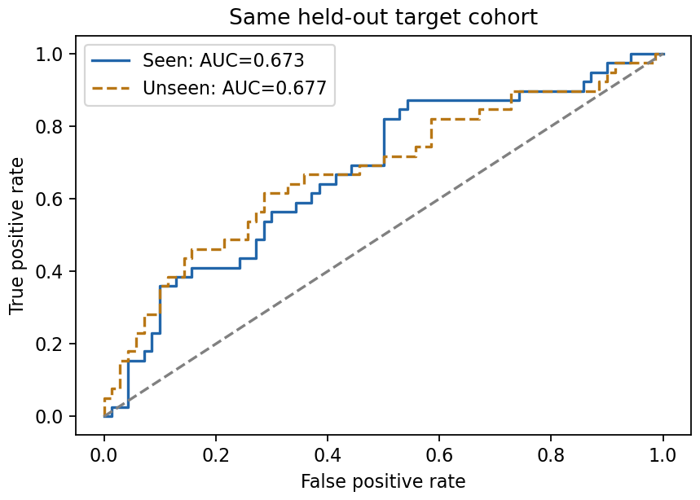
04
RESULTS
Same 109 test studies: AUROC 0.673 (seen) vs 0.677 (unseen)
Both models beat a constant-probability baseline, and their ROC curves cross repeatedly.
Metric | Seen | Unseen | Constant baseline
AUROC ↑ | 0.673 | 0.677 | 0.500
AUPRC ↑ | 0.511 | 0.573 | 0.358
Brier ↓ | 0.222 | 0.219 | 0.246
HOW TO READ THE METRICS
AUROC chance that a random positive study is ranked above a random negative one (0.5 = chance). Not accuracy.
AUPRC precision–recall summary; its chance level is the prevalence, 39/109 = 0.358.
Brier mean squared error of the predicted probabilities; lower is better.
ROC on the common test cohort (109 studies · 55 patients · 39 positive). Figure: results/midterm_v1/results.png
Constant baseline predicts the training positive rate for every study. Point estimates only; no separate significance test against the baseline.
09
Notes:
⏱ 45 秒 | 建议分段 4：第 9–11 页，约 115 秒 | 全套主讲 420 秒
EN script:
On the common test cohort, the seen model reaches an AUROC of 0.673 and the unseen model 0.677, and the ROC curves cross repeatedly. AUROC is the probability that a random positive study is ranked above a random negative one — it is not accuracy. AUPRC is 0.511 versus 0.573, against a chance level of 0.358, and the Brier scores are 0.222 and 0.219, versus 0.246 for a constant prediction. So both models learned some signal, but performance is modest.
中文要点：
同一测试集上 AUROC：seen 0.673，unseen 0.677，两条 ROC 曲线多次交叉。AUROC 表示随机一个阳性排在随机一个阴性之前的概率，不是正确率（不能说“准确率 67%”）。AUPRC 0.511 / 0.573（随机水平 = 阳性比例 0.358）；Brier 0.222 / 0.219（常数基线 0.246，越低越好）。两模型点估计均优于常数基线，但未单独做显著性检验；整体性能属中等。本版未报告阈值下的混淆矩阵，不要从 AUROC 推算假阳性/假阴性比例。
Sources: results/midterm_v1/results.json ; results/midterm_v1/results.png

Slide 10



04
RESULTS
All three paired 95% intervals include zero
Seen − unseen on the same test patients: no stable difference in this pilot.
METRIC
SEEN − UNSEEN (95% CI)
ESTIMATE [95% CI]
AUROC
−0.004 [−0.080, +0.060]
higher is better
AUPRC
−0.062 [−0.167, +0.074]
higher is better
Brier
+0.003 [−0.034, +0.042]
lower is better
−0.20
−0.15
−0.10
−0.05
0
+0.05
+0.10
No stable difference
Not proof of equivalence
Uncertainty is partial
Training with A’s 46 studies gave no detectable difference on A’s patients in this pilot.
AUROC differences from −0.080 to +0.060 remain compatible with these data.
Intervals resample test patients only, not retraining with another seed.
Δ = seen − unseen. A negative Δ for AUROC/AUPRC, or a positive Δ for Brier, numerically favours the unseen model. 1,000 paired patient-level bootstrap resamples, all valid.
10
Notes:
⏱ 35 秒 | 建议分段 4：第 9–11 页，约 115 秒 | 全套主讲 420 秒
EN script:
The key result is the paired difference. Seen minus unseen AUROC is minus 0.004, with a 95 percent interval from minus 0.080 to plus 0.060. The AUPRC and Brier intervals also include zero. So this pilot shows no stable difference. That is not proof of equivalence: the intervals are wide, and they only reflect which patients were sampled, not the randomness of retraining.
中文要点：
核心结论：AUROC 差值 −0.004，95% 区间 [−0.080, 0.060]；AUPRC、Brier 的区间也都包含 0 → 本次小规模实验没有稳定的组间差异证据。不能说“两组等效”或“医生没有影响”：区间很宽，且只反映测试病人抽样，不包含换种子重新训练的随机性。三项点估计在数值上都偏向 unseen，但都不稳定。
Sources: results/midterm_v1/results.json (paired_bootstrap)

Slide 11



04
CONCLUSION & NEXT STEPS
What the pilot shows, and what comes next
A working paired pipeline on real images, with uncertainty still too wide for a firm conclusion.
Limits of this pilot
Plan for the final project
One physician group, one training seed
Small samples: 256 training studies per group, 55 test patients
Report-derived labels, not an image gold standard
Case mix not fully matched (e.g. 167 vs 171 training patients)
1
Repeat across more attending IDs and several seeds
2
Train on the prepared full-size sets (1,409 studies per group)
3
Audit a random sample of “not mentioned” labels
4
Examine case mix (views, patient overlap) and 512 px inputs
Fixed in advance: test cohorts, selection rules and metrics — no re-picking physicians or test sets to improve the numbers.
Physician IDs describe study associations only: these results say nothing about physician quality or a causal physician effect.
11
Notes:
⏱ 35 秒 | 建议分段 4：第 9–11 页，约 115 秒 | 全套主讲 420 秒
EN script:
To conclude: the paired pipeline works end to end on real images, but this pilot has one physician group, one seed, small samples and report-derived labels. For the final project we will repeat it across more physicians and seeds, train on the full-size sets, audit “not mentioned” labels, and examine case mix and higher resolution — with test cohorts and selection rules fixed in advance. Thank you.
中文要点：
总结：配对流程已在真实图像上跑通；限制是单医生组、单种子、小样本、报告来源标签（机械未提及部分未复核）、病例构成未完全匹配。期末计划：扩展到更多主治医生和多个种子；使用已准备的完整规模训练集（每组 1,409 次，尚未训练）；随机抽查“未提及”报告；分析体位、病人重叠等病例构成，尝试 512 像素。测试集和选择规则提前固定，不为更好的结果改选医生或测试集。结束语：谢谢。
Sources: HANDOFF.md ; results/midterm_v1/README.md ; docs/PROJECT.md

Slide 12
References and credits
Backup slide — not part of the 7-minute talk.
[1]
Johnson AEW, Pollard TJ, Berkowitz SJ, et al. MIMIC-CXR, a de-identified publicly available database of chest radiographs with free-text reports. Scientific Data 6, 317 (2019). Data: MIMIC-CXR v2.1.0, PhysioNet.
physionet.org/content/mimic-cxr/2.1.0
[2]
Smit A, Jain S, Rajpurkar P, et al. CheXbert: combining automatic labelers and expert annotations for accurate radiology report labeling using BERT. EMNLP 2020.
arxiv.org/abs/2004.09167
[3]
Zech JR, Badgeley MA, Liu M, et al. Variable generalization performance of a deep learning model to detect pneumonia in chest radiographs: a cross-sectional study. PLOS Medicine 15(11): e1002683 (2018).
doi.org/10.1371/journal.pmed.1002683
[4]
He K, Zhang X, Ren S, Sun J. Deep residual learning for image recognition. CVPR 2016.
arxiv.org/abs/1512.03385
Project results: experiment run on 27 Sep 2026 (one physician group, one seed); metrics, figure and configuration in results/midterm_v1.
github.com/Grayye123/BN5212_group
Artwork: lung illustration adapted and recoloured from Servier Medical Art, licensed under CC BY 4.0.
smart.servier.com
12
Notes:
⏱ 0 秒 | 备用页 | 全套主讲 420 秒
EN script:
Backup slide with full references; not presented within the 7 minutes.
中文要点：
参考文献与图片来源，不计入七分钟主讲。项目结果对应 results/midterm_v1（实验运行于 2026-09-27；单医生组、单种子）。本演示文稿未重新训练模型，所有数字取自公开结果文件。
Sources: results/midterm_v1/README.md

