Slide 2
An input voltage that must be higher than the battery voltage!
A linear charger | Modulates the resistance of a pass device in order to regulate the charge current and charge voltage.
A direct charger | Modulates the input voltage source directly. The charger consists of a pass device used as a shorting resistor, and the battery charging system must communicate with the input source to achieve a complete charging cycle

Slide 3
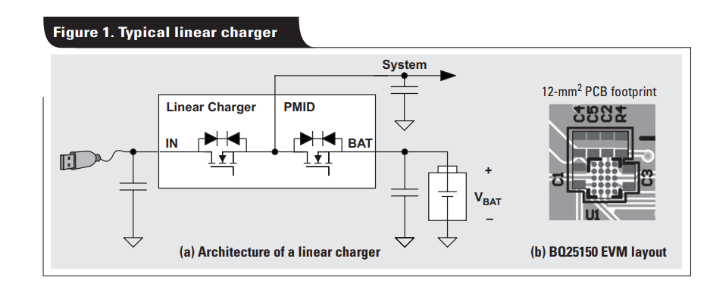
A linear charger : Power Path Management
During normal operation with an input present, the first switch turns on and shorts the input to PMID, while the second switch modulates its resistance in order to regulate the current and voltage at the battery output.
The main drawback associated with this device is the low efficiency (η), which is dictated only by the ratio of input and battery voltages, η = VBAT/VIN.
Its use is typically limited to applications requiring less than 1 A of charge current.

Slide 4
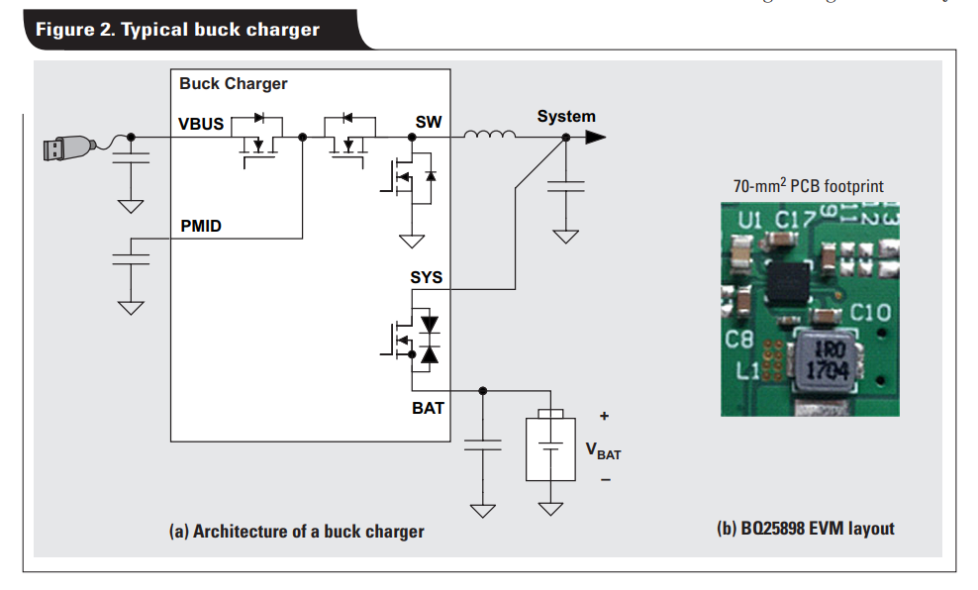
Buck switch-mode chargers
In this architecture, the system is powered from either the buck converter output (when an input is present) or the battery (when an input is removed or overloaded).
The reverse blocking field-effect transistor (FET) used to prevent battery discharge into the input.
Two switching FETs used as a DC/DC buck converter
A battery FET used to achieve the power-path management feature

Slide 5
Buck switch-mode chargers
maintain efficiencies on the order of 91% at the optimal point of operation.
A larger circuit area translates to higher efficiency at higher charge currents.
A popular choice when charge currents exceed abou
High-frequency switching to achieve voltage conversion, which also generates noise and potential EMI concerns.t 1 A.
EVM of a buck-charger design with the BQ25898.

Slide 6
Three-level buck switch-mode chargers

