Slide 1
KAERI Modelling Approach
Direction and 2026 development summary
Integrated groundwater, surface-water and conduit flow for KURT
MUT · MODFLOW-USG · QGIS · Tecplot
Current MUT release: 2025.026
11 September 2026
1

Slide 2
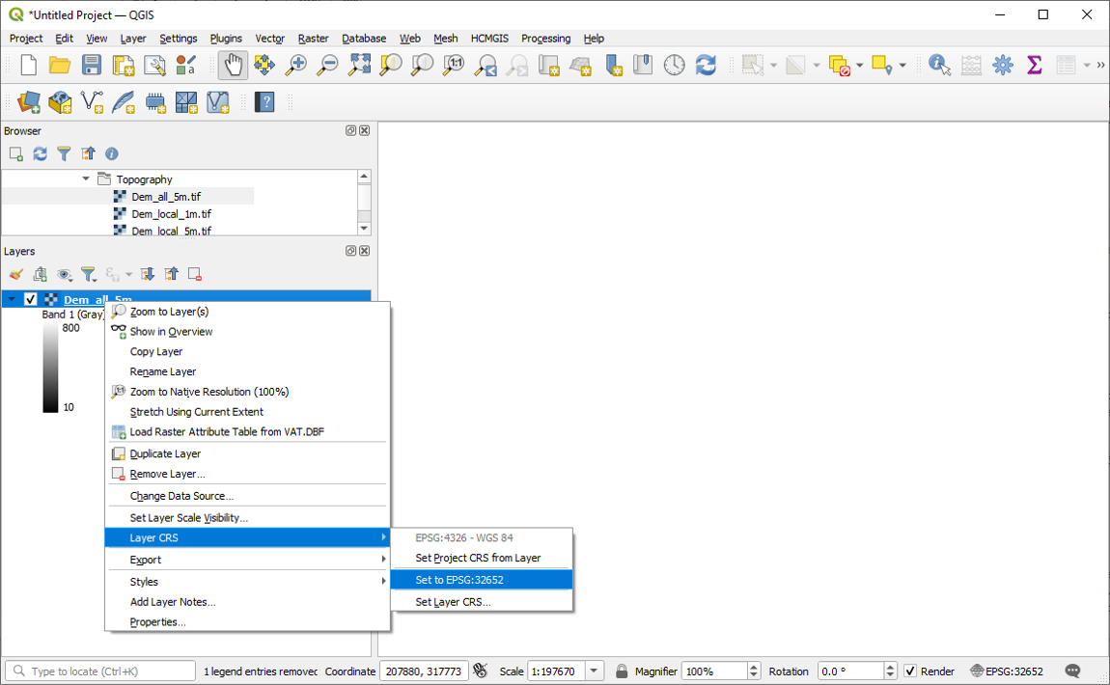
Purpose - Supporting KURT engineering assessment
The KAERI/KURT assessment needs a reproducible path from site GIS into a coupled flow model that can represent regional groundwater, overland response to rainfall, and engineered conduits or shafts.
QGIS organises DEMs and spatial layers; MUT translates those into MODFLOW-USG inputs; usgs_1 solves the flow system; Tecplot and the model dossier communicate water levels, exchange fluxes and budgets for engineering review.
Example project DEM prepared in QGIS for regional model construction.
11 September 2026
2
KAERI modelling direction · MUT 2025.026

Slide 3
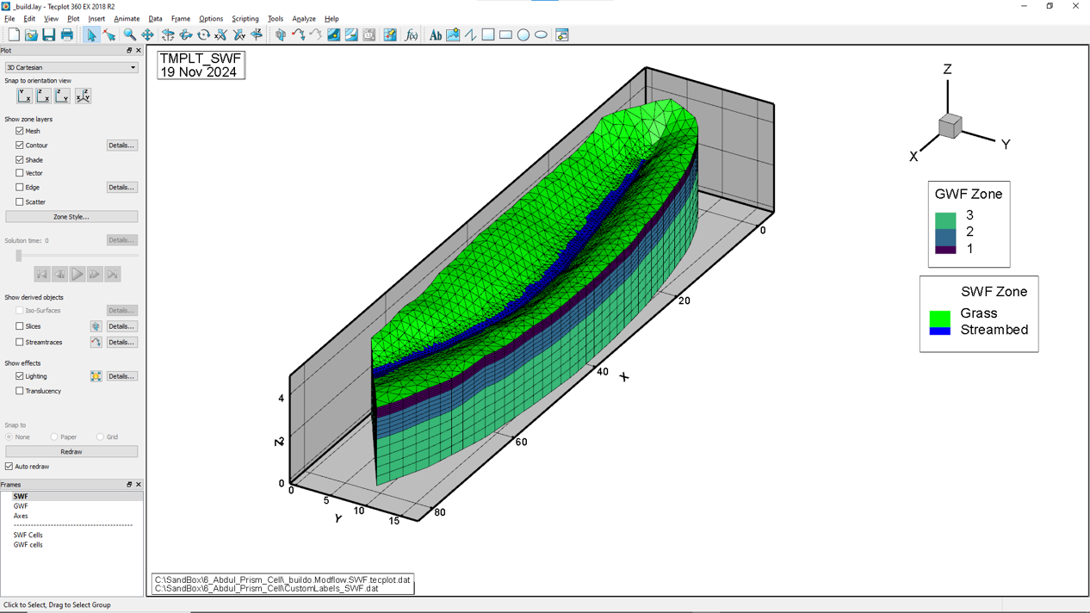
Coupled domains - Groundwater, surface water and conduits
Engineering questions at KURT are rarely single-domain. Rainfall first wets the surface (SWF), infiltrates to the porous medium (GWF), and may interact with discrete conduits or shafts (CLN).
The 2026 toolchain builds these domains on a shared mesh so exchange fluxes, heads and budgets can be examined together rather than as separate models stitched after the fact.
SWF surface cells overlying the GWF mesh - dual-domain exchange geometry.
11 September 2026
3
KAERI modelling direction · MUT 2025.026

Slide 4
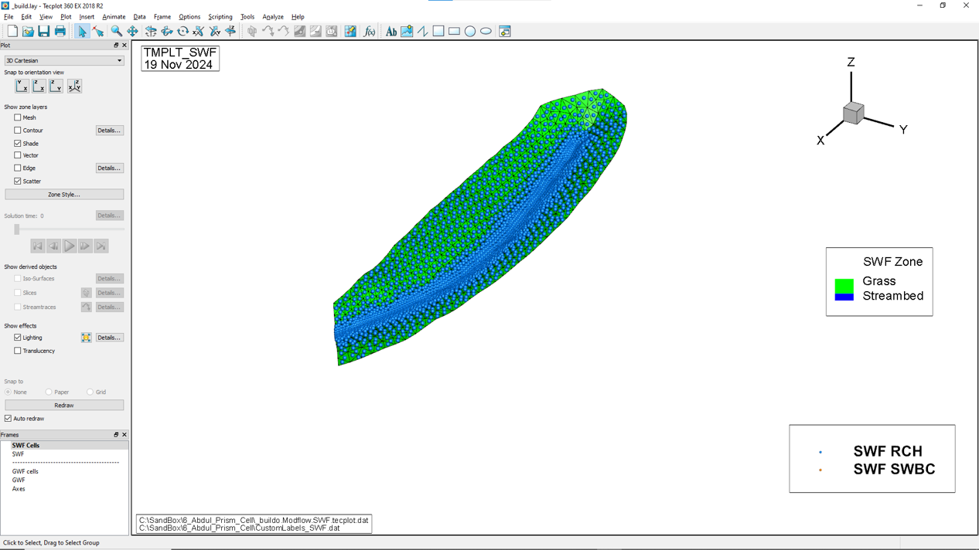
Rainfall and surface forcing - Zones, transient recharge and controls
Surface hydrology for engineering design needs spatially varying rainfall and controllable boundary heads. MUT now supports multi-zone SWF transient recharge (merged RTS columns and matching RCH zone maps), reports whether each stress period uses RCH or RTS, and writes CLN/SWF constant-head boundaries as start-to-end head ramps so engineered water levels can be imposed consistently through a simulation.
Applied SWF recharge mapped on the surface domain for review in Tecplot.
11 September 2026
4
KAERI modelling direction · MUT 2025.026

Slide 5
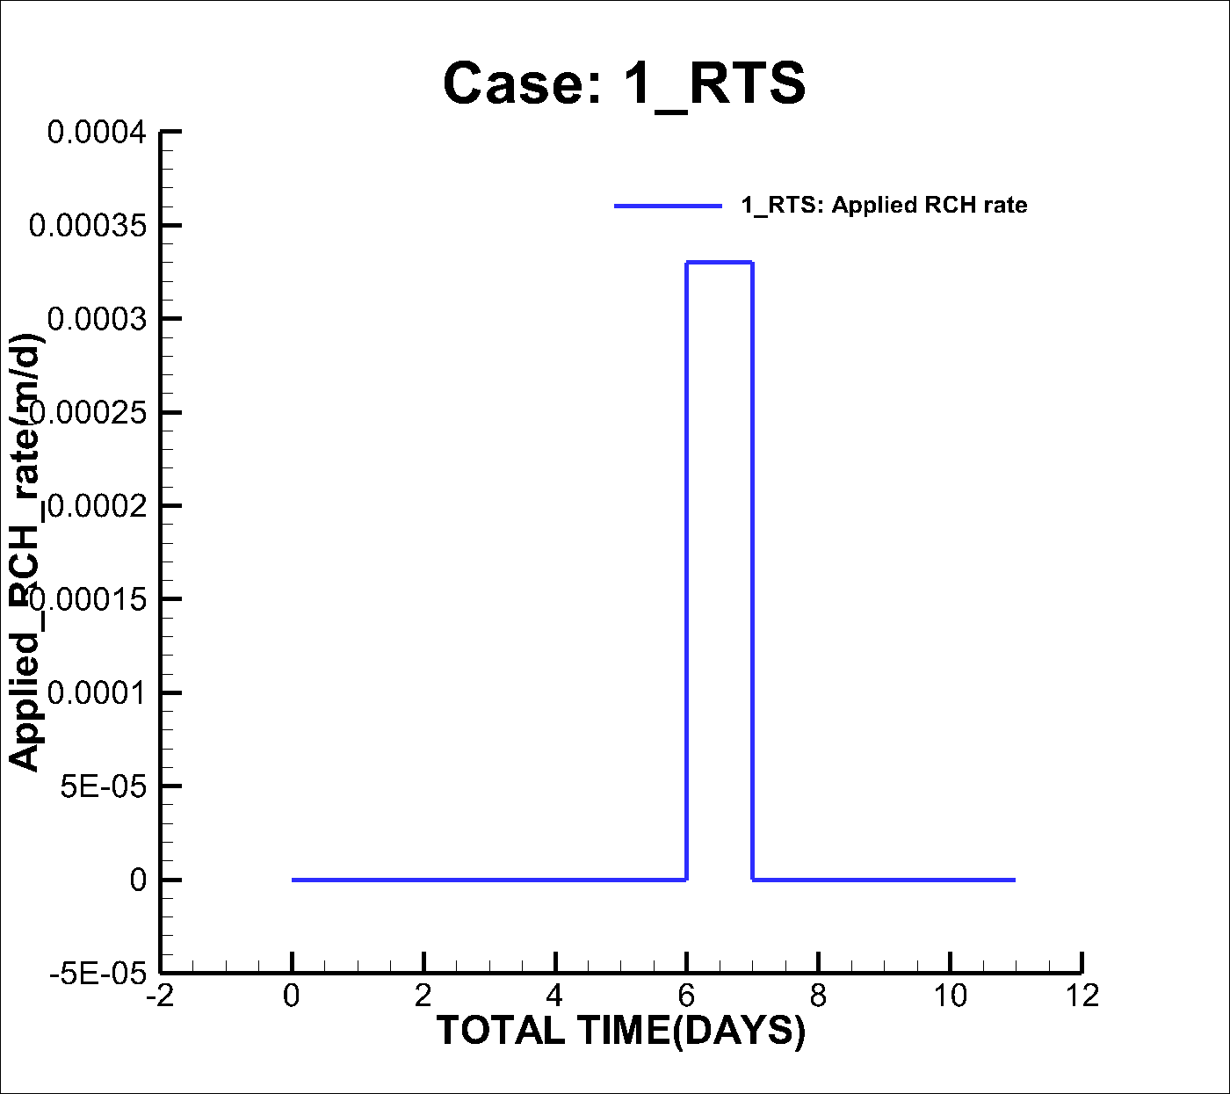
Spatio-temporal recharge - Raster snapshots for transient rain
For storms and spatially migrating rainfall fields, General Spatio-Temporal Recharge (GSTR) assigns ArcASCII raster snapshots to named GWF, SWF or CLN instances and interpolates rates in time. Existing RCH/RTS packages remain available; when both are active the fluxes add.
A KURT demonstration lives under the transient-rainfall GSTR test model. The figure shows applied recharge from the related RTS workflow used to evaluate surface response.
Applied recharge field from the KURT transient-rainfall RTS review (proxy for GSTR-style spatial forcing).
11 September 2026
5
KAERI modelling direction · MUT 2025.026

Slide 6
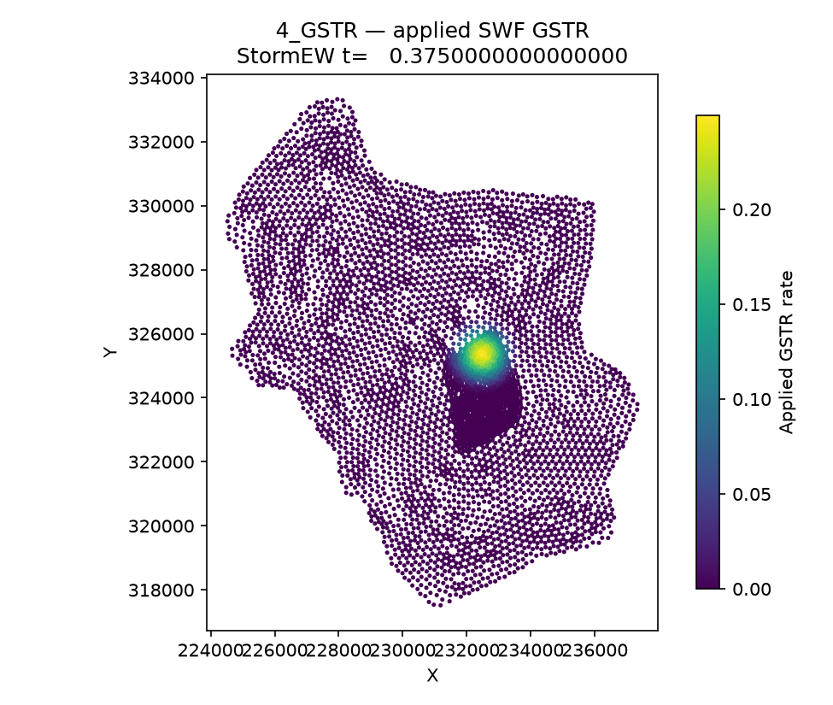
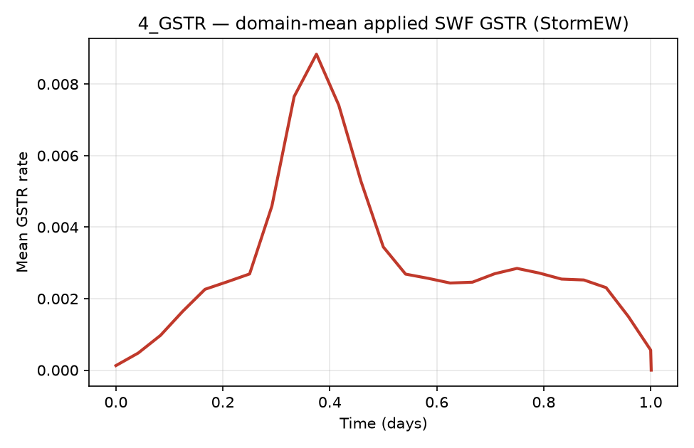
KURT 4_GSTR example - Circular storm applied to SWF
The TestTransientRainfall/4_GSTR model drives SWF recharge with named GSTR instance StormEW: ArcASCII storm rasters are interpolated in time and applied on the surface domain. Post-processing writes cell-by-cell applied rates (_posto.modflow.SWF_GSTR.tecplot.dat) and a domain-mean time series. The maps below show the peak applied-rate field (t = 0.375 d) and the short storm pulse in mean GSTR before rates return to zero for the remainder of the run.
Domain-mean applied GSTR rate vs time (first 2 days)
Applied SWF GSTR rate at peak mean (StormEW, t = 0.375 d)
11 September 2026
6
KAERI modelling direction · MUT 2025.026

Slide 7
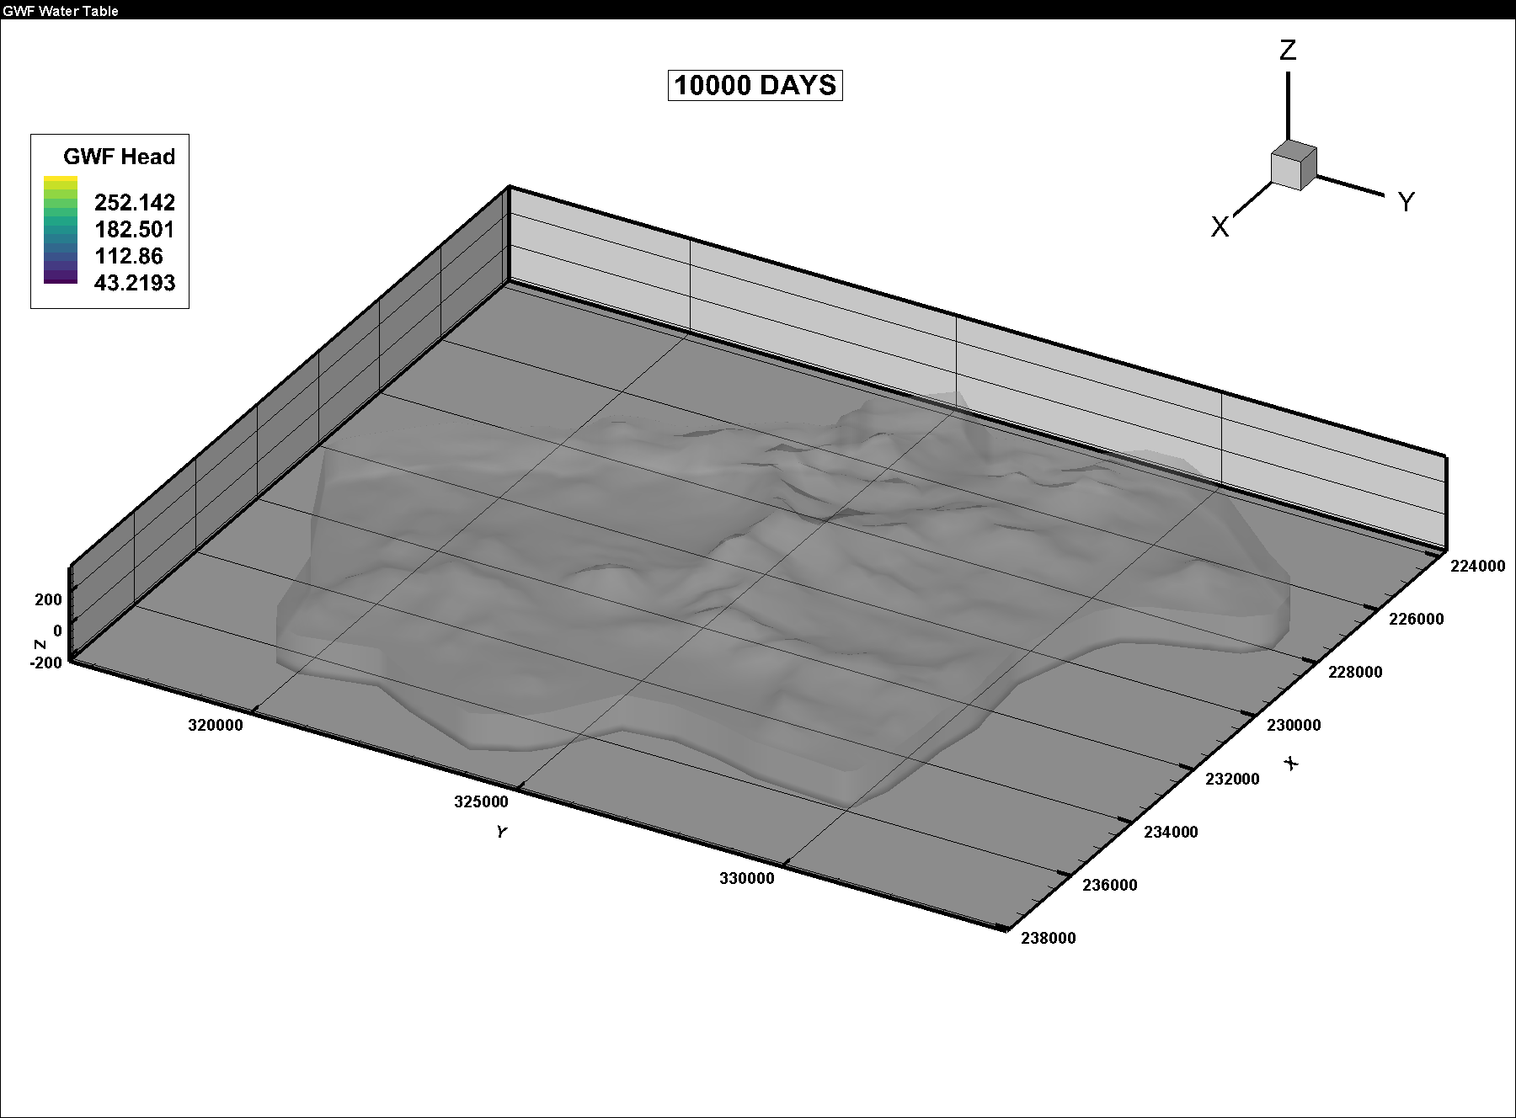
Evapotranspiration in MODFLOW-USG - Head-dependent plant and soil water loss
usgs_1 (MODFLOW-USG / USG-Transport) already provides classical groundwater ET packages that remove water from the saturated zone as a function of water-table position. The EVT package applies a maximum ET rate that declines linearly to zero over an extinction depth below a specified ET surface. The ETS package extends this with a segmented (piecewise) ET-versus-depth curve for non-linear plant uptake.
EVT can also take time-varying maximum rates (ETS keyword / time-series option) so seasonal potential ET can be imposed. These packages act on GWF nodes and appear as budget terms when activated - the practical path today for regional ET sinks alongside rainfall recharge.
Regional water-table surface - ET demand in EVT/ETS is controlled by proximity to the land surface / extinction depth.
11 September 2026
7
KAERI modelling direction · MUT 2025.026

Slide 8
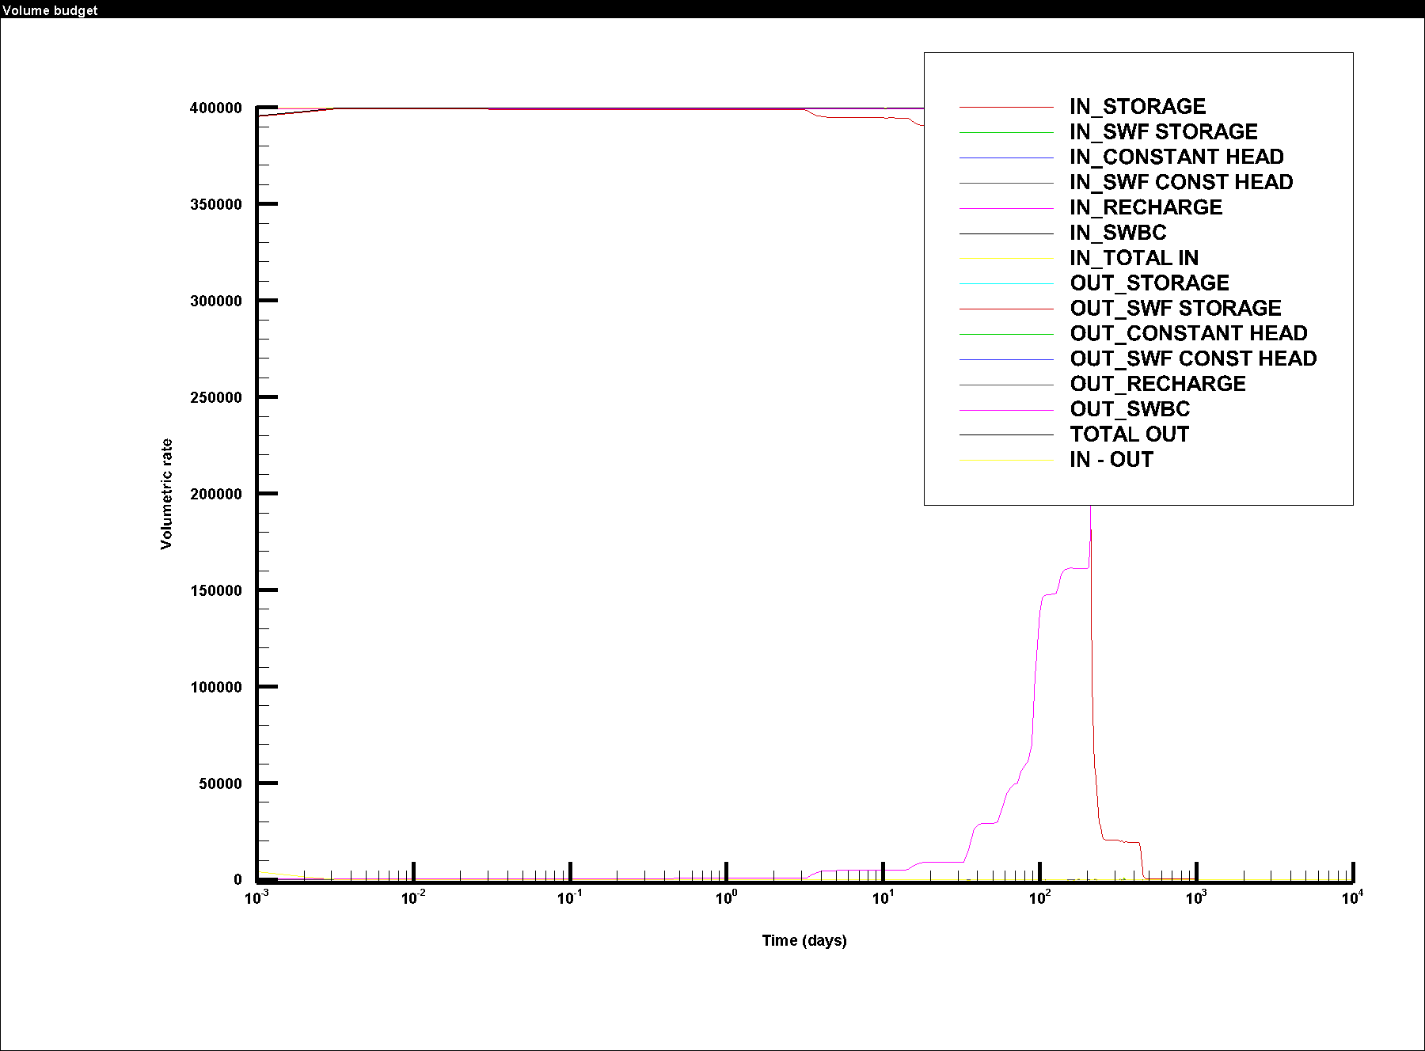
Evapotranspiration in MUT - Database scaffolding, writers still to come
MUT can load an ET parameter database (et database) whose fields mirror an HGS-style plant/soil ET concept: evaporation and root depths, LAI tables, wilting point and field capacity, oxic/anoxic limits, and canopy interception storage. Sparse ET material IDs are supported alongside GWF/CLN/SWF databases.
However, ET.xlsx / LAI.xlsx remain placeholders for future development: MUT does not yet assign ET zones to cells or write EVT/ETS package files. Name-file recognition of EVT/EVS/ETS exists for reading external datasets, but the KURT workflow today is rainfall and infiltration without an automated MUT-driven ET sink. Closing the gap means mapping the ET database (or a simpler EVT/ETS instruction set) onto usgs_1 package writers and exposing ET in volume-budget and Tecplot review.
Current KURT volume-budget dossier frame - ET package terms appear only when EVT/ETS are active in usgs_1.
11 September 2026
8
KAERI modelling direction · MUT 2025.026

Slide 9
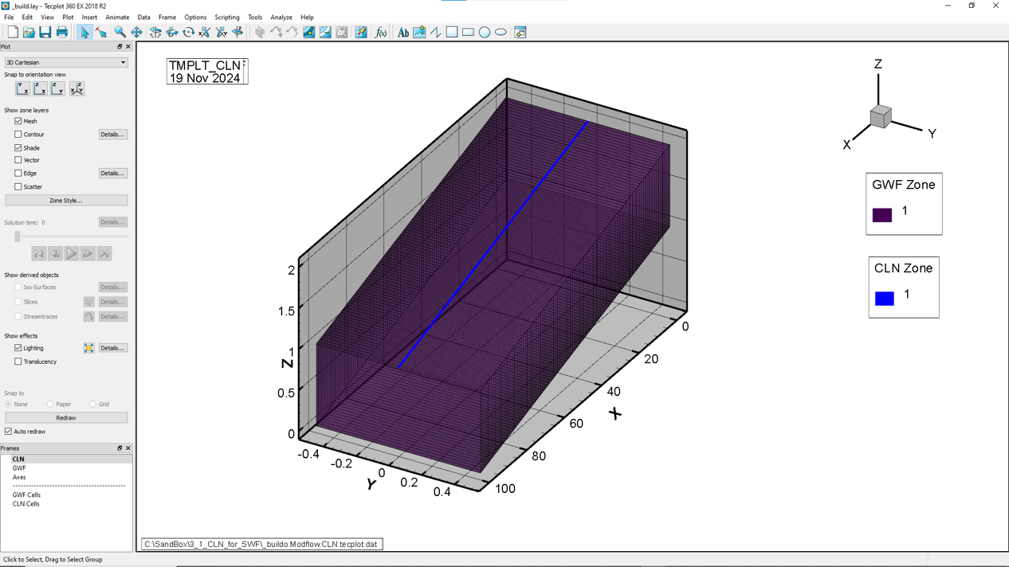
Conduits and shafts - Building CLN from the mesh
Engineered openings and discrete pathways are represented with the Connected Linear Network (CLN). Development this year focused on intersecting conduit polylines with GWF/SWF element faces, preserving network connectivity, and connecting CLN nodes to the groundwater mesh for simple and shaft-style configurations.
Conduits can also be rebuilt from a structure file with a companion coordinate list for geometry checks.
CLN conduits shown with the surrounding porous-medium mesh.
11 September 2026
9
KAERI modelling direction · MUT 2025.026

Slide 10
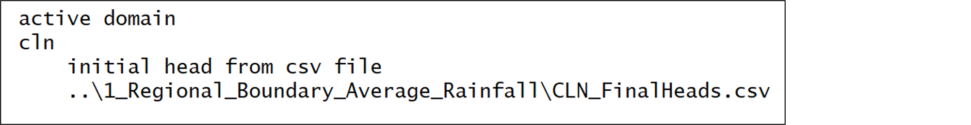
CLN hydraulic detailing - Skin, geometry and initial heads
Once the conduit geometry exists, hydraulic behaviour must match the engineering concept. Per-cell skin conductivity (FSKIN) defaults from connected GWF horizontal conductivity, general tabular cross-sections support non-circular conduits, and initial CLN heads can be set from the land surface via column tops - a practical starting condition for shafts that daylight at topography.
CLN initial heads assigned from surface elevation / GWF column tops.
11 September 2026
10
KAERI modelling direction · MUT 2025.026

Slide 11
Velocity and pathways - Darcy and average-linear flow
Flow interpretation and future solute transport both need velocities, not only heads. Builds now emit a default VEL package for active GWF, CLN and SWF domains. Post-processing writes Darcy and average-linear velocity components for Tecplot; porosity (and CLN infill porosity where used) converts Darcy flux to pore velocity.
An optional original SWF Manning velocity path remains available for continuity with HGS-style surface flow.
Regional water-table iso-surface from the KURT average-rainfall model dossier.
11 September 2026
11
KAERI modelling direction · MUT 2025.026

Slide 12
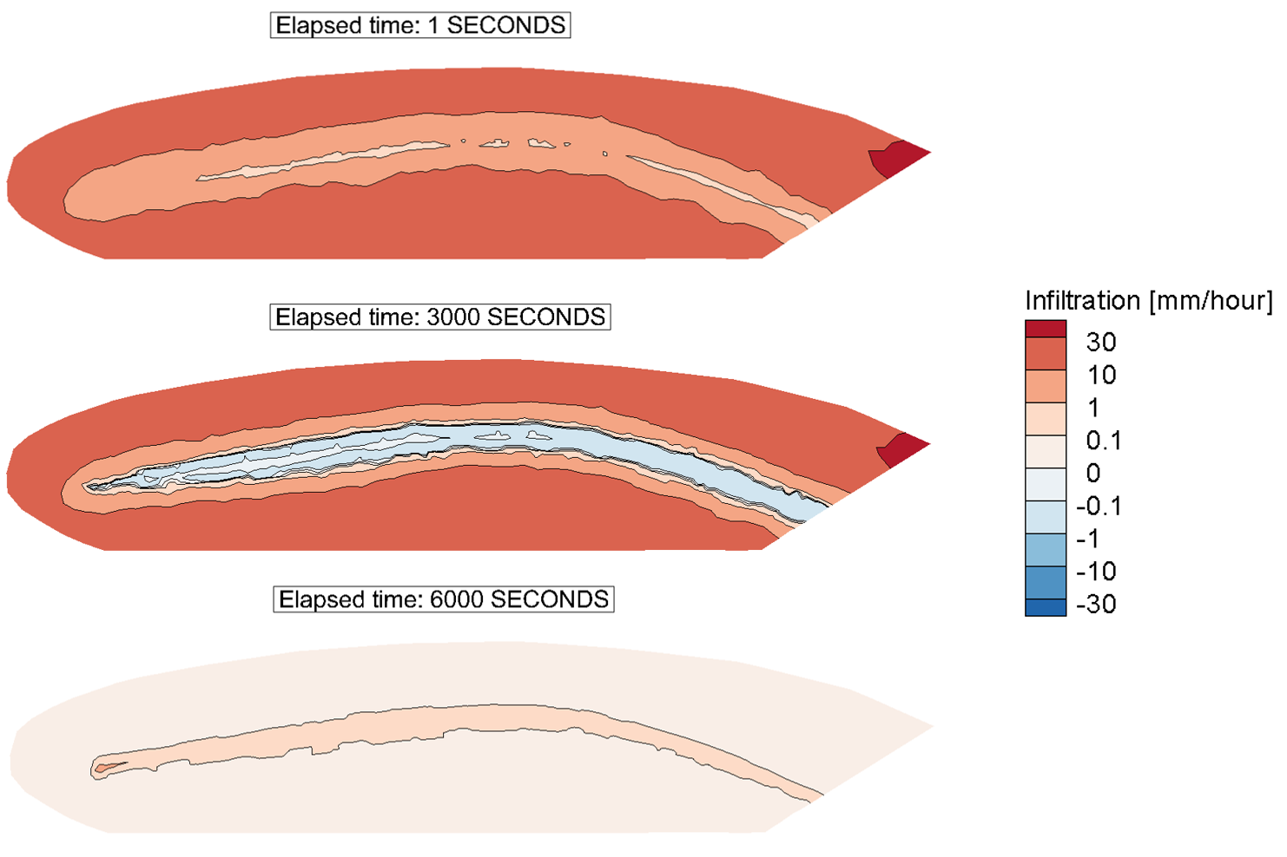
Communicating results - Tecplot SZL and model dossiers
Engineering review depends on clear maps of saturation, infiltration, water table and volume budgets. Finite-element results default to compact TecIO SZL files with all output times.
After build or post-processing, mut_document writes a model dossier PDF and sectioned Tecplot layouts - including dedicated views for volume budget, water table, SWF-to-GWF infiltration and saturation slices - so reviewers see the same figures the modeller used.
Example SWF-to-GWF infiltration map used in post-processed hillslope review.
11 September 2026
12
KAERI modelling direction · MUT 2025.026

Slide 13
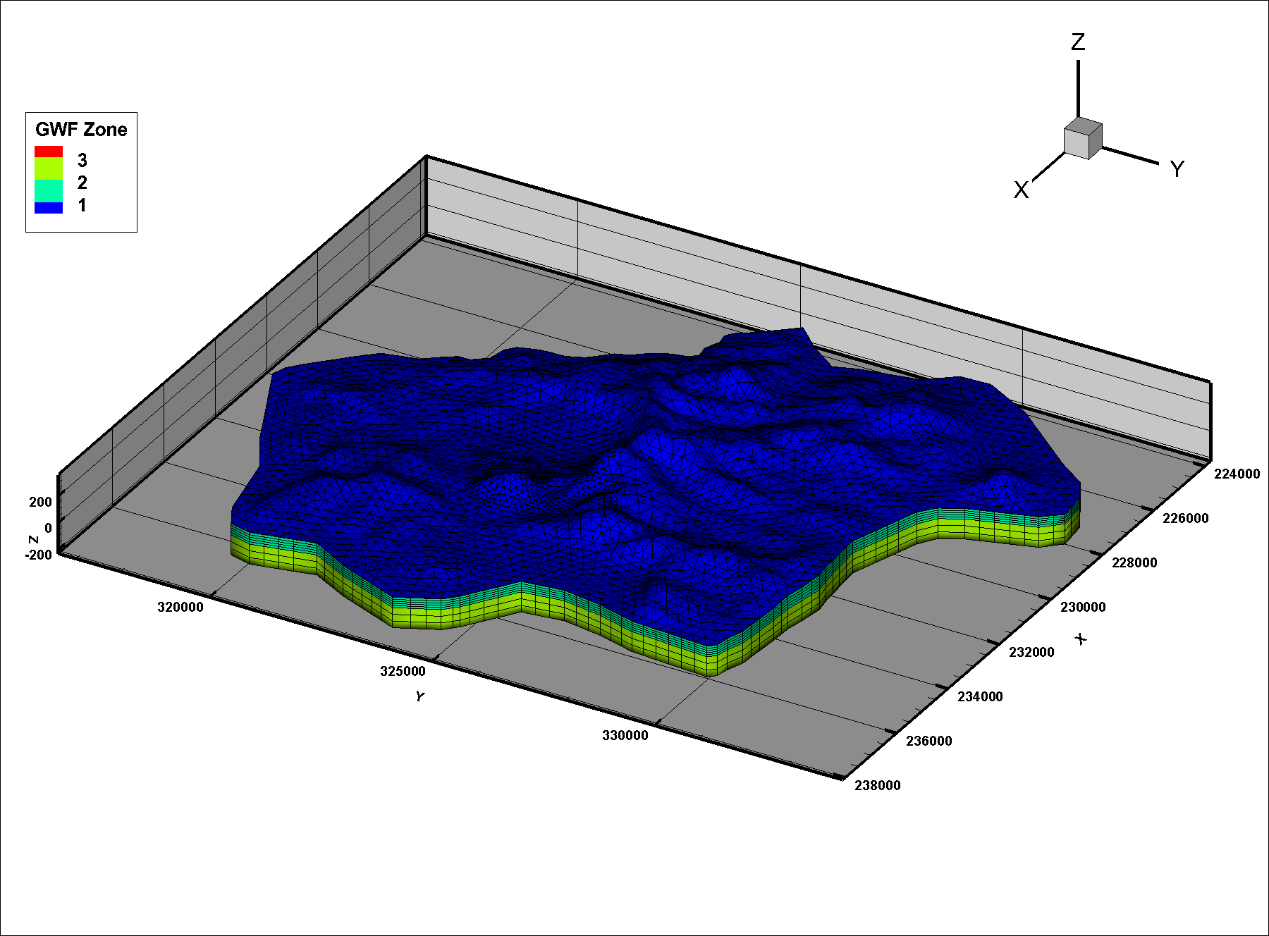
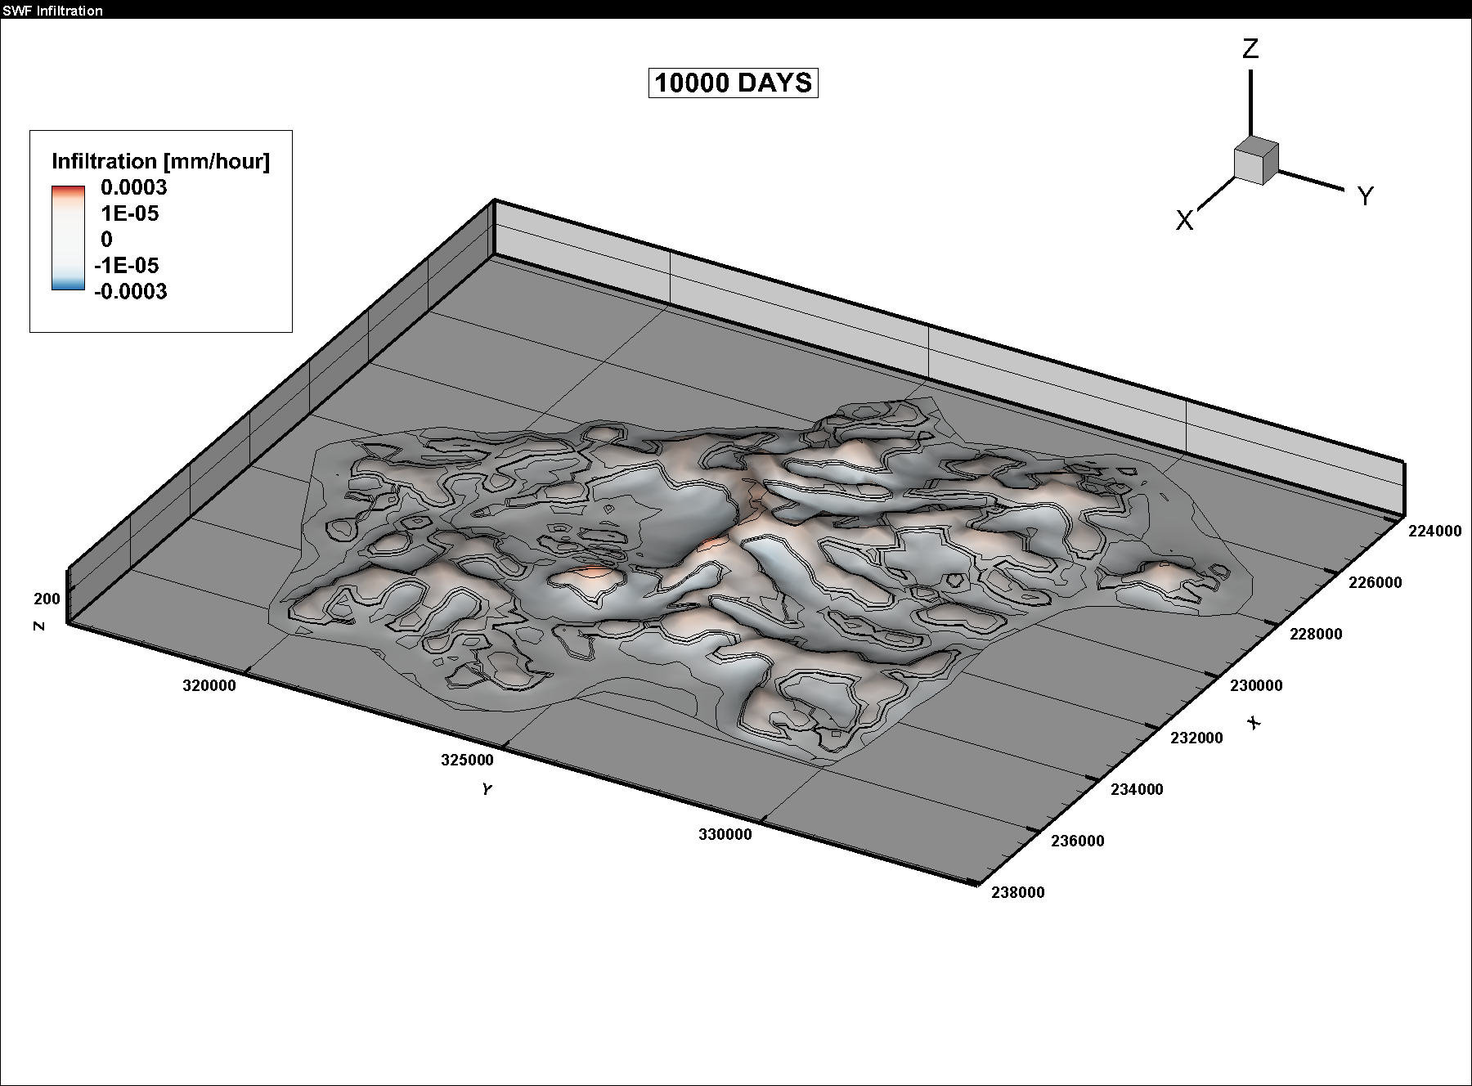
Regional KURT illustration - Mesh, water table and infiltration
The regional average-rainfall KURT model exercises the full stack on site-scale geometry: dual-domain mesh, transient surface response, and groundwater storage. Side-by-side dossier frames below illustrate how mesh structure, water-table position and infiltration patterns are delivered together for engineering discussion.
GWF mesh / domain overview
Water-table surface
SWF-to-GWF infiltration
11 September 2026
13
KAERI modelling direction · MUT 2025.026

Slide 14
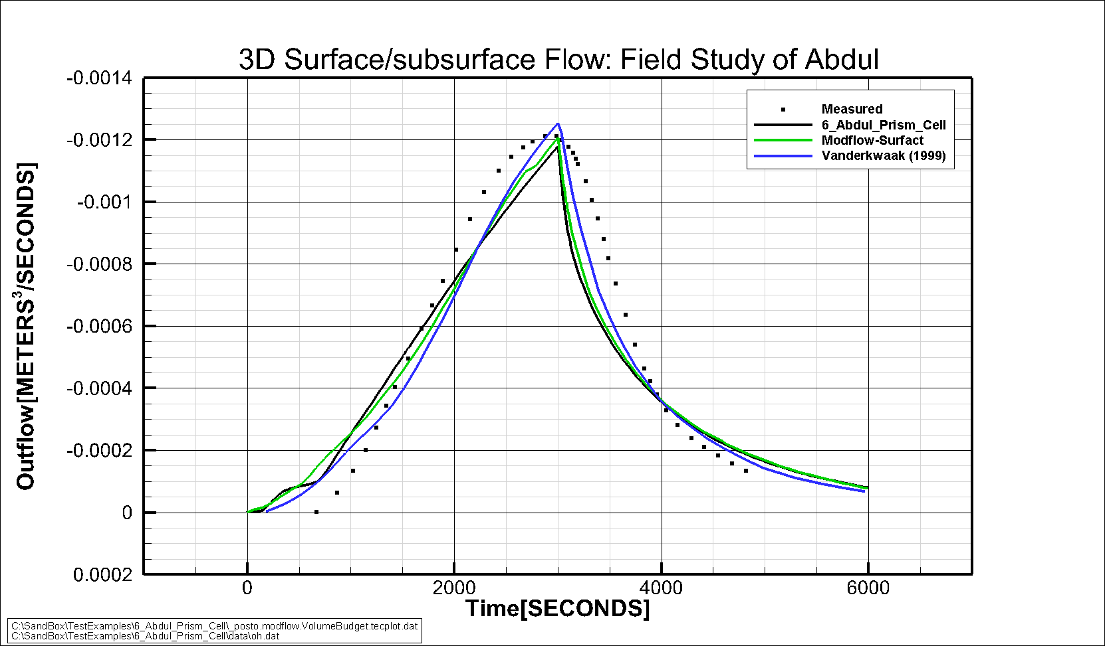
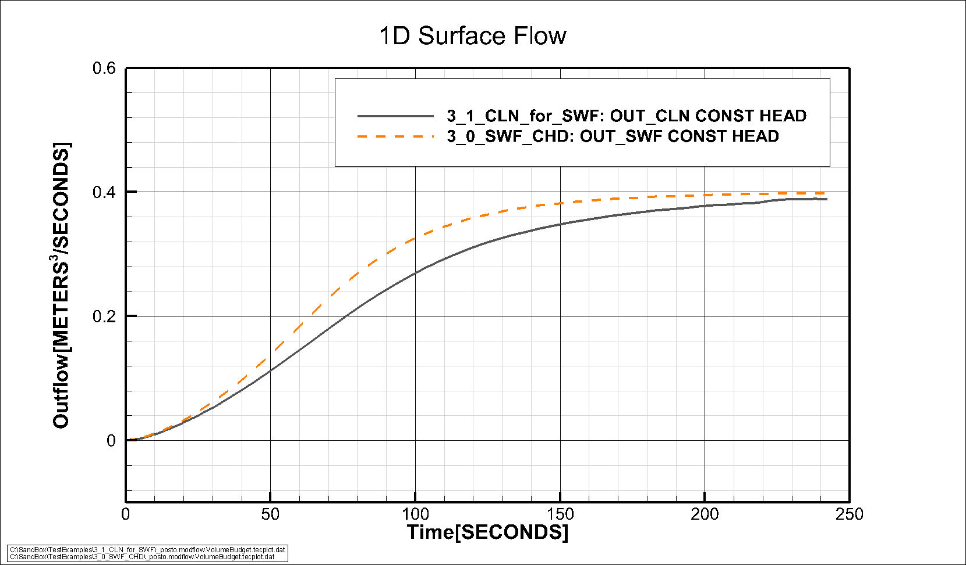
Verification practice - Confidence from known problems
Before relying on regional forecasts, the same toolchain is checked against published and in-house flow problems (Abdul hillslope, SWF critical-depth and CLN-for-SWF cases). Outflow and depth comparisons against accepted solutions provide engineering confidence that surface–subsurface coupling and conduit representations behave as intended when rainfall, outlets and materials are known.
Abdul outlet hydrograph comparison
CLN-for-SWF outflow comparison
11 September 2026
14
KAERI modelling direction · MUT 2025.026

Slide 15
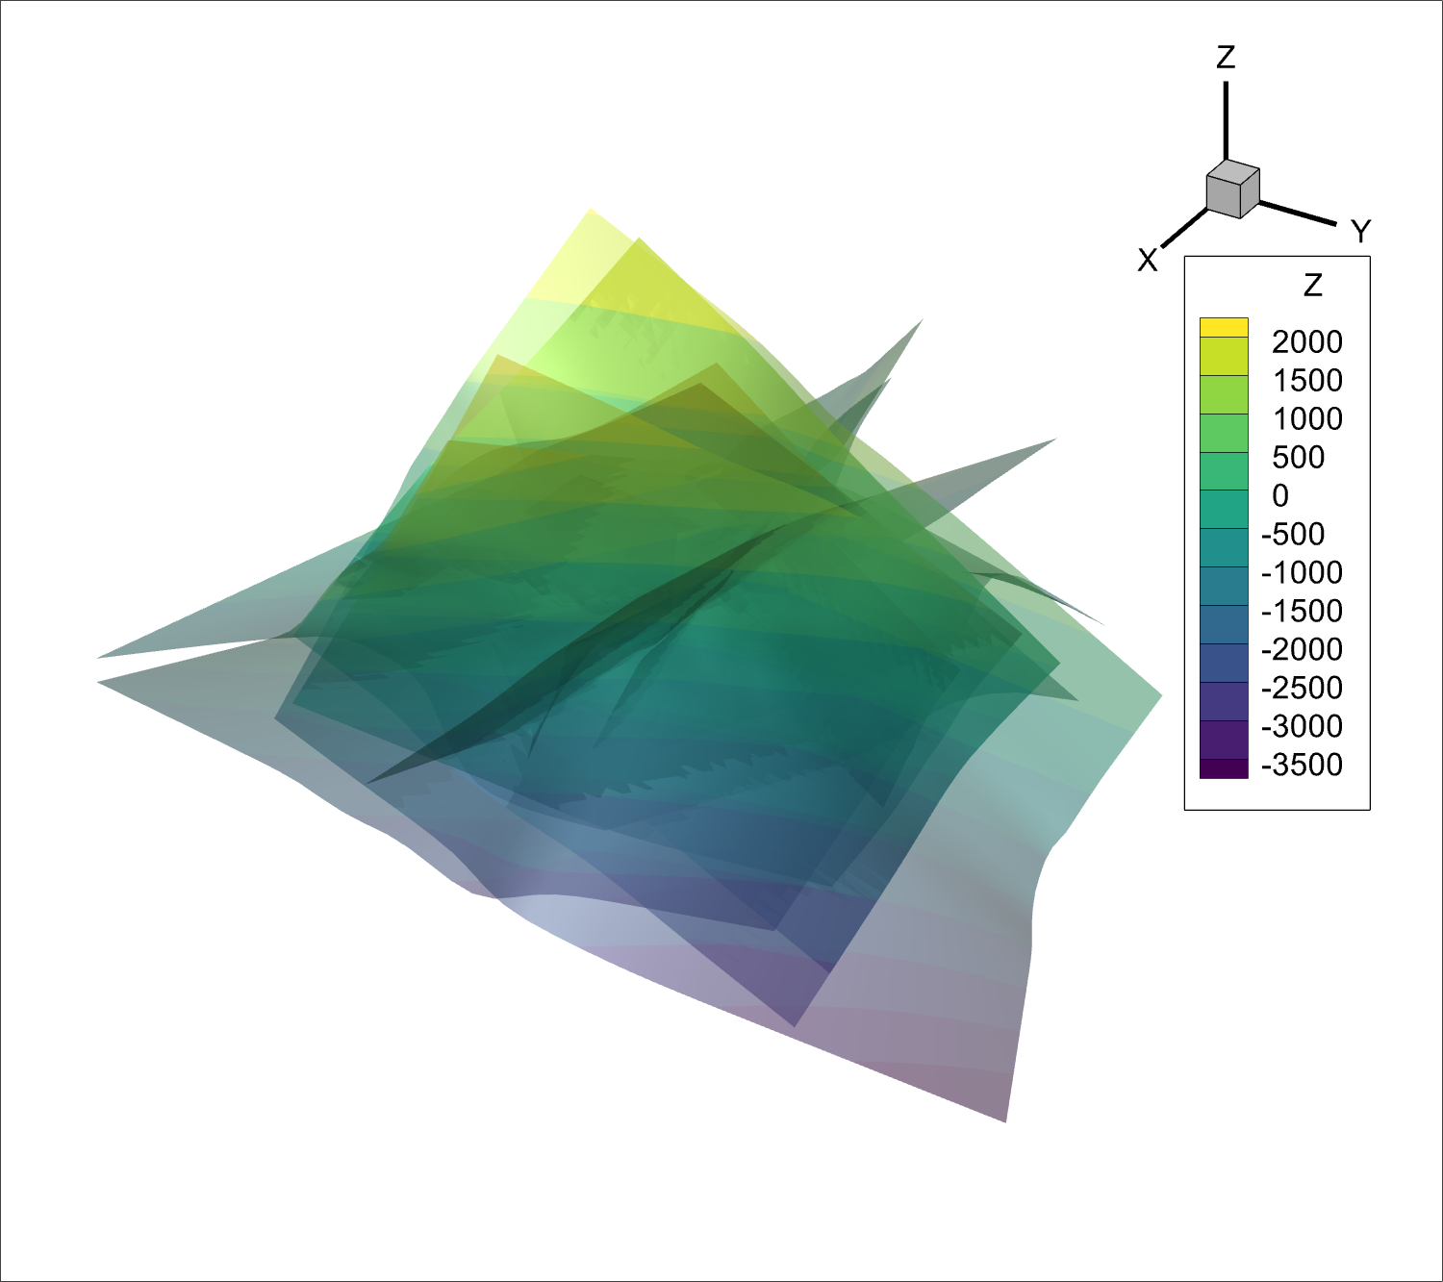
Future capability - Discrete Fracture Network (DFN) medium
KURT fracture zones are naturally represented as discrete 2D flow surfaces embedded in 3D porous rock, not as continuum smearing alone and not as 1D pipes. A new medium, DFN, would sit alongside GWF, CLN and SWF: planar fracture elements with aperture and transmissivity, exchanging water (and later solute) with the surrounding GWF matrix.
CLN remains the right tool for shafts and tubular conduits; DFN targets sheet-like fractures imported from site STL/GIS fracture surfaces (as in the KURT incoming fracture set).
KURT fracture surfaces (incoming STL set) - candidate geometry for a DFN medium.
11 September 2026
15
KAERI modelling direction · MUT 2025.026

Slide 16
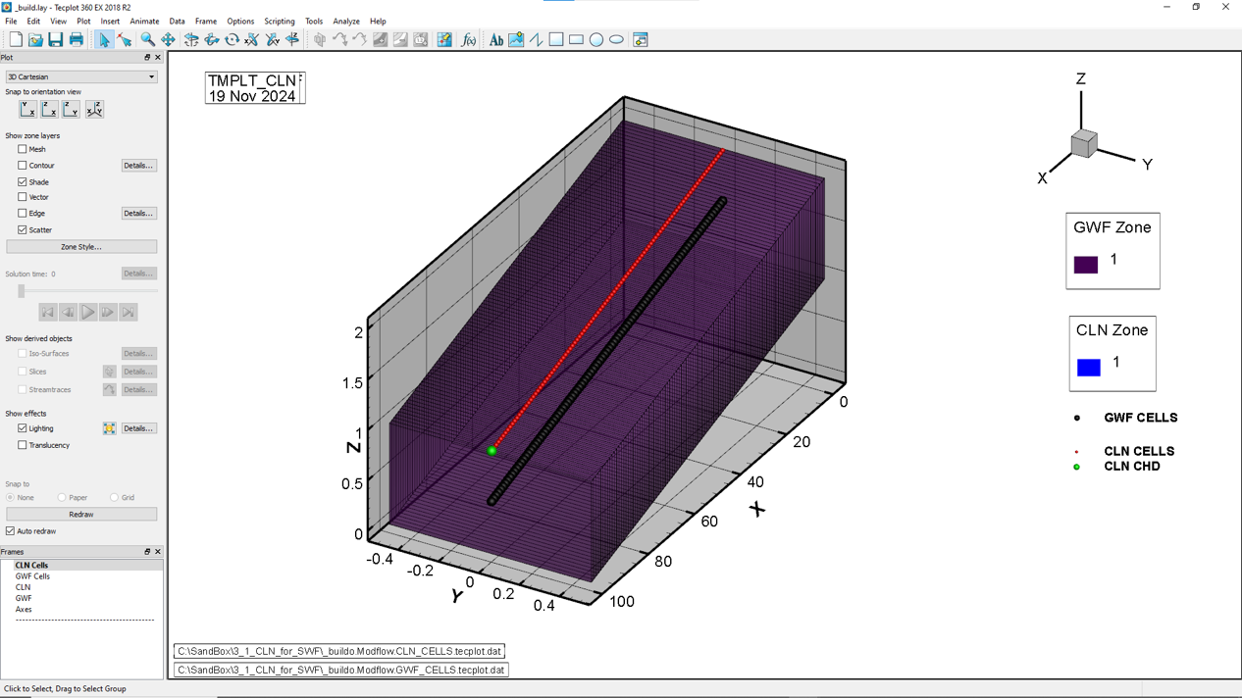
Implementing DFN - Steps for 2D fracture flow and transport
1. Design - Equations, aperture/T properties, DFN-GWF exchange; NAM type and IDOMAIN code
2. usgs_1 flow - Domain arrays, matrix assembly, budgets, binary heads/fluxes (patterned on CLN/SWF)
3. Geometry - Import fracture surfaces; intersect/mesh onto GWF; write DFN GSF connectivity
4. MUT - Domain, DFN materials DB, _build.mut verbs, package writers, Tecplot/dossier views
5. Transport - BCT (or equivalent) on DFN nodes; matrix exchange; CON save and observations
6. Verify - Single-fracture flow then transport; multi-fracture KURT case against a known solution
Analogue: CLN-GWF coupling today - DFN would add planar fracture-matrix exchange in the same multi-domain stack.
11 September 2026
16
KAERI modelling direction · MUT 2025.026

Slide 17
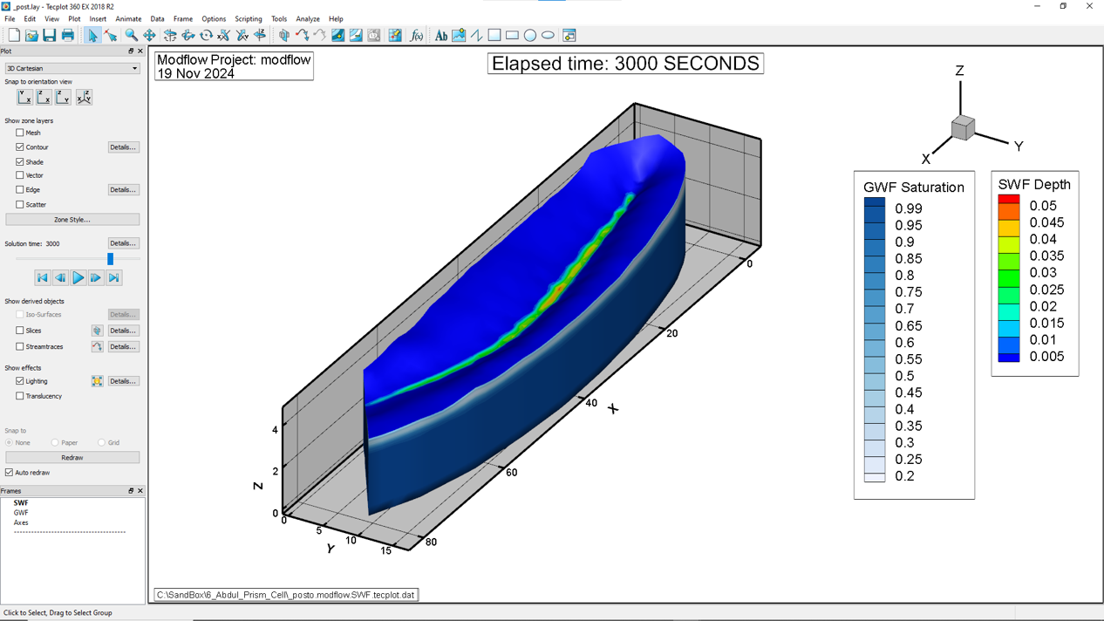
Gaps and next direction - Aligning solvers, ET writers and transport
The flow modelling stack is usable today at MUT 2025.026, but a few pieces still need aligned USG builds: velocity post-processing requires a usgs_1 that recognises the VEL name-file type, and GSTR rates must be solved by a USG-Beta build that includes the GSTR package. MUT ET package writers (EVT/ETS from the existing ET database or a simpler instruction set) are still future work.
Further ahead: SWF/GWF solute transport (Abdul path) and a new DFN medium for 2D fracture flow and transport on KURT fracture surfaces.
Abdul hillslope post-processed results - candidate platform for transport verification.
11 September 2026
17
KAERI modelling direction · MUT 2025.026

Slide 18
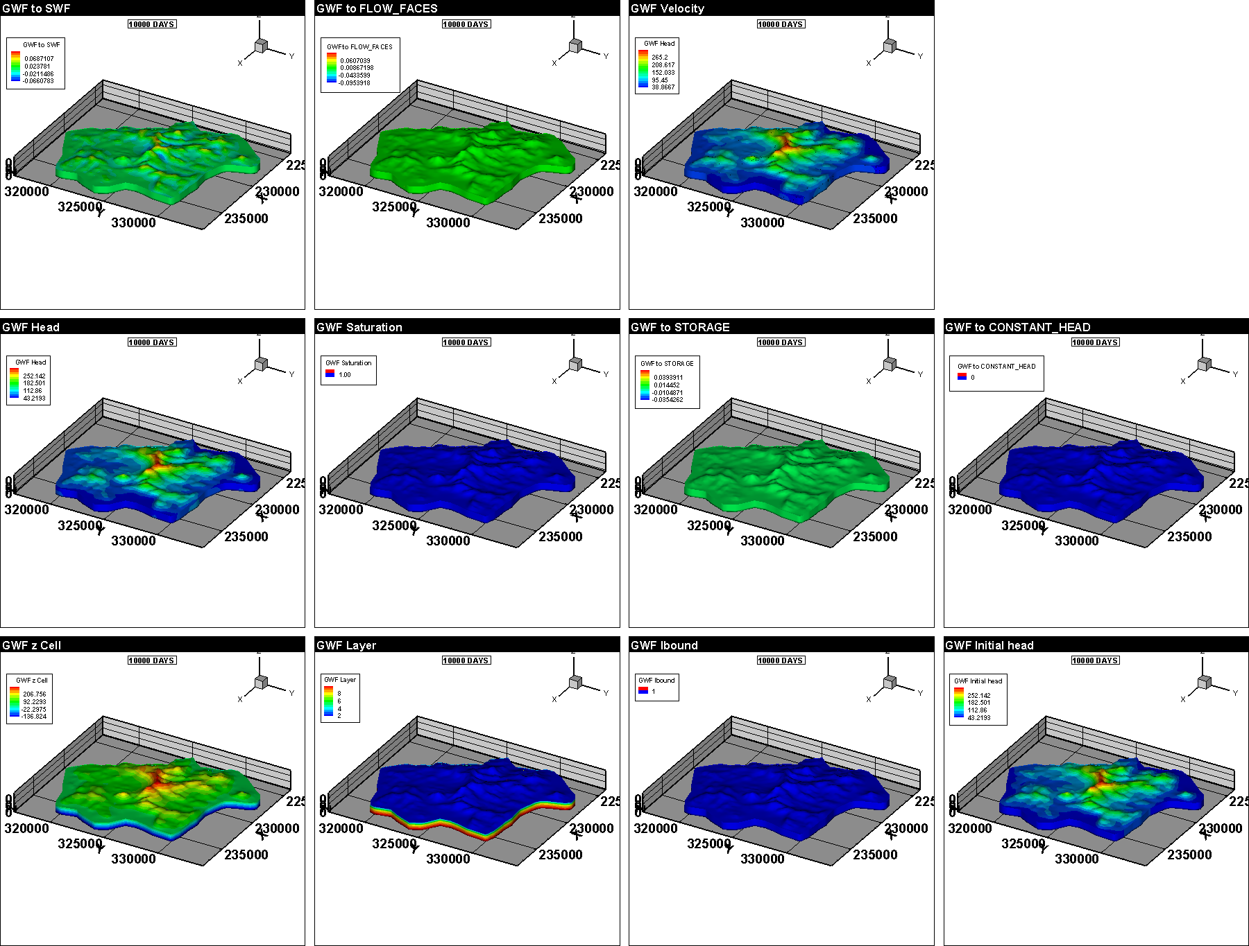
Discussion - Priorities for the next phase
With the 2026 flow capabilities in place, the meeting should set priorities for KURT delivery:
1. Deepen rainfall and GSTR workflows for regional transient forcing
2. Add MUT writers for MODFLOW EVT/ETS (or fuller HGS-style ET) so regional water balances include plant/soil water loss
3. Extend shaft / CLN engineering detail on the regional mesh
4. Advance surface-subsurface transport (Abdul verification path)
5. Scope DFN (2D discrete fracture flow and transport) against KURT fracture geometry
6. Agree which usgs_1 build is the project standard for VEL and GSTR
Example regional GWF results frame from the KURT model dossier.
11 September 2026
18
KAERI modelling direction · MUT 2025.026

