Slide 1
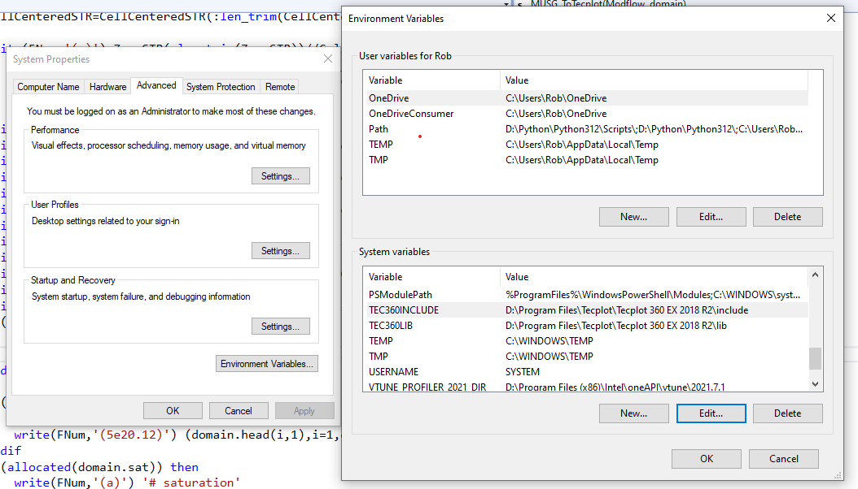
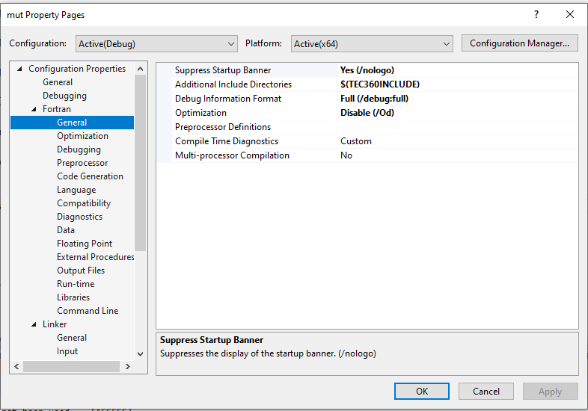

Slide 2
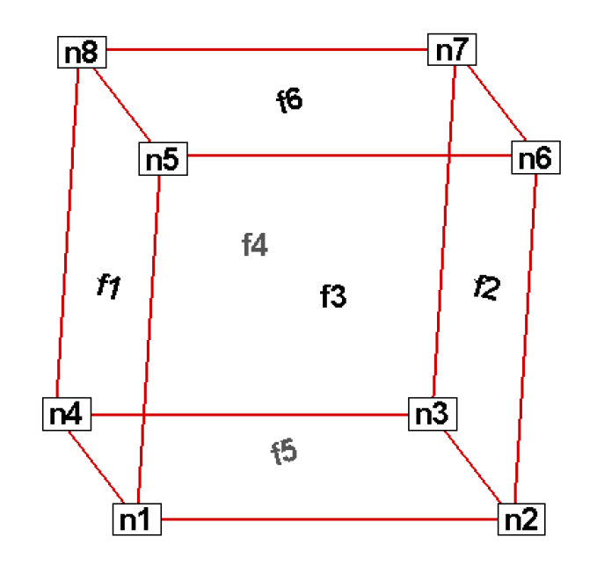
Tecplot Node and Face Numbering Convention
6-node prism (no face f4)
8-node block
Grid Builder Side 3
Grid Builder Side 2
Grid Builder Side 1

