Slide 1
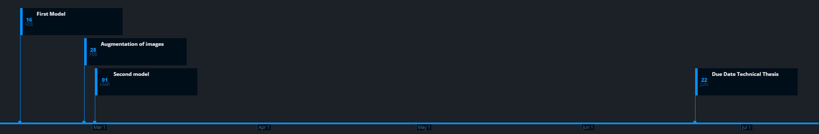
Status Quo
18.02.2020

Slide 2
Tools used for the technical thesis
Visual Studio Code
As development enviroment for python files
Why? Clean, nice looking, easy to use, „hyped“
GIT & GitHub
As code versioning and sharing
As project organizational tool
Using issues and milestones
Milestone <- grouping several issues/tasks into milestones
Issues <- documenting status quo of task, problems which occured and expectatiosn before starting the task
GitKraken
Visualisation of Git&GitHub Project
Timelines for Milestones & Issues

Slide 3
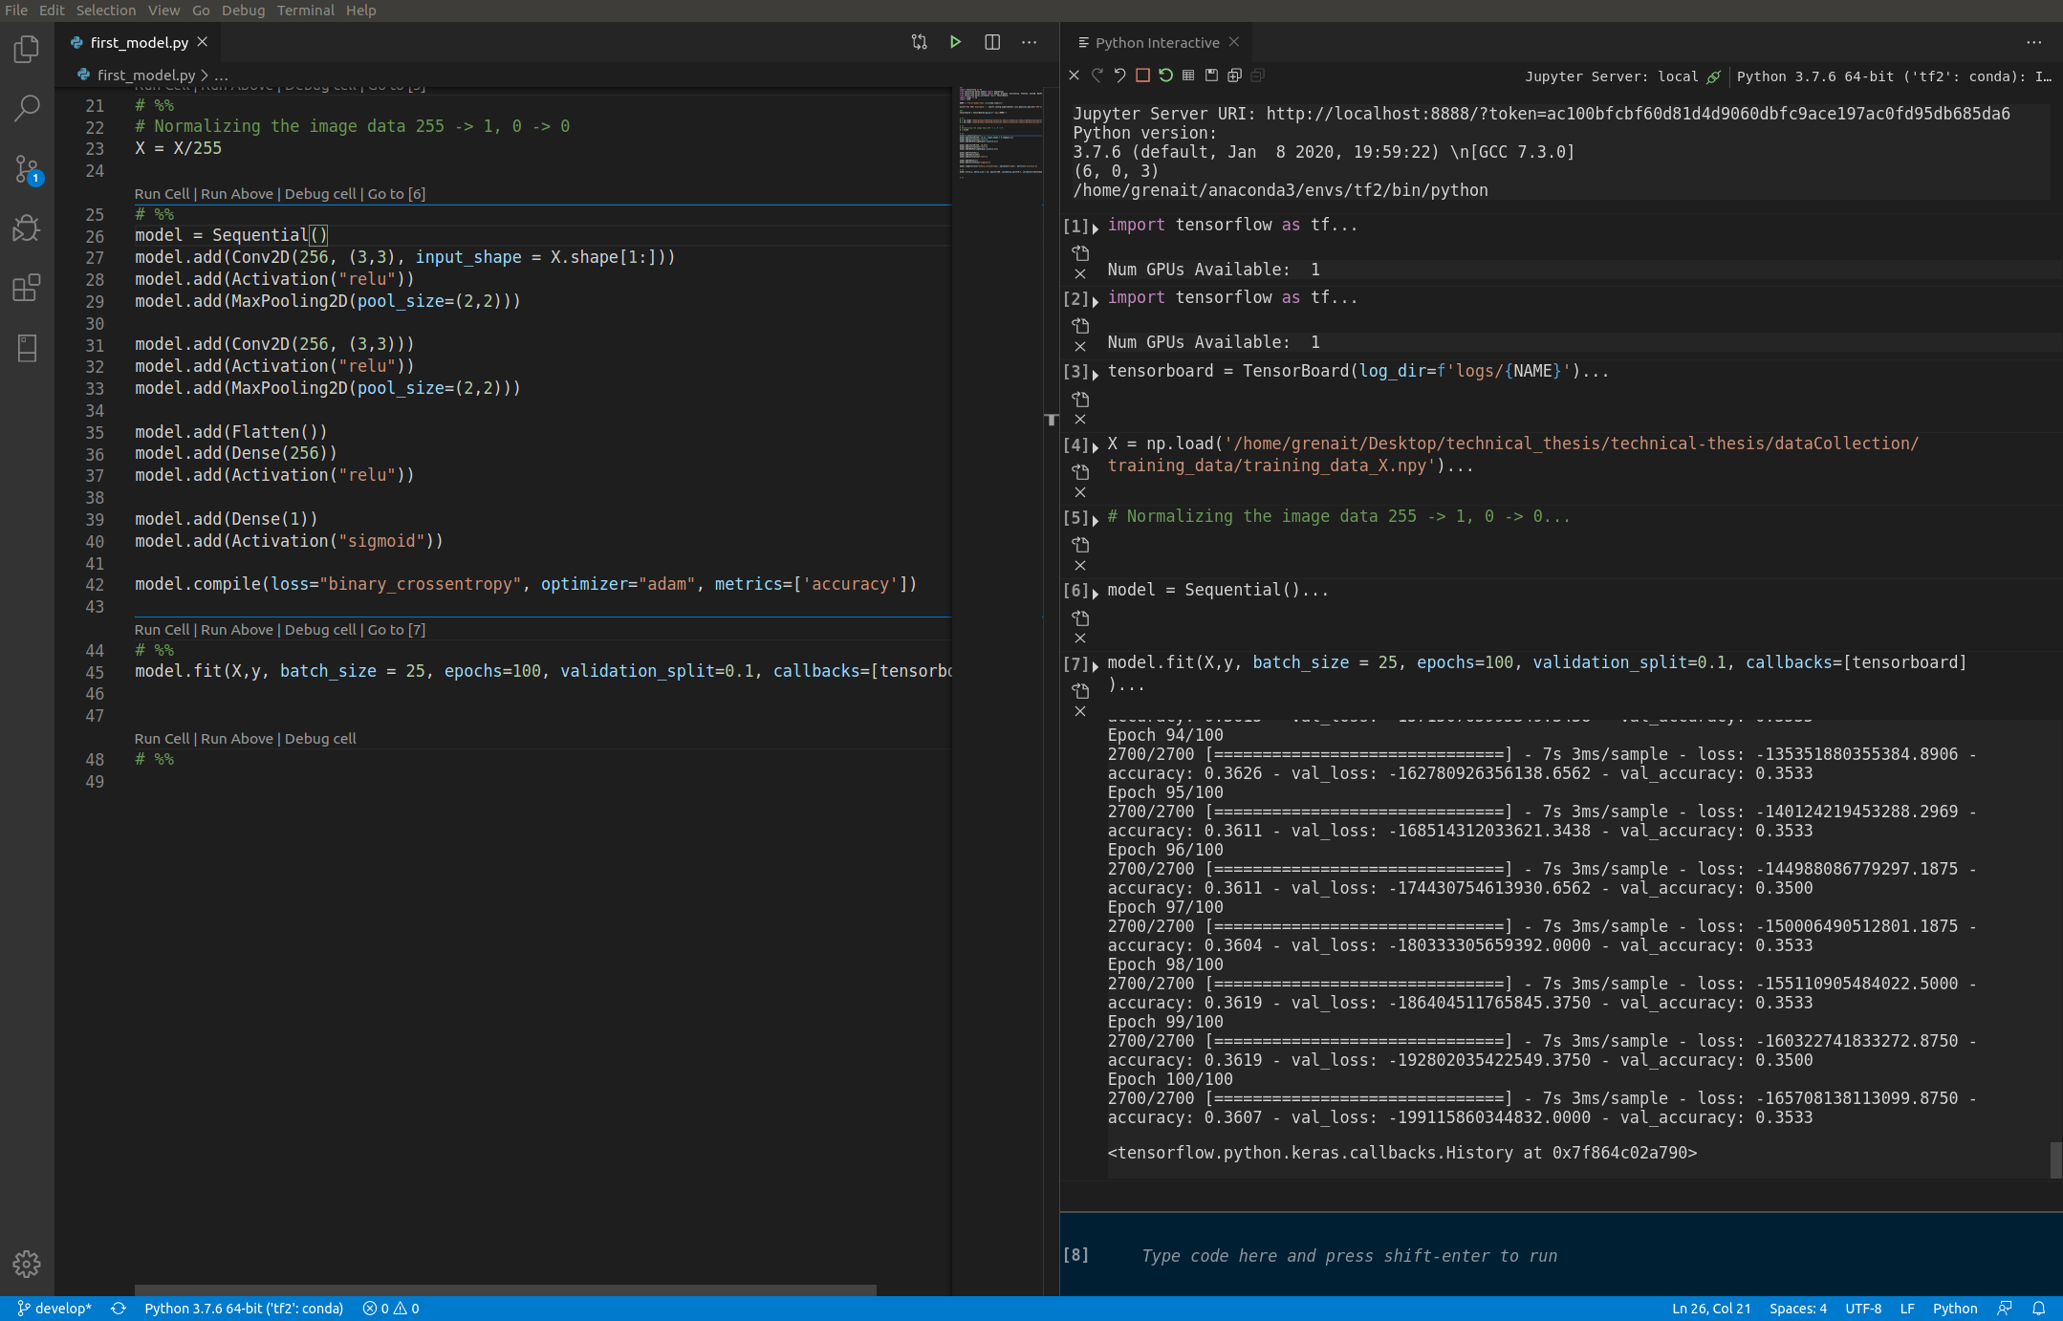
Visual Studio Code

Slide 4
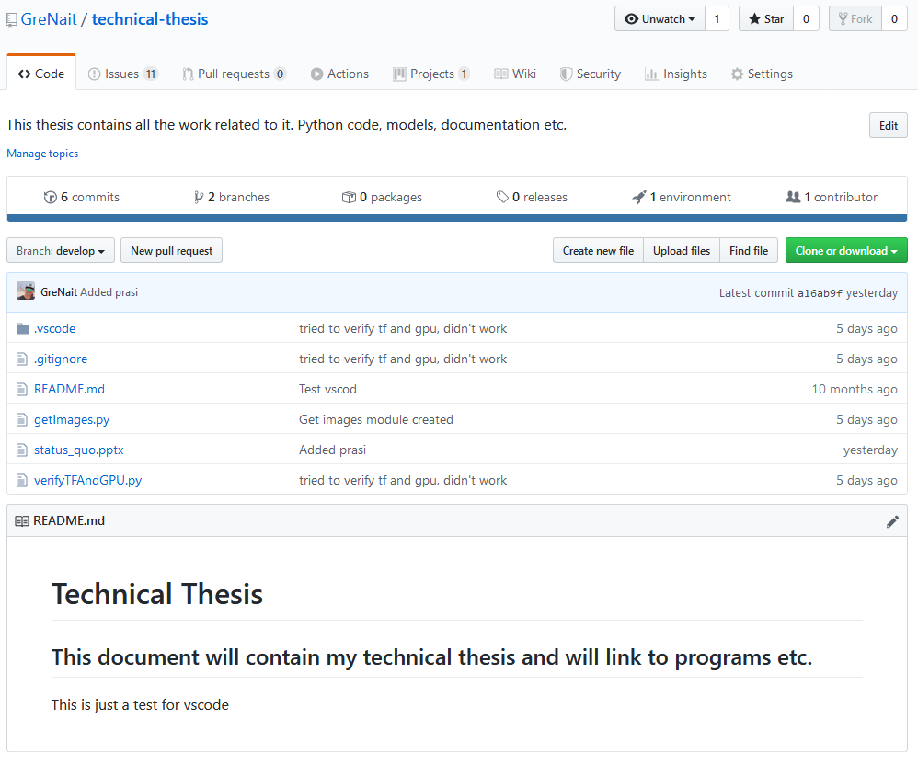
GitHub

Slide 5
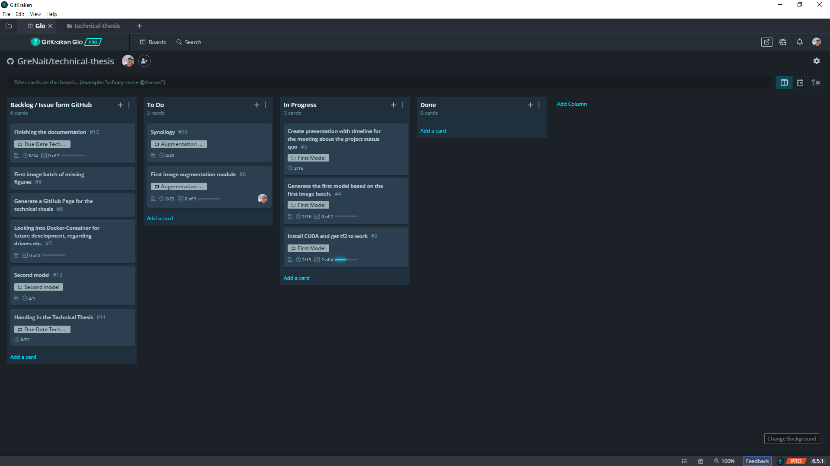
GitKraken

Slide 6
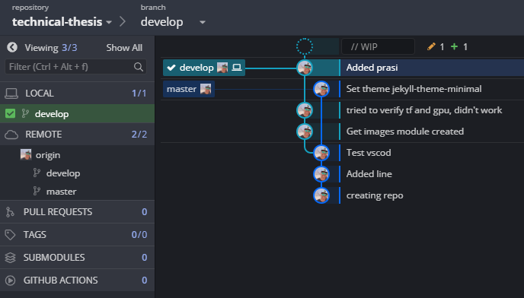
GitKraken

Slide 7
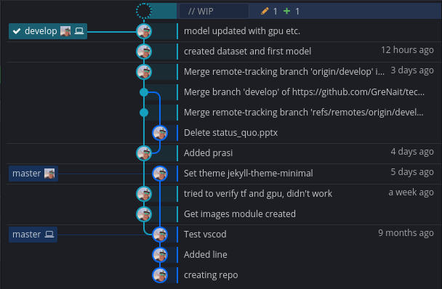
GitKraken

Slide 8
Tasks done for reaching milestone one: „First model“
Images generated
10 different figures each figure with 1000 different positions
Arduino programm for moving the figures „pseudo randomly“ in circles
Python program for configuring the webcam (exposure time, focus) and saving the images
Model created
Using tensorflow 2
[Using CUDA and cuDNN] → Many issues with drivers and „black screens“ but apperently working
Some little twerking on the model was done, but the accuracy was still at around 35% → Better model and more images needed → Milestone 2&3
Overfitting the model with 6 images for two figures
Proofing the model idea and set up

Slide 9
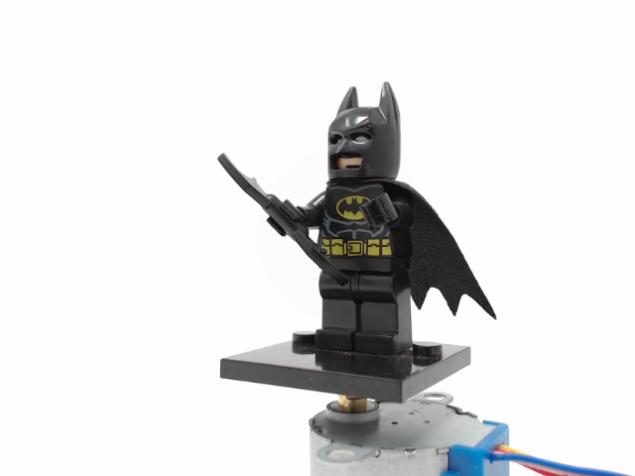
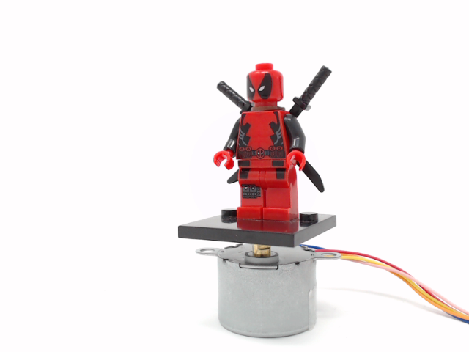
Sample images
Batman
Deadpool

Slide 10
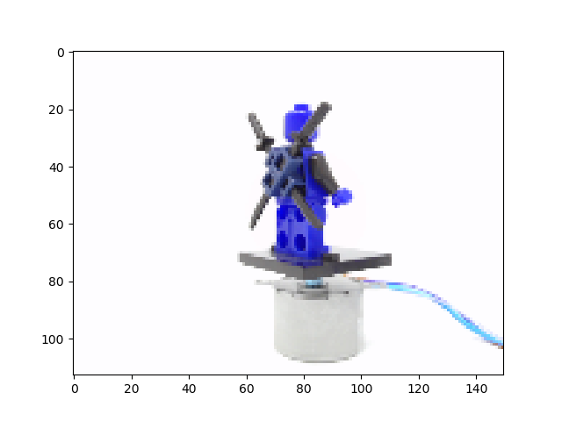
Normalized images

Slide 11
Issues encountered reaching first milestone
Driver problems
Installing CUDA and cuDNN was not possible with the first try
It appears that the already installed NVIDIA driver caused problems
Why using CUDA?
GPU for faster model calculations
Data preparation
Labesl and feature
Input pipeline for the model

Slide 12
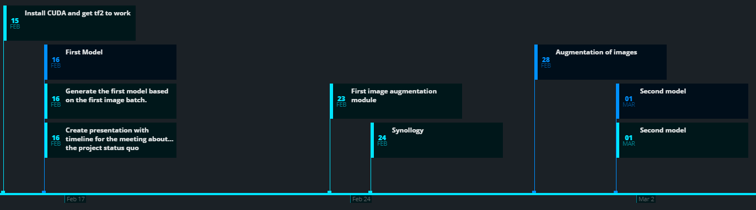
Tasks for up to second and third milestone

Slide 13
Tasks for the next milestone
Augmentation for images
Generating more images for each figure
Generate more „real“ images for each figure and future augmentation
Better image collection through better set up

