Slide 1
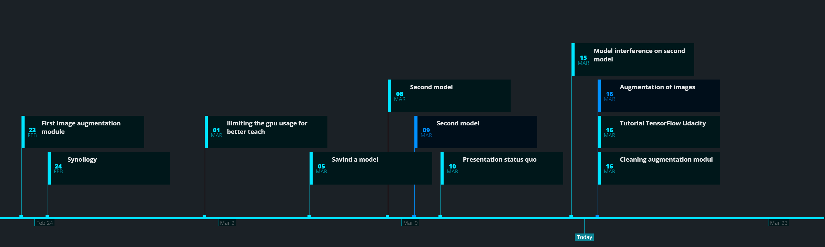
Status Quo
16.03.2020

Slide 2
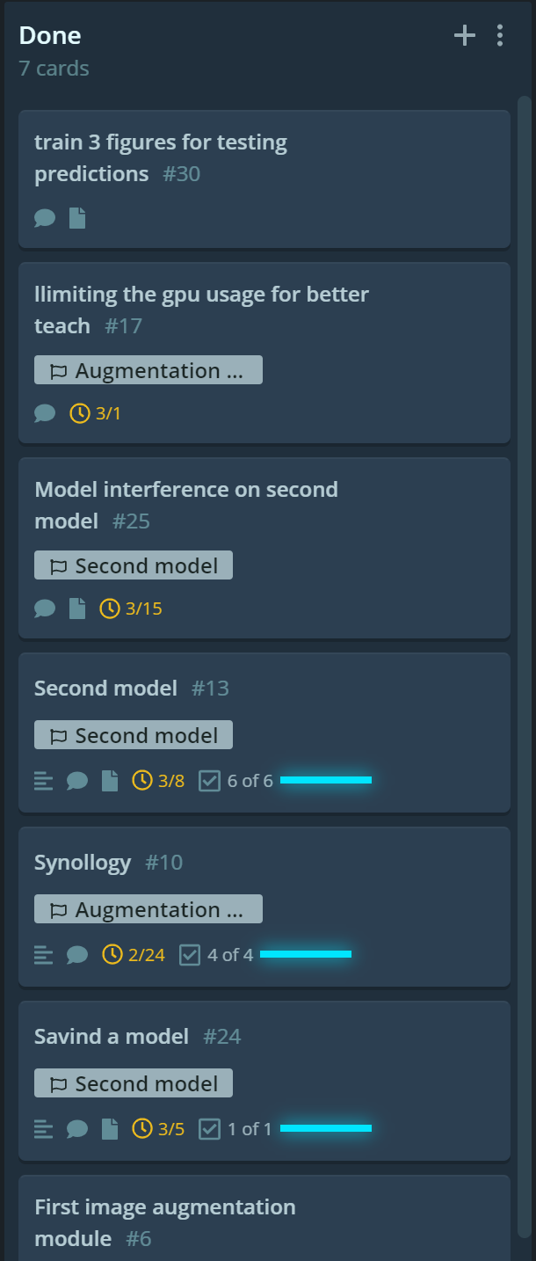
Tasks done for reaching next milestones (2&3)
Fixed problems with the GPU usage
Driver update to tf 2.1.0 and cuDNN 10.2.xx
Image augmentation
Experiments with OpenCV, numpy and tensorflow
Tensorflow is used now most of the time
Cleaning the stepper motor of the image
Adding gaussian noise against overfitting problems
Generating second model
Different model approaches tried – no relevant testing, just pure experimenting
Inference tested on one smartphone image
Problems (hopefully) overcome about the model prediction
Saving a model for later usage
Using callbacks for checkpoint saving

Slide 3
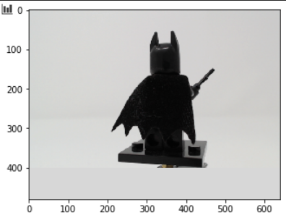
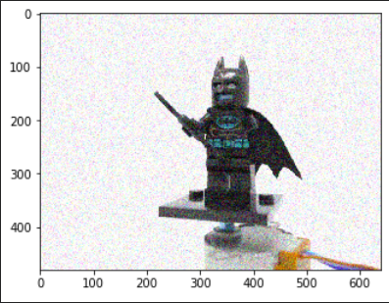
Image augmentation
Batman clean
Batman noise

Slide 4
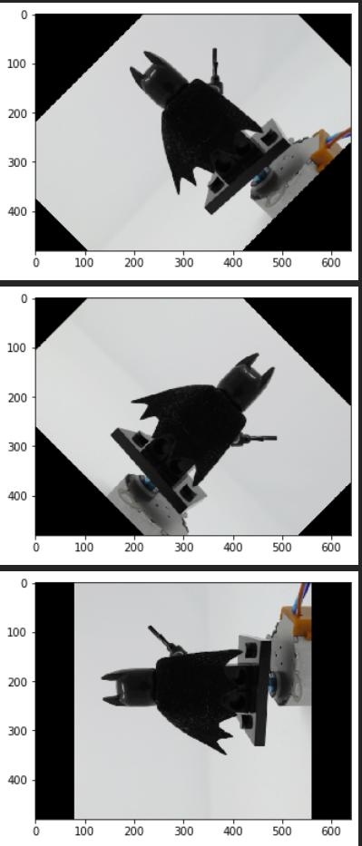
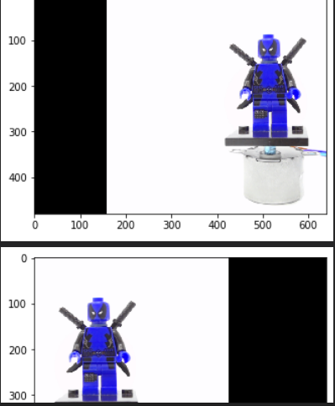
Image augmentation
Rotation
Movement

Slide 5
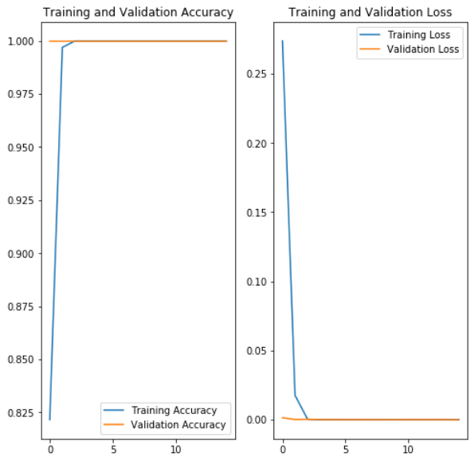
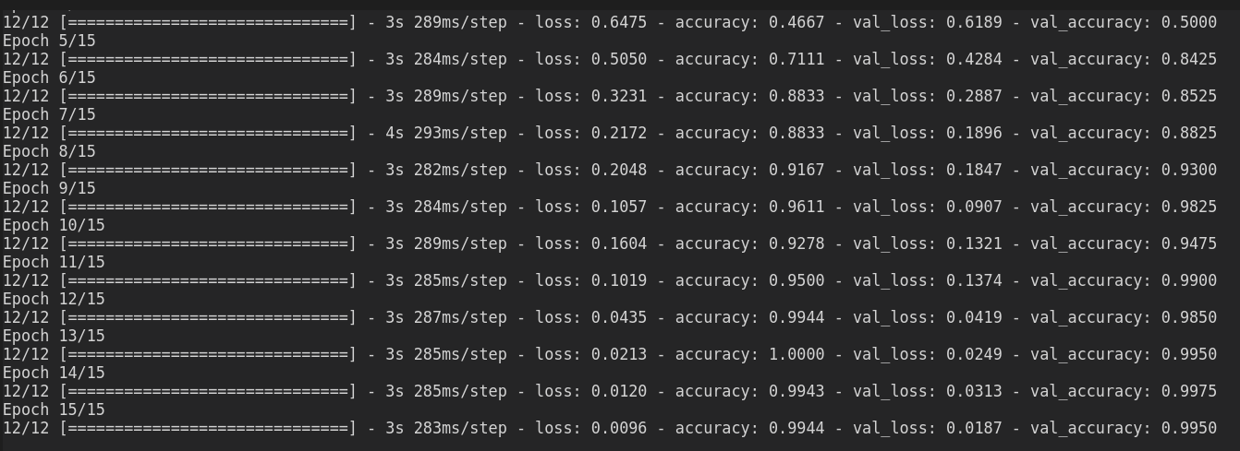
Model training
Overfitting
Epochs & accuracy

Slide 6
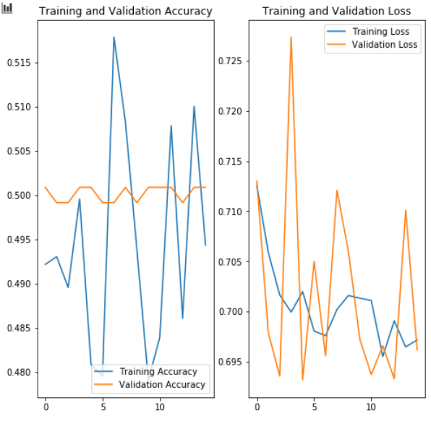
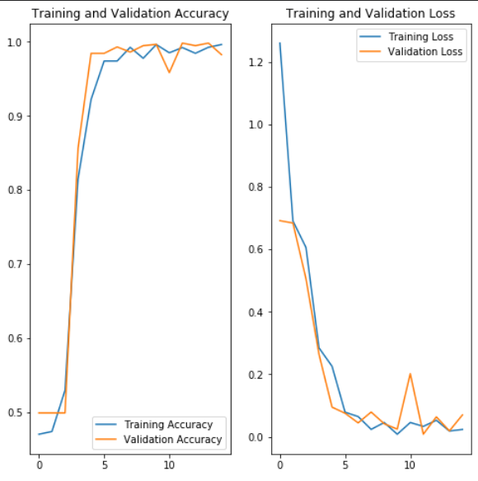
Model training
Sigmoid instead of relu
Better but still leading to overfitting

Slide 7
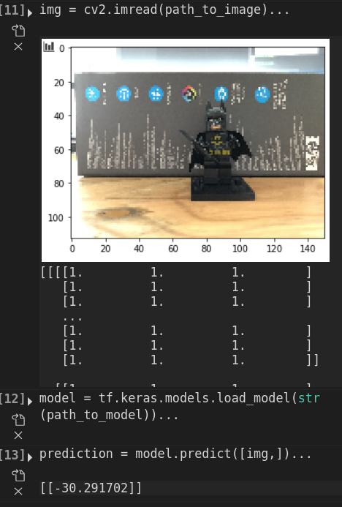
Model training
First prediction
First prediction on a smartphone image
Result = -30
No idea what -30 means
Probable that the model was not right configured or wrongly trained

Slide 8
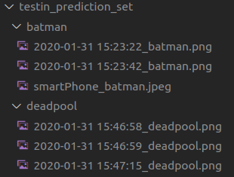
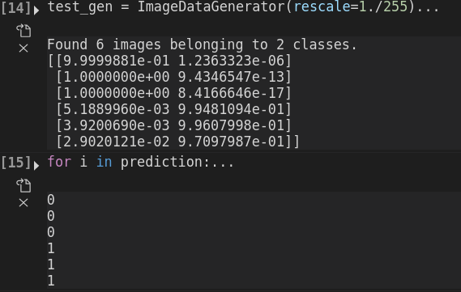
Model training
Image data directory structure
Result (0 = Batman, 1 = Deadpool)

Slide 9
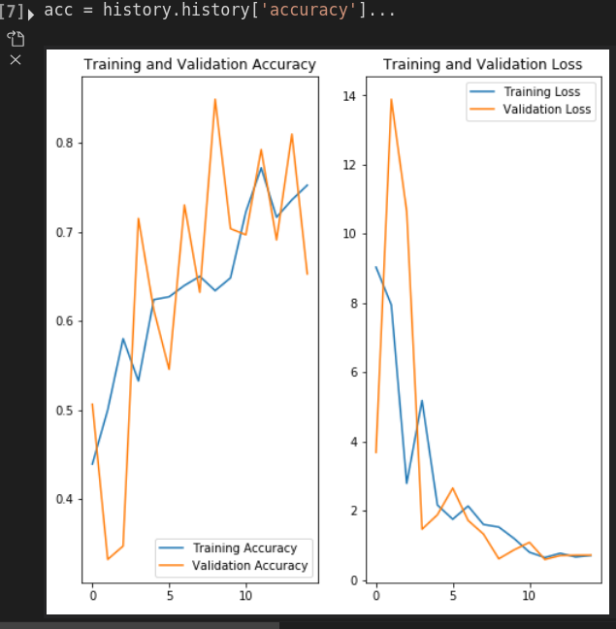
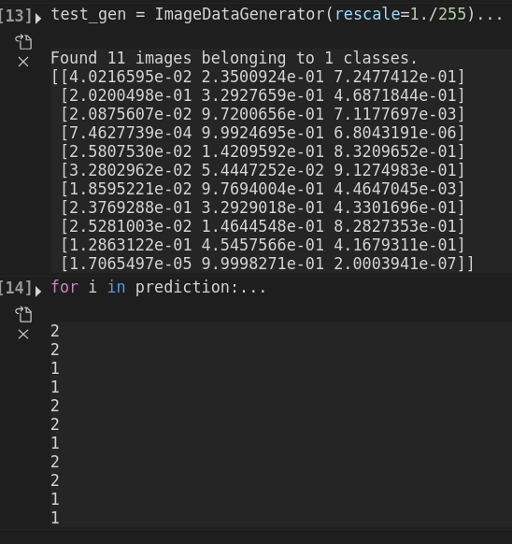
Model training
Training a model with 3 figures (Antman, Batman, Deadpool)
Result (0 = Antman, 1 = Batman, 2 = Deadpool)

Slide 10
Tasks for the next milestone
Model comparison
Small, medium, large model training on 2&3 figures
Sigmoid, relu, leaky relu difference
Convolutions, Dropout, random noise addition
Make an overview and use Tensorboard for a visual representation of the models
Cleaning the code
Clean the augmentation, model and image cleaning modul
Generating more images for Batman, Deadpool, Antman
Different pose of the figures
Additional augmentation
Adding different backgrounds like, forest, rooms, random texture

Slide 11
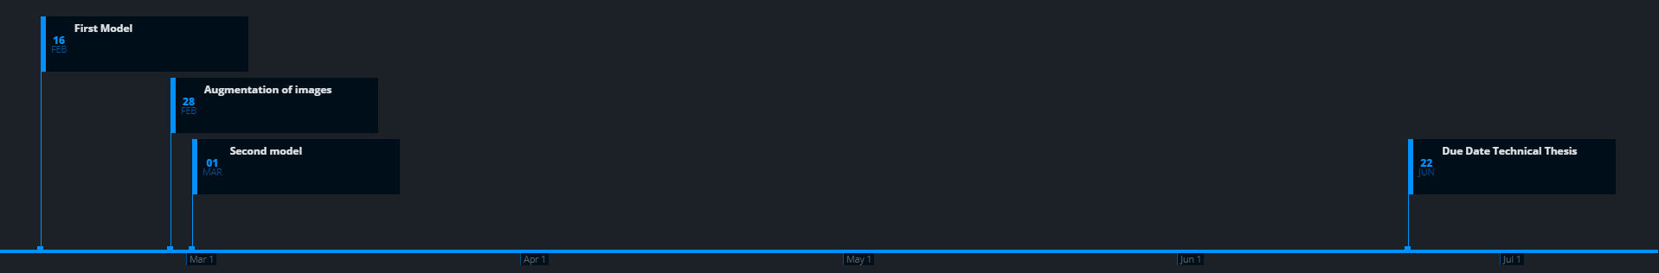
Status Quo
18.02.2020.

Slide 12
Tools used for the technical thesis
Visual Studio Code
As development enviroment for python files
Why? Clean, nice looking, easy to use, „hyped“
GIT & GitHub
As code versioning and sharing
As project organizational tool
Using issues and milestones
Milestone <- grouping several issues/tasks into milestones
Issues <- documenting status quo of task, problems which occured and expectatiosn before starting the task
GitKraken
Visualisation of Git&GitHub Project
Timelines for Milestones & Issues

Slide 13
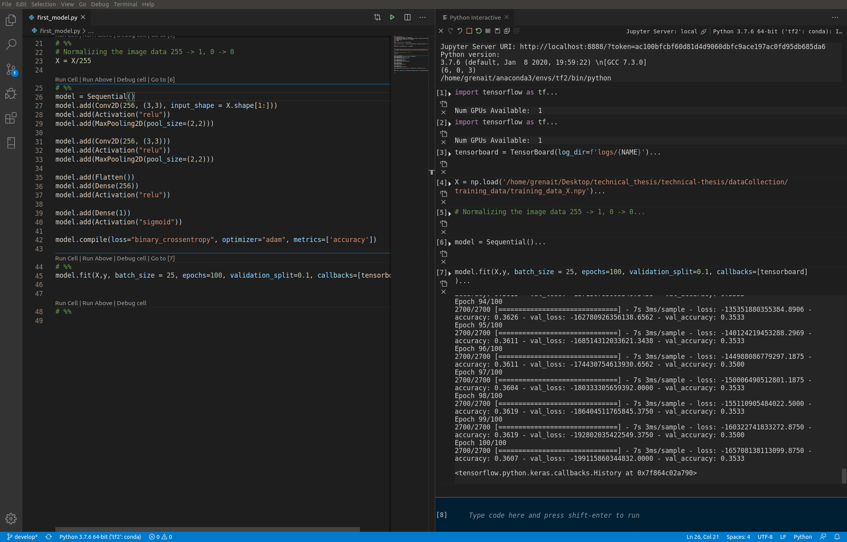
Visual Studio Code

Slide 14
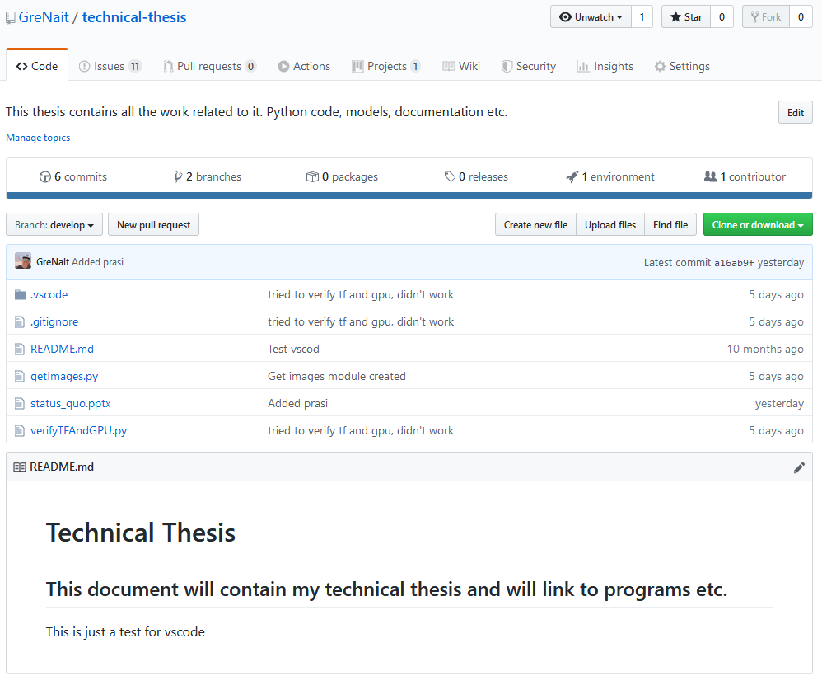
GitHub

Slide 15
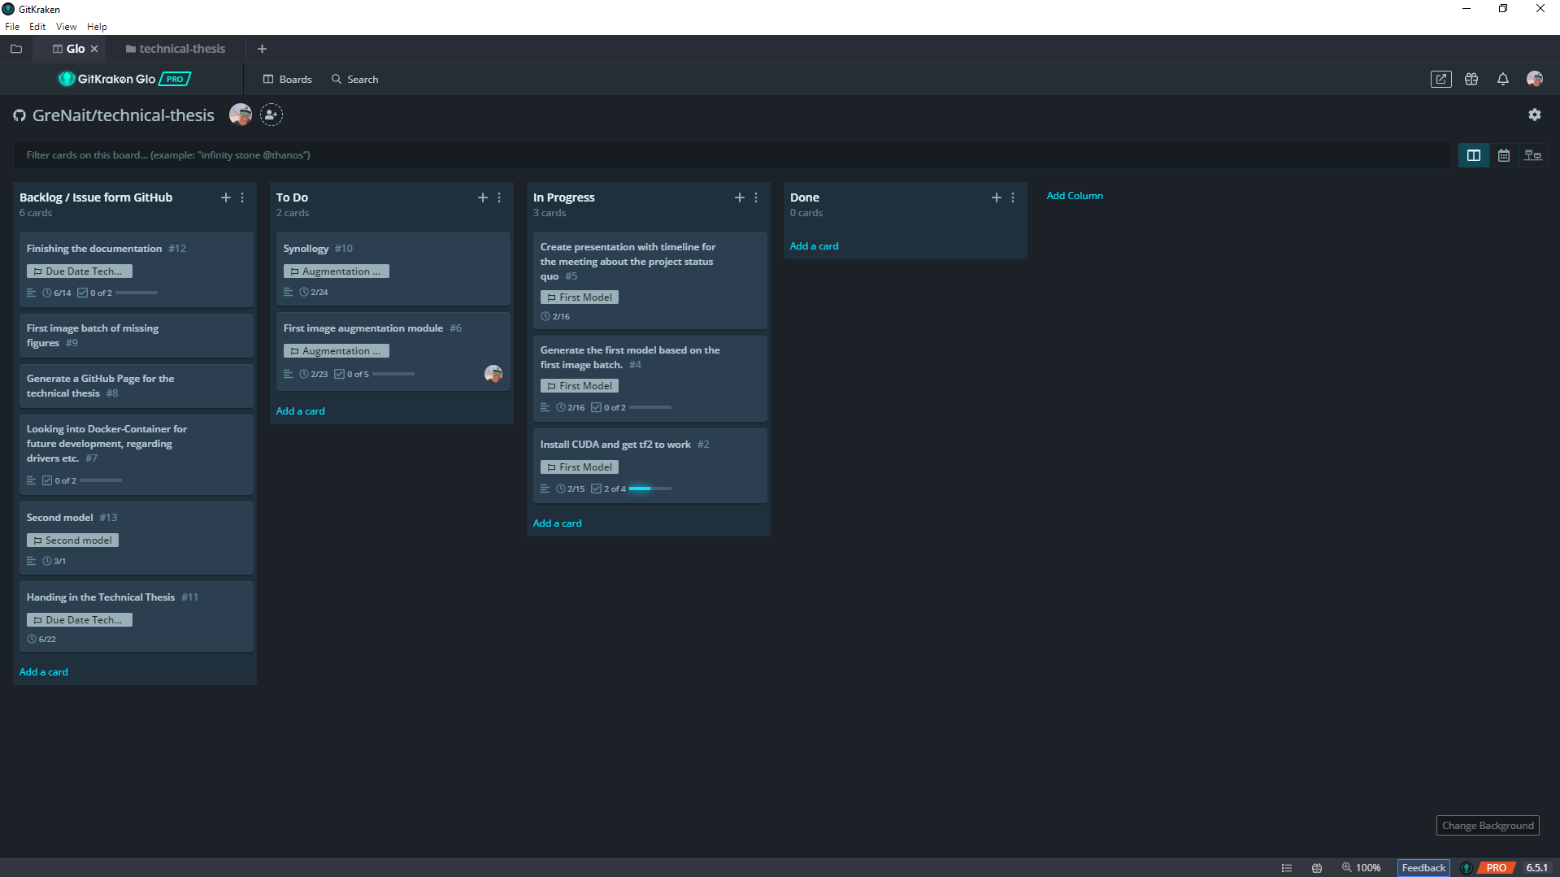
GitKraken

Slide 16
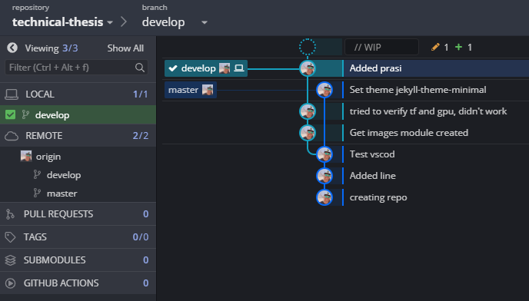
GitKraken

Slide 17
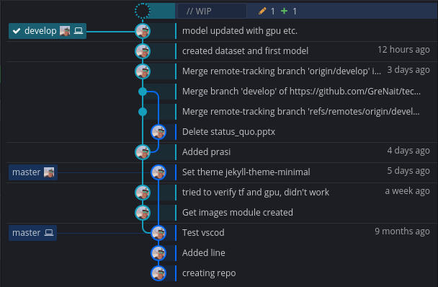
GitKraken

Slide 18
Tasks done for reaching milestone one: „First model“
Images generated
10 different figures each figure with 1000 different positions
Arduino programm for moving the figures „pseudo randomly“ in circles
Python program for configuring the webcam (exposure time, focus) and saving the images
Model created
Using tensorflow 2
[Using CUDA and cuDNN] → Many issues with drivers and „black screens“ but apperently working
Some little twerking on the model was done, but the accuracy was still at around 35% → Better model and more images needed → Milestone 2&3
Overfitting the model with 6 images for two figures
Proofing the model idea and set up

Slide 19
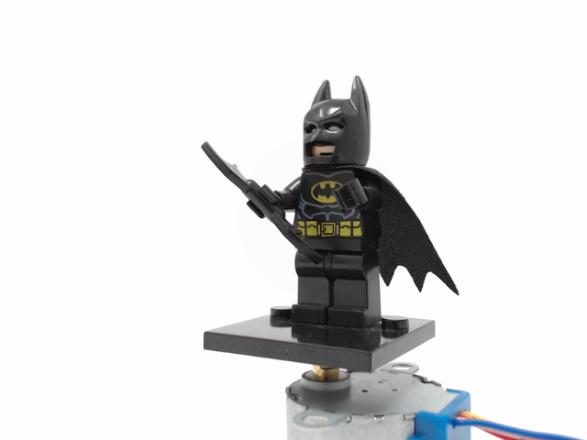
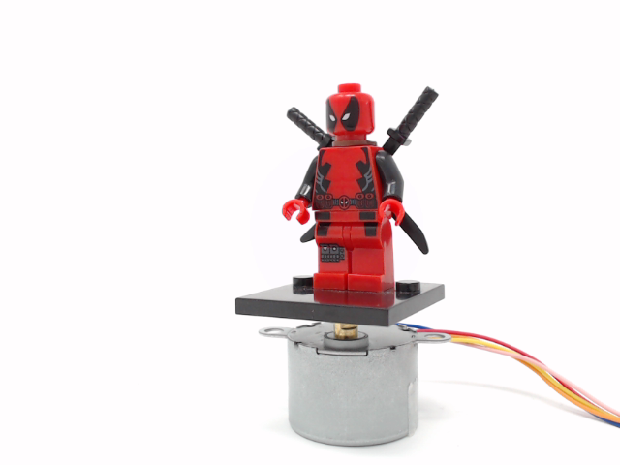
Sample images
Batman
Deadpool

Slide 20
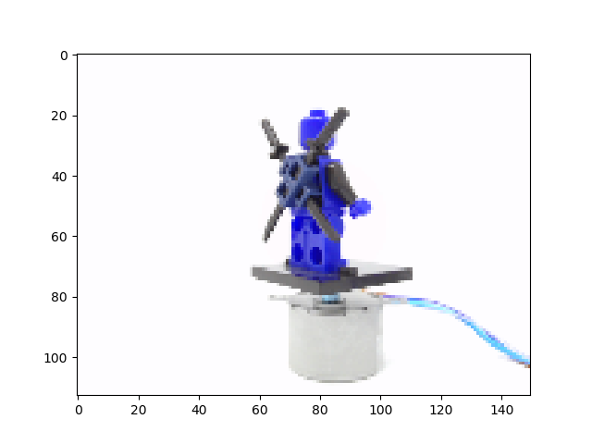
Normalized images

Slide 21
Issues encountered reaching first milestone
Driver problems
Installing CUDA and cuDNN was not possible with the first try
It appears that the already installed NVIDIA driver caused problems
Why using CUDA?
GPU for faster model calculations
Data preparation
Labels and feature
Input pipeline for the model

Slide 22
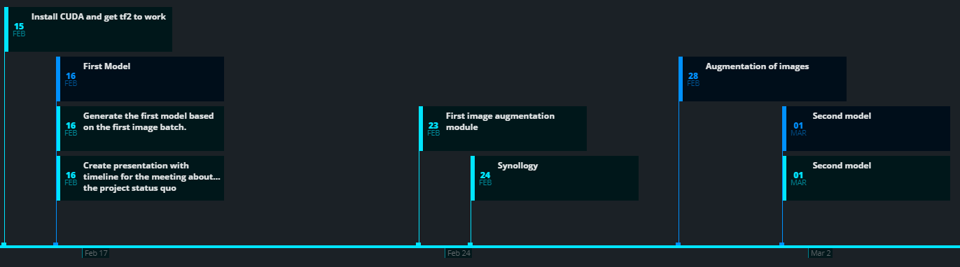
Tasks for up to second and third milestone

Slide 23
Tasks for the next milestone
Augmentation for images
Generating more images for each figure
Generate more „real“ images for each figure and future augmentation
Better image collection through better set up

