Slide 1
Multiple Predictive models for Predicting the treatment effectiveness for Refractory Epilepsy Population Using Spark
Poojalakshmi Sreedhar

Slide 2
Introduction
30% epileptic patients show intractable response to Anti Epileptic Drugs
diagnosed with uncontrollable and recurrent seizures
significant positive correlation between periodontal disease and seizure severity
likelihood of remission to be 19%

Slide 3
Motivation
deleterious effects on the patient health and quality of life
Early diagnosis improves patient care
Reduces effects of AEDs
Provides scope for better treatment

Slide 4
Problem Formulation
Refractory Patients: patient's failure to achieve control of seizure after the treatment with five or more Anti Epileptic Drugs(AEDs)
Non Refractory Patients: patients who have had at most two AEDs
Build classification model to predict the effectiveness of the treatment with AEDs

Slide 5
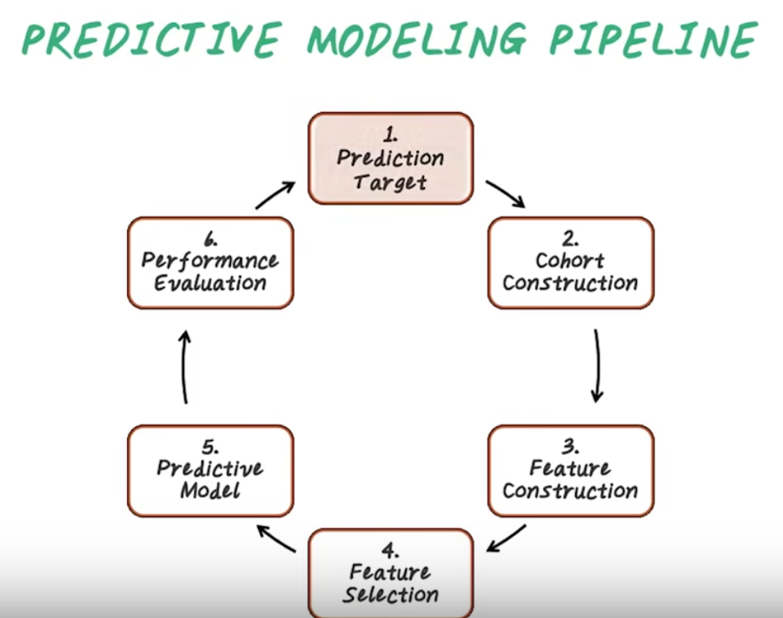
Approach: Prediction Target

Slide 6
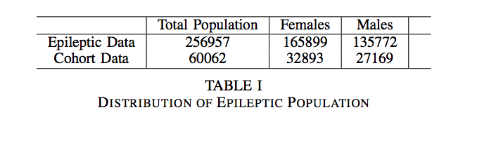
Cohort Construction
Cohort construction : constructed based of definition of refractory and non-refractory population

Slide 7
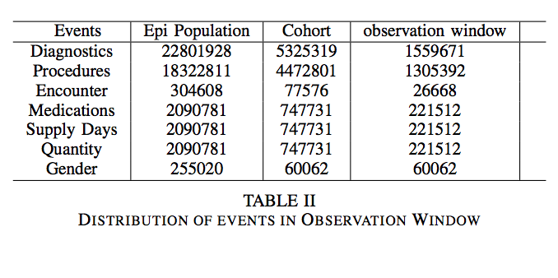
Feature Construction

Slide 8
Improvements
Using the larger dataset of 256957 patients
Changing the observation window to include events before the index date

Slide 9
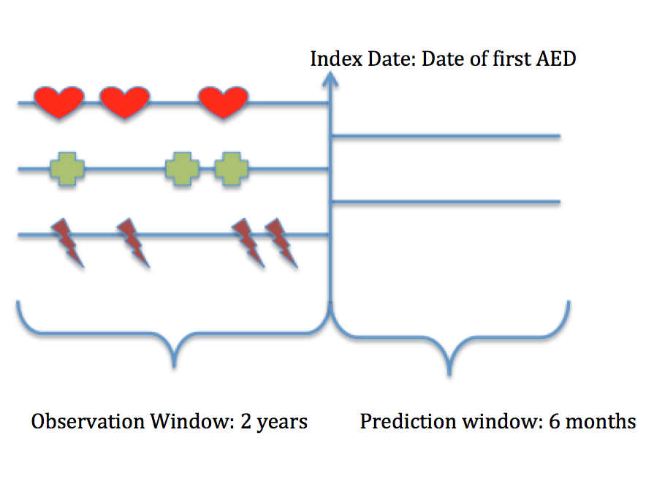
Feature Selection

Slide 10
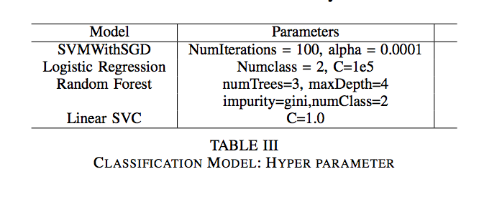
Predictive Models

Slide 11
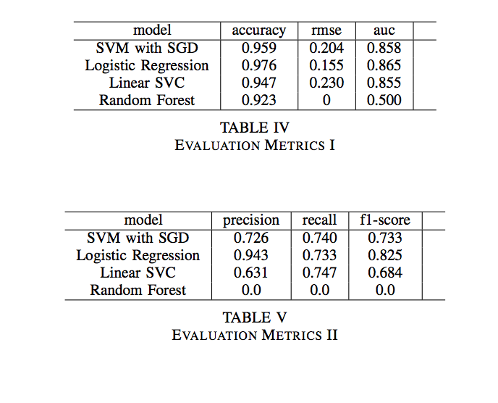
Results: Evaluations Metrics

Slide 12
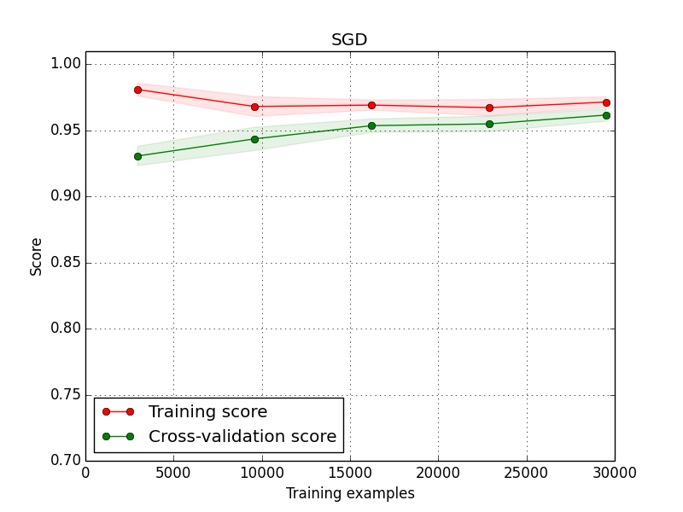
Learning Curve: SVM With SGD

Slide 13
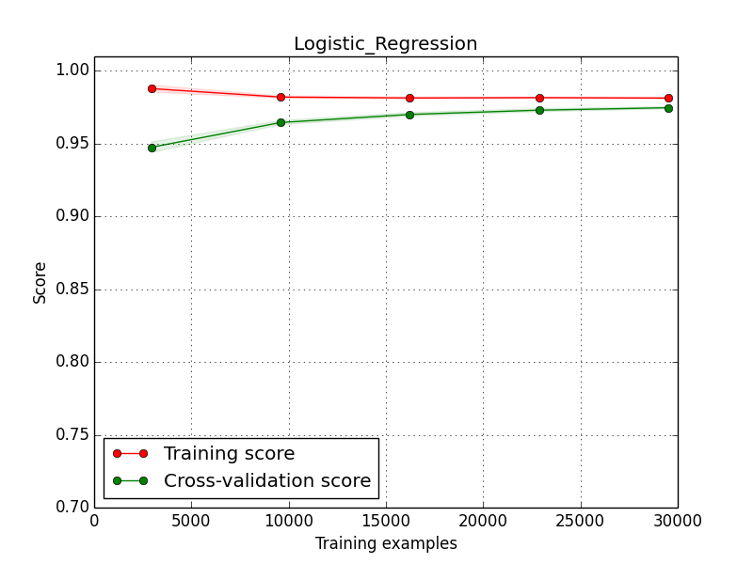
Learning Curve: Logistic Regression

Slide 14
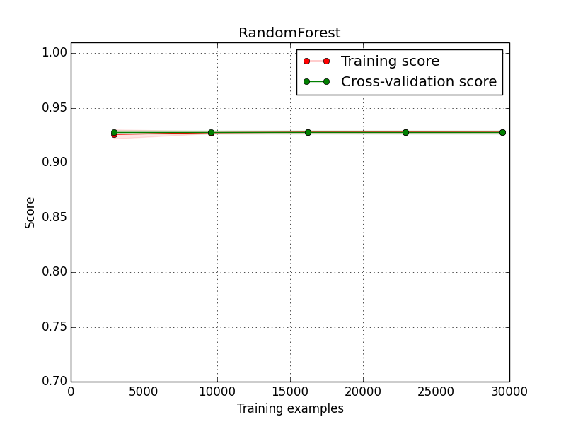
Learning Curve: Random Forest

Slide 15
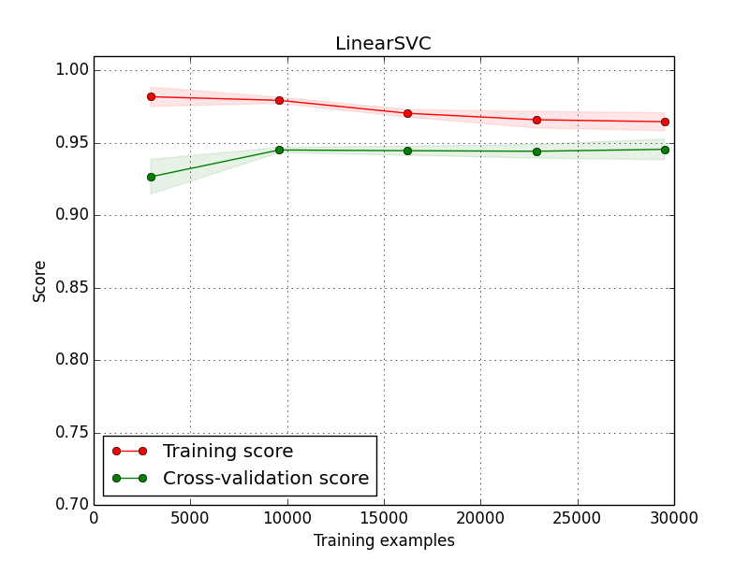
Learning Curve: Linear SVC

Slide 16
Challenge
One major challenge was getting the larger set to compile without any memory issue
Tried AWS – huge learning curve
Splitting files and refactoring the script
Serializations, partitions, memory management

Slide 17
Conclusion
Classification models are good predictors
Large data set gives a better model
Reduces over fitting
Balances bias and variance
Develop better patient care with classification models for big data

Slide 18

Thank you!

