Slide 1
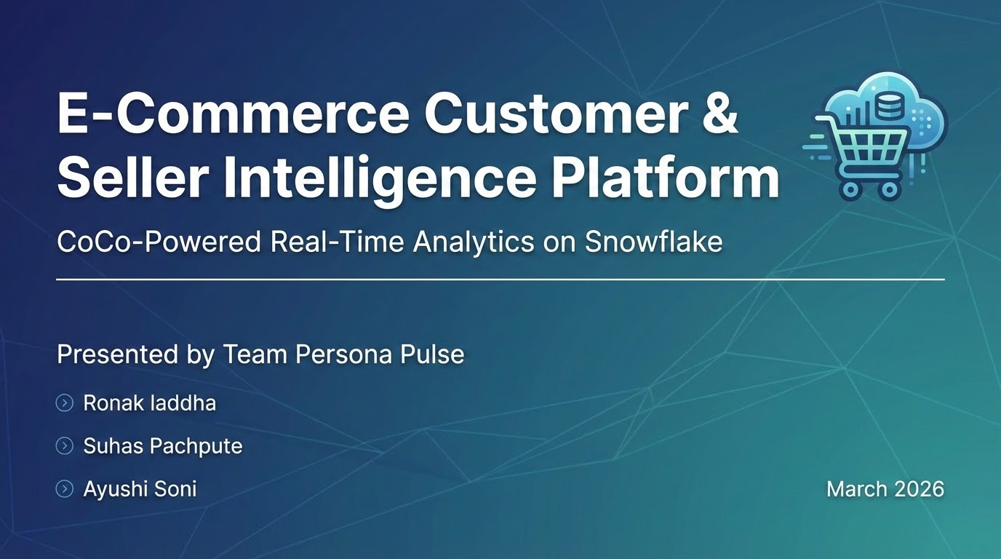
E-Commerce Customer & Seller Intelligence Platform
CoCo-Powered Real-Time Analytics on Snowflake
Presented by Team Persona Pulse
>Ronak laddha
>Suhas Pachpute
>Ayushi Soni
March 2026

Slide 2
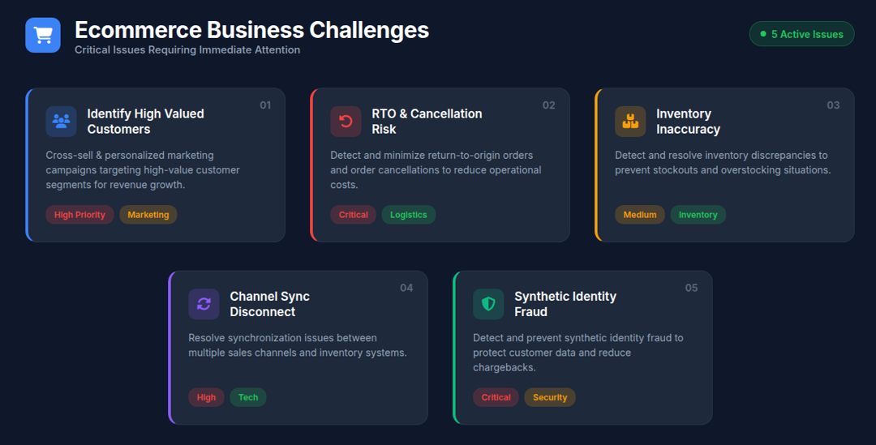

Slide 3
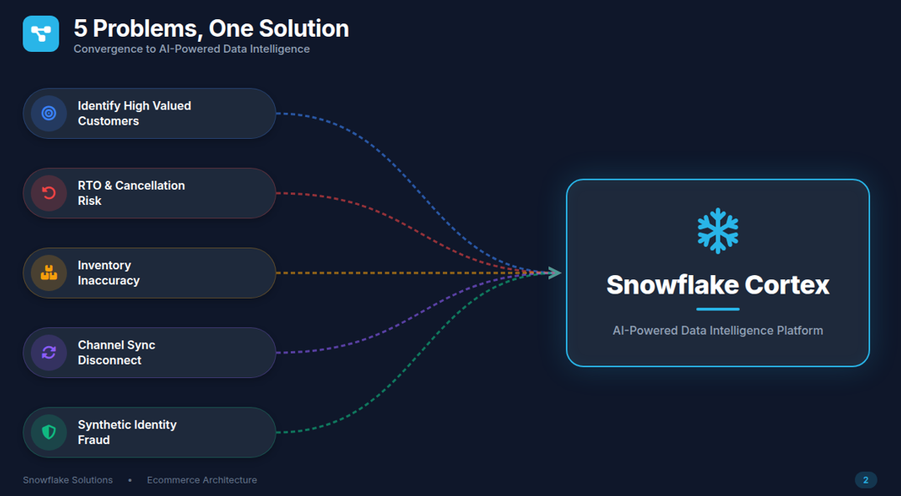

Slide 4
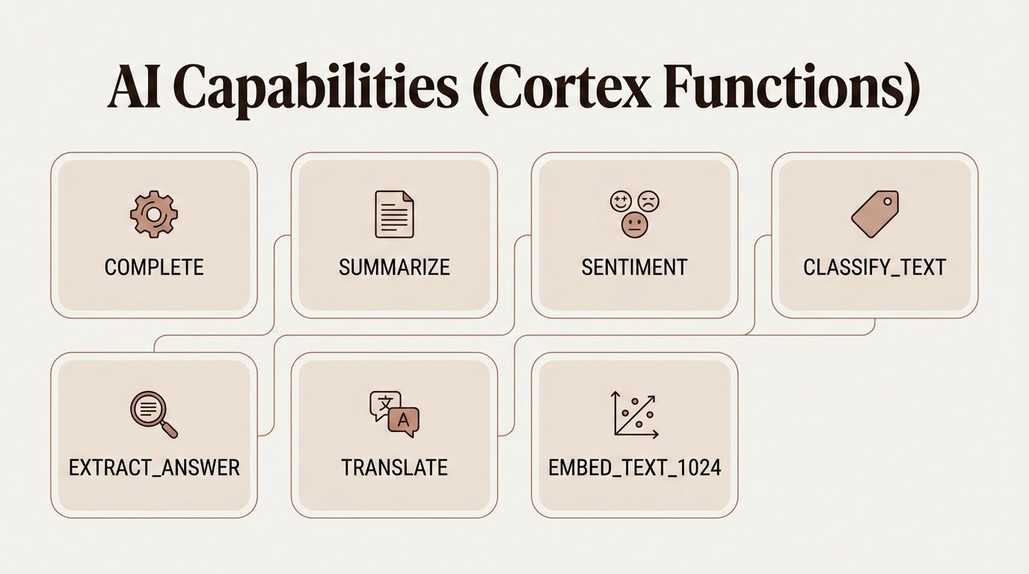
AI Capabilities (Cortex Functions)
COMPLETE, SUMMARIZE, SENTIMENT, CLASSIFY_TEXT,
EXTRACT_ANSWER, TRANSLATE, EMBED_TEXT_1024

Slide 5
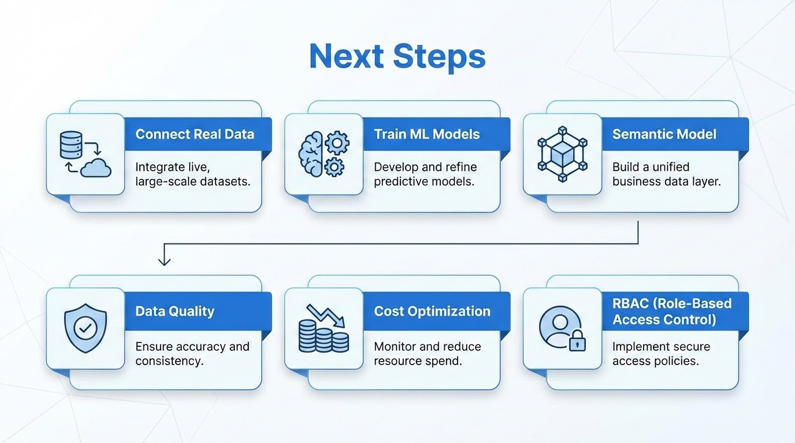
Next Steps
Connect real data
Train ML models
Semantic model
Data quality
Cost optimization
RBAC

Slide 6
